Slide 1
VITALVAULT
CSE7101- Capstone Project
Review-1
Batch Number: CSE_259
20221CSE0691 | MANOHARA S
20221CSE0729 | VINAY KUMAR J K
20221CSE0683 | K C DARSHAN
Under the Supervision of,
Mr. Gyanesh Verma
Assistant Professor
School of Computer Science and Engineering
Presidency University
Roll Number | Student Name
Name of the Program: B.TECH - Computer Science and Engineering
Name of the HoD: Dr. Asif Mohammed
Name of the Program Project Coordinator: Dr. Jayavadivel Ravi
Name of the School Project Coordinators: Dr. Sampath A K , Dr. Geetha A

Slide 2
Content
Problem Statement
Objectives
Background and Related work for title Selection
Analysis of Problem Statement
Innovation or Novel Contributions
Git-hub Link
Timeline of the Project
References

Slide 3
Problem Statement Number: PSCS_486
Organization : Null
Category (Hardware / Software / Both) : Software
Problem Description: Automatic Health Monitoring System: In present days, the patients belonging to rural and sub-urban communities do not maintain the diagnosis reports for which they frequently go for regular checkups wasting their valuable money. Thus, an automatic report maintaining system is to be developed to avoid repetative diagnosing of the patients.

Slide 4
Objectives
Create a cross-platform mobile app using React Native.
Implement multi-profile management in a single account.
Enable offline-first data storage with automatic cloud synchronization.
Provide secure digital storage for health documents and reports.
Integrate push notifications for medical reminders and checkups.
Design an icon-driven, elder-friendly interface.

Slide 5
Background and Related Work for Title Selection
Existing Solutions:
Practo, mFine → urban-focused, limited offline support.
WHO mHealth Guidelines → recommend low-literacy, offline-friendly design.
iCare (IEEE 2010) → elderly health monitoring, but lacks multi-profile capability.
Opportunistic mHealth Architecture (HotMobile ’19) → focuses on intermittent connectivity, but not family-based record management.
Gap Identified: Need for a family-managed, offline-first, elder-friendly mobile health record app.
Chosen Title: VitalVault
– Family Health Record & Monitoring System.
- conveys security (“vault”) and health data focus (“vital”).

Slide 6
Analysis of Problem Statement
Technology Stack Components:
Frontend: React Native(JavaScript) Backend: Node.js (Express.js) Database & Storage: Firebase Firestore & Firebase Storage Authentication: Firebase Auth (Email/Phone) Notifications: Firebase Cloud Messaging (FCM) Deployment: Google Play Store
Target Users:
Families in rural/semi-urban areas, elderly individuals, healthcare providers.
Key Challenges:
Poor internet connectivity, lack of record maintenance, accessibility issues for elders.
Solution Fit:
Offline-first mobile app with cloud sync, profile switching, and simple icon-based navigation.

Slide 7
Innovation or Novel Contributions
Multi-profile management in a single login.
Offline-first architecture for rural deployment.
Simplified, icon-based UI for elders.
Emergency medical info accessible from lock screen.
Easy sharing of reports with healthcare providers.

Slide 8
Links
Github Link: https://github.com/manohara-s-1110/vital-vault.git
Figma Link: https://www.figma.com/design/MSM5UB5bnSRkfe5q7a2jD1/CapStone_project?node-id=1-2&t=iVBhDrIzWhj0R1qc-1

Slide 9
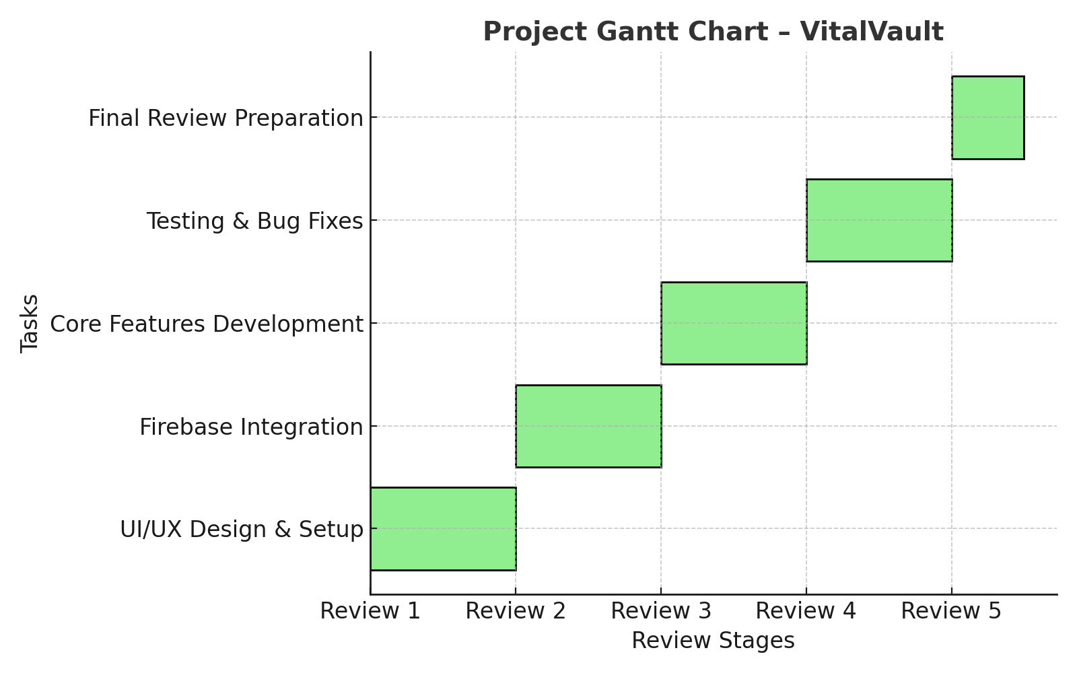
Timeline of the Project (Gantt Chart)

Slide 10
References (IEEE Paper format)
[1] Y. Yuan, J. Xu, J. Zhang, and G. Yu, "iCare: A Mobile Health Monitoring System for the Elderly," 2010 IEEE 3rd International Conference on Biomedical Engineering and Informatics, Yantai, China, Oct. 2010, pp. 1-5, doi: 10.1109/BMEI.2010.5639705.
[2] A. Vahdatpour, M. Amini, and M. Sarrafzadeh, "An Opportunistic mHealth Architecture for Remote Patient Monitoring," in Proc. 20th Int. Workshop on Mobile Computing Systems and Applications (HotMobile '19), Santa Cruz, CA, USA, Feb. 2019, pp. 57-62, doi: 10.1145/3301293.3309558.
[3] K. S. Abhishek, P. Kumar, A. Sharma, and P. Kumar, "Remote based patient monitoring system using wearable sensors through online and offline mode for android based mobile platforms," 2017 International Conference on Computer, Communications and Electronics (Comptelix), Jaipur, India, Jul. 2017, pp. 227-231, doi: 10.1109/COMPTELIX.2017.8003982.
[4] H. Maneshti, M. Dadashi, and K. Rostami, "IoT-Enabled Low-Cost Fog Computing System with Online Machine Learning for Accurate and Low-Latency Heart Monitoring in Rural Healthcare Settings," 2023 4th International Conference on Electrical, Communication and Computer Engineering (ICECCE), Kuala Lumpur, Malaysia, Jun. 2023, pp. 1-6, doi: 10.1109/ICECCE57971.2023.10159458.

Slide 11


