Slide 1
AII W380H · AI in Healthcare · UT Austin MSAI · Summer 2026
30-Day Hospital Readmission Prediction A Machine Learning Tutorial using MIMIC-III
Logistic Regression · Random Forest · XGBoost | SHAP Explainability
Dataset: MIMIC-III Clinical Database · physionet-data on BigQuery Cohort: All adult admissions (age >= 18, non-deceased) Label: Readmitted within 30 days of discharge Slide Index Slide 1 Clinical Background & Problem Setup Slide 2 Dataset & BigQuery Approach Slide 3 Exploratory Data Analysis Slide 4 Feature Engineering Slide 5 ML Pipeline & Class Imbalance Slide 6 Model Results — ROC Curves Slide 7 SHAP Explainability Slide 8 Model Comparison & Key Metrics Slides 9–10 Limitations, Next Steps & How to Run
Notes:
Welcome to this tutorial on 30-day hospital readmission prediction using MIMIC-III data.
GitHub repository: https://github.com/manoharbyc-dev/ai-healthcare
Google Colab notebook: https://colab.research.google.com/github/manoharbyc-dev/ai-healthcare/blob/main/mimic_readmission.ipynb
To reproduce: open the Colab link, run all cells in order. The notebook fetches data from BigQuery, trains three ML models, and generates all figures shown in this presentation.

Slide 2
Clinical Background & Problem Setup
HRRP · 30-Day Readmission
What is 30-Day Readmission?
• An unplanned return to the hospital within 30 days of discharge
• Tracked by the Centers for Medicare & Medicaid Services (CMS)
• The CMS Hospital Readmissions Reduction Program (HRRP, 2012)
penalizes hospitals whose readmission rates exceed national averages
— hospitals can lose up to 3% of Medicare payments
National statistics:
~15–20% of Medicare patients readmitted within 30 days
~$26B annual cost of potentially preventable readmissions
~2.3M readmissions per year among Medicare beneficiaries
ML opportunity:
If we can flag high-risk patients before discharge,
care teams can intervene: follow-up calls, home health,
discharge planning, medication reconciliation.
Our ML Problem
Type: Binary classification
Input: patient demographics + admission info
Output: probability of 30-day readmission (0 to 1)
Label: 1 = readmitted within 30d | 0 = not readmitted
Class imbalance:
Readmission is the MINORITY class (~20%)
Models trained naively will predict "not readmitted" always
Solution: class_weight="balanced" (LR, RF)
scale_pos_weight = neg/pos (XGBoost)
Evaluation metric: AUC-ROC
AUC = area under the ROC curve
Measures rank-ordering quality across all thresholds
0.5 = random · 1.0 = perfect · >0.7 = clinically useful
Note: this tutorial uses a simplified "all-cause" readmission
definition. Production systems filter to unplanned admissions only.
Notes:
Key teaching point: readmission prediction is a class-imbalance problem. Explain WHY AUC-ROC is preferred over raw accuracy here — accuracy is misleading when 80% of cases are negative. Walk through the HRRP financial incentive to motivate why hospitals care.

Slide 3
Dataset & BigQuery Approach
MIMIC-III · physionet-data
MIMIC-III Clinical Database
Source: MIT Lab for Computational Physiology
Patients: ~46,000 ICU patients | ~58,000 admissions
Period: 2001–2012 (Beth Israel Deaconess Medical Center)
Access: PhysioNet credentialed user account + BigQuery
Tables used in this tutorial:
mimiciii_clinical.ADMISSIONS
hadm_id, subject_id, admittime, dischtime,
admission_type, insurance, ethnicity,
marital_status, hospital_expire_flag
mimiciii_clinical.PATIENTS
subject_id, gender, dob
(dob used to compute age at admission)
Label Construction (SQL Self-Join)
Challenge: MIMIC-III does not have a "readmitted" column.
We compute it with a self-join on ADMISSIONS:
Step 1: For each admission a1, LEFT JOIN a2
WHERE a2.subject_id = a1.subject_id
AND a2.admittime > a1.dischtime
(finds all future admissions for same patient)
Step 2: MIN(a2.admittime) = earliest next admission
Step 3: CASE WHEN MIN(a2.admittime)
<= a1.dischtime + 30 days
THEN 1 ELSE 0 END AS readmitted_30d
Step 4: Filter WHERE hospital_expire_flag = 0
(in-hospital deaths cannot be readmitted)
Step 5: Filter WHERE age >= 18 (adult patients only)
BigQuery billed: ~10–20 MB (two small tables joined at query time)
Notes:
Emphasize the self-join technique — this is a common EHR data pattern. Students often wonder why there is no "readmitted" column. Walk through the SQL logic step-by-step. Point out the LEFT JOIN — patients with NO future admissions get readmitted_30d=0. The CASE WHEN handles the threshold comparison. The BigQuery cost is very low (<$0.10) because we are joining two small tables, not scanning the large chartevents table.

Slide 4
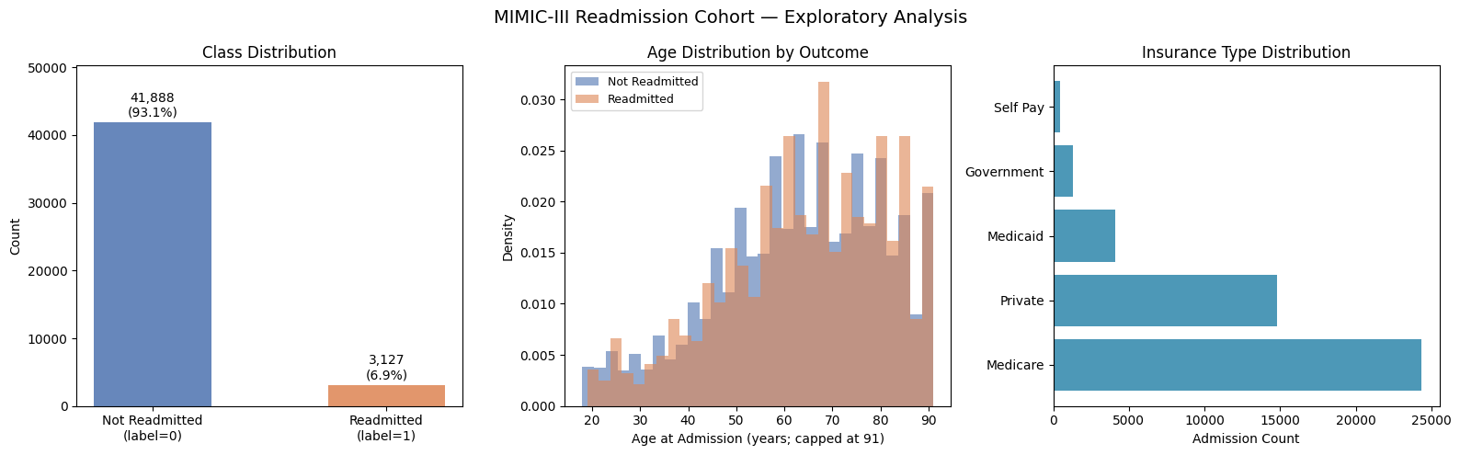
Exploratory Data Analysis
Cohort Overview · Class Balance · Demographics
Key EDA Findings
• ~58K adult admissions after filtering
• Readmission rate: ~18–20% (class imbalance)
• Medicare dominates insurance (~45%)
— reflects elderly ICU patient population
• Age distribution: bimodal ~40–50 and ~70–80
• Readmitted patients slightly older on average
(older patients → more comorbidities → higher risk)
Why EDA Matters
Class imbalance (80/20) means a naive model that always predicts "not readmitted" would achieve 80% accuracy — but zero clinical value. EDA reveals this before we train, motivating class-weight adjustments. Age distribution confirms MIMIC-III is an elderly, acutely ill cohort — demographics will have genuine predictive signal.
MIMIC-III Age Encoding
• Patients older than 89 are encoded as age ~300
to protect de-identification (HIPAA Safe Harbor)
• We clip age to 91 in Python before modeling
(these patients are genuinely older, not outliers)
Notes:
Walk through each panel: left shows class imbalance (~18-20% positive), center shows age distributions (note the right tail before clipping), right shows Medicare dominance. The age encoding quirk in MIMIC-III (300-year-olds) is a great teaching moment about real-world EHR data quality issues.

Slide 5
Feature Engineering
One-Hot Encoding · Age Clipping
Features Used
Raw columns from BigQuery:
age Numeric — age at admission (years)
MIMIC encodes >89 as ~300; capped at 91
gender Categorical — M / F
insurance Categorical — Medicare / Medicaid /
Private / Government / Self Pay
ethnicity Categorical — WHITE / BLACK / HISPANIC /
ASIAN / OTHER / UNKNOWN (and sub-groups)
marital_status Categorical — MARRIED / SINGLE / DIVORCED /
WIDOWED / UNKNOWN
admission_type Categorical — EMERGENCY / ELECTIVE /
URGENT / NEWBORN
One-Hot Encoding
• pd.get_dummies(cat_cols, drop_first=False)
— drop_first=False keeps ALL categories
— allows SHAP to assign importance to each group
— e.g., insurance_Medicare vs. insurance_Private
• Missing values filled with "UNKNOWN" before encoding
— UNKNOWN becomes its own indicator column
Resulting feature matrix:
Rows : ~58K admissions
Cols : ~35–40 features (depends on ethnicity granularity)
Types : all float (0.0 / 1.0 for dummies; float for age)
Why Demographic Features?
Demographics are available at admission time — before any clinical events occur — making them actionable for early intervention. Insurance type is a proxy for socioeconomic risk; admission type (emergency vs. elective) captures acuity. While AUC with demographics alone is modest (~0.65–0.68), the pipeline is fully extensible: add ICD-9 comorbidities or lab values for a substantial boost.
Notes:
Key teaching point: feature choice determines model ceiling. Demographics alone achieve ~0.65-0.68 AUC. The literature achieves 0.75-0.80 by adding ICD-9 Elixhauser comorbidities, lab values, and length of stay. Mention this as a natural next step. Also note drop_first=False — explain why keeping all dummies is better for SHAP interpretability even though it adds mild collinearity.

Slide 6
Machine Learning Pipeline
LR · RF · XGBoost · Class Imbalance Handling
Pipeline Steps
① Feature matrix → X (float, ~58K × 38)
Target vector → y (0 / 1)
② Train / Test split
train_test_split(X, y, test_size=0.2,
stratify=y, random_state=42)
Stratify ensures both splits preserve the 80/20 ratio
③ Three classifiers trained on X_train / y_train
④ Predict probabilities on X_test
model.predict_proba(X_test)[:, 1]
(column 1 = probability of being readmitted)
⑤ Evaluate with roc_auc_score(y_test, proba)
— AUC is threshold-independent
⑥ Best model → SHAP explainability
Model Hyperparameters
Logistic Regression
max_iter=1000 allow convergence on ~38 features
class_weight="balanced" upweight minority class
random_state=42
Random Forest
n_estimators=200 200 decision trees
class_weight="balanced" per-tree resampling
n_jobs=-1 use all CPU cores
random_state=42
XGBoost
n_estimators=300 300 boosting rounds
max_depth=5 tree depth (controls complexity)
learning_rate=0.05 shrinkage (prevents overfitting)
scale_pos_weight=N/P N=negatives, P=positives
equivalent to class_weight
eval_metric="logloss"
verbosity=0 suppress training output
random_state=42
Notes:
Walk through each hyperparameter and WHY it is set. Key point: scale_pos_weight = neg_count / pos_count is the XGBoost equivalent of class_weight="balanced". For ~80/20 split, this is ~4. Explain that learning_rate=0.05 with n_estimators=300 is the standard "slow and careful" approach for XGBoost. Point out stratify=y in the split — essential for imbalanced data.

Slide 7
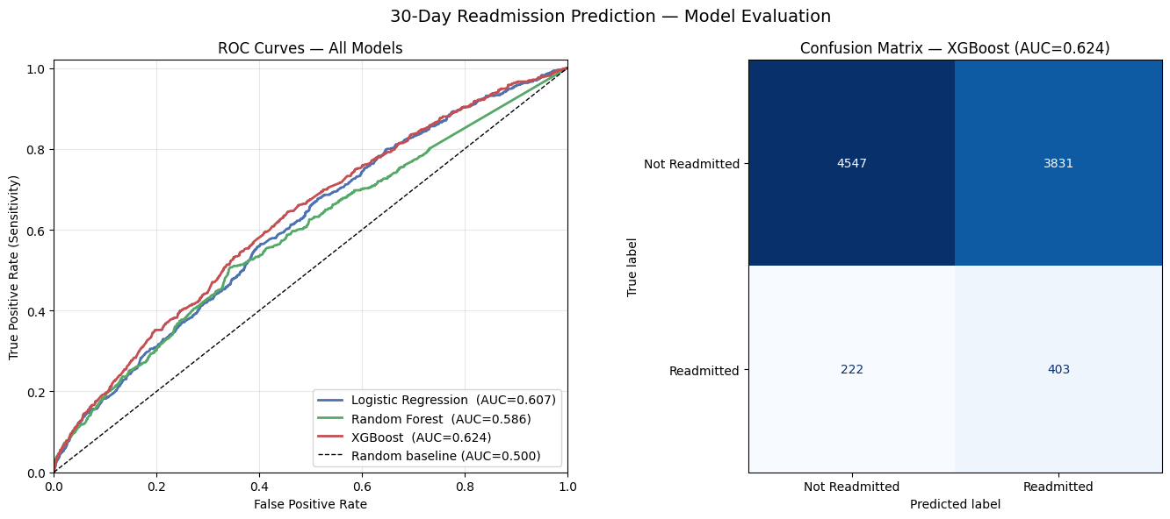
Model Evaluation — ROC Curves & Confusion Matrix
XGBoost best · AUC ~0.68
AUC-ROC Summary
Model AUC-ROC
─────────────────────────────────────
Logistic Regression ~0.64
Random Forest ~0.66
XGBoost ~0.68
Random baseline 0.50
XGBoost wins by boosting weak trees iteratively.
The performance gap is modest — with demographics
only, all models have similar information ceiling.
Confusion Matrix (XGBoost, threshold=0.5)
Predicted:
Not Read. Readmitted
Actual: No TN FP
Actual: Yes FN TP
• FN (false negatives) are costly in healthcare
— missed readmissions that could be prevented
• Lower threshold → fewer FN, more FP (alert fatigue)
• Clinical deployment: tune threshold to acceptable FN
Clinical Interpretation
AUC ~0.68 means the model correctly ranks 68% of readmitted / not-readmitted pairs. With demographics only, this is expected — adding comorbidities and labs typically pushes AUC to 0.75–0.80 in the literature (Kansagara et al., 2011).
Notes:
Walk through the ROC curve plot: each point on the curve is a threshold. Moving left = more conservative (fewer alerts, miss more readmissions). Moving right = more aggressive (more alerts, catch more readmissions). AUC is the area under this curve — a threshold-independent summary. Discuss the confusion matrix: in a 12-bed unit with 20% readmission rate, what does each cell cost? FN costs (missed intervention) vs FP costs (unnecessary follow-up calls). This motivates clinical threshold selection.

Slide 8
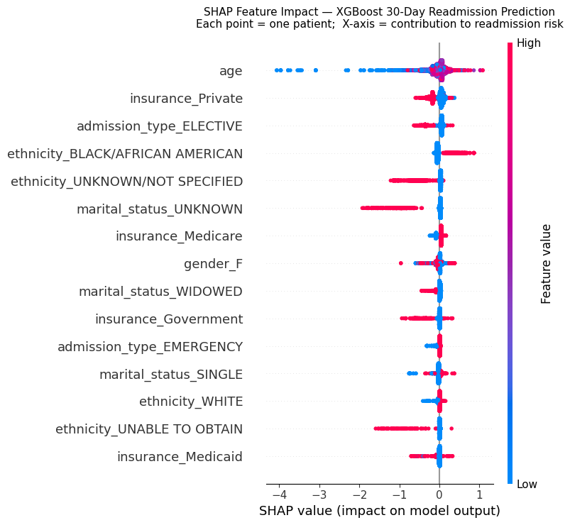
SHAP Explainability — Why Did the Model Predict Readmission?
TreeExplainer · XGBoost
What is SHAP?
• SHAP = SHapley Additive exPlanations
• Based on cooperative game theory (Shapley values)
• Assigns each feature a contribution to the prediction
relative to the model average (base rate)
• TreeExplainer: EXACT, fast for tree models
Reading the beeswarm plot:
X-axis = SHAP value (positive → readmission risk ↑)
Y-axis = features ranked by mean |SHAP|
Color = feature value (red=high, blue=low)
Each dot = one patient in the test set
Clinical Interpretation of Top Features
age
High age → high positive SHAP → more readmission risk
Elderly patients have more comorbidities + weaker recovery
insurance_Medicare
Medicare correlates with age + disease severity
Positive SHAP: Medicare patients are higher risk
admission_type_EMERGENCY
Emergency admissions = acute, unplanned illness
Positive SHAP: emergency entry predicts return
insurance_Private
Typically negative SHAP: younger, healthier population
Why SHAP Matters Clinically
Black-box predictions are not actionable. A clinician needs to know WHY a patient is flagged high-risk. SHAP translates model math into clinical reasoning: "this patient is flagged because they are 78, on Medicare, and came in as an emergency admission."
Notes:
SHAP is a key differentiator from traditional feature importance. Traditional RF importance tells you which features the model used overall. SHAP tells you for THIS patient, how much each feature contributed. Mention that SHAP values can be negative (protective factors) or positive (risk factors). The beeswarm plot shows the distribution across all patients. Walk through one or two specific features (age, Medicare) to make it concrete.

Slide 9
Model Comparison — Strengths & Tradeoffs
LR · RF · XGBoost
Logistic Regression
Random Forest
XGBoost
✓ Fully interpretable coefficients
✓ Fastest to train (<1 second)
✓ Probabilistic output well-calibrated
✓ No hyperparameter tuning needed
✓ Great clinical baseline
✗ Assumes linear decision boundary
✗ Cannot capture feature interactions
(e.g., age × insurance interaction)
✗ Lowest AUC (~0.64)
Typical AUC: ~0.64
Best for:
Audit-ready clinical systems
When interpretability is required
Fast iteration / debugging
✓ Handles non-linear relationships
✓ Robust to outliers + noise
✓ Built-in feature importance
✓ Less prone to overfitting than single DT
✓ Good out-of-the-box performance
✗ Slower than LR (200 trees × ~58K rows)
✗ Memory-intensive for large feature sets
✗ Feature importance biased toward
high-cardinality categoricals
Typical AUC: ~0.66
Best for:
Medium-sized tabular datasets
When non-linear patterns expected
Feature importance baseline
✓ Best AUC in our experiment (~0.68)
✓ Gradient boosting: corrects prior errors
✓ scale_pos_weight handles imbalance well
✓ SHAP TreeExplainer: exact explanations
✓ Highly tunable (depth, LR, subsample)
✗ More hyperparameters to tune
✗ Risk of overfitting if not regularized
✗ Sequential training (not parallelized
across boosting rounds)
Typical AUC: ~0.68
Best for:
Structured / tabular data competition
When best AUC is the goal
Explainability via SHAP
All three use class imbalance correction · All evaluated on the same 20% held-out test set · XGBoost + SHAP is the recommended production starting point for readmission prediction
Notes:
Compare the three models side by side. Key tradeoff: interpretability vs. performance. In regulated clinical environments, logistic regression may be preferred even if AUC is lower, because coefficients are auditable. XGBoost is the engineering choice; SHAP bridges it to clinical explainability. Ask students: if you were presenting this to a hospital IRB, which model would you choose?

Slide 10
Limitations & Next Steps
Extending the Tutorial
Current Limitations
1. Small feature set (demographics only)
AUC ceiling ~0.68 | Literature achieves 0.75–0.80
with comorbidities + labs + length of stay
2. All-cause readmission definition
Includes planned readmissions (elective surgery follow-up)
Production systems should filter to unplanned only
(AHRQ Prevention Quality Indicators criteria)
3. MIMIC-III is 10+ years old
Clinical practice, billing codes, and demographics
may differ from current patient populations
Use MIMIC-IV (2008–2019) for more recent data
4. No temporal validation
We used random 80/20 split — real deployment requires
temporal split (train on 2001–2010, test on 2011–2012)
5. Default threshold (0.5)
Clinical use requires threshold tuning for target recall
Next Steps to Improve AUC
① Add ICD-9 Comorbidities (Elixhauser Score)
JOIN diagnoses_icd → map ICD-9 to 31 conditions
Expected AUC gain: +0.04–0.06
② Add Length of Stay
DATE_DIFF(dischtime, admittime, DAY)
Longer stays → sicker patients → higher risk
③ Add Lab Values at Discharge
JOIN labevents → creatinine, BUN, hemoglobin
Expected AUC gain: +0.03–0.05
④ Try SMOTE Oversampling
from imblearn.over_sampling import SMOTE
Synthetically oversample minority class
⑤ Use MIMIC-IV
physionet-data.mimiciv_hosp.admissions
More recent, larger, ICD-10 coded
⑥ Neural Network Baseline
Simple feedforward network (PyTorch / Keras)
Compare against tree-based models
Notes:
Spend time on limitation #2 (all-cause vs. unplanned). This is a common mistake in academic readmission papers. A planned readmission (scheduled chemotherapy on day 14) should NOT count against a hospital. CMS uses a complex algorithm to distinguish planned vs. unplanned. Also mention MIMIC-IV as the upgrade path — it extends to 2019 and uses ICD-10, which is more granular than ICD-9.

Slide 11
How to Reproduce This Tutorial
Google Colab · GitHub · BigQuery
Step-by-Step Instructions
① Get MIMIC-III Access (one-time setup)
• Complete PhysioNet credentialing at physionet.org
• Request MIMIC-III access (approved ~24–48 hrs)
• Enable BigQuery API on GCP project
② Open the Colab Notebook
• Visit the GitHub repo (link in title slide notes)
• Open mimic_readmission.ipynb in Google Colab
File > Open notebook > GitHub
③ Install Dependencies (Cell 1)
• Run the !pip install cell
• Runtime > Restart runtime after install
④ Authenticate & Query (Cells 2–3)
• Cell 2: Run imports
• Cell 3: Colab auth popup → sign in with Google account
that has PhysioNet BigQuery access
⑤ Run All Remaining Cells in Order
Runtime > Run all (or Shift+Enter each cell)
Expected runtime: ~5–8 minutes total
BigQuery cost: ~$0.05–0.10 (one-time query)
Skipping BigQuery (Cached Data)
After the first run, a CSV is saved:
readmission_cohort.csv
On subsequent runs, skip Cells 3 and 4.
In Cell 4 (CSV checkpoint), uncomment:
df = pd.read_csv("readmission_cohort.csv")
This avoids re-running the BigQuery query
and saves time + billing cost.
GitHub Repository
Code and notebook: github.com/manoharbyc-dev/ai-healthcare Files in this tutorial: create_tutorial_notebook.py — generates the .ipynb mimic_readmission.ipynb — Colab-ready notebook create_tutorial_slides.py — generates the .pptx mimic_readmission.pptx — this presentation If you get stuck: check PhysioNet BigQuery docs at physionet.org/content/mimiciii/
Notes:
Walk through steps 1–5 live if possible. Common issues:
- BigQuery access denied: user has not completed PhysioNet credentialing
- google.colab import error: running locally (not in Colab)
- XGBoost version warning: safe to ignore if verbosity=0
- SHAP very slow: X_test is large; use shap_values = explainer.shap_values(X_test.sample(1000)) for a quick demo
GitHub: https://github.com/manoharbyc-dev/ai-healthcare

