Slide 1






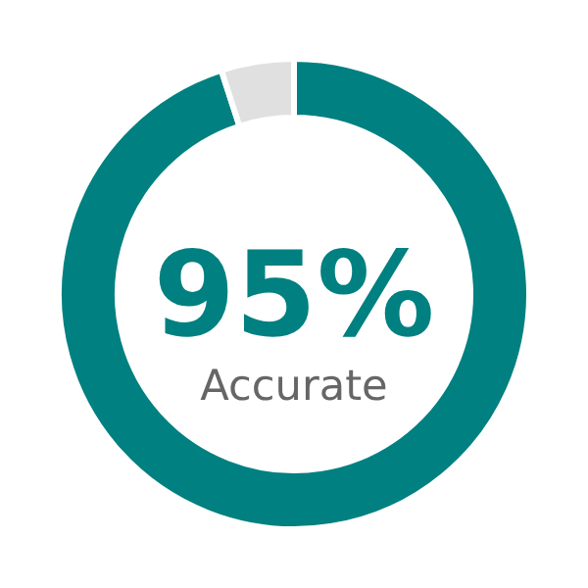












Kumbh 2025: Successes and Gaps
Maha Kumbh 2025 demonstrated breakthrough AI visibility but faced challenges in achieving real-time autonomy and adaptive crowd response
Successes
Gaps & Challenges
AI & Data Analytics
Centralized Command Dependency
95% accurate head-counting and heatmap analytics from AI-enabled cameras and drones, supporting 24x7 situational awareness
Edge decisions lagged during peak crowd phases; AI data was visible but not converted into timely actions
Fragmented Alert Dissemination
Audio/text announcements were missed due to language and connectivity issues
RFID & IoT Integration
Behavioral and Environmental Blind Spots
Over 1.5 million RFID wristbands enabled real-time people tracking and missing-person resolution
Lacked analytics to anticipate panic or emotion-based movement patterns
Bhashini & Kumbh SahAI'yak Chatbot
Delivered multilingual guidance and information delivery to pilgrims
Key Takeaway: Technology detects well but doesn't interpret context or adapt on its own.

Slide 2



















Ubiquitous Computing for a Stampede-Free Kumbh 2028
A self-learning Ubicomp ecosystem can turn World's largest gathering into a self-regulating, human-aware event
Edge‑AI Crowd Flow
Predictive Communication
Emotion-Aware Behavioral Analytics
Smart Mobility
Ambient Intelligence
Deploy edge AI nodes across Ghats to autonomously reroute pilgrims and prevent choke-zones without central commands
Sensor-triggered, multilingual alerts delivered instantly via phones, wearables, and smart signage
AI analyses movement and expressions to detect unrest or panic, activating rapid de-escalation protocols when needed
IoT- controlled transit loops, geo-fenced vehicles, and sensor-optimized
pathways that coordinate pedestrians
Smart lighting, color cues, and soundscapes intuitively guide and calm pilgrims, complementing traditional verbal instructions
Expected Impact
Shift from monitoring to anticipation – real-time decision loops at ground level
Inclusive, sensor-triggered multilingual safety guidance on every device and public touchpoint
Emotionally and physically safe pilgrim flows, verified instantly by behavior AI and responsive environment
Anticipate | Adapt | Assure – The UbiComp Vision for Stampede-Proof Kumbh

