Slide 1

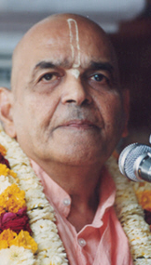
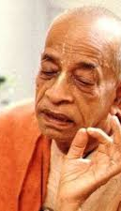
भीष्म पितामह Bhisma Pitamah
Based on Bhagavat Saptah Lecture by HH Maha Vishnu Goswami Maharaj in Sydney

Slide 2
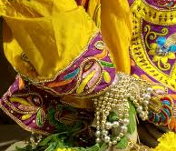
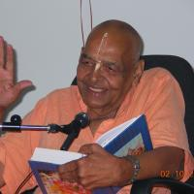
Recap
Duty in this age
Lead simple life
Don’t waste time in mental concoction
Utilize time in serious study of Bhagavatam
Medicine for this age
Hear, Study and Contemplate
Heart is meant for Krishna
Solution to our dissatisfaction
Spirit cannot be happy with matter.
Glorify Lord Sri Krishna
What is Real Wealth
Pleasing Krishna pleases everyone
Laxmi or Durga
Remembrance of Krishna

Slide 3
Recap
How to handle distress
Humbly Tolerance and have Patience
Improved karma leads to happiness
No one knows plan of the invisible actor
Art of Living
We have to go!
Blame yourself not others – See only Krishna
Eat sparingly and depend on Krishna
Dhruva Maharaj
Wish good to all and focus on Krishna!
God is great – worship Him
Take shelter of Krishna with determination

Slide 4
पुनरावृत्ति
इस युग में कर्तव्य
सादा जीवन जिए
मानसिक मनगढ़ंत में समय बर्बाद न करें
भागवतम् के गंभीर अध्ययन करें
इस युग के लिए दवा
तच्छृण्वन् सुपठन् विचारणपरो [SB 12.13.18]
हृदय कृष्ण के लिए है
हमारे असंतोष का समाधान
आत्मा पदार्थ से खुश नहीं हो सकती
भगवान कृष्ण की महिमा करें
वास्तविक धन क्या है
यास्मीन तुष्टे जगत् तुष्टे
लक्ष्मी या दुर्गा
कृष्ण का स्मरण

Slide 5
पुनरावृत्ति
संकट से कैसे निपटें ?
विनम्रता, धीरज, सभी का सम्मान
अच्छे कर्म से खुशी मिलती है
अदृश्य अभिनेता की योजना कोई नहीं जानता
जीने की कला
हमें जाना है
दूसरों को दोष न दें - केवल कृष्ण को देखें
संयमपूर्वक भोजन करें और कृष्ण पर निर्भर रहें
ध्रुव महाराज
सभी को शुभकामनाएं और कृष्ण पर ध्यान केंद्रित करें!
ईश्वर महान है - उसकी पूजा करो
निश्चय के साथ कृष्ण की शरण लें

Slide 6
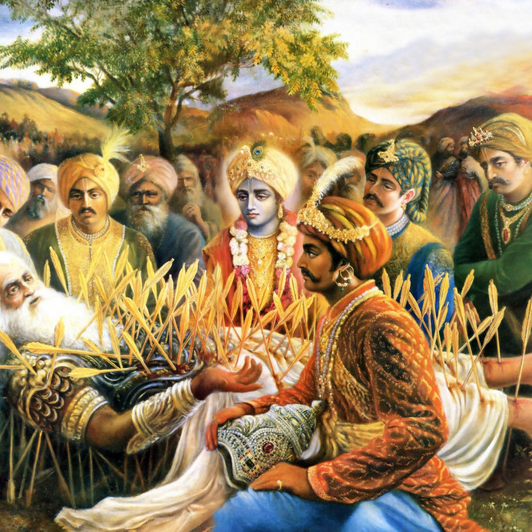
No one knows His plan
न ह्यस्य कर्हिचिद्राजन् पुमान् वेद विधित्सितम् । यद्विजिज्ञासया युक्ता मुह्यन्ति कवयोऽपि हि ॥ १६ ॥
na hy asya karhicid rājan pumān veda vidhitsitam yad vijijñāsayā yuktā muhyanti kavayo ’pi hi
na — never; hi — certainly; asya — His; karhicit — whatsoever; rājan — O King; pumān — anyone; veda — knows; vidhitsitam — plan; yat — which; vijijñāsayā — with exhaustive inquiries; yuktāḥ — being engaged; muhyanti — bewildered; kavayaḥ — great philosophers; api — even; hi — certainly.
O King, no one can know the plan of the Lord [Śrī Kṛṣṇa]. Even though great philosophers inquire exhaustively, they are bewildered.[SB 1.19.16]

Slide 7
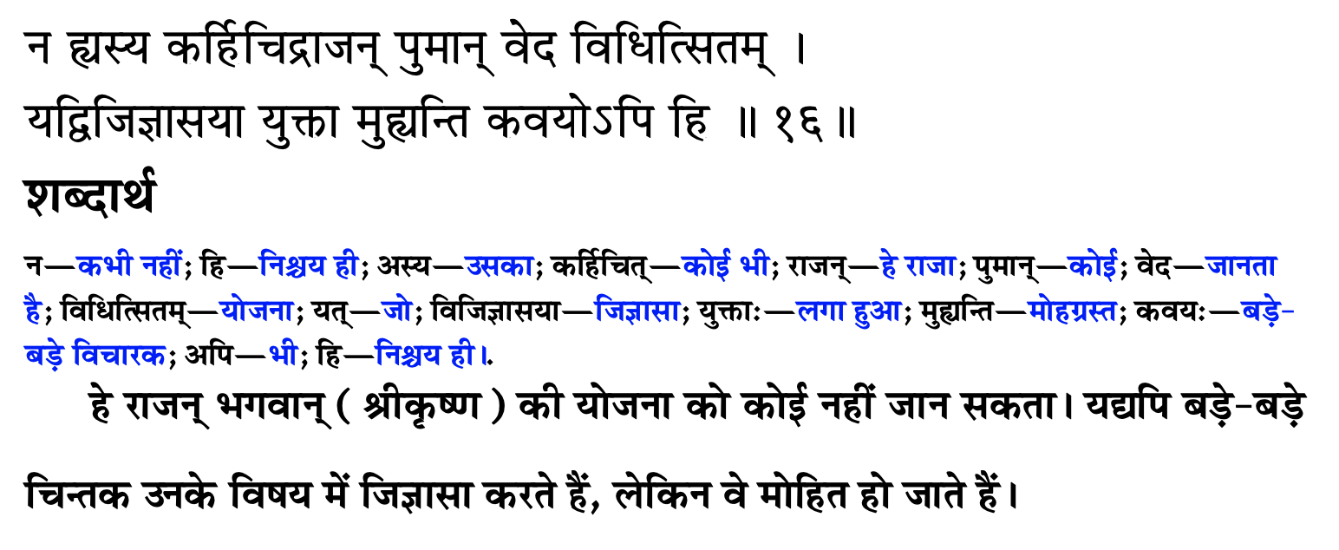
उसकी योजना कोई नहीं जानता

Slide 8
Purport 1.9.16: Abide by the orders of Krishna
The bewilderment of Mahārāja Yudhiṣṭhira over his past sinful acts and the resultant sufferings, etc., is completely negated by the great authority Bhīṣma (one of the twelve authorized persons). Bhīṣma wanted to impress upon Mahārāja Yudhiṣṭhira that since time immemorial no one, including such demigods as Śiva and Brahmā, could ascertain the real plan of the Lord. So what can we understand about it? It is useless also to inquire about it. Even the exhaustive philosophical inquiries of sages cannot ascertain the plan of the Lord. The best policy is simply to abide by the orders of the Lord without argument. The sufferings of the Pāṇḍavas were never due to their past deeds. The Lord had to execute the plan of establishing the kingdom of virtue, and therefore His own devotees suffered temporarily in order to establish the conquest of virtue. Bhīṣmadeva was certainly satisfied by seeing the triumph of virtue, and he was glad to see King Yudhiṣṭhira on the throne, although he himself fought against him. Even a great fighter like Bhīṣma could not win the Battle of Kurukṣetra because the Lord wanted to show that vice cannot conquer virtue, regardless of who tries to execute it. Bhīṣmadeva was a great devotee of the Lord, but he chose to fight against the Pāṇḍavas by the will of the Lord because the Lord wanted to show that a fighter like Bhīṣma cannot win on the wrong side.

Slide 9
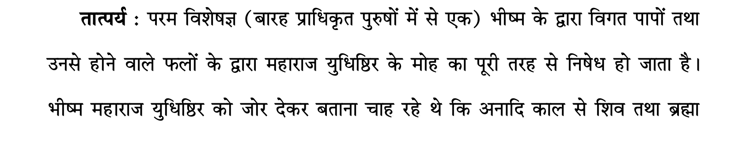
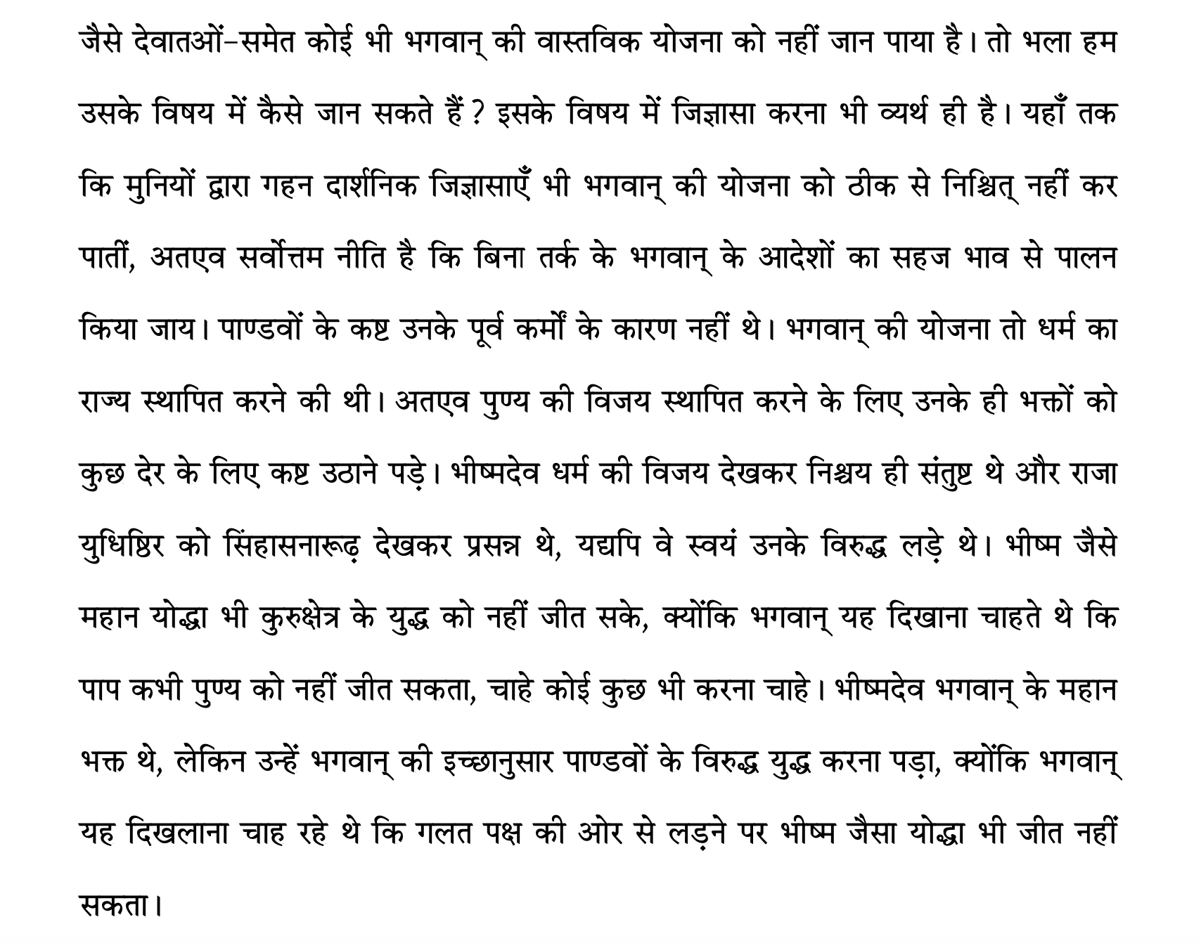

Slide 10
Accept and follow His plan
तस्मादिदं दैवतन्त्रं व्यवस्य भरतर्षभ । तस्यानुविहितोऽनाथा नाथ पाहि प्रजा: प्रभो ॥ १७ ॥
tasmād idaṁ daiva-tantraṁ vyavasya bharatarṣabha tasyānuvihito ’nāthā nātha pāhi prajāḥ prabho
tasmāt — therefore; idam — this; daiva-tantram — enchantment of providence only; vyavasya — ascertaining; bharata-ṛṣabha — O best among the descendants of Bharata; tasya — by Him; anuvihitaḥ — as desired; anāthāḥ — helpless; nātha — O master; pāhi — just take care of; prajāḥ — of the subjects; prabho — O Lord.
O best among the descendants of Bharata [Yudhiṣṭhira], I maintain, therefore, that all this is within the plan of the Lord. Accepting the inconceivable plan of the Lord, you must follow it. You are now the appointed administrative head, and, my lord, you should now take care of those subjects who are now rendered helpless. [SB 1.9.17]

Slide 11
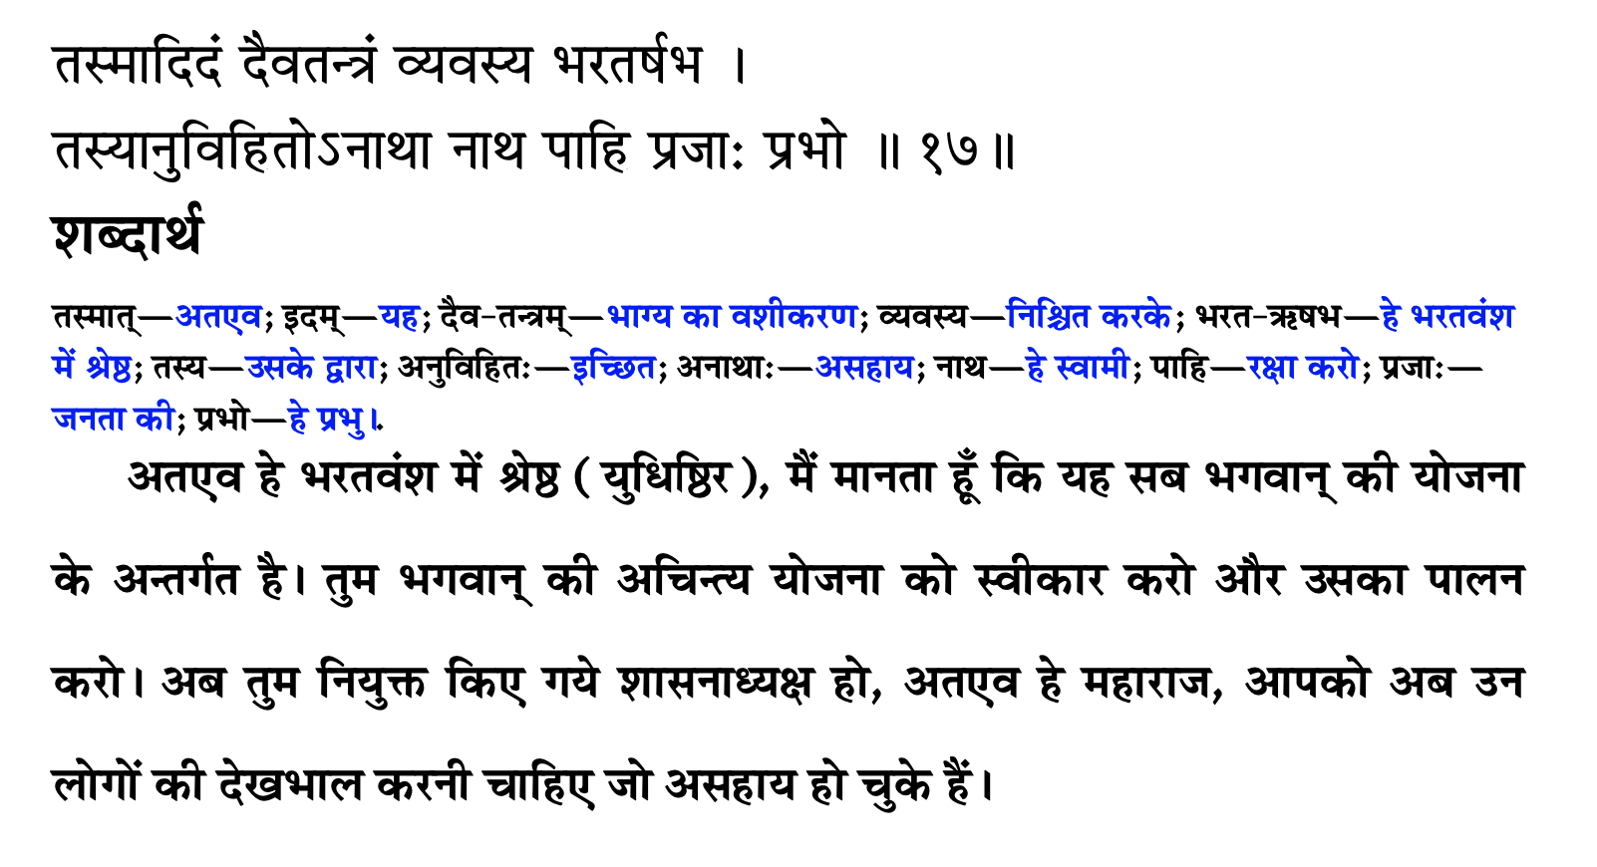
उसकी योजना को स्वीकार करें और उसका पालन करें

Slide 12
Purport 1.9.17: Accept tribulations as favors
The popular saying is that a housewife teaches the daughter-in-law by teaching the daughter. Similarly, the Lord teaches the world by teaching the devotee. The devotee does not have to learn anything new from the Lord because the Lord teaches the sincere devotee always from within. Whenever, therefore, a show is made to teach the devotee, as in the case of the teachings of Bhagavad-gītā, it is for teaching the less intelligent men. A devotee’s duty, therefore, is to ungrudgingly accept tribulations from the Lord as a benediction. The Pāṇḍavas were advised by Bhīṣmadeva to accept the responsibility of administration without hesitation. The poor subjects were without protection due to the Battle of Kurukṣetra, and they were awaiting the assumption of power by Mahārāja Yudhiṣṭhira. A pure devotee of the Lord accepts tribulations as favors from the Lord. Since the Lord is absolute, there is no mundane difference between the two.

Slide 13
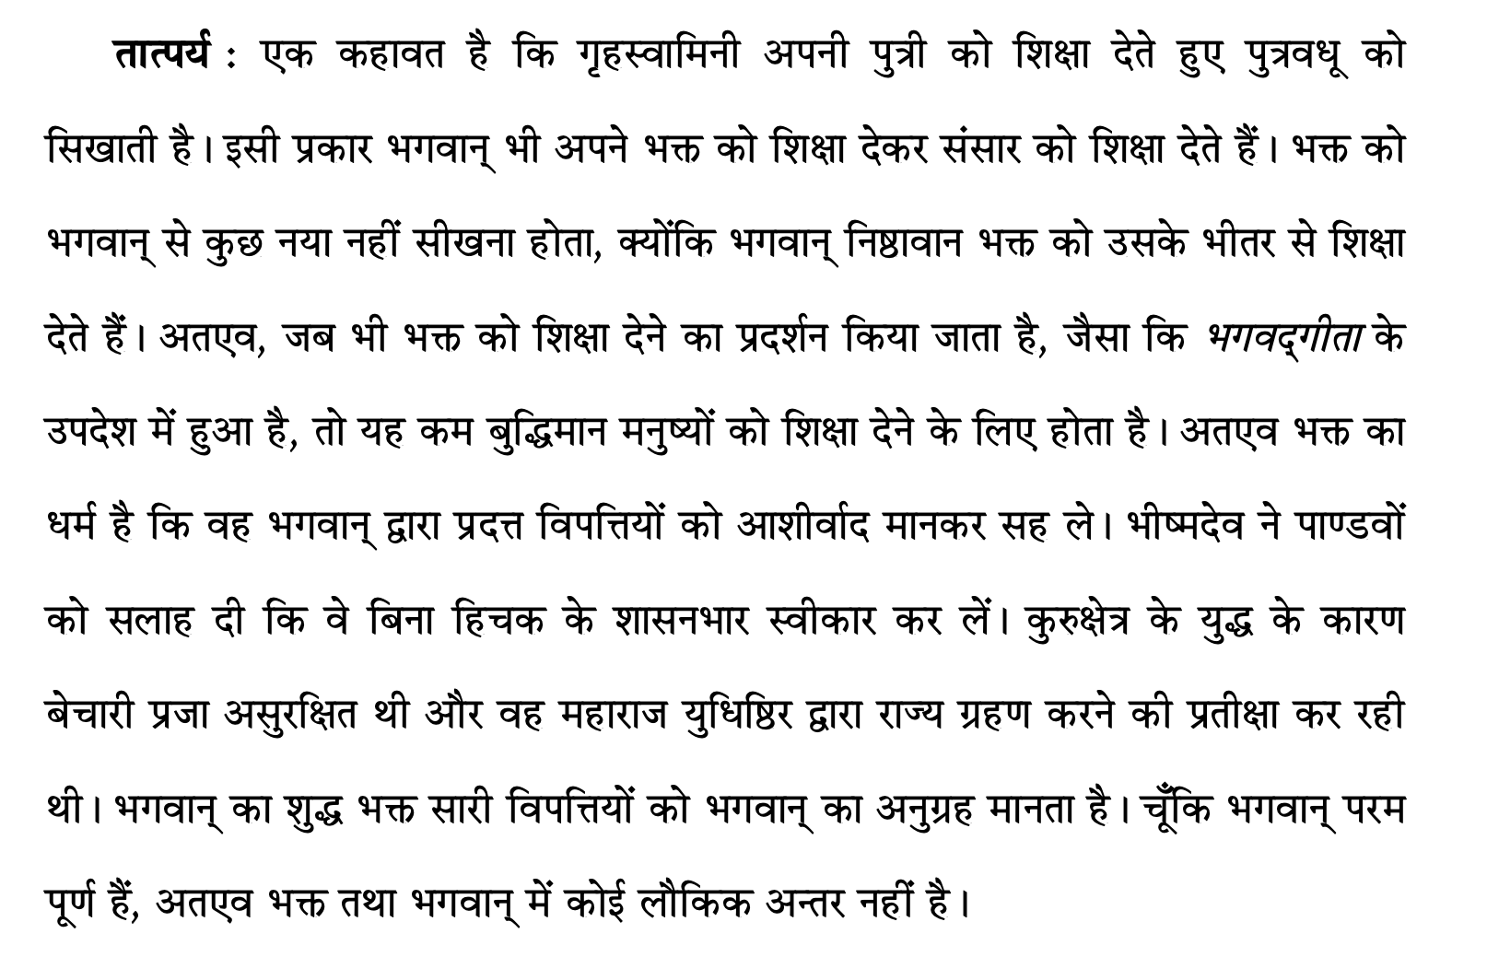

Slide 14
What is secret of success?
स्वयम्भूर्नारद: शम्भु: कुमार: कपिलो मनु: । प्रह्लादो जनको भीष्मो बलिर्वैयासकिर्वयम् ॥ ६.३.२० ॥
Lord Brahmā, Bhagavān Nārada, Lord Śiva, the four Kumāras, Lord Kapila [the son of Devahūti], Svāyambhuva Manu, Prahlāda Mahārāja, Janaka Mahārāja, Grandfather Bhīṣma, Bali Mahārāja, Śukadeva Gosvāmī and I myself know the real religious principle. [SB 6.3.20]
Mahajans means they know everything and are unalloyed devotees of Lord Sri Krishna. They are unflinching devotees of the Lord are never defeated.
kåñṇeti näm, kåñṇa iti näm yasya, vächi, pravartate, labhas tesam jayas tesam.
Those who take the name of Krishna are always benefitted and they keep succeeding
यत्र योगेश्वर: कृष्णो यत्र पार्थो धनुर्धर: । तत्र श्रीर्विजयो भूतिर्ध्रुवा नीतिर्मतिर्मम ॥ १८.७८ ॥
Wherever there is Kṛṣṇa, the master of all mystics, and wherever there is Arjuna, the supreme archer, there will also certainly be opulence, victory, extraordinary power, and morality. That is my opinion. [BG 18.78]

Slide 15
Misery Can bring us closer to Krishna
मात्रास्पर्शास्तु कौन्तेय शीतोष्णसुखदुःखदाः । आगमापायिनोऽनित्यास्तांस्तितिक्षस्व भारत ॥ २.१४ ॥
O son of Kuntī, the nonpermanent appearance of happiness and distress, and their disappearance in due course, are like the appearance and disappearance of winter and summer seasons. They arise from sense perception, O scion of Bharata, and one must learn to tolerate them without being disturbed.
Krishna devotees go to only Krishna in case of trouble
Kaaliya Snake
Govardhan Lila

Slide 16
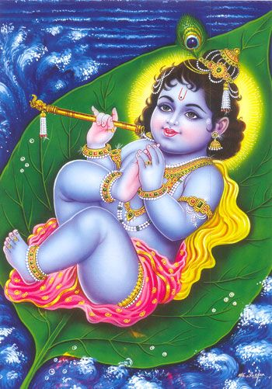
Solution to our problems
karäravindena padäravindam mukhäravinde viniveshayantam
vatasya patrasya pute shayänam bälam mukundam manasä smarämi
The one who keeps His lotus like feet on His lotus like mouth with His lotus like hand, I think of that Balamukunda who sleeps on the vata patra, banyan leaf
How muchever problems we may have, we must do only this - bälam mukundam manasä smarämi. There is no problem, which is too big for Him.

Slide 17
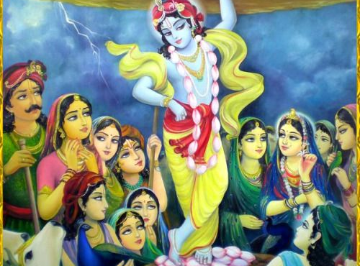

Slide 18
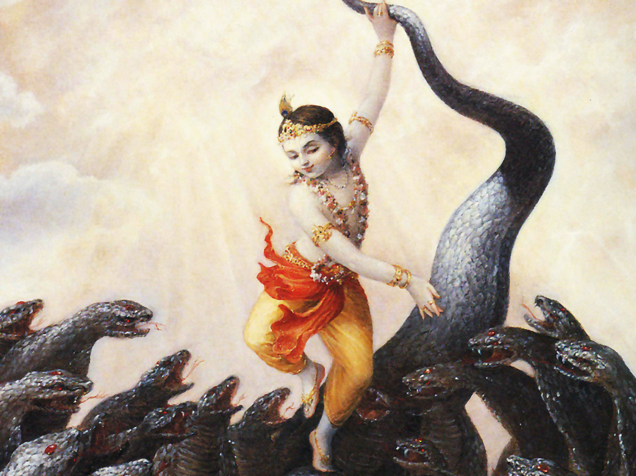

Slide 19
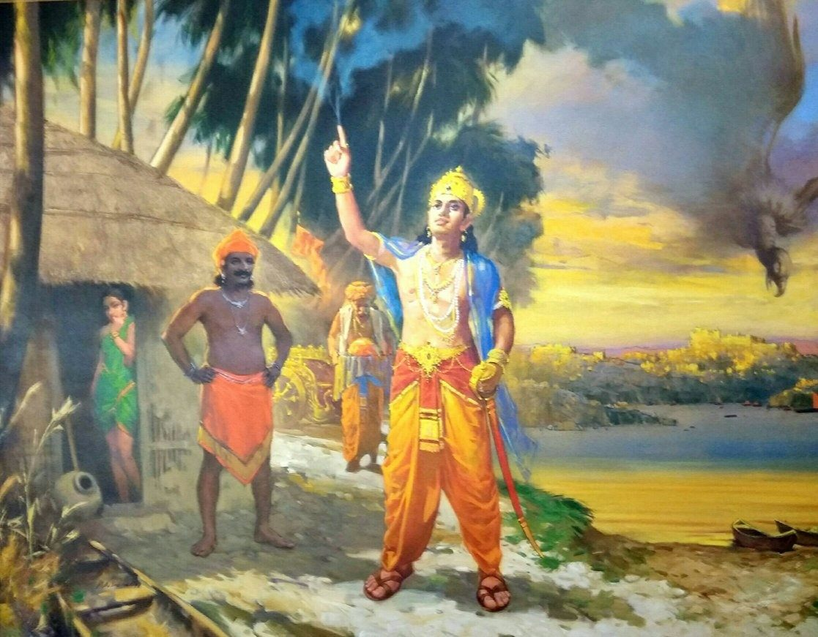
Bhishma Pitamah
Best of the 8 Vasus
Son of Mother Ganga and Shantanu
Life full of sacrifice for father, family and empire
Fully surrendered devotee of Lord Krishna
One of the twelve Mahajans

Slide 20
भीष्म पितामह
आठ वसुओं में से श्रेष्ठ
माँ गंगा और शांतनु के पुत्र
पिता, परिवार और साम्राज्य के लिए बलिदान से भरा जीवन
पूरी तरह से भगवान कृष्ण के भक्त
बारह महाजनों में से एक

Slide 21
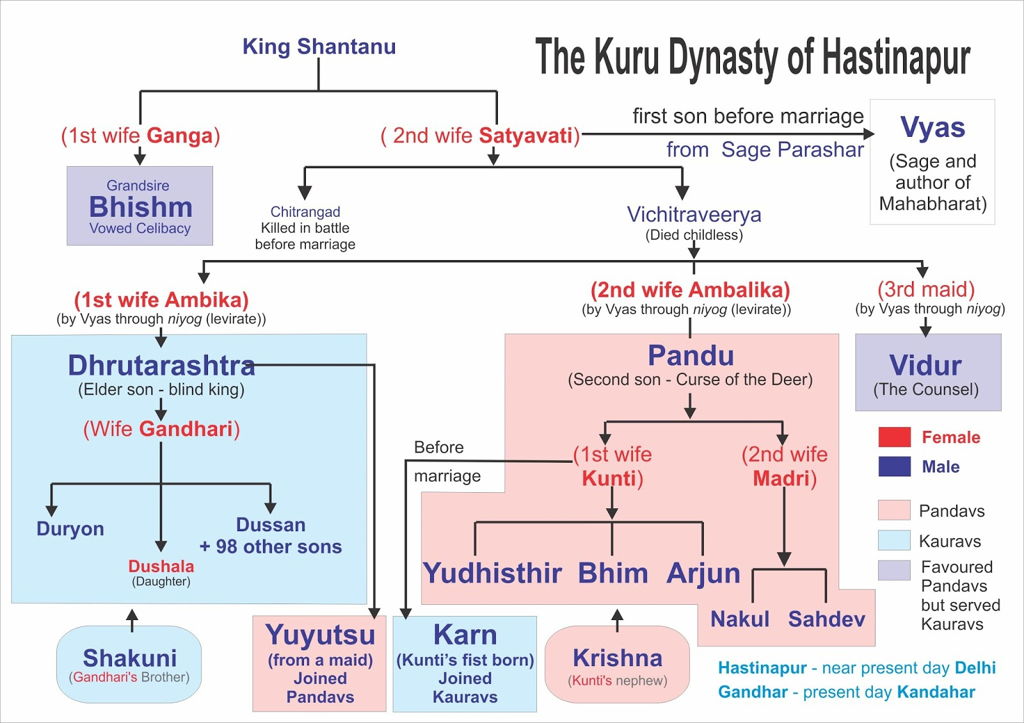

Slide 22
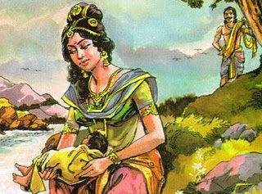
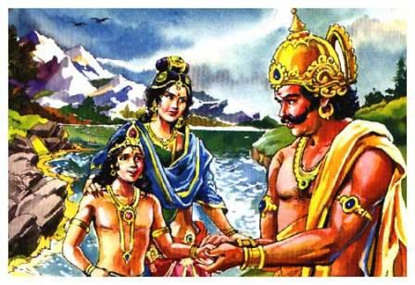
Ganga and Shantanu -> Devavrata
Cow stealing by Vasus
Ganges accepts to be mother
King Mahabhisha in previous life visited heaven and exchanged loving glance with Ganga – Ganga cursed
Shantanu while hunting meets Ganga and agrees to all marriage conditions – no questions asked – yes Madam!
Mother Ganga drowns her children in river Ganges

Slide 23
गंगा और शांतनु -> देवव्रत
वसुओं द्वारा गाय की चोरी
गंगा माँ बनना स्वीकार करती है
पूर्व जन्म में राजा महाभिषेक ने स्वर्ग का दौरा किया और गंगा के साथ प्रेमपूर्ण नज़रिया का आदान-प्रदान किया - गंगा को श्राप
शिकार करते समय शांतनु गंगा से मिलते हैं और शादी की सभी शर्तों पर सहमत होते हैं - कोई सवाल नहीं - हाँ मैडम!
माँ गंगा अपने बच्चों को गंगा नदी में डुबो देती हैं

Slide 24
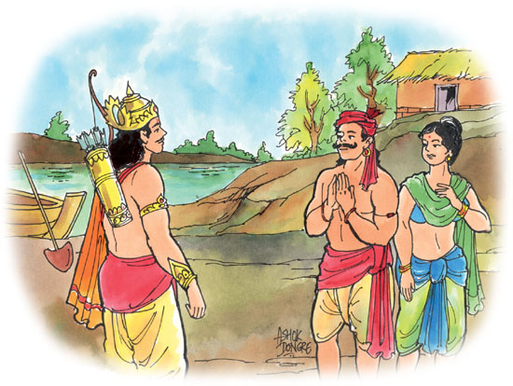
Satyavati and Shantanu -> Great Vow of Bhisma
Shantanu got Devavrata but Ganga left
Shantanu declares Devavrata the heir
Shantanu falls in love with fisherman’s daughter
Satyavati father’s marriage conditions
Devavrata takes vow for the pleasure of father

Slide 25
सत्यवती और शांतनु -> भीष्म का महान व्रत
शांतनु को देवव्रत मिला लेकिन गंगा ने छोड़ दिया
शांतनु ने देवव्रत को उत्तराधिकारी घोषित किया
शांतनु को मछुआरे की बेटी से प्यार हो गया
सत्यवती पिता की शादी की शर्तें
देवव्रत पिता के सुख के लिए संकल्प लेते हैं

Slide 26
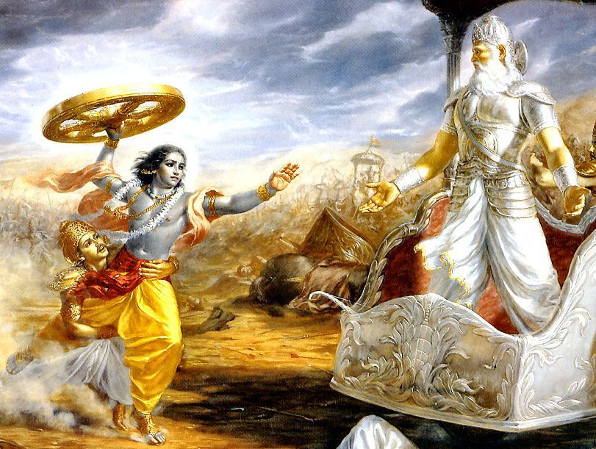
Fulfilling my vow and sacrificing His own promise, He got down from the chariot, took up its wheel, and ran towards me hurriedly, just as a lion goes to kill an elephant. He even dropped His outer garment on the way. [SB 1.9.37]

Slide 27
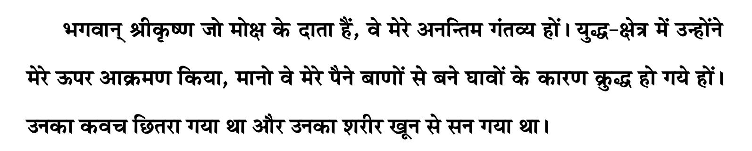

Slide 28
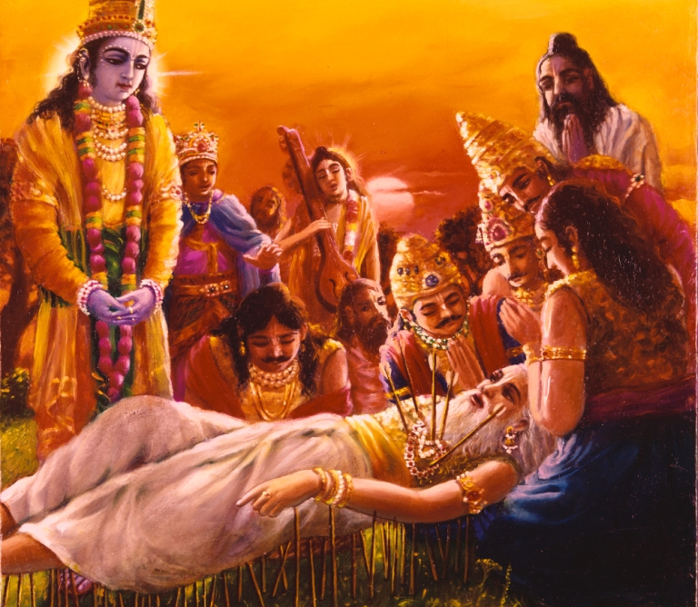
How to leave body?
At the moment of death, let my ultimate attraction be to Śrī Kṛṣṇa, the Personality of Godhead. I concentrate my mind upon the chariot driver of Arjuna who stood with a whip in His right hand and a bridle rope in His left, who was very careful to give protection to Arjuna’s chariot by all means. Those who saw Him on the Battlefield of Kurukṣetra attained their original forms after death. [SB 1.9.39]

Slide 29
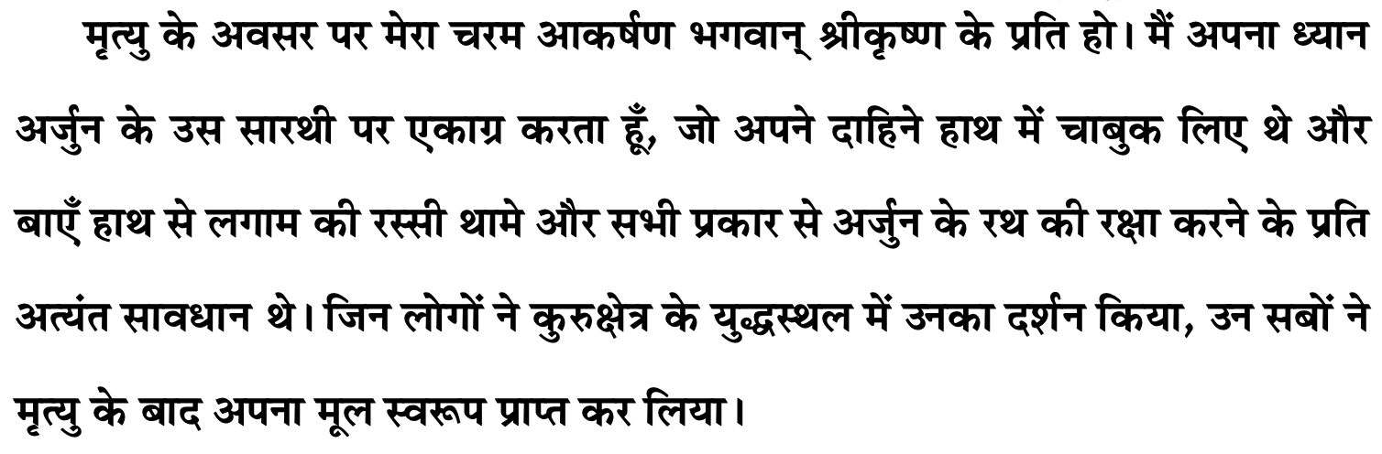
शरीर कैसे छोड़ें ?

Slide 30
Arrows of actions create Fate
Fate never tolerates that everything should go alright. That is the quality of fate or bhāgya. Fate can never be changed.
Fate will not give you anything and everything. From every point of view, you will not be joyful at all in this life and that is material life
Fate is the force which cannot be controlled, which is already there and we have to suffer. That is all. Nothing else. Nothing else. Only thing we can do is to purify our activities and purify our existence.
So we are chanting Krishna's names and because we are somehow or the other attracted to Srila Prabhupada's books and to the Lord, and that's why the poison teeth from our miseries is taken out. Otherwise it is horrible misery.
Lone time if it is not utilized in understanding Krishna, then we become mad, mental
In lone moments, you can do some creative things and the best creative thing, is to know the Absolute Truth. That is the best creative thing and we will not feel lonely.
Shoot arrows of action following sadhu/sastra/guru with FULL faith on Lord/Guru/Sadhu [16.23]
Amba kidnapping by Bhishma - Out actions (arrows shot) NOT done under protection of Vishnu creates bad reactions
Sacrifice and commitment uplifts us while sense gratification drags us down [BG 6.17]
If you take the help of sincerely chanting the Mahamantra, and good culture then you will be able to control
Controlling senses is very difficult without prasad/harinaam = Vindhya mountain float
Vishwamitra / Parashara vs Haridas Thakur
Lack of control of senses – causes Mahabharata
Maha-Mantra or Maha-Bharata
Tapasya – actions according to sastra – keep away from psychiatrist
Amba’s tapasya to avenge her insult against Bhishma
यं यं वापि स्मरन्भावं त्यजत्यन्ते कलेवरम् । तं तमेवैति कौन्तेय सदा तद्भ‍ावभावित: ॥ ६ ॥
Whatever state of being one remembers when he quits his body, O son of Kuntī, that state he will attain without fail. [BG 8.6]
Bharat Maharaj vs BhishmaDeva

Slide 31
Gita Connecting Verses
मात्रास्पर्शास्तु कौन्तेय शीतोष्णसुखदुःखदाः । आगमापायिनोऽनित्यास्तांस्तितिक्षस्व भारत ॥ २.१४ ॥
O son of Kuntī, the nonpermanent appearance of happiness and distress, and their disappearance in due course, are like the appearance and disappearance of winter and summer seasons. They arise from sense perception, O scion of Bharata, and one must learn to tolerate them without being disturbed.
दुःखेष्वनुद्विग्न‍मनाः सुखेषु विगतस्पृहः । वीतरागभयक्रोधः स्थिधीर्मुनिरुच्यते ॥ २.५६ ॥
One who is not disturbed in mind even amidst the threefold miseries or elated when there is happiness, and who is free from attachment, fear and anger, is called a sage of steady mind.
इन्द्रियाणि मनो बुद्धिरस्याधिष्ठानमुच्यते । एतैर्विमोहयत्येष ज्ञानमावृत्य देहिनम् ॥ ३.४० ॥
The senses, the mind and the intelligence are the sitting places of this lust. Through them lust covers the real knowledge of the living entity and bewilders him.
यं यं वापि स्मरन्भावं त्यजत्यन्ते कलेवरम् । तं तमेवैति कौन्तेय सदा तद्भ‍ावभावित: ॥ ८.६ ॥
Whatever state of being one remembers when he quits his body, O son of Kuntī, that state he will attain without fail.
य: शास्त्रविधिमुत्सृज्य वर्तते कामकारत: । न स सिद्धिमवाप्‍नोति न सुखं न परां गतिम् ॥ १६.२३ ॥
He who discards scriptural injunctions and acts according to his own whims attains neither perfection, nor happiness, nor the supreme destination.

Slide 32
Bhisma Prayers [1.9.32-42]
श्रीभीष्म उवाच इति मतिरुपकल्पिता वितृष्णा भगवति सात्वतपुङ्गवे विभूम्नि । स्वसुखमुपगते क्‍वचिद्विहर्तुं प्रकृतिमुपेयुषि यद्भ‍वप्रवाह: ॥ १.९.३२ ॥
Bhīṣmadeva said: Let me now invest my thinking, feeling and willing, which were so long engaged in different subjects and occupational duties, in the all-powerful Lord Śrī Kṛṣṇa. He is always self-satisfied, but sometimes, being the leader of the devotees, He enjoys transcendental pleasure by descending to the material world, although from Him only the material world is created.

Slide 33
Prayer unto lotus feet of Gurudeva that I may please learn how to …
Take care of parents and respect them
Perform actions for the Krishna
Tolerate
Smilingly accept tribulations as favors from Krishna
Be determined in vows of Bhakti
Accept bad fate and have full faith in Lord Krishna
Be Krishna Conscious in every situation unflinchingly
Leave the body remembering Lord Krishna
His lotus feet always remain the object of my attraction.

Slide 34
प्रार्थना - गुरुदेव के चरण कमल कि मैं कैसे…
माता-पिता का ख्याल रखें और उनका सम्मान करें
कृष्ण के लिए कर्म करें
सहन करें
कृष्ण के अनुग्रह के रूप में मुस्कुराते हुए क्लेशों को स्वीकार करें
भक्ति के व्रतों में संकल्पित हों
बुरे भाग्य को स्वीकार करें और भगवान पर पूरा भरोसा रखें
हर हाल में बेखौफ होकर कृष्णभावनामृत करें
भगवान कृष्ण को याद करते हुए शरीर को छोड़ दें
उनके चरणकमल हमेशा मेरे आकर्षण का विषय बने रहते हैं।

Slide 37
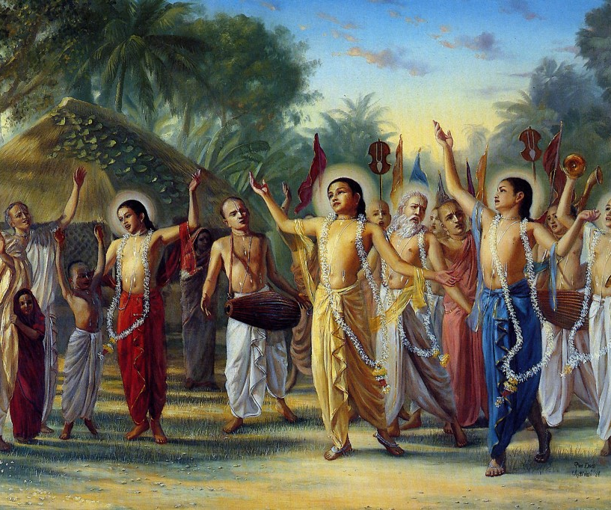
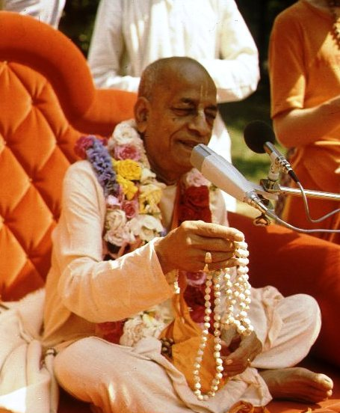
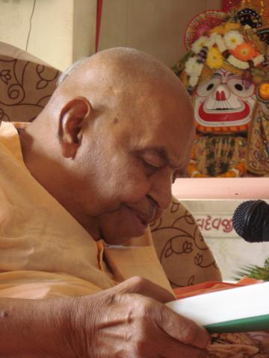
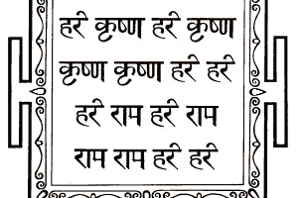
हरे कृष्णा
श्रील प्रभुपाद की जय
गुरुदेव की जय

