Slide 1
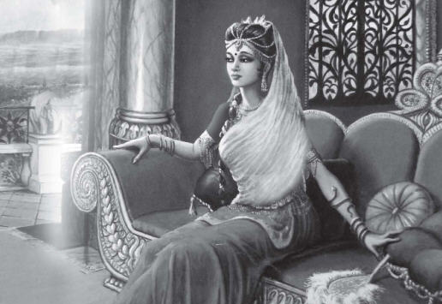
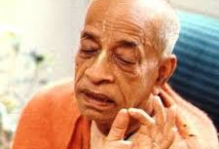
Draupadi – the heroine of Mahabharata SB 1.7.43-45
Reservoir of Compassion

Slide 2
SB 1.7.43-45
Text 43: She could not tolerate Aśvatthāmā’s being bound by ropes, and being a devoted lady, she said: Release him, release him, for he is a brāhmaṇa, our spiritual master.
Text 44: It was by Droṇācārya’s mercy that you learned the military art of throwing arrows and the confidential art of controlling weapons.
Text 45: He [Droṇācārya] is certainly still existing, being represented by his son. His wife Kṛpī did not undergo a satī with him because she had a son.

Slide 3
उवाच चासहन्त्यस्य बन्धनानयनं सती । मुच्यतां मुच्यतामेष ब्राह्मणो नितरां गुरु: ॥ uvāca cāsahanty asya bandhanānayanaṁ satī mucyatāṁ mucyatām eṣa brāhmaṇo nitarāṁ guruḥ
uvāca — said; ca — and; asahantī — being unbearable for her; asya — his; bandhana — being bound; ānayanam — bringing him; satī — the devoted; mucyatām mucyatām — just get him released; eṣaḥ — this; brāhmaṇaḥ — a brāhmaṇa; nitarām — our; guruḥ — teacher.
She could not tolerate Aśvatthāmā’s being bound by ropes, and being a devoted lady, she said: Release him, release him, for he is a brāhmaṇa, our spiritual master.[SB 1.7.43]

Slide 4
SB 1.7.43 points
Draupadi was compassionate – full of empathy, felt others pain, soft hearted woman
She had full respect and gratitude towards brahmana and guru
She could not tolerate the suffering of others especially son of guru a brahmana.
A brahmana is accepted as such by his/her character and actions and not birth and parentage – otherwise can be rejected
Guru – Acharya – is one who behaves as one preaches and helps disciples adopt the ways.
A devotee of the Lord can tolerate all sorts of tribulation personally, but still such devotees are never unkind to others, even to the enemy

Slide 5
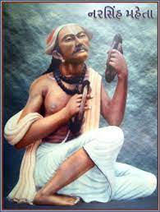
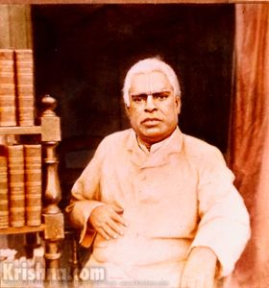
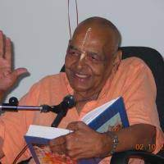
Connecting Points
Be merciless to yourself but be merciful to others.
Vaishnav Jan to tene kahiye je peed parai jaane re वैष्णव जन तो तेने कहिये जे पीड़ परायी जाणे रे
jīve dayā, kṛṣṇa-nāma sarva-dharma-sāra
Show compassion to other jīvas and chant kṛṣṇa-nāma – that is the essence of all dharma.
Thakur Bhakti Vinod

Slide 6
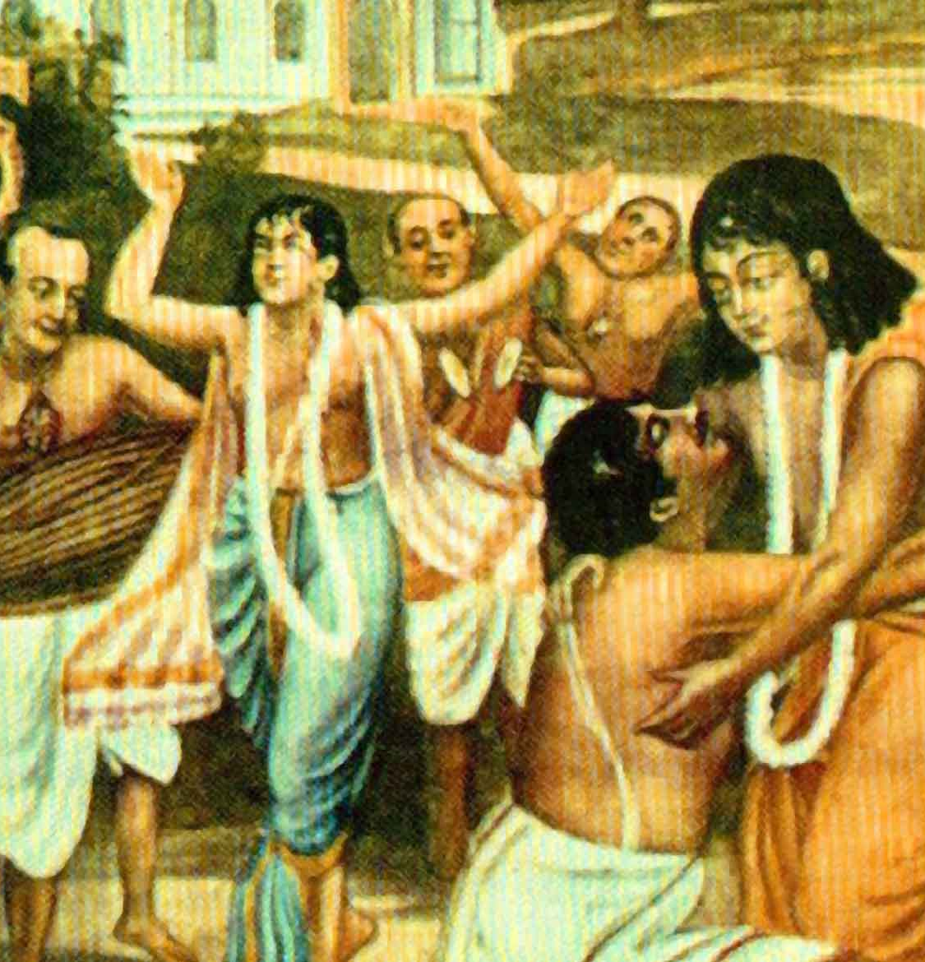
jīve dayā, kṛṣṇa-nāma sarva-dharma-sāra
(śraddhāvān jana he) nadīyā-godrume nityānanda mahājana pātiyāche nāma-haṭṭa jīvera kāraṇa
prabhura ājñāya, bhāi, māgi ei bhikṣā bala `kṛṣṇa,’ bhajo kṛṣṇa, kara kṛṣṇa-śikṣa
aparādha-śūnya ha’ye laha kṛṣṇa-nāma kṛṣṇa mātā, kṛṣṇa pitā, kṛṣṇa dhana-prāṇa
kṛṣṇera saṁsāra kara chāḍi’ anācāra jīve dayā, kṛṣṇa-nāma sarva-dharma-sāra
“O people with faith! In Nadīyā, at Godruma, that great personality Nityānanda has opened a marketplace of the Holy Name for delivering the jīvas. O brothers, by the order of the Lord, I beg this favour – Chant “Kṛṣṇa,” worship Kṛṣṇa, and follow Kṛṣṇa’s teachings. Being free of offences, take up the Holy Name of Kṛṣṇa. Kṛṣṇa is your mother, Kṛṣṇa is your father, and Kṛṣṇa is the wealth of your life. Abandon unrighteous activities and perform your worldly duties in relation to Kṛṣṇa. Show compassion to other jīvas and chant kṛṣṇa-nāma – that is the essence of all dharma.”

Slide 7
Jīvera dayā - Mercy to living entities
The instinct that arises from recognizing the suffering of a jīva, which produces tenderness in favor of that jīva, is called dayā (kindness).
Jīvera dayā is one of the main constituents of Vaiṣṇava dharma.
It is the inherent nature of a Vaiṣṇava to be kind to the jīvas. When this nature is not detected, one cannot become a Vaiṣṇava
Jīvera dayā nāme ruci vaiṣṇava sevana (compassion to the jīvas, a taste for the Holy Name and service to the Vaiṣṇavas) is the only teaching that Śrī Śacīnandana has propagated everywhere.
There are three kinds of sufferings
ātmā-niṣṭha (those inflicted upon the ātmā) : Illusion, as a result of ignorance
When kṛṣṇa-dāsya (servitorship to Kṛṣṇa), the inherent identification (svarūpa) of the jīva, is forgotten. Root of all suffering for the jīva.
liṅga-deha-niṣṭha (those inflicted upon the subtle body)
Bound and bewildered by māyā, the false ego has accepted the intellect, mind and consciousness to be the jīva. That is his subtle-body (liṅga-śarīra). Mentality of “I and mine” is said to be a product of the false ego working under the dictates of māyā.
sthula-deha-niṣṭha (those inflicted upon the gross body)

Slide 8
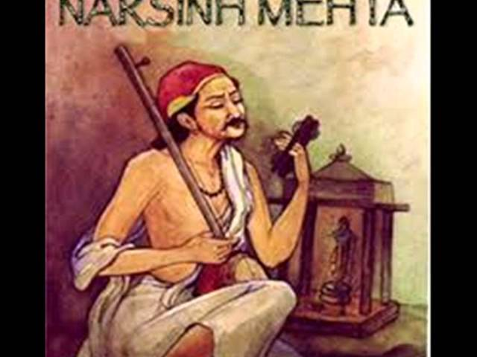
Vaiṣṇava jana to tene kahiye je by Narsimha Mehta
वैष्णव जन तो तेने कहिये जे पीड परायी जाणे रे । पर दुःखे उपकार करे तो ये मन अभिमान न आणे रे ॥ | vaiṣṇava jana to tene kahiye je pīḍa parāyī jāṇe re, para duḥkhe upakāra kare to ye mana abhimāna na āṇe re | Call those people Vaishnav who Feel the pain of others, Help those who are in misery, but never let self-conceit enter their mind.
सकळ लोकमां सहुने वंदे, निंदा न करे केनी रे । वाच काछ मन निश्चल राखे, धन धन जननी तेनी रे ॥ | sakaḷa loka māṁ sahune vande, nindā na kare kenī re, vāca kācha mana nischala raakhe, dhana dhana jananī tenī re | They respect the entire world, Do not disparage anyone, Keep their words, actions and thoughts pure, the mother of such a soul is blessed.
समदृष्टि ने तृष्णा त्यागी, परस्त्री जेने मात रे । जिह्वा थकी असत्य न बोले, परधन नव झाले हाथ रे ॥ | sama-dṛṣṭi ne tṛṣṇā tyāgī, para-strī jene māta re, jihvā thakī asatya na bole, para-dhana nava jhāle hātha re | They see all equally, renounce craving, Respect other women as their own mother, Their tongue never utters false words, Their hands never touch the wealth of others.
मोह माया व्यापे नहि जेने, दृढ़ वैराग्य जेना मनमां रे । रामनाम शुं ताळी रे लागी, सकळ तीरथ तेना तनमां रे ॥ | moha māyā vyāpe nahi jene, dhruda-vairāgya jenā manamāṁ re, rāma-nāma shu tāḷī lāgī, sakaḷa tīratha tenā tanamāṁ re | They do not succumb to worldly attachments, They are firmly detached from the mundane, They are enticed by the name of Raam, All places of pilgrimage are embodied in them.
वणलोभी ने कपटरहित छे, काम क्रोध निवार्या रे । भणे नरसैयॊ तेनुं दरसन करतां, कुळ एकोतेर तार्या रे ॥ | vaṇa-lobhī ne kapaṭa-rahita che, kāma krodha nivāryā re, bhaṇe narasaiyo tenuṁ darasana karatāṁ, kuḷa ekotera tāryā re | They have forsaken greed and deceit, They stay afar from desire and anger, Narsi says: I'd be grateful to meet such a soul, Whose virtue liberates their entire lineage.

Slide 9
सरहस्यो धनुर्वेद: सविसर्गोपसंयम: । अस्त्रग्रामश्च भवता शिक्षितो यदनुग्रहात् ॥ sarahasyo dhanur-vedaḥ savisargopasaṁyamaḥ astra-grāmaś ca bhavatā śikṣito yad-anugrahāt
sa-rahasyaḥ — confidential; dhanuḥ-vedaḥ — knowledge in the art of manipulating bows and arrows; sa-visarga — releasing; upasaṁyamaḥ — controlling; astra — weapons; grāmaḥ — all kinds of; ca — and; bhavatā — by yourself; śikṣitaḥ — learned; yat — by whose; anugrahāt — mercy of.
It was by Droṇācārya’s mercy that you learned the military art of throwing arrows and the confidential art of controlling weapons.[SB 1.7.44]

Slide 10
SB 1.7.44 points
Draupadi was reminded Arjuna of mercy of guru
She reminded Arjuna to be obliged towards guru and expertise imparted
Vedic mantras, or the transcendental science of sound, controlled weapons
Mahārāja Daśaratha used to control arrows by sound only.
A learned brāhmaṇa can become a teacher of any branch of knowledge, a priest and a recipient of charity
One should never try to be greater than guru always feel less

Slide 11
तद् धर्मज्ञ महाभाग भवद्भ‍िर्गौरवं कुलम् । वृजिनं नार्हति प्राप्तुं पूज्यं वन्द्यमभीक्ष्णश: ॥ tad dharmajña mahā-bhāga bhavadbhir gauravaṁ kulam vṛjinaṁ nārhati prāptuṁ pūjyaṁ vandyam abhīkṣṇaśaḥ
tat — therefore; dharma-jña — one who is aware of the principles of religion; mahā-bhāga — the most fortunate; bhavadbhiḥ — by your good self; gauravam — glorified; kulam — the family; vṛjinam — that which is painful; na — not; arhati — does deserve; prāptum — for obtaining; pūjyam — the worshipable; vandyam — respectable; abhīkṣṇaśaḥ — constantly.
O most fortunate one who know the principles of religion, it is not good for you to cause grief to glorious family members who are always respectable and worshipful. [SB 1.7.45]

Slide 12
SB 1.7.45 points
One who knows the principles of religion are most fortunate
Grief should not be imparted to anyone especially those who are glorious family members – who should be constantly worshipped.
Slight insult for a respectable family is sufficient to invoke grief
Cultured man should always be careful in dealing with worshipful family members
Family means the generation. That is Vedic conception. So if something is wrong done by any member of the family, that becomes a scar to the whole family. So she is, from family-wise, she is warning that "Do not do anything which will be a discredit to the whole Pāṇḍava family."

Slide 13
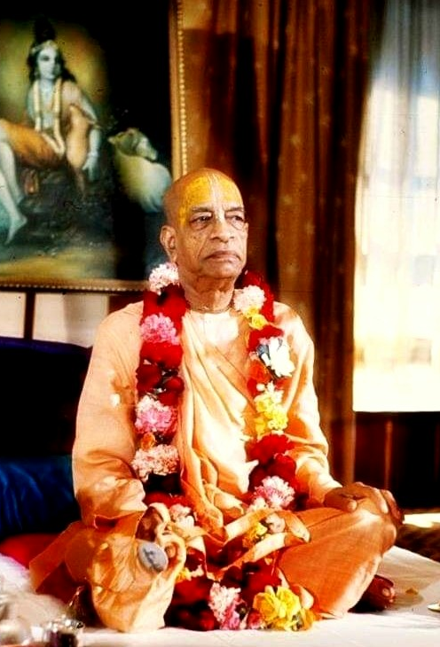
Srila Prabhupada says
Guru means he must be abiding by the rules and regulation of the śāstra.
Ācārya should be respected as Kṛṣṇa. Ācārya should not be considered as ordinary human being.
As we receive knowledge from the ācārya, similarly, our activities, the result of activities, is carried by the ācārya to the Supreme Personality of Godhead.
So guru, ācārya, being representative of the Supreme Personality of Godhead, he should be worshiped. Never think of envying. As soon as we become envious of the ācārya, there is falldown, immediately.
Kṛṣṇa and guru, they should be accepted on the same level. Therefore Draupadī has addressed Droṇācārya as bhagavān. Sākṣād-dharitvena samasta-śāstrair uktas tathā bhāvyata eva sadbhiḥ. It is accepted. We should also accept.

Slide 14
MSC: Merciful, Satisfied and Controlled
दयया सर्वभूतेषु सन्तुष्ट्या येन केन वा । सर्वेन्द्रियोपशान्त्या च तुष्यत्याशु जनार्दन: ॥
dayayā sarva-bhūteṣu santuṣṭyā yena kena vā sarvendriyopaśāntyā ca tuṣyaty āśu janārdanaḥ
dayayā — by showing mercy; sarva-bhūteṣu — to all living entities; santuṣṭyā — by being satisfied; yena kena vā — somehow or other; sarva-indriya — all the senses; upaśāntyā — by controlling; ca — also; tuṣyati — becomes satisfied; āśu — very soon; janārdanaḥ — the Lord of all living entities.
By showing mercy to all living entities, being satisfied somehow or other, and restricting the senses from sense enjoyment, one can very quickly satisfy the Supreme Personality of Godhead, Janārdana.

Slide 15
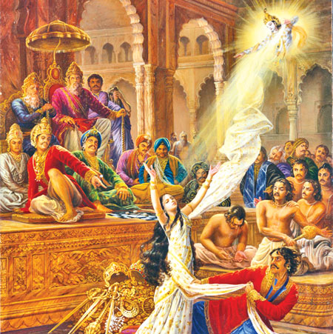
Draupadi surrendered devotee of Krishna
Appeared as dark complexioned Krishnā along with her brother Dhristadyumna from fire sacrifice performed by sage Yaja when requested by King Drupada of Panchala
Compassionate and pure – she invoked Lord Krishna direct mercy
Despite an unconventional marriage to five men, her surrender and unalloyed devotion to Krishna proved she was untouched by sin.

Slide 16

Krishnaa’s Appearance
King Drupada had nursed a grudge against Drona
He performed the sacrifice known as putrakama-yajna, under priest Yaja with dual objective: to get a son to kill Drona and a daughter to marry Arjuna. The sacrifice produced Dhristadyumna and Draupadi.
Draupadi was as beautiful as a demigoddess. Her smiling eyes were black and shaped like lotus petals. Her long, curly blue-black hair cascaded down her back. At the end of her graceful fingers her nails shone bright like copper. She emanated a sweet fragrance, like blue lotuses an aroma that traveled two full miles.

Slide 17
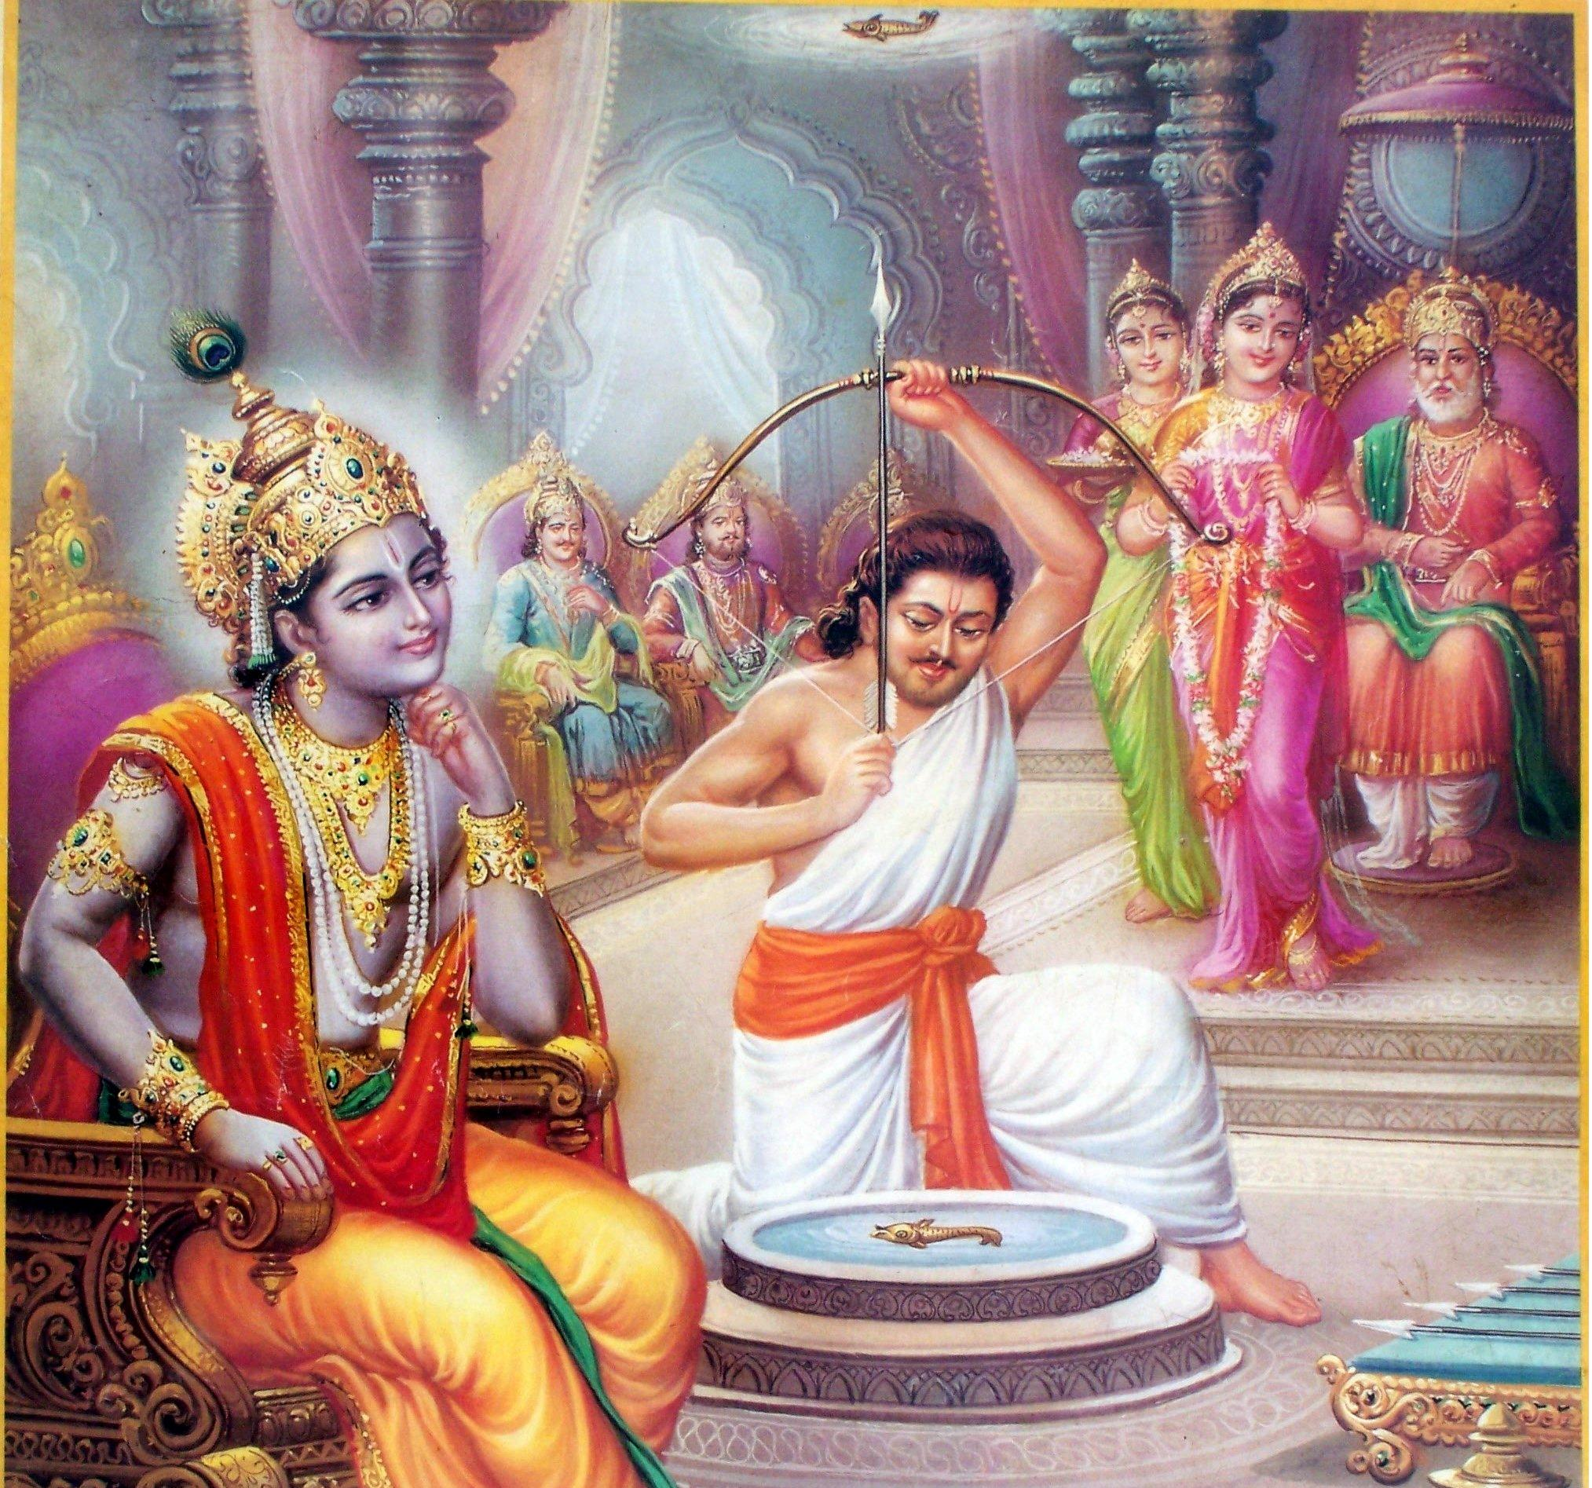
Panchali’s Marriage
King Drupada had arranged a great svayamvara ceremony in Kampilya
Drupada created an archery challenge only Arjuna could master: candidates had to pierce the eye of a fish suspended on the ceiling by looking at its reflection in a pot of water on the floor.
When the Pandavas returned home, Arjuna called out to his mother, Kunti, “O Mother, just see the wonderful treasure we have obtained today!”
Draupadi had received a boon from Lord Siva to marry five elevated men.

Slide 18
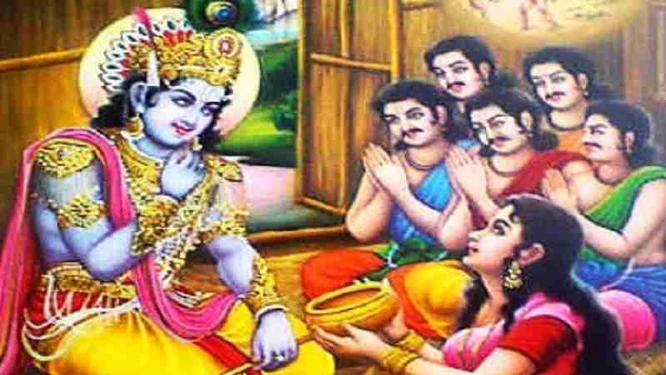
Devotion to Krishna
When Duhshasana dragged Draupadi into the Kuru assembly hoping to insult herattempted to pull off her sari. At first Draupadi tried to protect herself, but then she raised her arms and cried, “O Govinda! O Keshava! You are the destroyer of all afflictions. Save me, who am distressed and losing my senses in this evil assembly. There is no one but You to whom I can turn.”
When the Pandavas were in the forest during their exile, the sage Durvasa and ten thousand of his disciples visited them in the forest, spurred on by Duryodhana, who wanted to cause them trouble.

Slide 19
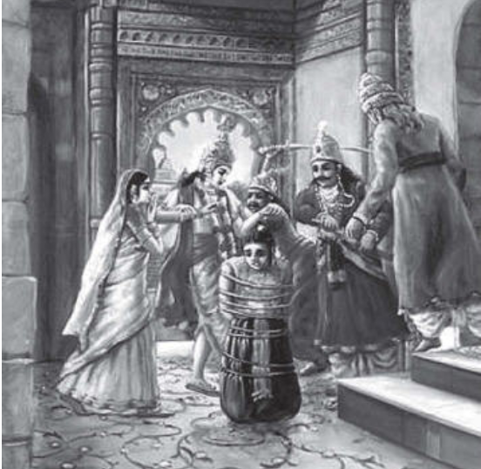
Reservoir of Compassion
Asvatthama, the son of Drona, had mercilessly killed the five sleeping sons of Draupadi in the middle of the night.
She said to Arjuna, “Release him, for he is the son of your martial teacher. Killing Asvatthama will cause Kripi, our worshipful superior, grief and cannot be in accord with religious principles. Such a sin can burn the whole body of a royal family to ashes.”

Slide 20
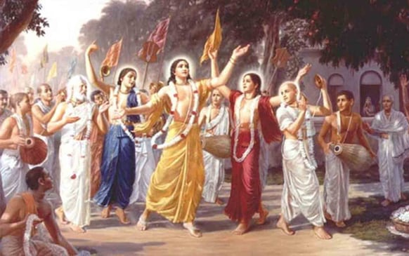
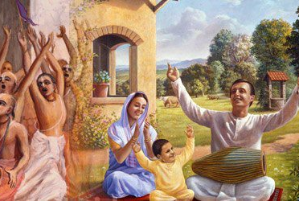
Take Home Points
One should develop merciful attitude towards all living entities
Merciful attitude towards towards others can be developed by being merciless to own own self.
Krishna’s can be easily approached by pure hearted
Krishna very quicky satisfied if one is Merciful, Satisfied and Controlled (MSC)
Obey Guru and regard him as good as Bhagavan.

Slide 21
References
https://vedabase.io/en/library/sb/1/7/
https://bhaktivinodainstitute.org/jivera-daya-mercy-to-living-entities/

Slide 22
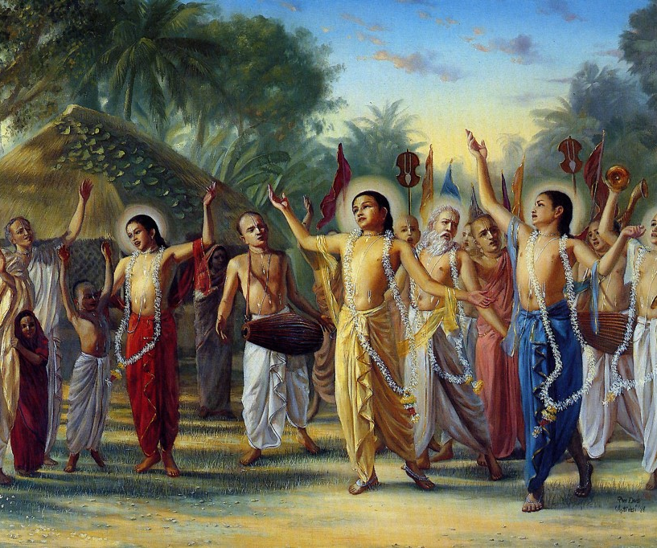
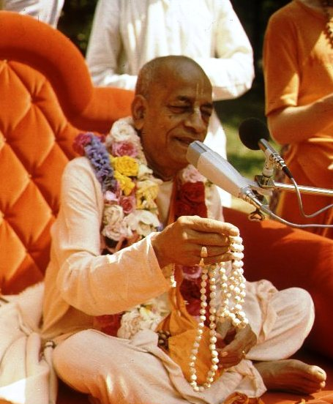
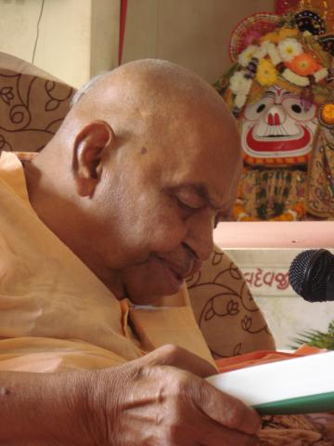
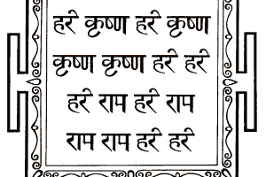
हरे कृष्णा
श्रील प्रभुपाद की जय
गुरुदेव की जय

