Slide 1
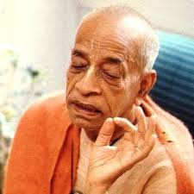
Nature, the Enjoyer and Consciousness Chapter 13
Nature, Enjoyer, Field, Knower of Field, Knowledge and Knower of Knowledge

Slide 2
Arjuna said: O my dear Kṛṣṇa, I wish to know about prakṛti [nature], puruṣa [the enjoyer], and the field and the knower of the field, and of knowledge and the object of knowledge. The Supreme Personality of Godhead said: This body, O son of Kuntī, is called the field, and one who knows this body is called the knower of the field. [BG 13.1-2]
Arjuna said nature and also enjoyer field and knower of the field all this I certainly wish to know knowledge and object of knowledge O Keśava
śrī-bhagavān said This body O son of Kunti Is called field One who knows this is called the knower of the field by those who know this
arjuna uvāca prakṛtiṁ puruṣaṁ caiva kṣetraṁ kṣetra-jñam eva ca etad veditum icchāmi jñānaṁ jñeyaṁ ca keśava
śrī-bhagavān uvāca idaṁ śarīraṁ kaunteya kṣetram ity abhidhīyate etad yo vetti taṁ prāhuḥ kṣetra-jña iti tad-vidaḥ

Slide 3
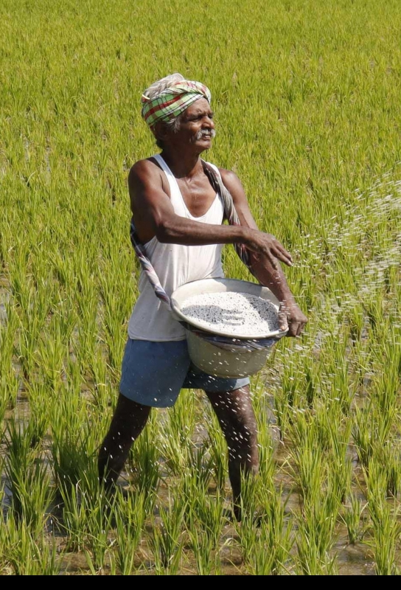
Field vs. Farmer
Seen and Seer, Apartment vs Resident
Knower of Body - who does not identify with the body
Simple to understand - BG 2.13 dehino ’smin
Garment vs Body – BG 2.22 vāsāṁsi jīrṇāni
BG 1-6 -> knower of the body
BG 7-12 -> Superiority of SPG and relationship between soul and SPG
BG 13-18 -> how living entity comes in contact with material nature and starts to relate with matter and how he is delivered by various ways
karma – fruitive activity
gyana – cultivation of knowledge
bhakti – devotional service

Slide 4
O scion of Bharata, you should understand that I am also the knower in all bodies, and to understand this body and its knower is called knowledge. That is My opinion. [BG 13.3]
I am also knower of the field and all fields, O son of Bharata to know the field and knower of field is knowledge, that is my opinion
kṣetra-jñaṁ cāpi māṁ viddhi sarva-kṣetreṣu bhārata kṣetra-kṣetrajñayor jñānaṁ yat taj jñānaṁ mataṁ mama

Slide 5

Two birds in a tree
This body is a machine, with driver and owner in the same car.
BG 18.61 īśvaraḥ sarva-bhūtānāṁ
Owner is directing and reminding the driver.
But the driver is whimsically after sense objects
If turn to owner, then He will give right direction.
Our business is to serve the whole with pure heart.

Slide 6
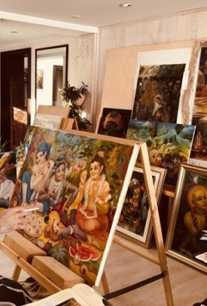
Lord, Living Entity and Matter
In everybody there are two souls – individual soul and Supersoul
From Krishna comes Supersoul
SB 1.2.11 - Krishna in 3 aspects - brahmeti paramātmeti bhagavān
Individual soul does not know about other bodies, Supersoul does.
Citizen vs King
Body (senses) vs Hṛṣīkeśa (owner or senses)
Nature (field of activity), enjoyer (living entity), controller of both
Painter : Painting : Easel = ? : ? : ?
Superior vs Inferior, fallible vs infallible

Slide 7
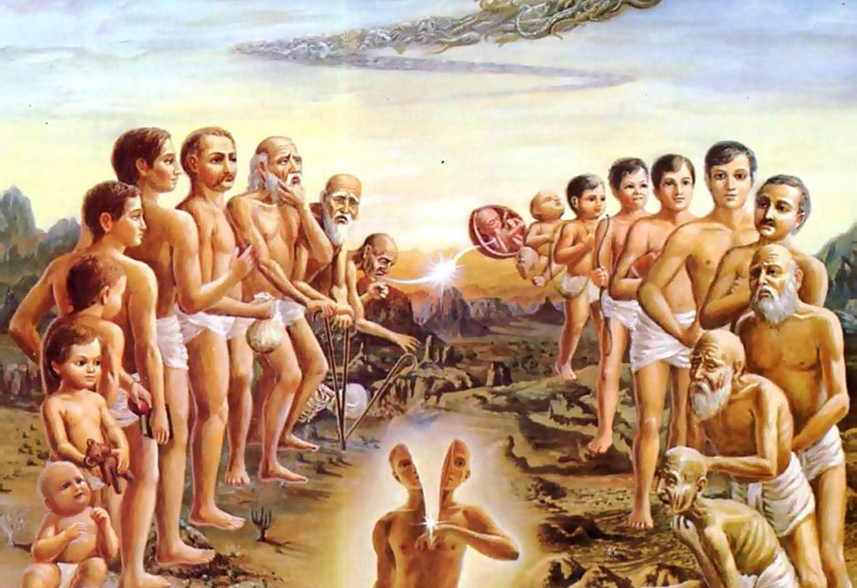

We are soul with a human body
We have lived in many bodies and done the same things over and over.
This body is given to us on rent.
This an opportunity to get liberation from material existence

Slide 8
Now please hear My brief description of this field of activity and how it is constituted, what its changes are, whence it is produced, who that knower of the field of activities is, and what his influences are. [BG 13.4]
Take information from right source
What constitutes body?
How does it change?
Who produces the changes?
What is the goal of the soul?
What are the influences of soul and Supersoul?
tat kṣetraṁ yac ca yādṛk ca yad-vikāri yataś ca yat sa ca yo yat-prabhāvaś ca tat samāsena me śṛṇu

Slide 9
That knowledge of the field of activities and of the knower of activities is described by various sages in various Vedic writings. It is especially presented in Vedānta-sūtra with all reasoning as to cause and effect. [BG 13.5]
We haven't got to accept anything blindly
athāto brahma jijñāsā
Three process of understanding
nyāya-prasthāna
Brahma-sūtra, or Vedānta-sūtra
śruti-prasthāna
smṛti-prasthāna
ṛṣibhir bahudhā gītaṁ chandobhir vividhaiḥ pṛthak brahma-sūtra-padaiś caiva hetumadbhir viniścitaiḥ
hetumadbhiḥ---with cause and effect; viniścitaiḥ---ascertain.

Slide 10
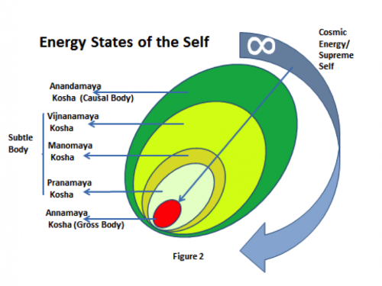
Five stages of Brahman realization
brahma pucchaṁ pratiṣṭhā - Taittirīya Upaniṣad (2.5)
anna-maya, dependence upon food for existence
prāṇa-maya, one can realize the Absolute Truth in the living symptoms or life forms
jñāna-maya, realization extends beyond the living symptoms to the point of thinking, feeling and willing
vijñāna-maya, in which the living entity’s mind and life symptoms are distinguished from the living entity himself
ānanda-maya, realization of the all-blissful nature

Slide 11
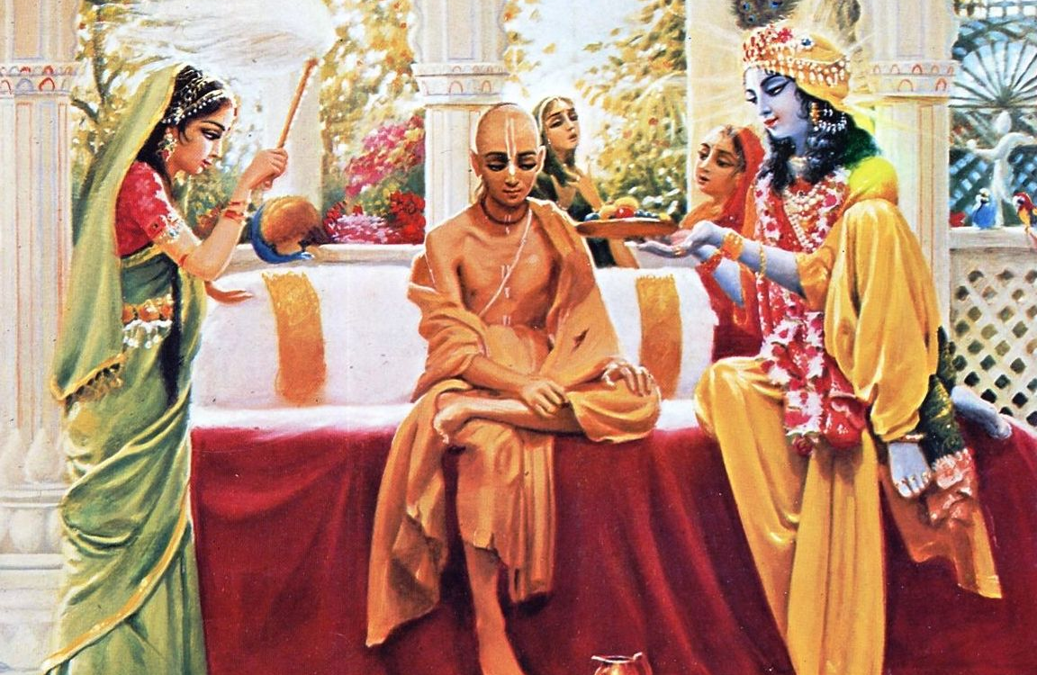
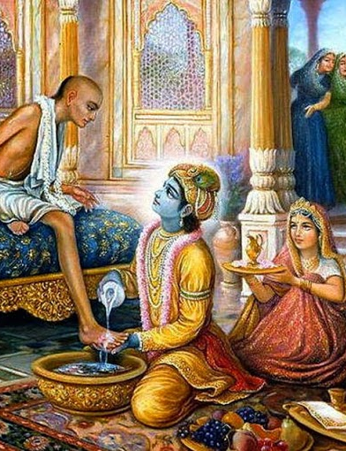
Krishna and Sudama

Slide 12
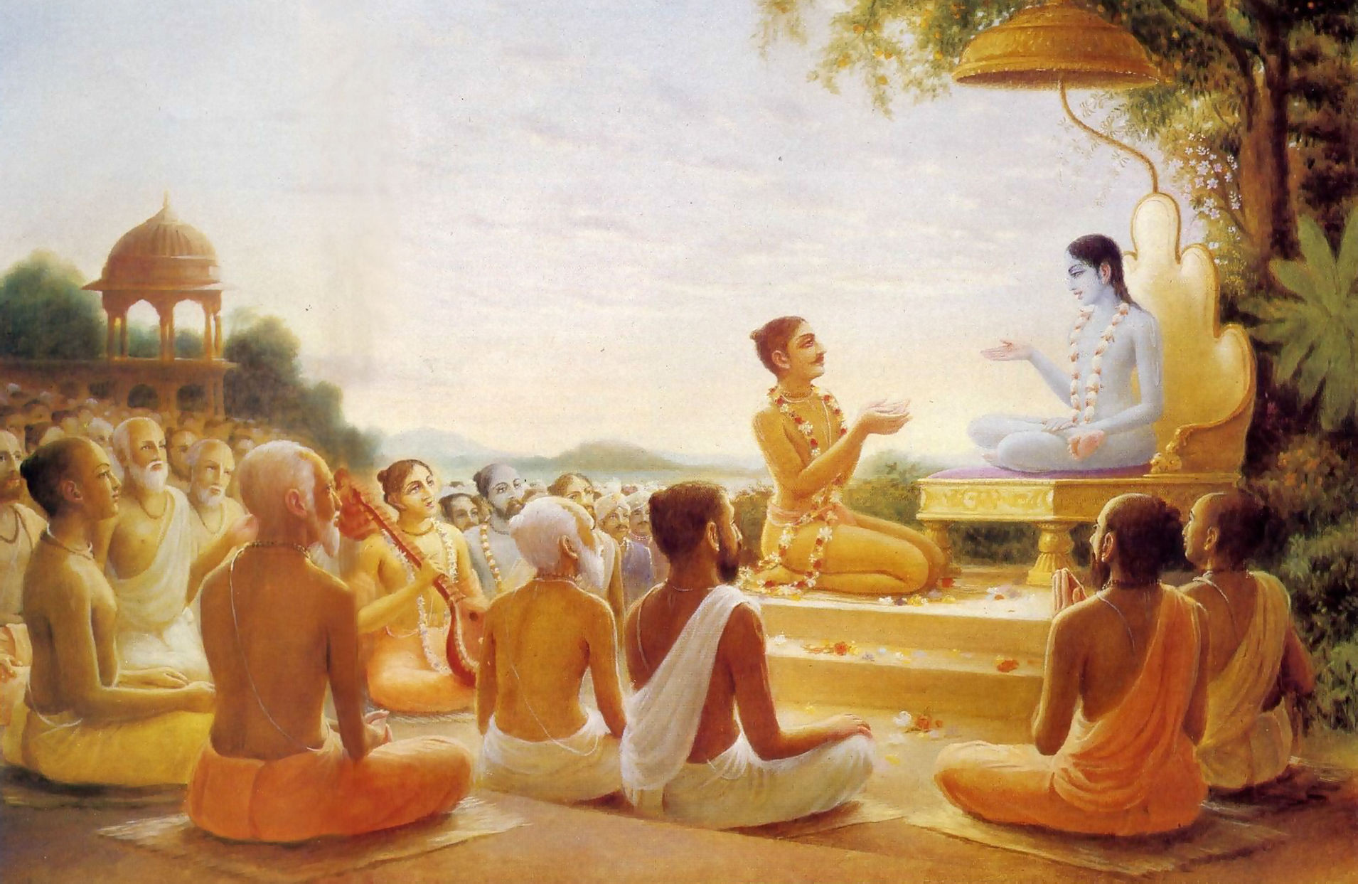
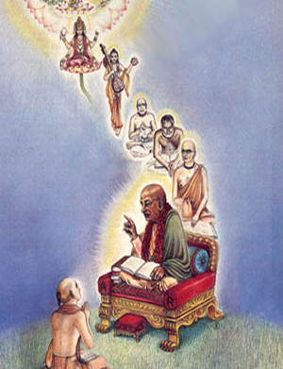
Maharaj Parikshit hears Krishna Katha

Slide 13
Take Home Points
Knowledge means three things : two birds in a tree
Field of activity, Occupier and Owner
Land : Occupier : Government :: Body : Soul : Supersoul
We have a choice
Go after sense enjoyment and remain miserable go-das
Serve Krishna and become happy Goswami
Human Body is very rare
Take this opportunity to do DS and regulate sense enjoyment
Death is inevitable – Parikshit Maharaj – BG 10.9
Learn with cool brain who we are and what its purpose.
Krishna is so kind – accepts little love - Sudama story
Transform material actions into devotional service
Chant and be happy

