Slide 1
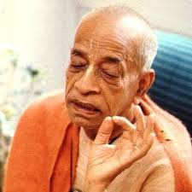
Nature, the Enjoyer and Consciousness Chapter 13
Nature, Enjoyer, Field, Knower of Field, Knowledge and Knower of Knowledge

Slide 2
ध्यानेनात्मनि पश्यन्ति केचिदात्मानमात्मना अन्ये सांख्येन योगेन कर्मयोगेन चापरे dhyānena — by meditation; ātmani — within the self; paśyanti — see; kecit — some; ātmānam — the Supersoul; ātmanā — by the mind; anye — others; sāṅkhyena — of philosophical discussion; yogena — by the yoga system; karma-yogena — by activities without fruitive desire; ca — also; apare — others.
Some perceive the Supersoul within themselves through meditation, others through the cultivation of knowledge, and still others through working without fruitive desires.[13.25]
dhyānenātmani paśyanti kecid ātmānam ātmanā anye sāṅkhyena yogena karma-yogena cāpare

Slide 3
How to realize the Supersoul?
Meditation, cultivation of knowledge and selfless work
One can get out of bodily concept of life by realizing Supersoul within
Two divisions of faith
MAAS – Monoists, Atheist , Agnostic Skeptics
IMPRW - Introspective Meditator, Philosophers, Renounced Workers
Devotees understand material nature and beyond that the spiritual world and the Supreme Person the cause of all causes.
Sankhya Yoga teaches that world consists of 24 elements
5+3 + 5*2 + 5 + 1 = 24 + 1 + 1 = 26
All three class of people can come to transcendence

Slide 4
अन्ये त्वेवमजानन्त: श्रुत्वान्येभ्य उपासते । तेऽपि चातितरन्त्येव मृत्युं श्रुतिपरायणा: anye — others; tu — but; evam — thus; ajānantaḥ — without spiritual knowledge; śrutvā — by hearing; anyebhyaḥ — from others; upāsate — begin to worship; te — they; api — also; ca — and; atitaranti — transcend; eva — certainly; mṛtyum — the path of death; śruti-parāyaṇāḥ — inclined to the process of hearing.
Again there are those who, although not conversant in spiritual knowledge, begin to worship the Supreme Person upon hearing about Him from others. Because of their tendency to hear from authorities, they also transcend the path of birth and death[13.26]
anye tv evam ajānantaḥ śrutvānyebhya upāsate te ’pi cātitaranty eva mṛtyuṁ śruti-parāyaṇāḥ

Slide 5
Hearing from authorities is very important
Tendency to listen from authorities can lead to transcendence
Worship of the SPG can be done by simply hearing process – sravana
Maharaj Pariksit
Even common man can be uplifted by hearing from authorities
One should give up speculative hearing.
Don’t be Mr. FROG WELL : Frog in the well
Hearing Mahamantra from person who has higher taste [BG 2.59] one has chance for progress
Knowing == Accepting

Slide 6
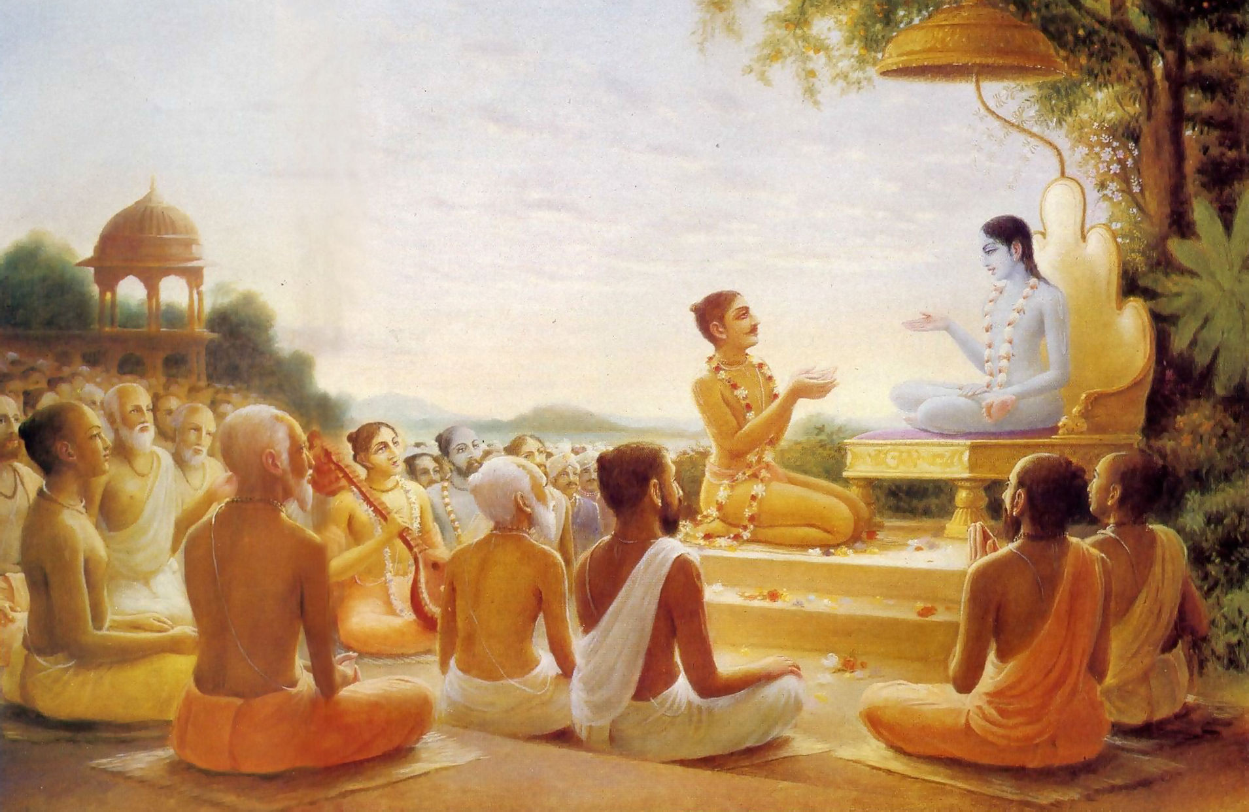
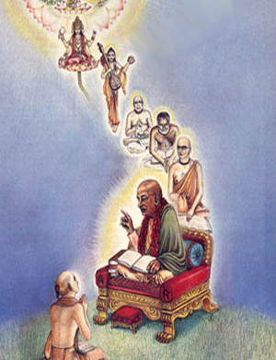
Maharaj Parikshit hears Krishna Katha

Slide 7
Connecting Verses
SB 1.2.12
tac chraddadhānā munayo jñāna-vairāgya-yuktayā paśyanty ātmani cātmānaṁ bhaktyā śruta-gṛhītayā
SB 1.8.36
śṛṇvanti gāyanti gṛṇanty abhīkṣṇaśaḥ smaranti nandanti tavehitaṁ janāḥ ta eva paśyanty acireṇa tāvakaṁ bhava-pravāhoparamaṁ padāmbujam
SB 2.1.11
etan nirvidyamānānām icchatām akuto-bhayam yogināṁ nṛpa nirṇītaṁ harer nāmānukīrtanam
SB 2.8.4
śṛṇvataḥ śraddhayā nityaṁ gṛṇataś ca sva-ceṣṭitam kālena nātidīrgheṇa bhagavān viśate hṛdi
Purport of SB 1.6.25 etāvad uktvopararāma
That the Personality of Godhead was not seen but only heard does not make any difference

Slide 8
यावत्सञ्जायते किञ्चित्सत्त्वं स्थावरजङ्गमम् क्षेत्रक्षेत्रज्ञसंयोगात्तद्विद्धि भरतर्षभ yāvat — whatever; sañjāyate — comes into being; kiñcit — anything; sattvam — existence; sthāvara — not moving; jaṅgamam — moving; kṣetra — of the body; kṣetra-jña — and the knower of the body; saṁyogāt — by the union between; tat viddhi — you must know it; bharata-ṛṣabha — O chief of the Bhāratas
O chief of the Bhāratas, know that whatever you see in existence, both the moving and the nonmoving, is only a combination of the field of activities and the knower of the field.13.27]
yāvat sañjāyate kiñcit sattvaṁ sthāvara-jaṅgamam kṣetra-kṣetrajña-saṁyogāt tad viddhi bharatarṣabha

Slide 9
समं सर्वेषु भूतेषु तिष्ठन्तं परमेश्वरम् । विनश्यत्स्वविनश्यन्तं य: पश्यति स पश्यति samam — equally; sarveṣu — in all; bhūteṣu — living entities; tiṣṭhan tam — residing; parama-īśvaram — the Supersoul; vinaśyatsu — in the destructible; avinaśyantam — not destroyed; yaḥ — anyone who; paśyati — sees; saḥ — he; paśyati — actually sees.
One who sees the Supersoul accompanying the individual soul in all bodies, and who understands that neither the soul nor the Supersoul within the destructible body is ever destroyed, actually sees.[13.28]
samaṁ sarveṣu bhūteṣu tiṣṭhantaṁ parameśvaram vinaśyatsv avinaśyantaṁ yaḥ paśyati sa paśyati

Slide 10
Equal vision = field + soul + super soul
Everyone is constitutionally same: matter + soul + supersoul
Everyone is Combination of known + knower
Equal vision = Transcendence (not degradation)

Slide 11

Two birds in a tree
This body is a machine, with driver and owner in the same car.
BG 18.61 īśvaraḥ sarva-bhūtānāṁ
Owner is directing and reminding the driver.
But the driver is whimsically after sense objects
If turn to owner, then He will give right direction.
Our business is to serve the whole with pure heart.

Slide 12
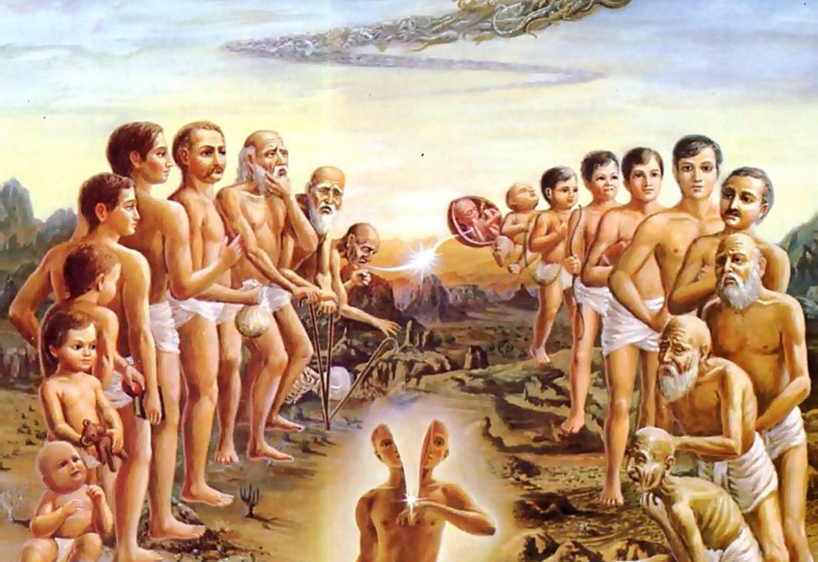

We are soul with a human body
We have lived in many bodies and done the same things over and over.
This body is given to us on rent.
This an opportunity to get liberation from material existence

Slide 13

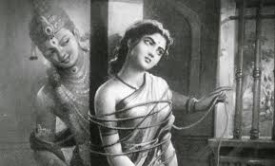
Sant Sakhu Bai
Sakhu Bai, an ardent devotee of Vitthal, lives with her husband and a cruel mother-in-law.
Sakhu sees a group of Vitthala devotees doing Naam-Kirtan. She joins
When we see Supersoul in everyone – one is not degraded

Slide 14
Take Home Points
We can know super soul dhyana, gyana & karma yoga
Everyone can benefit from hearing
Knowledge means three things : two birds in a tree
Field of activity, Occupier and Owner
Land : Occupier : Government :: Body : Soul : Supersoul
Equal vision = field + soul + super soul
Good Behavior + Firm faith in adverse times leads to Lord’s mercy

