Slide 1
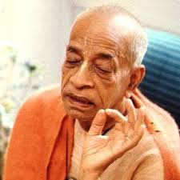
The Three Modes of Material Nature Chapter 14
Transcending Material Nature via devotional service.

Slide 2
Connecting Verse - BG 13.22
puruṣaḥ prakṛti-stho hi bhuṅkte prakṛti-jān guṇān kāraṇaṁ guṇa-saṅgo ‘sya sad-asad-yoni-janmasu
puruṣaḥ---the living entities; prakṛti-sthaḥ---being situated in the material world; hi---certainly; bhuṅkte---enjoys; prakṛti-jān---produced by the material nature; guṇān---modes of material nature; kāraṇam---cause; guṇa-saṅgaḥ---association with the modes of nature; asya---of the living entity; sat-asat---good and bad; yoni---species of life; janmasu---birth.
The living entity in material nature thus follows the ways of life, enjoying the three modes of nature. This is due to his association with that material nature. Thus he meets with good and evil amongst various species of life.”

Slide 3

Two birds in a tree
This body is a machine, with driver and owner in the same car.
BG 18.61 īśvaraḥ sarva-bhūtānāṁ
Owner is directing and reminding the driver.
But the driver is whimsically after sense objects
If turn to owner, then He will give right direction.
Our business is to serve the whole with pure heart.

Slide 4
Connecting verse SB 1.2.33
asau guṇamayair bhāvair bhūta-sūkṣmendriyātmabhiḥ sva-nirmiteṣu nirviṣṭo bhuṅkte bhūteṣu tad-guṇān
asau---that Paramātmā; guṇa-mayaiḥ---influenced by the modes of nature; bhāvaiḥ---naturally; bhūta---created; sūkṣma---subtle; indriya---senses; ātmabhiḥ---by the living beings; sva-nirmiteṣu---in His own creation; nirviṣṭaḥ---entering; bhuṅkte---causes to enjoy; bhūteṣu---in the living entities; tat-guṇān---those modes of nature.
"The Supersoul enters into the bodies of the created beings, who are influenced by the modes of material nature, and causes them to enjoy the effects of these by the subtle mind."

Slide 5
BG 14 : Transcending Material Nature
1-4 : Importance of this chapter – the best of Knowledge – position of living entity in material nature and the seed giving father
5-13: Modes of nature and its cause, characteristics and results.
14-15: Destination when one dies in various modes
16-18: Results of various modes further explained
19-21: Seeing Lord acting behind the modes and transcending modes and freeing oneself of BDOD and get nectar
22-25: Behavior of person who is beyond modes
26: How to transcend the modes? full DS unfailing in all circumstances
27: Lord is basis of Impersonal Brahman

Slide 6
BG 14.1-4
The Supreme Personality of Godhead said: Again I shall declare to you this supreme wisdom, the best of all knowledge, knowing which all the sages have attained the supreme perfection.
By becoming fixed in this knowledge, one can attain to the transcendental nature like My own. Thus established, one is not born at the time of creation or disturbed at the time of dissolution.
The total material substance, called Brahman, is the source of birth, and it is that Brahman that I impregnate, making possible the births of all living beings, O son of Bharata.
It should be understood that all species of life, O son of Kuntī, are made possible by birth in this material nature, and that I am the seed-giving father.

Slide 7
BG 14.1: The Best of Knowledge
श्रीभगवानुवाच
परं भूय: प्रवक्ष्यामि ज्ञानानां ज्ञानमुत्तमम् । ‍‍ ॥
यज्ज्ञात्वा मुनय: सर्वे परां सिद्धिमितो गता: ॥ १ ॥
śrī-bhagavān uvāca
paraṁ bhūyaḥ pravakṣyāmi jñānānāṁ jñānam uttamam
yaj jñātvā munayaḥ sarve parāṁ siddhim ito gatāḥ
śrī-bhagavān uvāca — the Supreme Personality of Godhead said; param — transcendental; bhūyaḥ — again; pravakṣyāmi — I shall speak; jñānānām — of all knowledge; jñānam — knowledge; uttamam — the supreme; yat — which; jñātvā — knowing; munayaḥ — the sages; sarve — all; parām — transcendental; siddhim — perfection; itaḥ — from this world; gatāḥ — attained.
The Supreme Personality of Godhead said: Again I shall declare to you this supreme wisdom, the best of all knowledge, knowing which all the sages have attained the supreme perfection.

Slide 8
BG 14.1 - P2+T4
P1: Lord is kindly again divulging a supreme wisdom
P2: Knowing this all sages in the past have attained supreme perfection
T1: In 13th chapter it was explained that by humbly developing knowledge one may be possibly freed from material nature. Chapter 14 explains what is that material nature.
T2: This knowledge is far far better than the knowledge attained so far
T3: This chapter explains what they are, how they act/bind/give liberation
T4: Due to the association of the modes we are bound

Slide 9
BG Chapters
[7.1] The Supreme Personality of Godhead said: Now hear, O son of Pṛthā, how by practicing yoga in full consciousness of Me, with mind attached to Me, you can know Me in full, free from doubt.
[9.1] The Supreme Personality of Godhead said: My dear Arjuna, because you are never envious of Me, I shall impart to you this most confidential knowledge and realization, knowing which you shall be relieved of the miseries of material existence.
[10.1] The Supreme Personality of Godhead said: Listen again, O mighty-armed Arjuna. Because you are My dear friend, for your benefit I shall speak to you further, giving knowledge that is better than what I have already explained.
[13.1-2] Arjuna said: O my dear Kṛṣṇa, I wish to know about prakṛti [nature], puruṣa [the enjoyer], and the field and the knower of the field, and of knowledge and the object of knowledge. The Supreme Personality of Godhead said: This body, O son of Kuntī, is called the field, and one who knows this body is called the knower of the field.

Slide 10
BG 14.2: Attaining Transcendental Nature
इदं ज्ञानमुपाश्रित्य मम साधर्म्यमागता: ।
सर्गेऽपि नोपजायन्ते प्रलये न व्यथन्ति च ॥ २ ॥
idaṁ jñānam upāśritya mama sādharmyam āgatāḥ
sarge ’pi nopajāyante pralaye na vyathanti ca
idam — this; jñānam — knowledge; upāśritya — taking shelter of; mama — My; sādharmyam — same nature; āgatāḥ — having attained; sarge api — even in the creation; na — never; upajāyante — are born; pralaye — in the annihilation; na — nor; vyathanti — are disturbed; ca — also.
By becoming fixed in this knowledge, one can attain to the transcendental nature like My own. Thus established, one is not born at the time of creation or disturbed at the time of dissolution.

Slide 11
BG 14.2 - P2+T4
P1: By becoming fixed in this knowledge one can attain transcendental nature like Krishna
P2: When one takes shelter of this knowledge then one is not born at the time of creation or disturbed at the time of dissolution.
T1: One attains qualitative equality with SPG without losing one’s identity as one always hankers for His devotional service.
T2: Material (3 modes) vs Transcendental Knowledge (platform of SPG)
T3: Spiritual platform is not formless – variety exists. Spiritual form and devotional activity exists
T4: To obtain such knowledge of must develop spiritual qualities that enables one to transcend material modes

Slide 12
BG 14.3: Source of Birth
मम योनिर्महद्‍ब्रह्म तस्मिन्गर्भं दधाम्यहम् ।
सम्भव: सर्वभूतानां ततो भवति भारत ॥ ३ ॥
mama yonir mahad brahma tasmin garbhaṁ dadhāmy aham
sambhavaḥ sarva-bhūtānāṁ tato bhavati bhārata
mama — My; yoniḥ — source of birth; mahat — the total material existence; brahma — supreme; tasmin — in that; garbham — pregnancy; dadhāmi — create; aham — I; sambhavaḥ — the possibility; sarva-bhūtānām — of all living entities; tataḥ — thereafter; bhavati — becomes; bhārata — O son of Bharata.
The total material substance, called Brahman, is the source of birth, and it is that Brahman that I impregnate, making possible the births of all living beings, O son of Bharata.

Slide 13
BG 14.3 - P2+T4
P1: Total material substance is known as Brahman (field,kṣetra)
P2: Lord impregnates Brahman giving birth to living beings (kṣetra-jña)
T1: Total Material cause (mahat-tattva) (includes 3 modes)
T2: Gardner plants seeds (living entity) in the field
T3: BG 7.4-6 – 24 material elements (5+3+5*2+5+1)
T4: Material nature is not cause of birth of living entity. Scorpion eggs of the mother scorpion not out of rice. We get body based on past deeds. Lord is the cause of all manifestations.

Slide 14
BG 14.4: Seeding giving Father
सर्वयोनिषु कौन्तेय मूर्तय: सम्भवन्ति या: ।
तासां ब्रह्म महद्योनिरहं बीजप्रद: पिता ॥ ४ ॥
sarva-yoniṣu kaunteya mūrtayaḥ sambhavanti yāḥ
tāsāṁ brahma mahad yonir ahaṁ bīja-pradaḥ pitā
sarva-yoniṣu — in all species of life; kaunteya — O son of Kuntī; mūrtayaḥ — forms; sambhavanti — they appear; yāḥ — which; tāsām — of all of them; brahma — the supreme; mahat yoniḥ — source of birth in the material substance; aham — I; bīja-pradaḥ — the seed-giving; pitā — father.
It should be understood that all species of life, O son of Kuntī, are made possible by birth in this material nature, and that I am the seed-giving father.

Slide 15
BG 14.4 - P2+T4
P1: All species of life is made possible by birth in material nature.
P2: Lord is the seed giving Father.
T1: Krishna is the original father of all living enties.
T2: Living entity = material + spiritual nature.
T3: Living entities are found in all planets
T4: Material world is impregnated with living entities, who come out in various forms at the time of creation according to their past deeds.

Slide 16
Quiz#1
BG Chapter 14 is the best of knowledge knowing which all ……. have attained supreme perfection.
By becoming fixed in this knowledge, one can attain
Degree from MIT
Fame and Money
Freedom from Birth and Death
Transcendental nature like Lord Krishna
The total material substance, called ………, is the source of birth.
All species of life take birth in this material nature, and that I am the ……. Father.
Notes:
#1 sages
#2 c,d
#3 Brahman
#4 seed giving

Slide 17
Quiz#2
Due to association with the modes of nature that the living entity is entangled in this material world
It is expected that one who understands this Fourteenth Chapter will attain perfection.
After acquiring perfect transcendental knowledge, one acquires qualitative equality with the Supreme Personality of Godhead
After liberation, the devotees lose their individual identities.
In spiritual existence there is no material variety.
Notes:
#1 True
#2 True
#3 True
#4 False
#5 False

Slide 18
Quiz#3
mahat-tattva is the total ……… of the total cosmic manifestation
Total substance of the material cause, in which there are three modes of nature, is sometimes called ………...
Material nature is mixed with superior nature by the will of ……., and thereafter all …….. are born of this material nature.
Material nature is the cause of the birth of the living entities just like scorpion is born out of rice.
Every living entity, according to his …………, has a different body, created by this material nature, so that the entity can enjoy or suffer according to his past deeds
Notes:
#1 total cause
#2 Brahman
# False
# False
#SPG, living entities
#5Past activities

Slide 19
Connecting Verses
ei rūpe brahmāṇḍa bhramite kona bhāgyavān jīva guru-kṛṣṇa-kṛpāya pāya bhakti-latā-bīja [CC M 19.151]
ābrahma-bhuvanāl lokāḥ punar āvartino 'rjuna [Bg. 8.16]
nashta-prayeshv abhadreshu nityam bhagavata-sevaya bhagavaty uttama-sloke bhaktir bhavati naishthiki [SB 1.2.18]
tadā rajas-tamo-bhāvā kāma-lobhādayas ca ye ceta etair anāviddha sthita sattve prasidati[SB 1.2.19]
ûrdhva gacchanti sattva-sthā madhye tihanti rājasā jaghanya-gua-vtti-sthā adho gacchanti tāmasā
asau guṇamayair bhāvair bhūta-sūkṣmendriyātmabhiḥ sva-nirmiteṣu nirviṣṭo bhuṅkte bhūteṣu tad-guṇān [SB 1.2.33]
māṁ ca yo 'vyabhicāreṇa bhakti-yogena sevate sa guṇān samatītyaitān brahma-bhūyāya kalpate [Bg. 14.26]
paras tasmāt tu bhāvaḥ anyaḥ [Bg. 8.20]
mayādhyakṣeṇa prakṛtiḥ sūyate sa-carācaram hetunānena kaunteya jagad viparivartate [Bg. 9.10]
Bījo 'haṁ sarva-bhūtānām [Bg. 7.10]
Notes:
SB 1.2.33 : The Supersoul enters into the bodies of the created beings, who are influenced by the modes of material nature, and causes them to enjoy the effects of these by the subtle mind

Slide 20
SP Lecture
We have come to this material world to enjoy
In spiritual world are enjoyed and Lord is the only enjoyer.
Spirit soul nature is to serve but is artificially wants to be master
3 qualities of nature – 3x3=9, 9x9=81… 8400,000 species of life
daivī hy eṣā guṇamayī mama māyā duratyayā [BG 7.14]
He is suffering, but he takes it as enjoying - That is called māyā
We should eat food in mode of goodness, prasad [BG 9.26]
Business of this human form of life, to get out of this cycle of birth and death and wandering in different species of life.
The result of pious activities is that you get your birth in a very good family, in a rich family; you get beauty, you become educated, janmaiśvarya-śruta-śrībhiḥ [SB 1.8.26]
We should save time and utilize – how to get out of this cycle of birth and death by purify existence so that we can revive our blissful eternal existence full of knowledge
Notes:
https://prabhupadavani.org/transcriptions/731020bgbom/?query=modes+of+material+nature+

Slide 21
SP Lecture
Not good to work with the deha-atma buddhih
Everyone working is on the bodily plane is as good as ass, cow
How to become happy in this society of cow, asses
BG 5.29 bhoktaram yajna tapasam – because He is the creator He is the only enjoyer – a thief can never be peaceful
BG 2.13 tathā dehāntara-prāptir – everyone changes
Under the influence of material desire, the entity is born sometimes as a demigod, sometimes as a man, sometimes as a beast, as a bird, as a worm, as an aquatic, as a saintly man, as a bug. This is going on. And in all cases the living entity thinks himself to be the master of his circumstances, yet he is under the influence of material nature. [BG 13.22 p]
Notes:
https://prabhupadavani.org/transcriptions/731020bgbom/?query=modes+of+material+nature+

Slide 22
SP Lecture
Total material energy is avakya (not manifest) - mahat-tattva
when it is agitated by the glance of the Supreme Lord, the three modes of material nature acts
His electronic machine is so subtle and powerful that we cannot understand. We say "nature.”
Lord is the Brain behind the machinery of material nature.

Slide 23
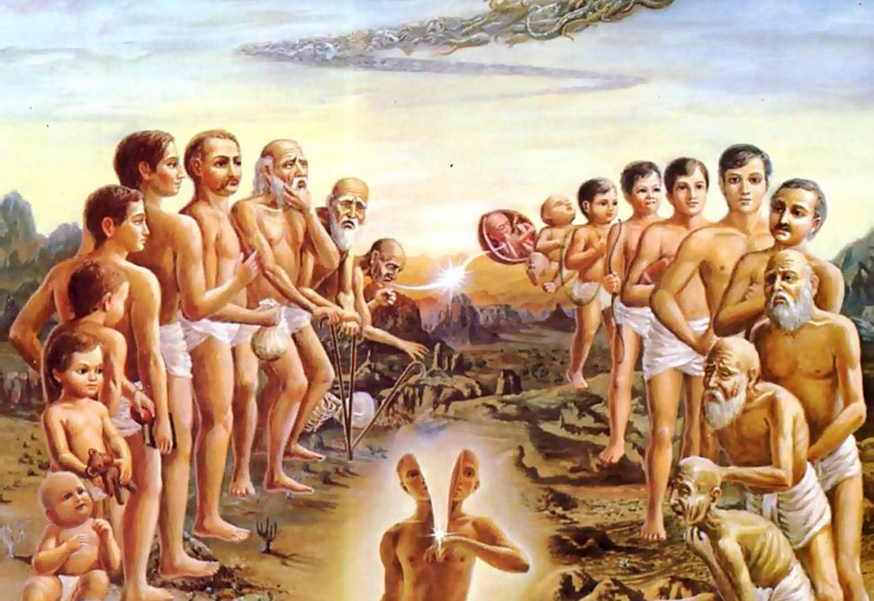

We are soul with a human body
We have lived in many bodies and done the same things over and over.
This body is given to us on rent.
This an opportunity to get liberation from material existence

Slide 24
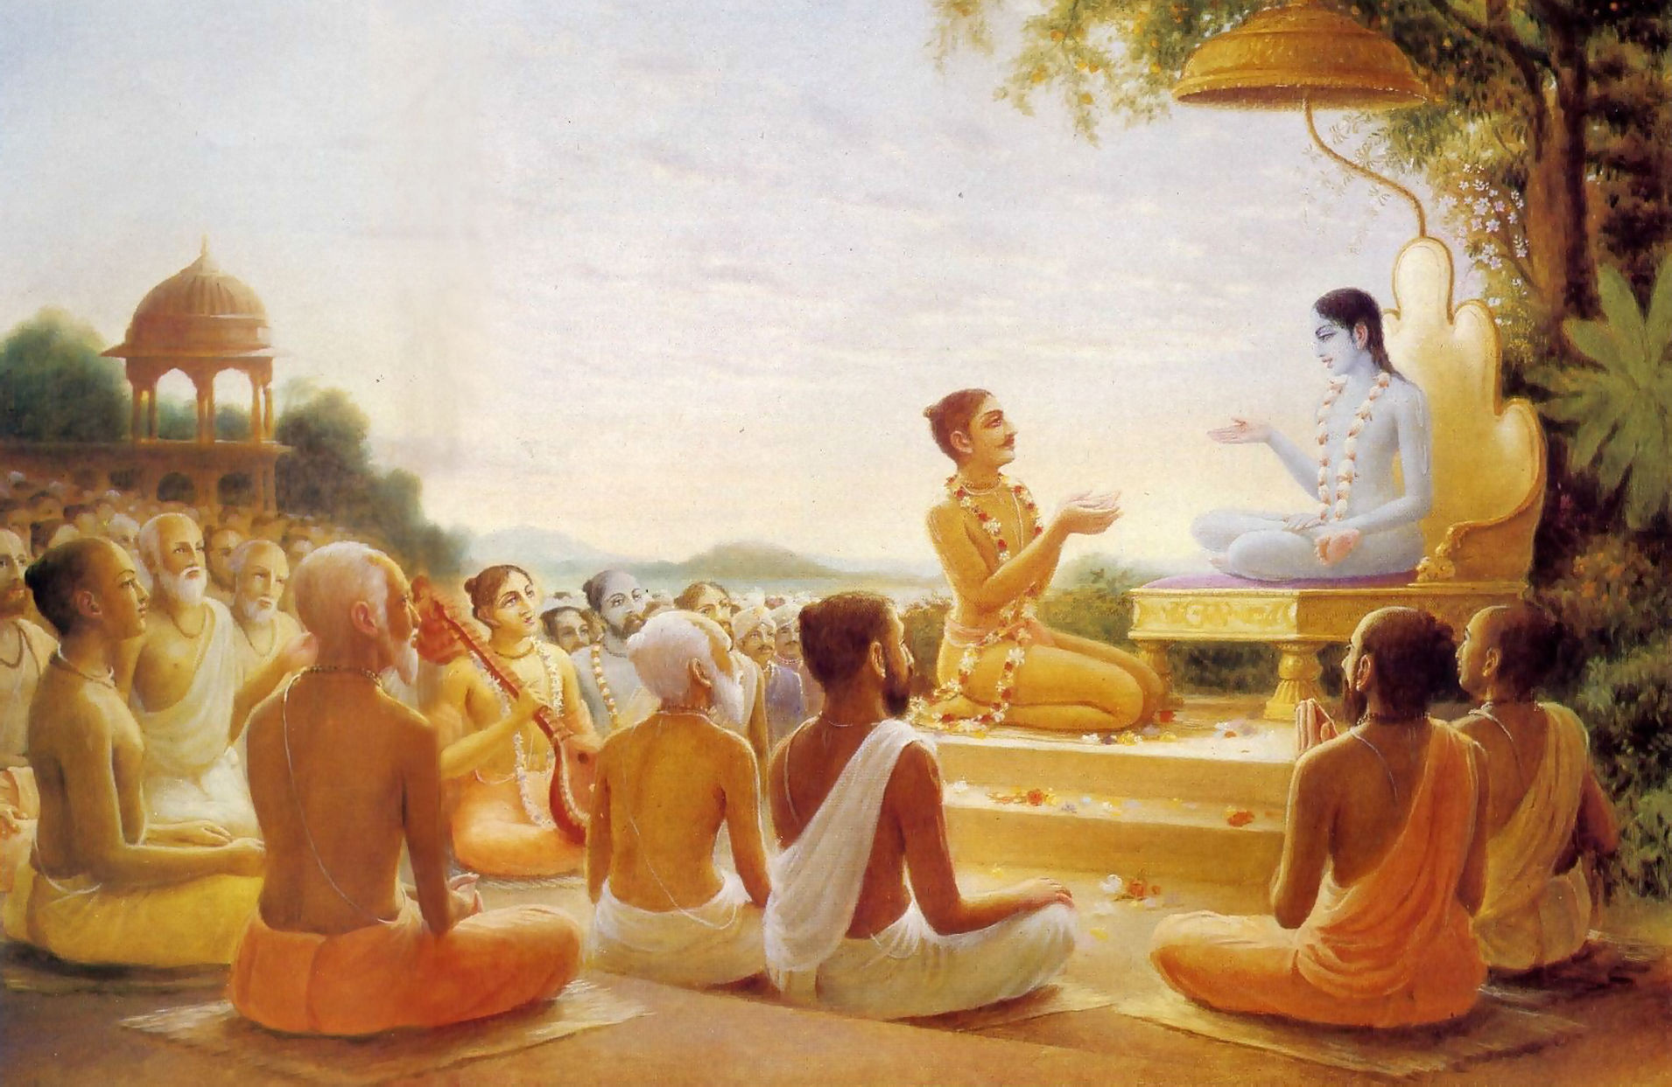
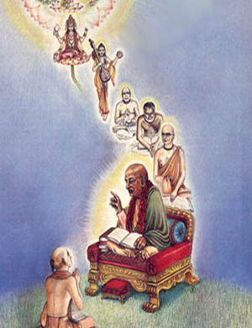
Maharaj Parikshit hears Krishna Katha

Slide 25
Lessons from History
Ajalima
Kamsa

Slide 26
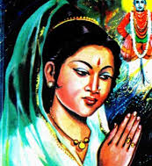
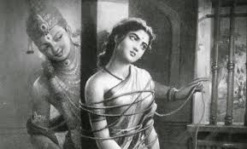
Sant Sakhu Bai
Sakhu Bai, an ardent devotee of Vitthal, lives with her husband and a cruel mother-in-law.
Sakhu sees a group of Vitthala devotees doing Naam-Kirtan. She joins
When we see Supersoul in everyone – one is not degraded

Slide 27
Take Home Points
Human Life is very valuable and should take shelter of the knowledge of Bhagavad-gita and Bhagavatam
We have to execute devotional service by regulative principles very strictly and sincerely
We have to understand that the Lord is the owner and therefore He is the enjoyer and our enjoyment is in His service
We are all not Lords but Lord’s
It behooves us to not act in bodily platform and treat all equally, see the hand of Krishna in everything and improve our behaviour.

