Slide 1
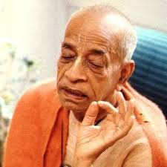
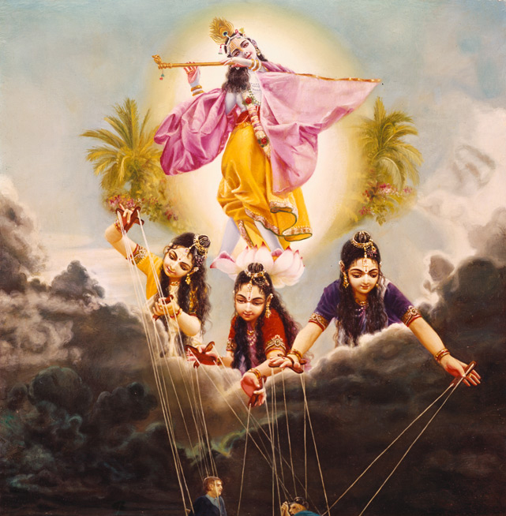
Symptom and Behavior of person who is beyond modes of nature
Transcending Material Nature via devotional service.

Slide 2
BG 14 : Transcending Material Nature
1-4 : Importance of this chapter – the best of Knowledge – position of living entity in material nature and the seed giving father
5-13: Modes of nature and its cause, characteristics and results.
14-15: Destination when one dies in various modes
16-18: Results of various modes further explained
19-21: Seeing Lord acting behind the modes and transcending modes and freeing oneself of BDOD and get nectar
21-25: Symptom and Behavior of person who is beyond modes
26: How to transcend the modes? full DS unfailing in all circumstances
27: Lord is basis of Impersonal Brahman

Slide 3
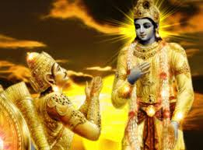
Questions from Arjuna BG 14.21
Arjuna inquired: O my dear Lord, by which symptoms is one known who is transcendental to these three modes? What is his behavior? And how does he transcend the modes of nature?

Slide 4
BG 14.22 श्रीभगवानुवाच प्रकाशं च प्रवृत्तिं च मोहमेव च पाण्डव । न द्वेष्टि सम्प्रवृत्तानि न निवृत्तानि काङ्‍क्षति ॥ २२
śrī-bhagavān uvāca prakāśaṁ ca pravṛttiṁ ca moham eva ca pāṇḍava na dveṣṭi sampravṛttāni na nivṛttāni kāṅkṣati
śrī-bhagavān uvāca — the Supreme Personality of Godhead said; prakāśam — illumination; ca — and; pravṛttim — attachment; ca — and; moham — illusion; eva ca — also; pāṇḍava — O son of Pāṇḍu; na dveṣṭi — does not hate; sampravṛttāni — although developed; na nivṛttāni — nor stopping development; kāṅkṣati — desires;
The Supreme Personality of Godhead said: O son of Pāṇḍu, he who does not hate illumination, attachment and delusion when they are present or long for them when they disappear;

Slide 5
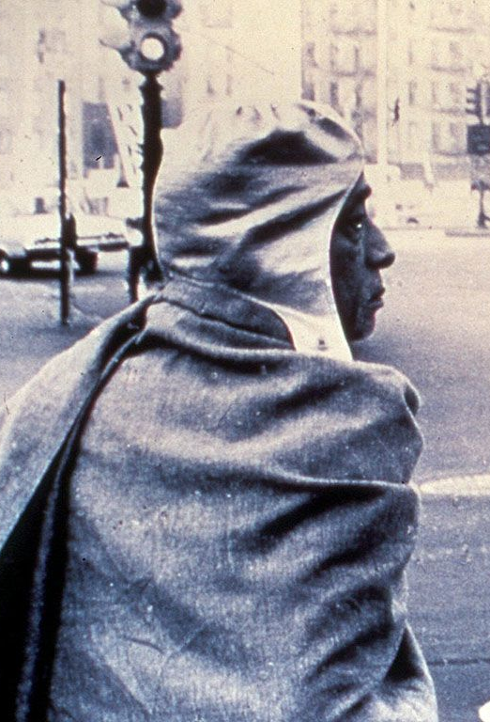
14.22
Does not hate or long for Illumination, Attachment and Delusion
Bhakta Prahlad/ Haridas Thakur/Narada (boy)
Person transcendentally situated has no envy and does not hanker for anything
Arjuna

Slide 6
BG 14.23 उदासीनवदासीनो गुणैर्यो न विचाल्यते । गुणा वर्तन्त इत्येवं योऽवतिष्ठति नेङ्गते ॥ २३ ॥
udāsīna-vad āsīno guṇair yo na vicālyate guṇā vartanta ity evaṁ yo ’vatiṣṭhati neṅgate
udāsīna-vat — as if neutral; āsīnaḥ — situated; guṇaiḥ — by the qualities; yaḥ — one who; na — never; vicālyate — is agitated; guṇāḥ — the qualities; vartante — are acting; iti evam — knowing thus; yaḥ — one who; avatiṣṭhati — remains; na — never; iṅgate — flickers;
who is unwavering and undisturbed through all these reactions of the material qualities, remaining neutral and transcendental, knowing that the modes alone are active;

Slide 7
14.23
unwavering and undisturbed through all these reactions of the material qualities, remaining neutral and transcendental
Bhakta Prahlad
Embodied by the material body, it is to be understood that he is under the control of one of the three modes of material nature.
When one is conscious of the material body, he acts only for sense gratification
When one transfers the consciousness to Kṛṣṇa, sense gratification automatically stops.
The qualities of the material modes in the body will act, but as spirit soul the self is aloof from such activities.

Slide 8

In the world but not of the world
brahmaṇy ādhāya karmāṇi saṅgaṁ tyaktvā karoti yaḥ lipyate na sa pāpena padma-patram ivāmbhasā [BG 5.15]
One who performs his duty without attachment, surrendering the results unto the Supreme Lord, is unaffected by sinful action, as the lotus leaf is untouched by water.

Slide 9
How to become aloof from activities of body?
He does not desire to enjoy the body, nor does he desire to get out of it.
When one is conscious of the material body, he acts only for sense gratification, but when one transfers the consciousness to Kṛṣṇa, sense gratification automatically stops.
He engages himself in the devotional service of the Lord so that his identity with the material body will automatically be forgotten.
Thus transcendentally situated, the devotee becomes automatically free. He need not try to become free from the influence of the modes of material nature.

Slide 10
BG 14.24 समदु:खसुख: स्वस्थ: समलोष्टाश्मकाञ्चन: । तुल्यप्रियाप्रियो धीरस्तुल्यनिन्दात्मसंस्तुति: ॥ २४ ॥
sama-duḥkha-sukhaḥ sva-sthaḥ sama-loṣṭāśma-kāñcanaḥ tulya-priyāpriyo dhīras tulya-nindātma-saṁstutiḥ
sama — equal; duḥkha — in distress; sukhaḥ — and happiness; sva-sthaḥ — being situated in himself; sama — equally; loṣṭa — a lump of earth; aśma — stone; kāñcanaḥ — gold; tulya — equally disposed; priya — to the dear; apriyaḥ — and the undesirable; dhīraḥ — steady; tulya — equal; nindā — in defamation; ātma-saṁstutiḥ — and praise of himself;
who is situated in the self and regards alike happiness and distress; who looks upon a lump of earth, a stone and a piece of gold with an equal eye; who is equal toward the desirable and the undesirable; who is steady, situated equally well in praise and blame;

Slide 11
BG 14.24
situated in the self and regards alike happiness and distress
looks upon a lump of earth, a stone and a piece of gold with an equal eye
Bhakti Sidhanta Saraswati
equal toward the desirable and the undesirable
MahaVishnu Goswami Maharaj
steady, situated equally well in praise and blame
Narada Muni
He performs selfless duty in Kṛṣṇa consciousness.

Slide 12
BG 14.25 मानापमानयोस्तुल्यस्तुल्यो मित्रारिपक्षयो: । सर्वारम्भपरित्यागी गुणातीत: स उच्यते ॥ २५ ॥
mānāpamānayos tulyas tulyo mitrāri-pakṣayoḥ sarvārambha-parityāgī guṇātītaḥ sa ucyate apamānayoḥ — and dishonor; tulyaḥ — equal; tulyaḥ — equal; mitra — of friends; ari — and enemies; pakṣayoḥ — to the parties; sarva — of all; ārambha — endeavors; parityāgī — renouncer; guṇa-atītaḥ — transcendental to the material modes of nature; saḥ — he; ucyate — is said to be.
situated equally well in honor and dishonor; who treats alike both friend and enemy; and who has renounced all material activities – such a person is said to have transcended the modes of nature.

Slide 13
BG 14.25
Equal in honor and dishonor
Ambarish Maharaj
Treats friend and enemy equally
Yudhisthir Maharaj
Renounces all material activities
Sukhadev Goswami
He takes everyone as his dear friend who helps him in his execution of Kṛṣṇa consciousness, and he does not hate his so-called enemy.
Social and political issues do not affect him, because he knows the situation of temporary upheavals and disturbances.
He does not attempt anything for his own sake. He can attempt anything for Kṛṣṇa, but for his personal self he does not attempt anything.

Slide 14
BG 14.22-25
śrī-bhagavān uvāca prakāśaṁ ca pravṛttiṁ ca moham eva ca pāṇḍava na dveṣṭi sampravṛttāni na nivṛttāni kāṅkṣati
udāsīna-vad āsīno guṇair yo na vicālyate guṇā vartanta ity evaṁ yo ’vatiṣṭhati neṅgate
sama-duḥkha-sukhaḥ sva-sthaḥ sama-loṣṭāśma-kāñcanaḥ tulya-priyāpriyo dhīras tulya-nindātma-saṁstutiḥ
mānāpamānayos tulyas tulyo mitrāri-pakṣayoḥ sarvārambha-parityāgī guṇātītaḥ sa ucyate

Slide 15
14.22-25: Symptoms and Behavior of devotee
The Supreme Personality of Godhead said: O son of Pāṇḍu, he who does not hate illumination, attachment and delusion when they are present or long for them when they disappear; who is unwavering and undisturbed through all these reactions of the material qualities, remaining neutral and transcendental, knowing that the modes alone are active; who is situated in the self and regards alike happiness and distress; who looks upon a lump of earth, a stone and a piece of gold with an equal eye; who is equal toward the desirable and the undesirable; who is steady, situated equally well in praise and blame, honor and dishonor; who treats alike both friend and enemy; and who has renounced all material activities – such a person is said to have transcended the modes of nature.

Slide 16
BG 14.22-25 - Purport Symptoms of a transcendental person
Arjuna submitted three different questions, and the Lord answers them one after another. In these verses, Kṛṣṇa first indicates that a person transcendentally situated has no envy and does not hanker for anything. When a living entity stays in this material world embodied by the material body, it is to be understood that he is under the control of one of the three modes of material nature. When he is actually out of the body, then he is out of the clutches of the material modes of nature. But as long as he is not out of the material body, he should be neutral. He should engage himself in the devotional service of the Lord so that his identity with the material body will automatically be forgotten. When one is conscious of the material body, he acts only for sense gratification, but when one transfers the consciousness to Kṛṣṇa, sense gratification automatically stops. One does not need this material body, and he does not need to accept the dictations of the material body. The qualities of the material modes in the body will act, but as spirit soul the self is aloof from such activities. How does he become aloof? He does not desire to enjoy the body, nor does he desire to get out of it. Thus transcendentally situated, the devotee becomes automatically free. He need not try to become free from the influence of the modes of material nature.

Slide 17
BG 14.22-25 - Purport (continued) Behavior: How he lives and what his activities are.
The next question concerns the dealings of a transcendentally situated person. The materially situated person is affected by so-called honor and dishonor offered to the body, but the transcendentally situated person is not affected by such false honor and dishonor. He performs his duty in Kṛṣṇa consciousness and does not mind whether a man honors or dishonors him. He accepts things that are favorable for his duty in Kṛṣṇa consciousness, otherwise he has no necessity of anything material, either a stone or gold. He takes everyone as his dear friend who helps him in his execution of Kṛṣṇa consciousness, and he does not hate his so-called enemy. He is equally disposed and sees everything on an equal level because he knows perfectly well that he has nothing to do with material existence. Social and political issues do not affect him, because he knows the situation of temporary upheavals and disturbances. He does not attempt anything for his own sake. He can attempt anything for Kṛṣṇa, but for his personal self he does not attempt anything. By such behavior one becomes actually transcendentally situated.

Slide 18
BG 12: Qualities of a pure devotee
TEXTS 13-14: One who is not envious but is a kind friend to all living entities, who does not think himself a proprietor and is free from false ego, who is equal in both happiness and distress, who is tolerant, always satisfied, self-controlled, and engaged in devotional service with determination, his mind and intelligence fixed on Me – such a devotee of Mine is very dear to Me.
TEXT 15: He by whom no one is put into difficulty and who is not disturbed by anyone, who is equipoised in happiness and distress, fear and anxiety, is very dear to Me.
TEXT 16: My devotee who is not dependent on the ordinary course of activities, who is pure, expert, without cares, free from all pains, and not striving for some result, is very dear to Me.
TEXT 17: One who neither rejoices nor grieves, who neither laments nor desires, and who renounces both auspicious and inauspicious things – such a devotee is very dear to Me.
TEXTS 18-19: One who is equal to friends and enemies, who is equipoised in honor and dishonor, heat and cold, happiness and distress, fame and infamy, who is always free from contaminating association, always silent and satisfied with anything, who doesn’t care for any residence, who is fixed in knowledge and who is engaged in devotional service – such a person is very dear to Me.

Slide 19
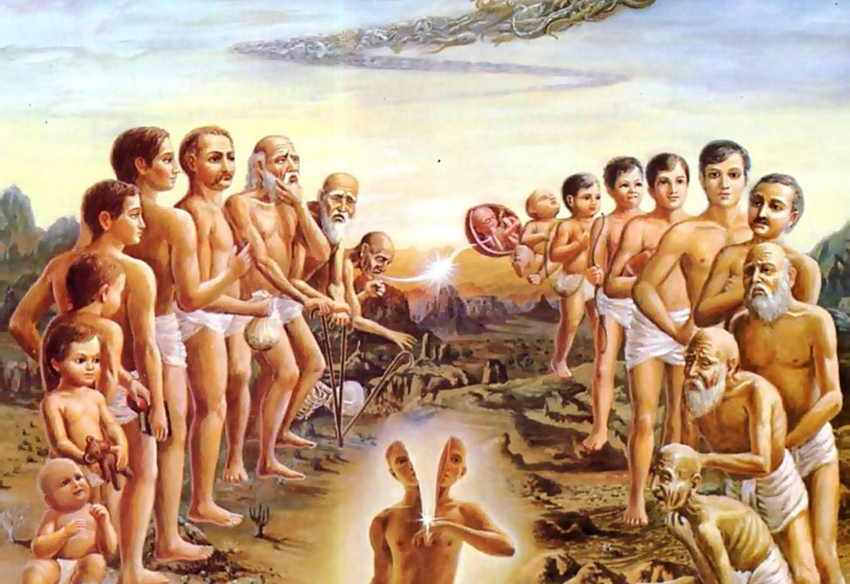

We are soul with a human body
We have lived in many bodies and done the same things over and over.
This body is given to us on rent.
This an opportunity to get liberation from material existence

Slide 20

Two birds in a tree
This body is a machine, with driver and owner in the same car.
BG 18.61 īśvaraḥ sarva-bhūtānāṁ
Owner is directing and reminding the driver.
But the driver is whimsically after sense objects
If turn to owner, then He will give right direction.
Our business is to serve the whole with pure heart.

Slide 21
References
SB 11.25.1-36
BG 2.45, 3.5, 3.27, 3.28, 3.29, 3.33, 3.37, 4.13, 4.23, 5.14,6.27
BG 7.12,7.13, 7.14, 9.9, 9.10, 9.13 11.38
BG 13.15, 13.20, 13.21, 14.1-27, 15.10, 17.1-28, 18.7-10, 18.19-41
Total BG verses on Modes of MN: 22+27+28+26 = 103 verses

Slide 22
SP lecture on BG 13.21
You get body according to our karma however we can enjoy/suffer according to our body
Hog is eating stool, but he is thinking he is enjoying.
Cockroaches, they are also thinking, "I am enjoying."
Tree is standing for seven thousands of years, thinking, "I am enjoying life."
This is called prakṣepātmikā-śakti.
BG 18.61: īśvaraḥ sarva-bhūtānāṁ hṛd-deśe ’rjuna tiṣṭhati bhrāmayan sarva-bhūtāni yantrārūḍhāni māyayā
The Supreme Lord is situated in everyone’s heart, O Arjuna, and is directing the wanderings of all living entities, who are seated as on a machine, made of the material energy.
BG 7.14: daivī hy eṣā guṇa-mayī mama māyā duratyayā mām eva ye prapadyante māyām etāṁ taranti te
This divine energy of Mine, consisting of the three modes of material nature, is difficult to overcome. But those who have surrendered unto Me can easily cross beyond it.
BG 3.27: prakṛteḥ kriyamāṇāni guṇaiḥ karmāṇi sarvaśaḥ ahaṅkāra-vimūḍhātmā kartāham iti manyate
The spirit soul bewildered by the influence of false ego thinks himself the doer of activities that are in actuality carried out by the three modes of material nature.

Slide 23
Trying for happiness is futile Save time for Krishna Consciousness
तस्यैव हेतो: प्रयतेत कोविदो न लभ्यते यद्भ्रमतामुपर्यध: । तल्लभ्यते दु:खवदन्यत: सुखं कालेन सर्वत्र गभीररंहसा ॥ १८ ॥
tasyaiva hetoḥ prayateta kovido na labhyate yad bhramatām upary adhaḥ tal labhyate duḥkhavad anyataḥ sukhaṁ kālena sarvatra gabhīra-raṁhasā
tasya — for that purpose; eva — only; hetoḥ — reason; prayateta — should endeavor; kovidaḥ — one who is philosophically inclined; na labhyate — is not obtained; yat — what; bhramatām — wandering; upari adhaḥ — from top to bottom; tat — that; labhyate — can be obtained; duḥkhavat — like the miseries; anyataḥ — as a result of previous work; sukham — sense enjoyment; kālena — in course of time; sarvatra — everywhere; gabhīra — subtle; raṁhasā — progress.
Persons who are actually intelligent and philosophically inclined should endeavor only for that purposeful end which is not obtainable even by wandering from the topmost planet [Brahmaloka] down to the lowest planet [Pātāla]. As far as happiness derived from sense enjoyment is concerned, it can be obtained automatically in course of time, just as in course of time we obtain miseries even though we do not desire them. [1.5.18]

Slide 24
Connecting Verses
ei rūpe brahmāṇḍa bhramite kona bhāgyavān jīva guru-kṛṣṇa-kṛpāya pāya bhakti-latā-bīja [CC M 19.151]
ābrahma-bhuvanāl lokāḥ punar āvartino 'rjuna [Bg. 8.16]
nashta-prayeshv abhadreshu nityam bhagavata-sevaya bhagavaty uttama-sloke bhaktir bhavati naishthiki [SB 1.2.18]
tadā rajas-tamo-bhāvā kāma-lobhādayas ca ye ceta etair anāviddha sthita sattve prasidati[SB 1.2.19]
mayādhyakṣeṇa prakṛtiḥ sūyate sa-carācaram hetunānena kaunteya jagad viparivartate [Bg. 9.10]
Notes:
SB 1.2.33 : The Supersoul enters into the bodies of the created beings, who are influenced by the modes of material nature, and causes them to enjoy the effects of these by the subtle mind

Slide 25
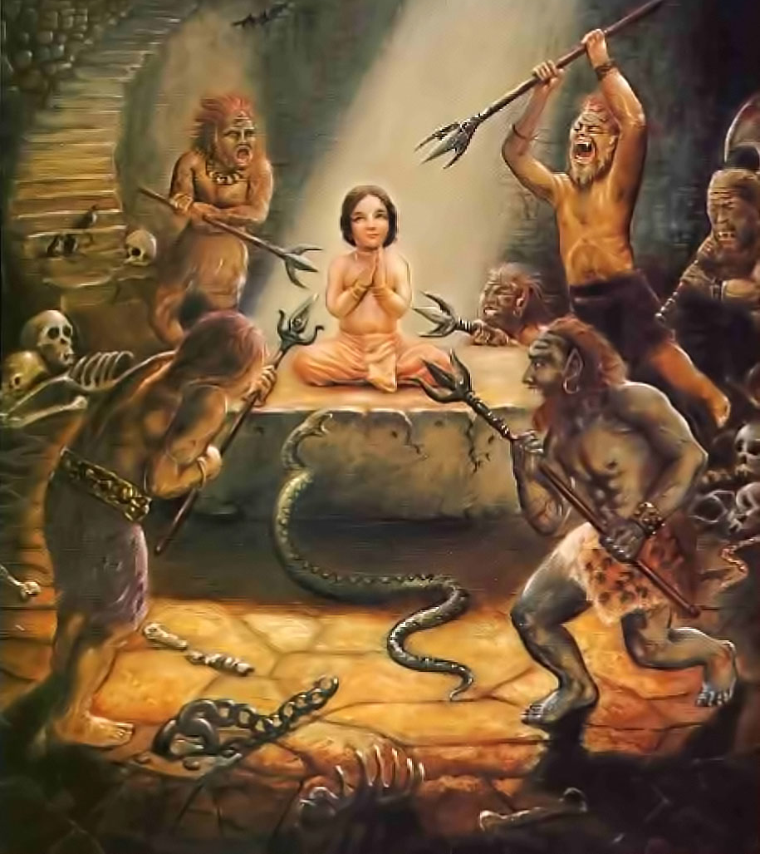
Fearless Bhakta Prahlad

Slide 26
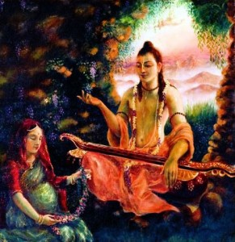
Prahlad Maharaj
Taught by Narada Muni in the womb of Kadayu
He listened to the instructions very carefully
Prahlad was always engaged in worshiping Lord Viṣṇu

Slide 27
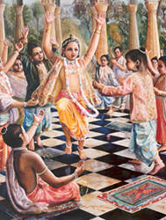
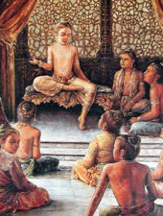
Prahlad taught his school friends
boys would only say, “Let us play, Prahlad! We’re only children.”
“Yes,” Prahlad would respond, “I know you want to play. But just listen a moment. There’s no need to try hard for sense happiness. That happiness will come without any endeavor, according to whatever body you have. Arrangements are already made by nature and will come on its own as misery comes. But there’s a need to develop an understanding of the dear most thing in life.”

Slide 28
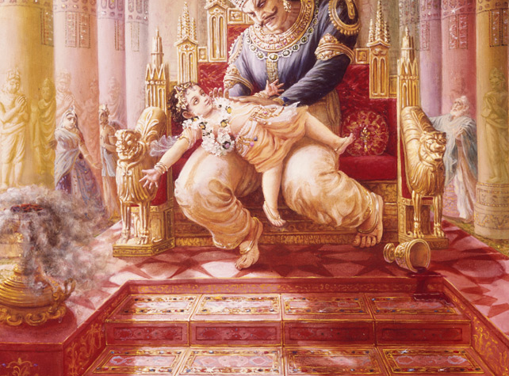

Slide 29
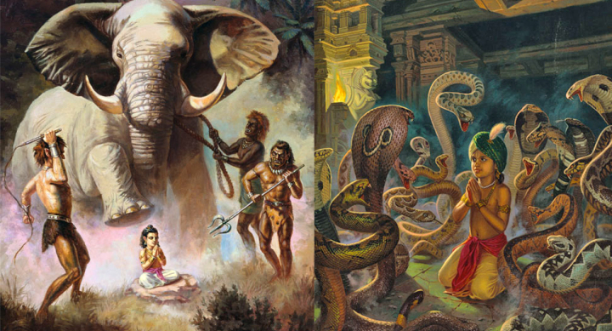

Slide 30
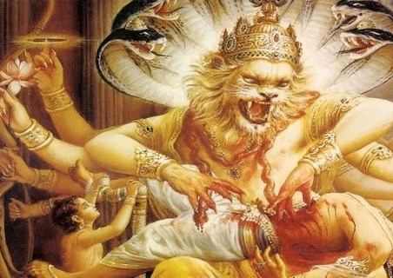
त्रैपिष्टपोरुभयहा स नृसिंहरूपं कृत्वा भ्रमद्भ्रुकुटिदंष्ट्रकरालवक्त्रम् । दैत्येन्द्रमाशु गदयाभिपतन्तमारा- दूरौ निपात्य विददार नखै: स्फुरन्तम् ॥ १४ ॥
trai-piṣṭaporu-bhaya-hā sa nṛsiṁha-rūpaṁ kṛtvā bhramad-bhrukuṭi-daṁṣṭra-karāla-vaktram daityendram āśu gadayābhipatantam ārād ūrau nipātya vidadāra nakhaiḥ sphurantam
The Personality of Godhead assumed the incarnation of Nṛsiṁhadeva in order to vanquish the great fears of the demigods. He killed the king of the demons [Hiraṇyakaśipu], who challenged the Lord with a club in his hand, by placing the demon on His thighs and piercing him with His nails, rolling His eyebrows in anger and showing His fearful teeth and mouth.

Slide 31
Take Home Points
Modes of nature acts under the direction of Krishna
Krishna is also in our hearts directing the wandering of living entities
Everything is being carried out by the directions of the Lord
Really speaking we have limited freedom and happiness and distress is destined and have false feeling of me and mine. (everything is His)
Devotees of the Lord realize this and engage in Krishna’s service without caring about me and mine that reflects on their behavior
It behooves us to not act in bodily platform and see the hand of Krishna in everything and improve our behavior.

