Slide 1
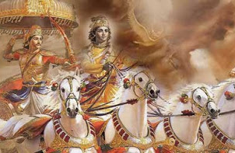
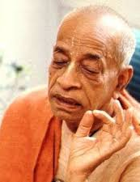
Solution to ALL our miseries - Lord Krishna the ONLY shelter SB 1.7.22-25
Guru can guide us to Him

Slide 2
SB 1.7.22-26
Text 22: Arjuna said: O my Lord Śrī Kṛṣṇa, You are the almighty Personality of Godhead. There is no limit to Your different energies. Therefore only You are competent to instill fearlessness in the hearts of Your devotees. Everyone in the flames of material miseries can find the path of liberation in You only.
Text 23: You are the original Personality of Godhead who expands Himself all over the creations and is transcendental to material energy. You have cast away the effects of the material energy by dint of Your spiritual potency. You are always situated in eternal bliss and transcendental knowledge.
Text 24: And yet, though You are beyond the purview of the material energy, You execute the four principles of liberation characterized by religion and so on for the ultimate good of the conditioned souls.
Text 25: Thus You descend as an incarnation to remove the burden of the world and to benefit Your friends, especially those who are Your exclusive devotees and are constantly rapt in meditation upon You.
Text 26: O Lord of lords, how is it that this dangerous effulgence is spreading all around? Where does it come from? I do not understand it.

Slide 3
अर्जुन उवाच कृष्ण कृष्ण महाबाहो भक्तानामभयङ्कर । त्वमेको दह्यमानानामपवर्गोऽसि संसृते: ॥ २२ ॥ arjuna uvāca kṛṣṇa kṛṣṇa mahā-bāho bhaktānām abhayaṅkara tvam eko dahyamānānām apavargo ’si saṁsṛteḥ
arjunaḥ uvāca — Arjuna said; kṛṣṇa — O Lord Kṛṣṇa; kṛṣṇa — O Lord Kṛṣṇa; mahā-bāho — He who is the Almighty; bhaktānām — of the devotees; abhayaṅkara — eradicating the fears of; tvam — You; ekaḥ — alone; dahyamānānām — those who are suffering from; apavargaḥ — the path of liberation; asi — are; saṁsṛteḥ — in the midst of material miseries.
Arjuna said: O my Lord Śrī Kṛṣṇa, You are the almighty Personality of Godhead. There is no limit to Your different energies. Therefore only You are competent to instill fearlessness in the hearts of Your devotees. Everyone in the flames of material miseries can find the path of liberation in You only.[SB 1.7.22]

Slide 4
Reviving our original quality
Kṛṣṇa is the original source of all living entities. This is confirmed in Bhagavad-gītā (15.7), wherein Kṛṣṇa says:
mamaivāṁśo jīva-loke jīva-bhūtaḥ sanātanaḥ manaḥ ṣaṣṭhānīndriyāṇi prakṛti-sthāni karṣati
“The living entities in this conditioned world are My eternal, fragmental parts. Due to conditioned life, they are struggling very hard with the six senses, which include the mind.” All living entities are part and parcel of Kṛṣṇa, and therefore when they revive their original Kṛṣṇa consciousness, they possess all the good qualities of Kṛṣṇa in a small quantity. When one engages himself in the nine processes of devotional service (śravaṇaṁ kīrtanaṁ viṣṇoḥ smaraṇaṁ pāda-sevanam/ arcanaṁ vandanaṁ dāsyaṁ sakhyam ātma-nivedanam), one’s heart becomes purified, and he immediately understands his relationship with Kṛṣṇa. He then revives his original quality of Kṛṣṇa consciousness.

Slide 5
Samsara Davanala Lidha Loka
saḿsāra-dāvānala-līḍha-loka-trāṇāya kāruṇya-ghanāghanatvam prāptasya kalyāṇa-guṇārṇavasya vande guroḥ śrī-caraṇāravindam
The spiritual master is receiving benediction from the ocean of mercy. Just as a cloud pours water on a forest fire to extinguish it, so the spiritual master delivers the materially afflicted world by extinguishing the blazing fire of material existence. I offer my respectful obeisances unto the lotus feet of such a spiritual master, who is an ocean of auspicious qualities.

Slide 6
Connecting Verses
BG 15.7: mamaivāṁśo jīva-loke jīva-bhūtaḥ sanātanaḥ manaḥ-ṣaṣṭhānīndriyāṇi prakṛti-sthāni karṣati
karṣati — is struggling hard.
Troubles come even unwanted
BG 13.9: janma-mṛtyu-jarā-vyādhi-duḥkha-doṣānudarśanam
Root cause of miseries – desires to enjoy senses -
BG 5.22: ye hi saṁsparśa-jā bhogā duḥkha-yonaya eva te
Material senses are sources of misery -
BG 7.14 daivī hy eṣā guṇa-mayī mama māyā duratyayā mām eva ye prapadyante māyām etāṁ taranti te
To cross easily - Surrender to Him
BG 2.7: kārpaṇya-doṣopahata-svabhāvaḥ pṛcchāmi tvāṁ dharma-sammūḍha-cetāḥ yac chreyaḥ syān niścitaṁ brūhi tan me śiṣyas te ’haṁ śādhi māṁ tvāṁ prapannam
BG 18.66: sarva-dharmān parityajya mām ekaṁ śaraṇaṁ vraja ahaṁ tvāṁ sarva-pāpebhyo mokṣayiṣyāmi mā śucaḥ

Slide 7
Connecting Verses
SB 1.7.6: anarthopaśamaṁ sākṣād bhakti-yogam adhokṣaje lokasyājānato vidvāṁś cakre sātvata-saṁhitām
The material miseries of the living entity, which are superfluous to him, can be directly mitigated by the linking process of devotional service. But the mass of people do not know this, and therefore the learned Vyāsadeva compiled this Vedic literature, which is in relation to the Supreme Truth.
SB 1.7.7: yasyāṁ vai śrūyamāṇāyāṁ kṛṣṇe parama-pūruṣe bhaktir utpadyate puṁsaḥ śoka-moha-bhayāpahā
Simply by giving aural reception to this Vedic literature, the feeling for loving devotional service to Lord Kṛṣṇa, the Supreme Personality of Godhead, sprouts up at once to extinguish the fire of lamentation, illusion and fearfulness.

Slide 8
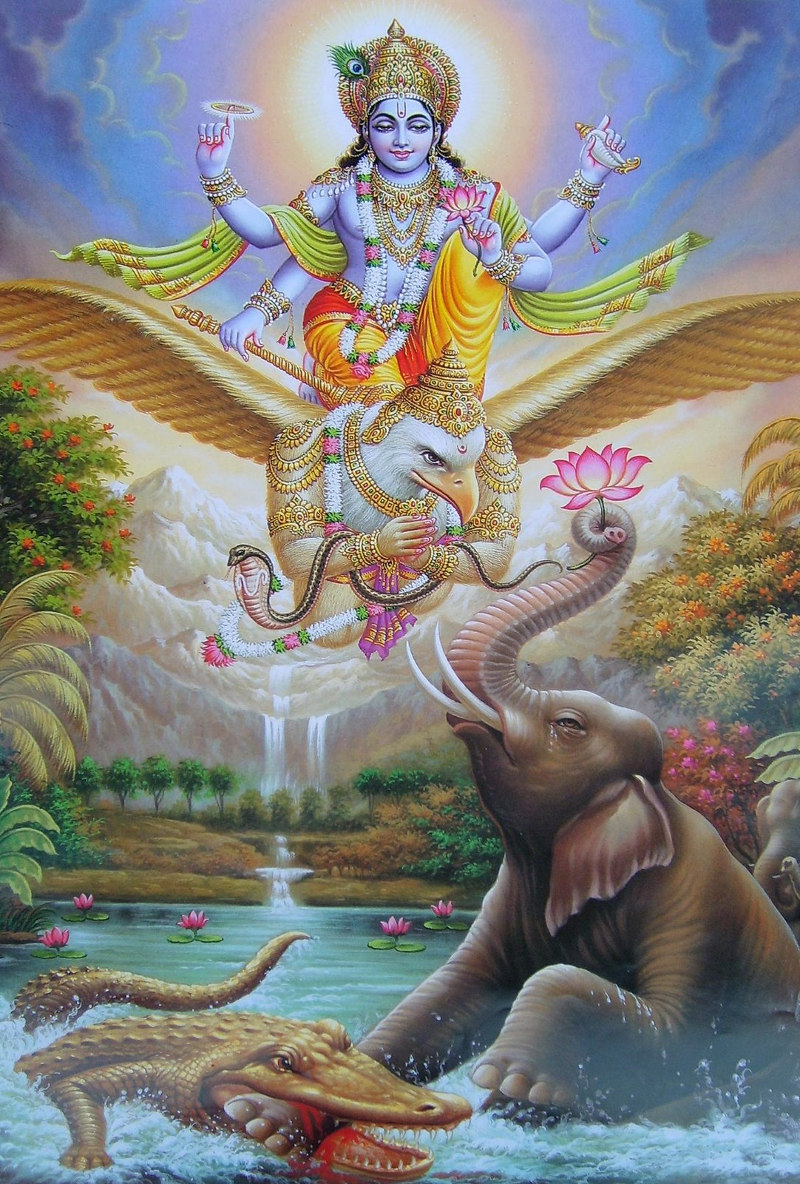
Intelligence – seek refuge
yaḥ kaścaneśo balino ’ntakoragāt pracaṇḍa-vegād abhidhāvato bhṛśam bhītaṁ prapannaṁ paripāti yad-bhayān mṛtyuḥ pradhāvaty araṇaṁ tam īmahi
yaḥ — He who (the Supreme Personality of Godhead); kaścana — someone; īśaḥ — the supreme controller; balinaḥ — very powerful; antaka-uragāt — from the great serpent of time, which brings death; pracaṇḍa-vegāt — whose force is fearful; abhidhāvataḥ — who is chasing; bhṛśam — endlessly (every hour and every minute); bhītam — one who is afraid of death; prapannam — who is surrendered (to the Supreme Personality of Godhead); paripāti — He protects; yat-bhayāt — from fear of the Lord; mṛtyuḥ — death itself; pradhāvati — runs away; araṇam — the actual shelter of everyone; tam — unto Him; īmahi — I surrender or take shelter.
The Supreme Personality of Godhead is certainly not known to everyone, but He is very powerful and influential. Therefore, although the serpent of eternal time, which is fearful in force, endlessly chases everyone, ready to swallow him, if one who fears this serpent seeks shelter of the Lord, the Lord gives him protection, for even death runs away in fear of the Lord. I therefore surrender unto Him, the great and powerful supreme authority who is the actual shelter of everyone. [SB 8.2.33]

Slide 9
13.9: Staircase to Lord Krishna (SPG)
Humility: one should not be anxious to have the satisfaction of being honored by others
pridelessness;
Nonviolence: not to put others into distress
Tolerance: practiced to bear insult and dishonor from others. Ex. Prahlad Maharaj
simplicity; without diplomacy one should be so straightforward that he can disclose the real truth even to an enemy
approaching a bona fide spiritual master: with all humility and offer him all services so that he will be pleased
Cleanliness: External cleanliness like taking a bath;internal cleanliness like always think of Kṛṣṇa and chant
Steadiness: very determined to make progress in spiritual life
self-control: not accept anything which is detrimental to the path of spiritual progress
renunciation of the objects of sense gratification;
absence of false ego;
the perception of the evil of birth, death, old age and disease;
detachment;
freedom from entanglement with children, wife, home and the rest;
even-mindedness amid pleasant and unpleasant events;
constant and unalloyed devotion to Me;
aspiring to live in a solitary place;
detachment from the general mass of people;
accepting the importance of self-realization;
philosophical search for the Absolute Truth

Slide 10
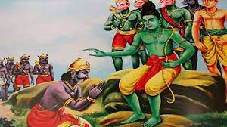
sakṛd eva prapanno yas tavāsmīti ca yācate abhayaṁ sarvadā tasmai dadāmy etad vrataṁ mama (Rāmāyaṇa, Yuddha-kāṇḍa 18.33)
Do your duties properly and come to Raam/Krishna and say “I am yours”
I give all of them fearlessness – this is My vow

Slide 11
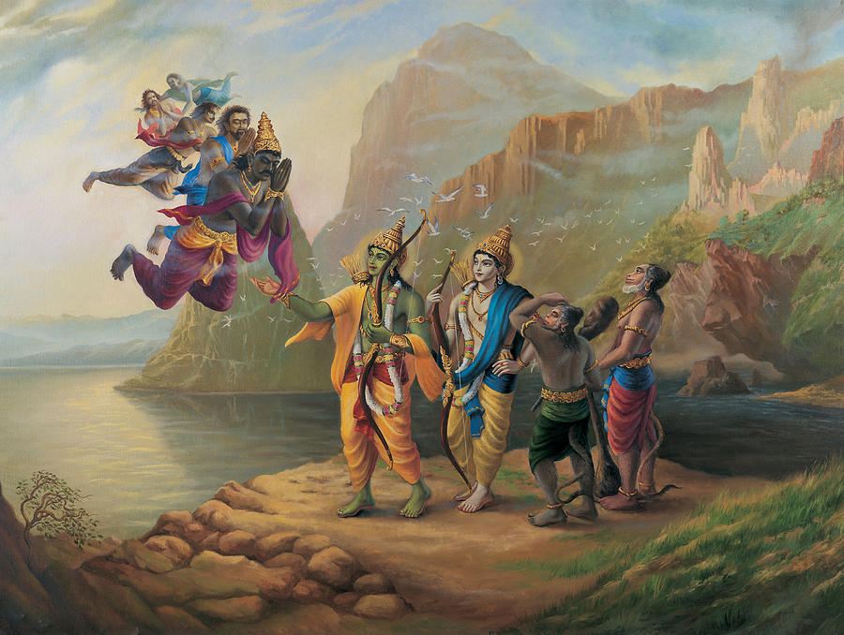

Slide 12
Straight forward gives fearlessness
Our life is very straight forward. There are no corners in it. And because it is without the corners, so the dirt cannot accumulate. The dirt can only accumulate, in the corners. If the room is straight forward, the dirt cannot accumulate. Our mind, because of constant remembrance of Krishna, is completely clarified of these dirt. And because there is no dirt, there is no anxiety, there is no misery at all. The miseries only when your mind has the corners and the corners are full of dirt. Please remove the corners from your mind and you will be fearless by His mercy.
Maha Vishnu Goswami

Slide 13
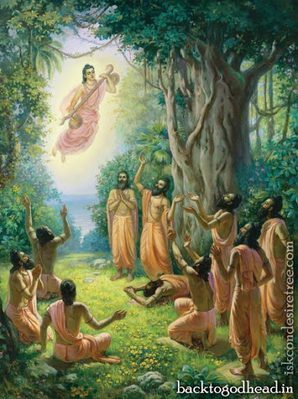
Transcendental Journey [25-29]
Then that supreme authority, personified by sound and unseen by eyes, but most wonderful, stopped speaking. Feeling a sense of gratitude, I offered my obeisances unto Him, bowing my head.
Thus I began chanting the holy name and fame of the Lord by repeated recitation, ignoring all the formalities of the material world. Such chanting and remembering of the transcendental pastimes of the Lord are benedictory. So doing, I traveled all over the earth, fully satisfied, humble and unenvious.
And so, O Brāhmaṇa Vyāsadeva, in due course of time I, who was fully absorbed in thinking of Kṛṣṇa and who therefore had no attachments, being completely freed from all material taints, met with death, as lightning and illumination occur simultaneously.
Having been awarded a transcendental body befitting an associate of the Personality of Godhead, I quit the body made of five material elements, and thus all acquired fruitive results of work [karma] stopped.
At the end of the millennium, when the Personality of Godhead, Lord Nārāyaṇa, lay down within the water of devastation, Brahmā began to enter into Him along with all creative elements, and I also entered through His breathing.

Slide 14
Chitā vs Chintā – be fiery with Krishna names
Chitā burns the dead body and Chintā burns the live body
So, please somehow or the other get rid of this anxiety. And there is no other way, You have to be very feelingly chanting about Krishna’s names. And you please call Him.
sakṛd eva prapanno yas tavāsmīti ca yācate abhayaṁ sarvadā tasmai dadāmy etad vrataṁ mama
I give them fearlessness. “That is my vrata. That is my vow” He says, and He never deters from His vows.
He is known as avyaya, He is completely fixed in His promises. We may deter, because we are limited in capacity. He is unlimited, you know and because of the unlimited Ananta, because of His Ananta nature, He can vanquish our anxieties and miseries within a second. And that is the purifying agent. The more you hear about Him;
Anxieties will pounce on you as soon as Krishna is absent, kaliyuga anxieties are on our shoulder. tad dinaat, kali aayaatah. kshmaam tyaktva, He left the planet, and sva padam gatah, and He went to His own abode, and tad dinaat, and from that day, Kaliyuga has come.
Material existence can only be mitigated by un-deviated devotional service unto the lotus feet of Krishna. Otherwise it can never be mitigated.

Slide 15
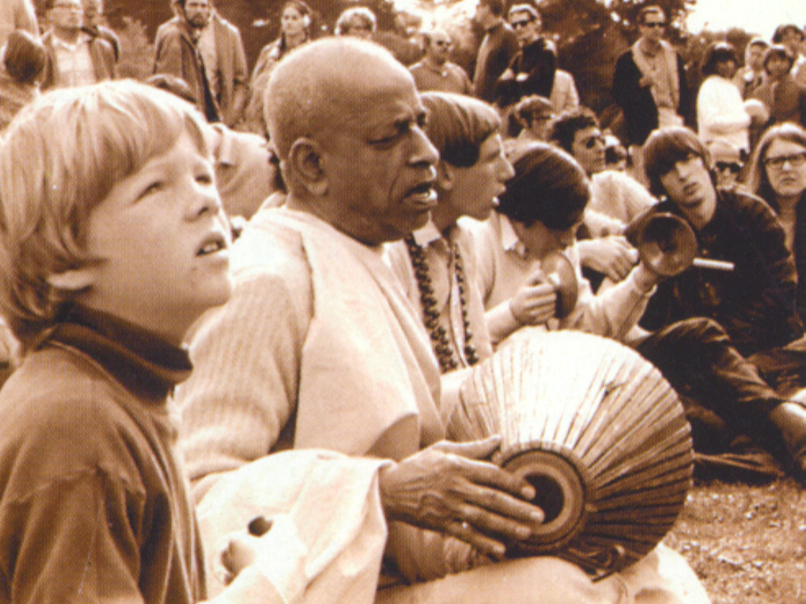
Srila Prabhupada depends only on Harinaam
Ignored material standards
Wear dhoti
nāmāny anantasya hata-trapaḥ paṭhan guhyāni bhadrāṇi kṛtāni ca smaran gāṁ paryaṭaṁs tuṣṭa-manā gata-spṛhaḥ kālaṁ pratīkṣan vimado vimatsaraḥ
Thus I began chanting the holy name and fame of the Lord by repeated recitation, ignoring all the formalities of the material world. Such chanting and remembering of the transcendental pastimes of the Lord are benedictory. So doing, I traveled all over the earth, fully satisfied, humble and unenvious. [SB 1.6.26]

Slide 16
Propagate - Don’t care for material standards
Prabhupada has given that first, with dhotis they go out for Harinama, they don’t care for the material standards.
In London or in European countries or in America or in Australia also, we go for Harinaam and we ignore all the standards because we are completely engrossed in the chanting the names of Krishna. This is the way, we should pass time. guhyāni bhadrāṇi kṛtāni ca smaran“I was always remembering His inconceivable activities.”

Slide 17
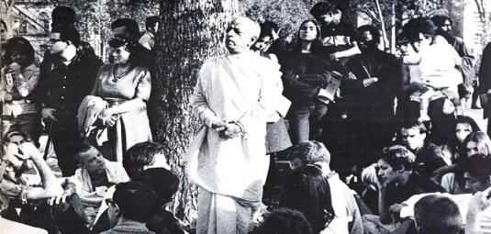

Slide 18
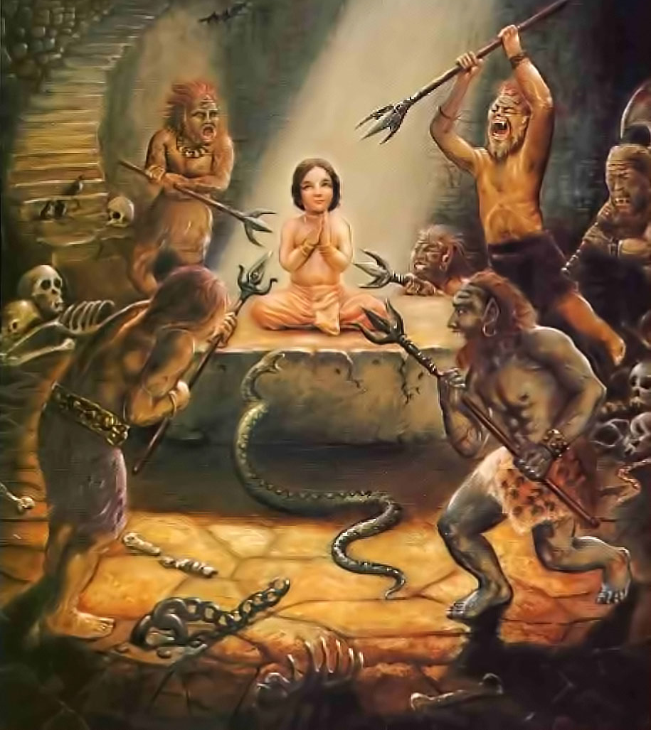
Lord is Unlimited Mighty Hirayakashipu Vanquished

Slide 19
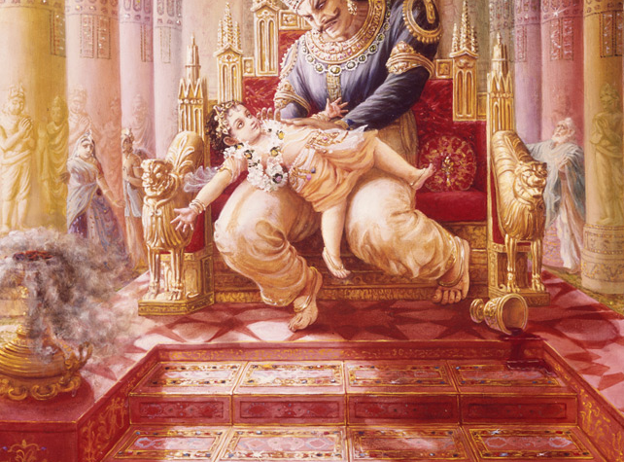

Slide 20
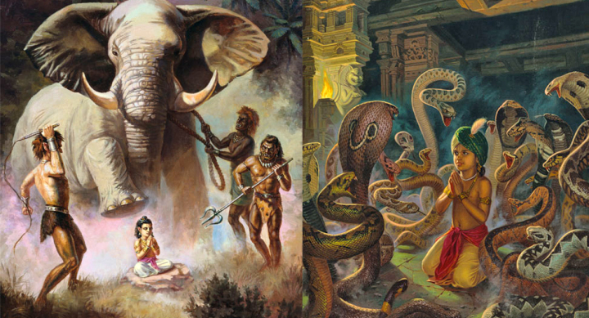

Slide 21
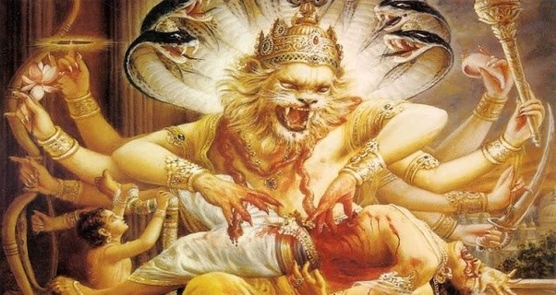

Slide 22
Powerful Hiranyakashipu vanquished
Hiranyakashipu was so very tall that he was touching the clouds
He was the owner of all the heavenly planets.
The demigods were shivering before him and even then he was defeated by Krishna.
Such a powerful Lord is in our hands
So please, such a powerful Lord is in our hands, just is the matter of devoting some time.

Slide 23
Bhaja hu re mana
bhajahū re mana śrī-nanda-nandana abhaya-caraṇāravinda re durlabha mānava-janama sat-sańge taroho e bhava-sindhu re
O mind just worship the lotus feet of the son of Nanda, which make one fearless. Having obtained this rare human birth, cross over this ocean of worldly existence through the association of saintly persons.
śīta ātapa bāta bariṣaṇa e dina jāminī jāgi re biphale sevinu kṛpaṇa durajana capala sukha-laba lāgi' re
Both in the day and at night I remain sleepless, suffering the pains of the heat and cold, the wind and the rain. For a fraction of flickering happiness I have uselessly served wicked and miserly men.
e dhana, yaubana, putra, parijana ithe ki āche paratīti re kamala-dala-jala, jīvana ṭalamala bhajahū hari-pada nīti re
What assurance of real happiness is there in all of one's wealth, youthfulness, sons, and family members? This life is tottering like a drop of water on a lotus petal; therefore you should always serve and worship the divine feet of Lord Hari.
śravaṇa, kīrtana, smaraṇa, vandana, pāda-sevana, dāsya re pūjana, sakhī-jana, ātma-nivedana govinda-dāsa-abhilāṣa re
It is the desire and great longing of Govinda Dasa to engage himself in the nine processes of bhakti, namely hearing the glories of Lord Hari and chanting those glories, constantly remembering Him and offering prayers to Him, serving the Lord's lotus feet, serving the Supreme Lord as a servant, worshiping Him with flowers and incense and so forth, serving Him as a friend, and completely offering the Lord one's very self.

Slide 24
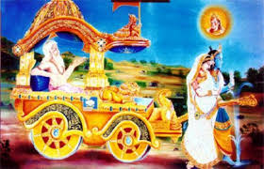
Durvasa Curses Krishna and Rukmini Social Distancing!
Those who get angry are foolish (BG 2.61-2)
In separation attachment increases - Vipralambha
Never leave saintly behavior
In conflict practice social distancing! ☺

Slide 25
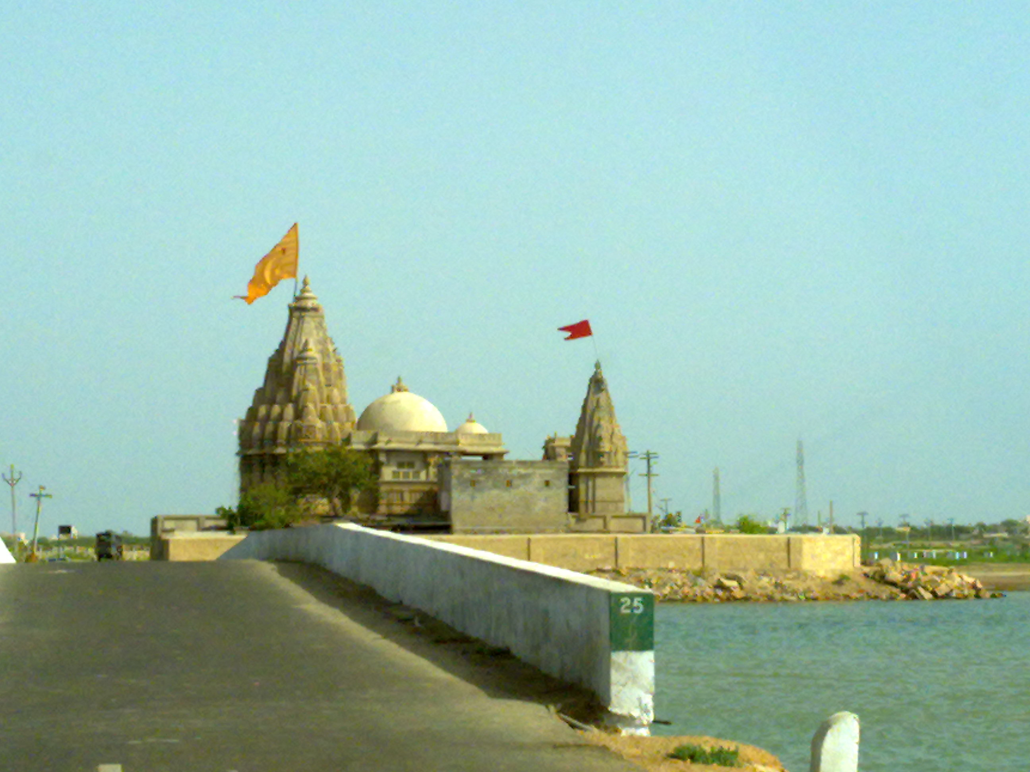
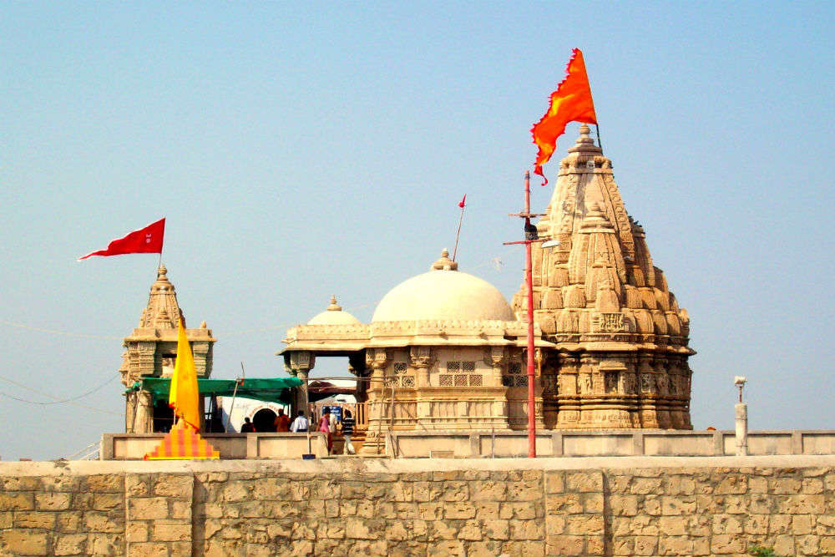
Rukmini Temple

Slide 26
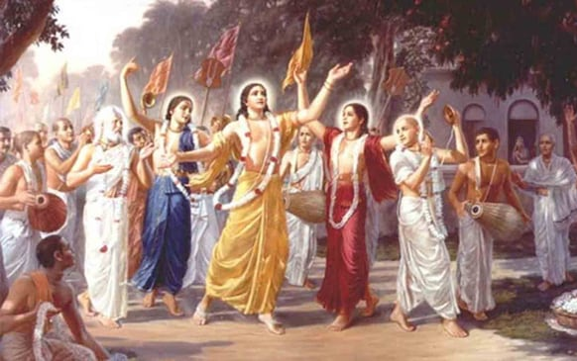

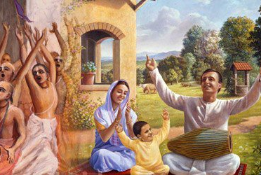
Take Home Points
W.O.R.L.D is full of problems.
Miseries catches us when we lack in Krishna Consciousness
Seek Refuge unto the all powerful
Feelingly get attached to Krishna’s names, qualities and pastimes, etc then miseries will not touch us
Do your duties properly with saintly behavior - just surrender unto Krishna
Krishna is the ONLY savior for He is Ananta - unlimited
Guru shows us the way to Krishna and thus fearlessness

Slide 27
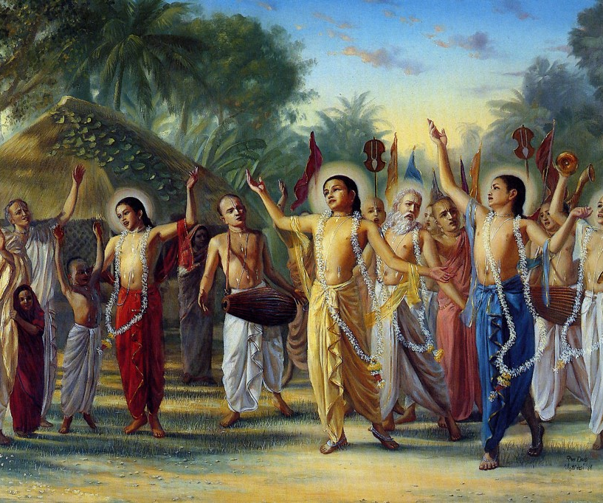
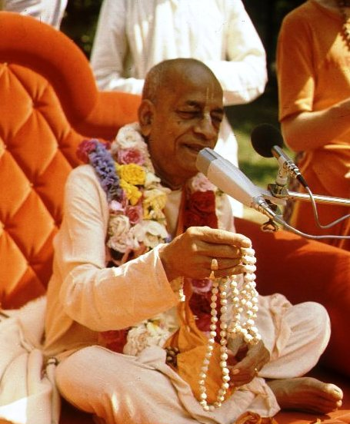
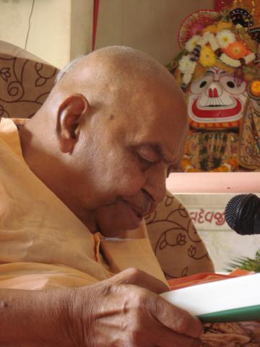
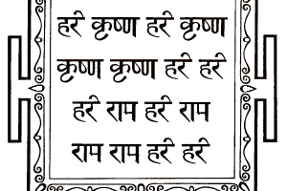
हरे कृष्णा
श्रील प्रभुपाद की जय
गुरुदेव की जय

