Slide 1
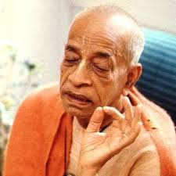
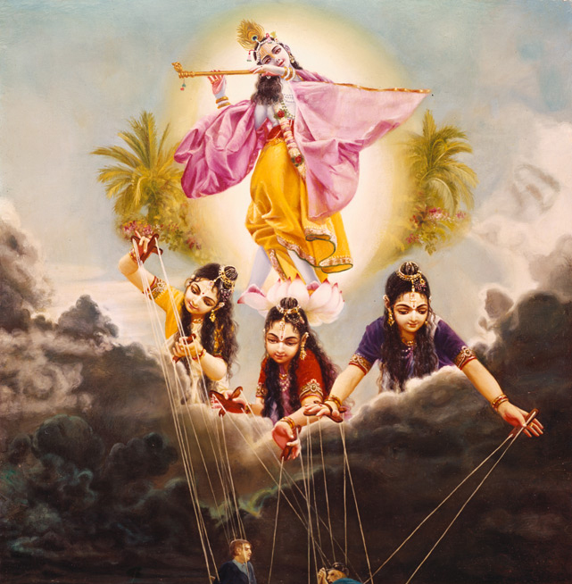
How to transcend the modes of nature
Transcending Material Nature via devotional service.

Slide 2
BG 14 : Transcending Material Nature
1-4 : Importance of this chapter – the best of Knowledge – position of living entity in material nature and the seed giving father
5-13: Modes of nature and its cause, characteristics and results.
14-15: Destination when one dies in various modes
16-18: Results of various modes further explained
19-21: Seeing Lord acting behind the modes and transcending modes and freeing oneself of BDOD and get nectar
21-25: Symptom and Behavior of person who is beyond modes
26: How to transcend the modes? full DS unfailing in all circumstances
27: Lord is basis of Impersonal Brahman

Slide 3
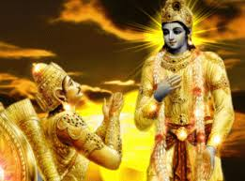
Questions from Arjuna BG 14.21
Arjuna inquired: O my dear Lord, by which symptoms is one known who is transcendental to these three modes? What is his behavior? And how does he transcend the modes of nature?

Slide 4
BG 14.27: Engage in full devotional service मां च योऽव्यभिचारेण भक्तियोगेन सेवते । स गुणान्समतीत्यैतान्ब्रह्मभूयाय कल्पते ॥ २६ ॥
mam ca yo 'vyabhicarena bhakti-yogena sevate sa gunan samatityaitan brahma-bhuyaya kalpate
mām — unto Me; ca — also; yaḥ — a person who; avyabhicāreṇa — without fail; bhakti-yogena — by devotional service; sevate — renders service; saḥ — he; guṇān — the modes of material nature; samatītya — transcending; etān — all these; brahma-bhūyāya — elevated to the Brahman platform; kalpate — becomes.
One who engages in full devotional service, unfailing in all circumstances, at once transcends the modes of material nature and thus comes to the level of Brahman.

Slide 5

How to transcend the modes?
One should not be disturbed by the activities of the modes of nature; instead - always act for Kṛṣṇa.
All His different plenary expansions such as Rāma and Nārāyaṇa are also equally potent being transcendental - omnipotent & omniscient
These modes of material nature are very difficult to overcome, one can overcome them easily when One who surrenders unto Kṛṣṇa
In devotional service one acquires qualitative equality with Kṛṣṇa
As pure parts of gold are part of gold mine
Bhakti-yoga means that the Lord is there, the devotee is there, and the activity of exchange of love between the Lord and the devotee is there.
If one is not situated in the same transcendental position with the Lord, one cannot serve the Supreme Lord.
To be a personal assistant to a king, one must acquire the qualifications. Thus the qualification is to become Brahman, or freed from all material contamination.
By attainment of Brahman, one does not lose his eternal Brahman identity as an individual soul.

Slide 6
14.27: Lord is the basis of Brahman ब्रह्मणो हि प्रतिष्ठाहममृतस्याव्ययस्य च । शाश्वतस्य च धर्मस्य सुखस्यैकान्तिकस्य च ॥
brahmaṇo hi pratiṣṭhāham amṛtasyāvyayasya ca śāśvatasya ca dharmasya sukhasyaikāntikasya ca
brahmaṇaḥ — of the impersonal brahma-jyotir; hi — certainly; pratiṣṭhā — the rest; aham — I am; amṛtasya — of the immortal; avyayasya — of the imperishable; ca — also; śāśvatasya — of the eternal; ca — and; dharmasya — of the constitutional position; sukhasya — of happiness; aikāntikasya — ultimate; ca — also.
And I am the basis of the impersonal Brahman, which is immortal, imperishable and eternal and is the constitutional position of ultimate happiness.

Slide 7
BG 14.27 Purport Ways of transcendence
Paramātmā and the impersonal Brahman are within the Supreme Person.
Lord impregnates the inferior, material nature with fragments of the superior nature [BG 7.4-6]
When a living entity conditioned by this material nature begins the cultivation of spiritual knowledge, he gradually rises up to the Brahman conception of the Supreme.
Stages of Realization
Brahman conception of life (not perfect realization – danger of falldown)
Paramātmā realization
Realization of the Supreme Personality of Godhead.
Example 4 Kumaras
When one understands the Personality of Godhead, the reservoir of pleasure, Kṛṣṇa, he actually becomes transcendentally blissful.” (Taittirīya Upaniṣad 2.7.1)
Servant of the King has quality of King and enjoys his bliss service unto King eternally

Slide 8
How to rise?
We fall down because of our unlawful desire to Lord Over
Gets entangled by the modes of nature
By DS he is situated in transcendental nature and unlawful desires are removed.
9 process of Bhakti should be followed in association of devotees
Gradually – by association - by influence of Guru this dominating nature is removed.

Slide 9
Devotional service to the Lord is very simple
One should always engage in the service of the Lord
Should eat the remnants of foodstuffs offered to the Deity
Smell the flowers offered to the lotus feet of the Lord
See the places where the Lord had His transcendental pastimes
Read of the different activities of the Lord, His reciprocation of love with His devotees
Chant always the transcendental vibration
Hare Kṛṣṇa, Hare Kṛṣṇa, Kṛṣṇa Kṛṣṇa, Hare Hare/ Hare Rāma, Hare Rāma, Rāma Rāma, Hare Hare
Observe the fasting days commemorating the appearances and disappearances of the Lord and His devotees.

Slide 10
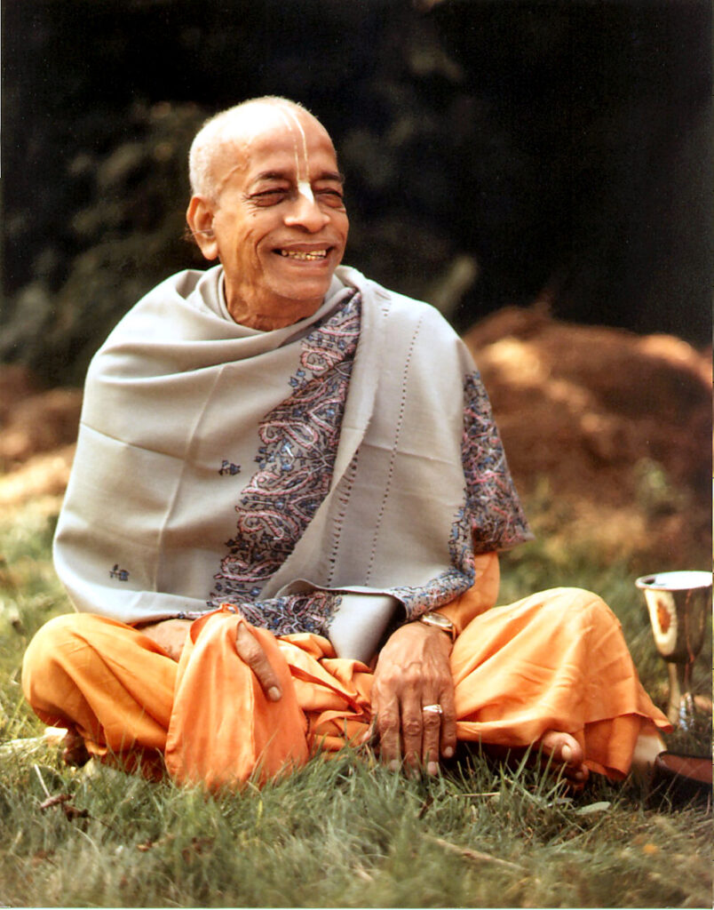
SP Lecture on BG 7.13 tribhir guṇa-mayair bhāvair ebhiḥ sarvam idaṁ jagat mohitaṁ nābhijānāti mām ebhyaḥ param avyayam
One who can see the root cause – is Krishna Consciousness
When you see cloth what do you see
Story: Narada meets Cobbler and Brahman where are you going?
Krishna: Brahman – will take time, Cobbler – in this life
Krishna: Tell them – was putting elephant thru the eye of the needle
Responses – Brahman did not believe, Cobbler cried with wonder
Cobbler – I can see that a fruit a banyan tree has seeds and even one seed can put a big tree
This is inconceivable energy of Krishna – Lord is Not like us humans.
We don’t have eyes to see soul what to speak of Krishna (BG 2.13)
We cannot see soul with charma chakshu
Krishna is the cause of everything – 5 gross + 3 subtle (BG 7.4)
We cannot see God with these eyes – that’s why mercifully appears as arca
We can see Krishna – with eyes anointed with love (BS – Premanjana)

Slide 11
How to see Lord?
Bhagavan has inconceivable energy : Story - Frog in the well
See a small ant moving
We are so proud to make a airplane
Try to find the inconceivable energy of Krishna
In ignorance we think God is without any form.
Millions of Universe is in Lord’s belly --- Yashoda sees millions of universes in Kanha’s mouth. (BS )
Chaitanya Mahaprabhuji fell down unconscious after seeing Lord Jagannatha
Cloud cannot cover the Sun. Maya cannot cover the Lord – Maya can cover our eyes.
We Sun rises in the morning – then we can see the Lord. When there is Lord’s mercy then we can see Him.
BG 18.55 bhaktyā mām abhijānāti yāvān yaś cāsmi tattvataḥ tato māṁ tattvato jñātvā viśate tad-anantaram
We need to have LOVE for Krishna we need to train ourselves in the devotional process.
We will come to know about Krishna when we practice DS.
Surrender to Him in all humility leaving all demoniac tendency (demons cannot understand Krishna – story of HK & Prahlad – as they are in illusion)

Slide 12
MoMN Quiz
Fixed in this knowledge, one can attain to the transcendental nature like My own. (True/False)
Thus established, one is born at the time of creation (True/False)
Material nature consists of three modes – goodness, passion and _______.
Eternal living entity comes in contact with nature, O mighty-armed Arjuna, he becomes _________ by these modes
In _______ mode one become conditioned by a sense of happiness and knowledge.
In ______ embodied living entity is bound to material fruitive actions
In ______ mode are madness, indolence and sleep, which bind the conditioned soul.
goodness conditions one to _______; passion conditions one to ______ action; and ignorance, covering one’s knowledge, binds one to _______.
A person remains in one of the modes thru out one’s life. (True/False)
When one dies in the mode of ignorance, he takes birth in the ________.

Slide 13
MoMN Quiz
Fixed in this knowledge, one can attain to the transcendental nature like My own. (True/False)
Thus established, one is NOT born at the time of creation (True/False)
Material nature consists of three modes – goodness, passion and ignorance.
Eternal living entity comes in contact with nature, O mighty-armed Arjuna, he becomes conditioned by these modes
In goodness mode one become conditioned by a sense of happiness and knowledge.
In passion embodied living entity is bound to material fruitive actions
In ignorance mode are madness, indolence and sleep, which bind the conditioned soul.
Goodness conditions one to happiness; passion conditions one to fruitive action; and ignorance, covering one’s knowledge, binds one to madness.
A person remains in one of the three modes throughout one’s life. (True/False) [BG 14.10]
When one dies in the mode of ignorance, he takes birth in the animal kingdom

Slide 14
References
SB 11.25.1-36
BG 2.45, 3.5, 3.27, 3.28, 3.29, 3.33, 3.37, 4.13, 4.23, 5.14,6.27
BG 7.12,7.13, 7.14, 9.9, 9.10, 9.13 11.38
BG 13.15, 13.20, 13.21, 14.1-27, 15.10, 17.1-28, 18.7-10, 18.19-41
Total BG verses on Modes of MN: 22+27+28+26 = 103 verses

Slide 15
Connecting Verses
ei rūpe brahmāṇḍa bhramite kona bhāgyavān jīva guru-kṛṣṇa-kṛpāya pāya bhakti-latā-bīja [CC M 19.151]
ābrahma-bhuvanāl lokāḥ punar āvartino 'rjuna [Bg. 8.16]
nashta-prayeshv abhadreshu nityam bhagavata-sevaya bhagavaty uttama-sloke bhaktir bhavati naishthiki [SB 1.2.18]
tadā rajas-tamo-bhāvā kāma-lobhādayas ca ye ceta etair anāviddha sthita sattve prasidati[SB 1.2.19]
mayādhyakṣeṇa prakṛtiḥ sūyate sa-carācaram hetunānena kaunteya jagad viparivartate [Bg. 9.10]
Notes:
SB 1.2.33 : The Supersoul enters into the bodies of the created beings, who are influenced by the modes of material nature, and causes them to enjoy the effects of these by the subtle mind

Slide 16
Introspect Yourself [SB 11.25.2-5] Character
Mind and sense control, tolerance, discrimination, sticking to one’s prescribed duty, truthfulness, mercy, careful study of the past and future, satisfaction in any condition, generosity, renunciation of sense gratification, faith in the spiritual master, being embarrassed at improper action, charity, simplicity, humbleness and satisfaction within oneself are qualities of the mode of goodness.
Material desire, great endeavor, audacity, dissatisfaction even in gain, false pride, praying for material advancement, considering oneself different and better than others, sense gratification, rash eagerness to fight, a fondness for hearing oneself praised, the tendency to ridicule others, advertising one’s own prowess and justifying one’s actions by one’s strength are qualities of the mode of passion.
Intolerant anger, stinginess, speaking without scriptural authority, violent hatred, living as a parasite, hypocrisy, chronic fatigue, quarrel, lamentation, delusion, unhappiness, depression, sleeping too much, false expectations, fear and laziness constitute the major qualities of the mode of ignorance.

Slide 17
Inspect Yourself [SB 11.25.10-11] Work Culture
Any person, whether man or woman, who worships Me with loving devotion, offering his or her prescribed duties unto Me without material attachment, is understood to be situated in goodness.
When a person worships Me by his prescribed duties with the hope of gaining material benefit, his nature should be understood to be in passion,
one who worships Me with the desire to commit violence against others is in ignorance.
Worker - free of attachment or blinded by personal desire or completely forgotten how to tell right from wrong or has taken shelter of Krishna

Slide 18
How to transcend modes of nature [SB 11.25.32-6]
O gentle Uddhava, all these different phases of conditioned life arise from work born of the modes of material nature. The living entity who conquers these modes, manifested from the mind, can dedicate himself to Me by the process of devotional service and thus attain pure love for Me. [SB 11.25.32]
Therefore, having achieved this human form of life, which allows one to develop full knowledge, those who are intelligent should free themselves from all contamination of the modes of nature and engage exclusively in loving service to Me.[SB 11.25.33]
A wise sage, free from all material association and unbewildered, should subdue his senses and worship Me. He should conquer the modes of passion and ignorance by engaging himself only with things in the mode of goodness. [SB 11.25.34]
Then, being fixed in devotional service, the sage should also conquer the material mode of goodness by indifference toward the modes. Thus pacified within his mind, the spirit soul, freed from the modes of nature, gives up the very cause of his conditioned life and attains Me.
Freed from the subtle conditioning of the mind and from the modes of nature born of material consciousness, the living entity becomes completely satisfied by experiencing My transcendental form. He no longer searches for enjoyment in the external energy, nor does he contemplate or remember such enjoyment within himself. [SB 11.25.36]

Slide 19
How are you feeling
slept excessively, indulged in false hopes, and displayed violence toward others
distorted intelligence because of too much activity, an unhealthy condition of the working physical organs, and the unsteady perplexity of the mind
one is thus unable to concentrate his attention, his mind is ruined and manifests depression
alert wakefulness or sleep with dreaming or deep, dreamless sleep

Slide 20
Take Home Points (FIRST)
Feel for others, smile ☺
Introspect – watch your current mode take corrective actions/pray
Responsible – Take responsibility of your actions – don’t blame others
Surrender to Krishna – humbly serve Him with love
Train yourself in devotional service under guidance of spiritual master in association of devotees.
We are here not to prove but to improve

