Slide 1
Docker & Kubernetes-based
Microservices Application
Deployment and Orchestration with Kubernetes
Submitted By:
GITHUB ID –
https://github.com/manoharkolar/DOCKER-CAPSTONE-MINI-PROJECT
Manohar B N, Graduate Trainee Engineer
Bhagyalaxmi , Graduate Trainee Engineer

Slide 2
Project Overview
Microservices Architecture
The project is designed using a microservices architecture, where the application is broken down into smaller, independent services. Each service is responsible for a specific business functionality, allowing for easier scalability, maintenance, and deployment.

Slide 3

Authentication Service : Handles user login, authentication, and session management. It ensures that users are properly authenticated before they can access other parts of the application. Product Service : Manages the product catalog, including product listings, descriptions, prices, and availability. This service provides APIs for retrieving product information that can be displayed to users. Order Service : Manages the order lifecycle, including order creation, updating, and tracking. This service interacts with both the Product and Payment services to ensure accurate order processing. Payment Service : Handles payment processing, including payment gateway integration, transaction management, and order finalization. This service is crucial for completing user purchases and ensuring secure transactions.
Primary Services:

Slide 4
Authentication Service Details
(Same for product, order, payment services)
Overview:
Built using Node.js and Express.
Manages user authentication and login.
Key Files:
app.js: Main application logic.
auth.js: Route handling.
Dockerfile: Instructions to containerize the service.

Slide 5
Technologies Used
Docker:
Containerization of microservices.
Kubernetes:
Orchestration and deployment.
Minikube:
Local Kubernetes cluster setup.
Other Tools:
Node.js, Express, MySQL, PostgreSQL, MongoDB.

Slide 6
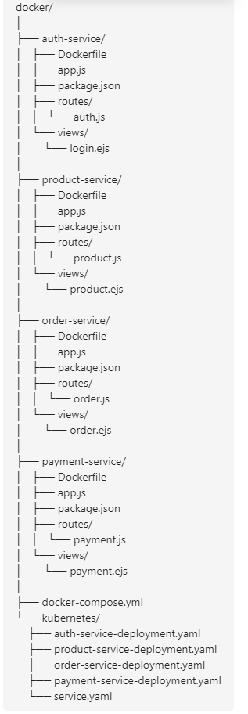
Microservices Architecture

Slide 7
Dockerfile Example (Authentication Service):
The Dockerfile is a script that contains instructions to build a Docker image for the Authentication Service. Here's a breakdown of the key parts:
Base Image:
FROM node:18-alpine
This line specifies the base image for your Docker container. In this case, it uses the node:18-alpine image, which is a lightweight version of Node.js. The Alpine version is used because it's minimal, making the final Docker image smaller and more efficient.
Working Directory:
WORKDIR /usr/src/app
This command sets the working directory inside the container where your application code will reside. All subsequent commands in the Dockerfile will be executed relative to this directory. It helps organize the container's file system and keeps the application code isolated.
Copy Instructions:
COPY package*.json ./
COPY . .
The first COPY command copies the package.json and package-lock.json files from your local machine to the container. These files are necessary for installing dependencies.
The second COPY command copies all the files in the current directory on your local machine to the working directory inside the container. This includes your application's source code.

Slide 8
Run Instructions:
RUN npm install
This command installs all the Node.js dependencies listed in the package.json file. It's essential to run this command after copying the package.json to ensure that all necessary libraries and frameworks are available for your application.
Expose Port:
EXPOSE 3000
This command tells Docker that the container will listen on port 3000 at runtime. It doesn't publish the port, but it documents the intended network configuration.
CMD Instruction:
CMD ["npm", "start"]
This command specifies the command to run when the container starts. In this case, it starts the Node.js application by running the npm start command, which is defined in the package.json file.
Docker Compose:
Docker Compose is a tool used to define and run multi-container Docker applications. The docker-compose.yml file allows you to configure the services that make up your application.
Overview of the docker-compose.yml File:
This file defines the services, networks, and volumes for your multi-service application. It simplifies the process of managing multiple containers, ensuring that they are orchestrated correctly and can communicate with each other.
Service Definitions for Each Microservice:
Authentication Service (auth-service):
Defined with a build context pointing to the auth-service directory.
Ports are mapped from the container to the host (3000:3000), allowing external access to the service on port 3000.

Slide 9
Product Service (product-service), Order Service (order-service), and Payment Service (payment-service):
Similarly defined with their respective directories and ports. These services are configured to communicate with each other and the databases.
Networks Setup:
Networks:
networks:
microservices-network: is defined to ensure that all services can communicate within an isolated Docker network. This custom network allows the services to discover each other using their service names as hostnames.
Volumes Setup:
Volumes:
volumes:
Persistent storage is configured for databases like PostgreSQL (postgres-data), MongoDB (mongo-data), and MySQL (mysql-data). This ensures that data is not lost when the containers are stopped or removed. The volumes map directories on the host machine to directories inside the containers.

Slide 10
.
Pushing to Docker Hub
Steps:
Log in to Docker Hub:
Before you can push your Docker images to Docker Hub, you need to log in to your Docker Hub account from the command line.
docker login
Tagging Docker Images:
Docker images need to be tagged before they can be pushed to Docker Hub. Tagging assigns a version or label to your image, typically in the format username/repository:tag
docker tag <image_id_or_name> <username>/<repository>:<tag>
.
Pushing Images to Docker Hub:
Once the image is tagged, you can push it to Docker Hub using the docker push command
docker push <username>/<repository>:<tag>
docker login
docker tag <image_id_or_name> <username>/<repository>:<tag>
docker push <username>/<repository>:<tag>

Slide 11
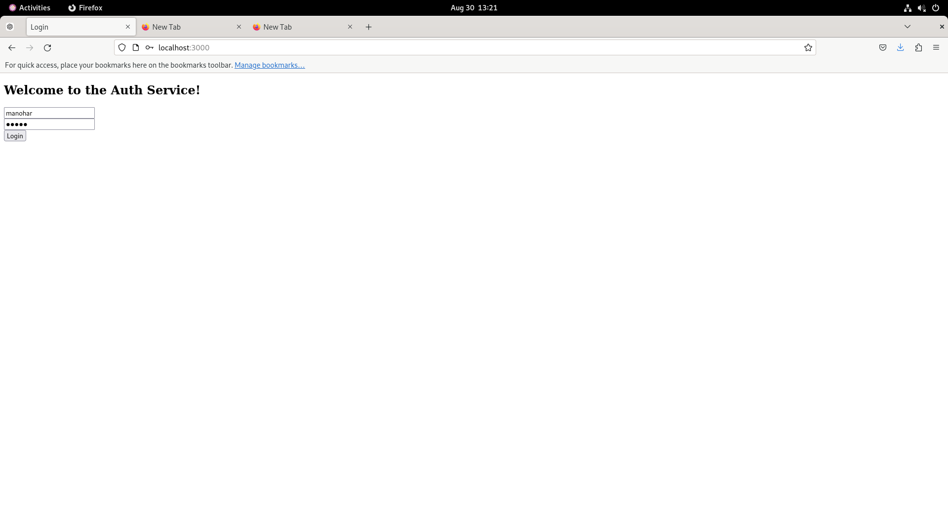
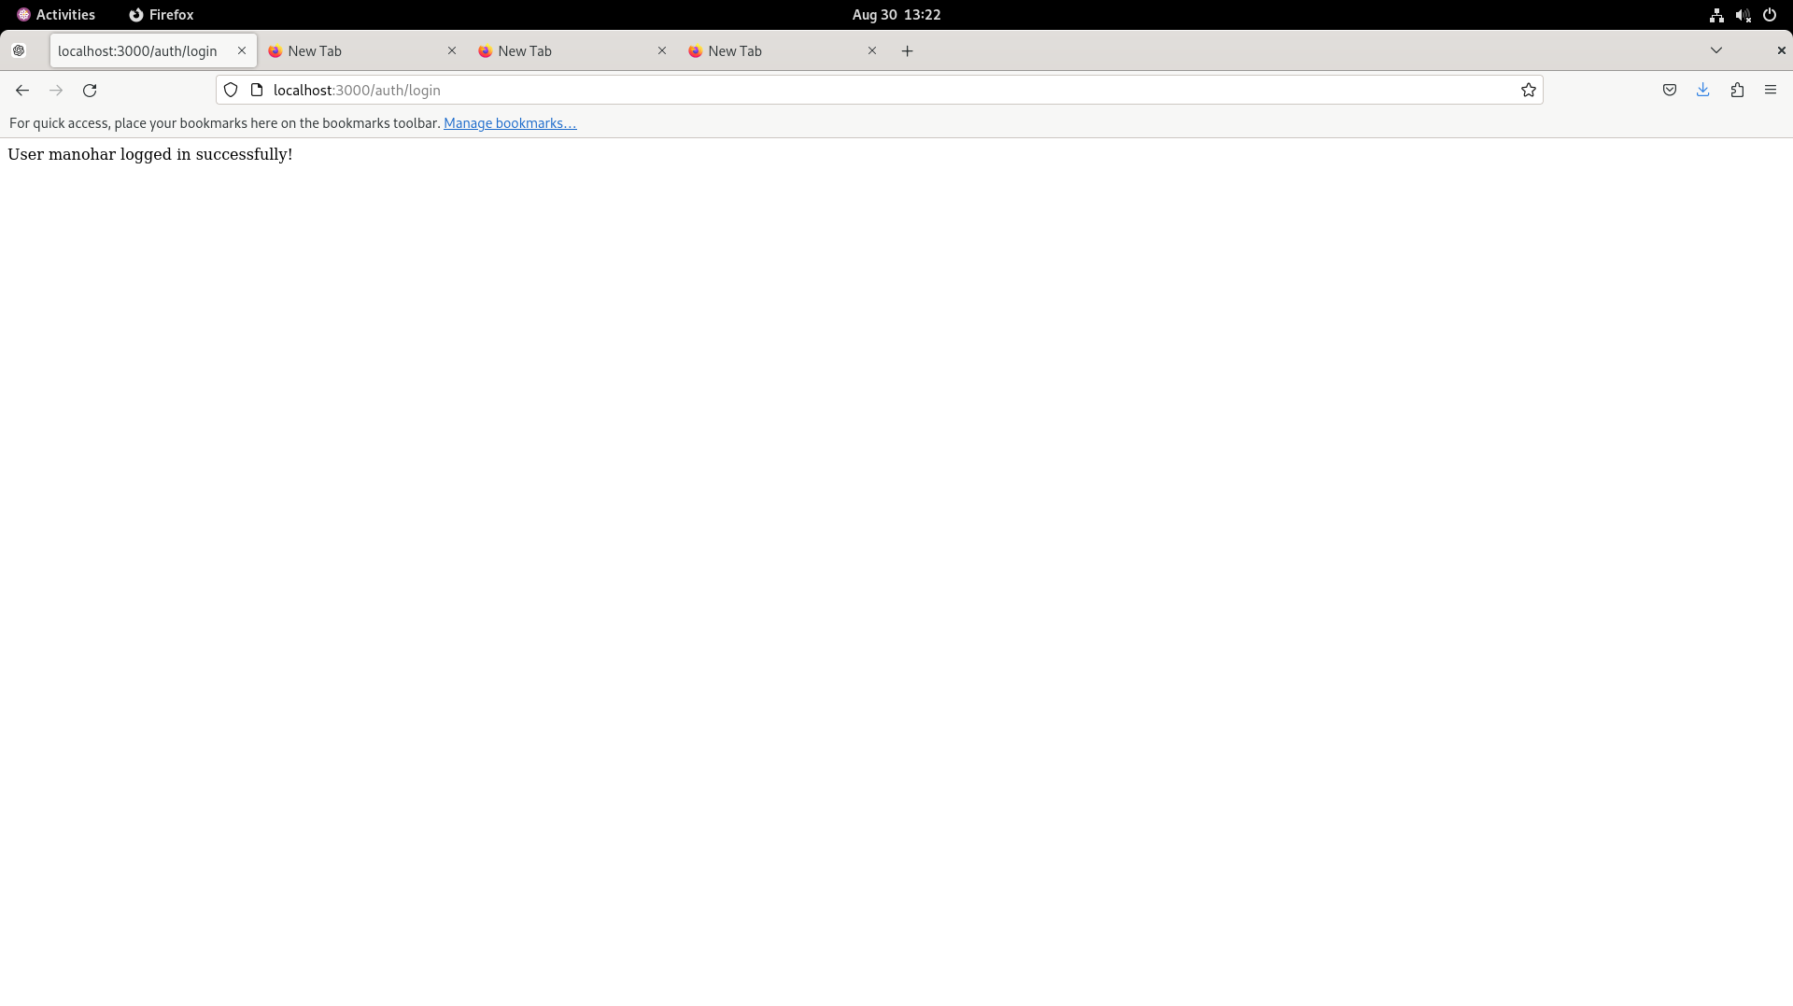
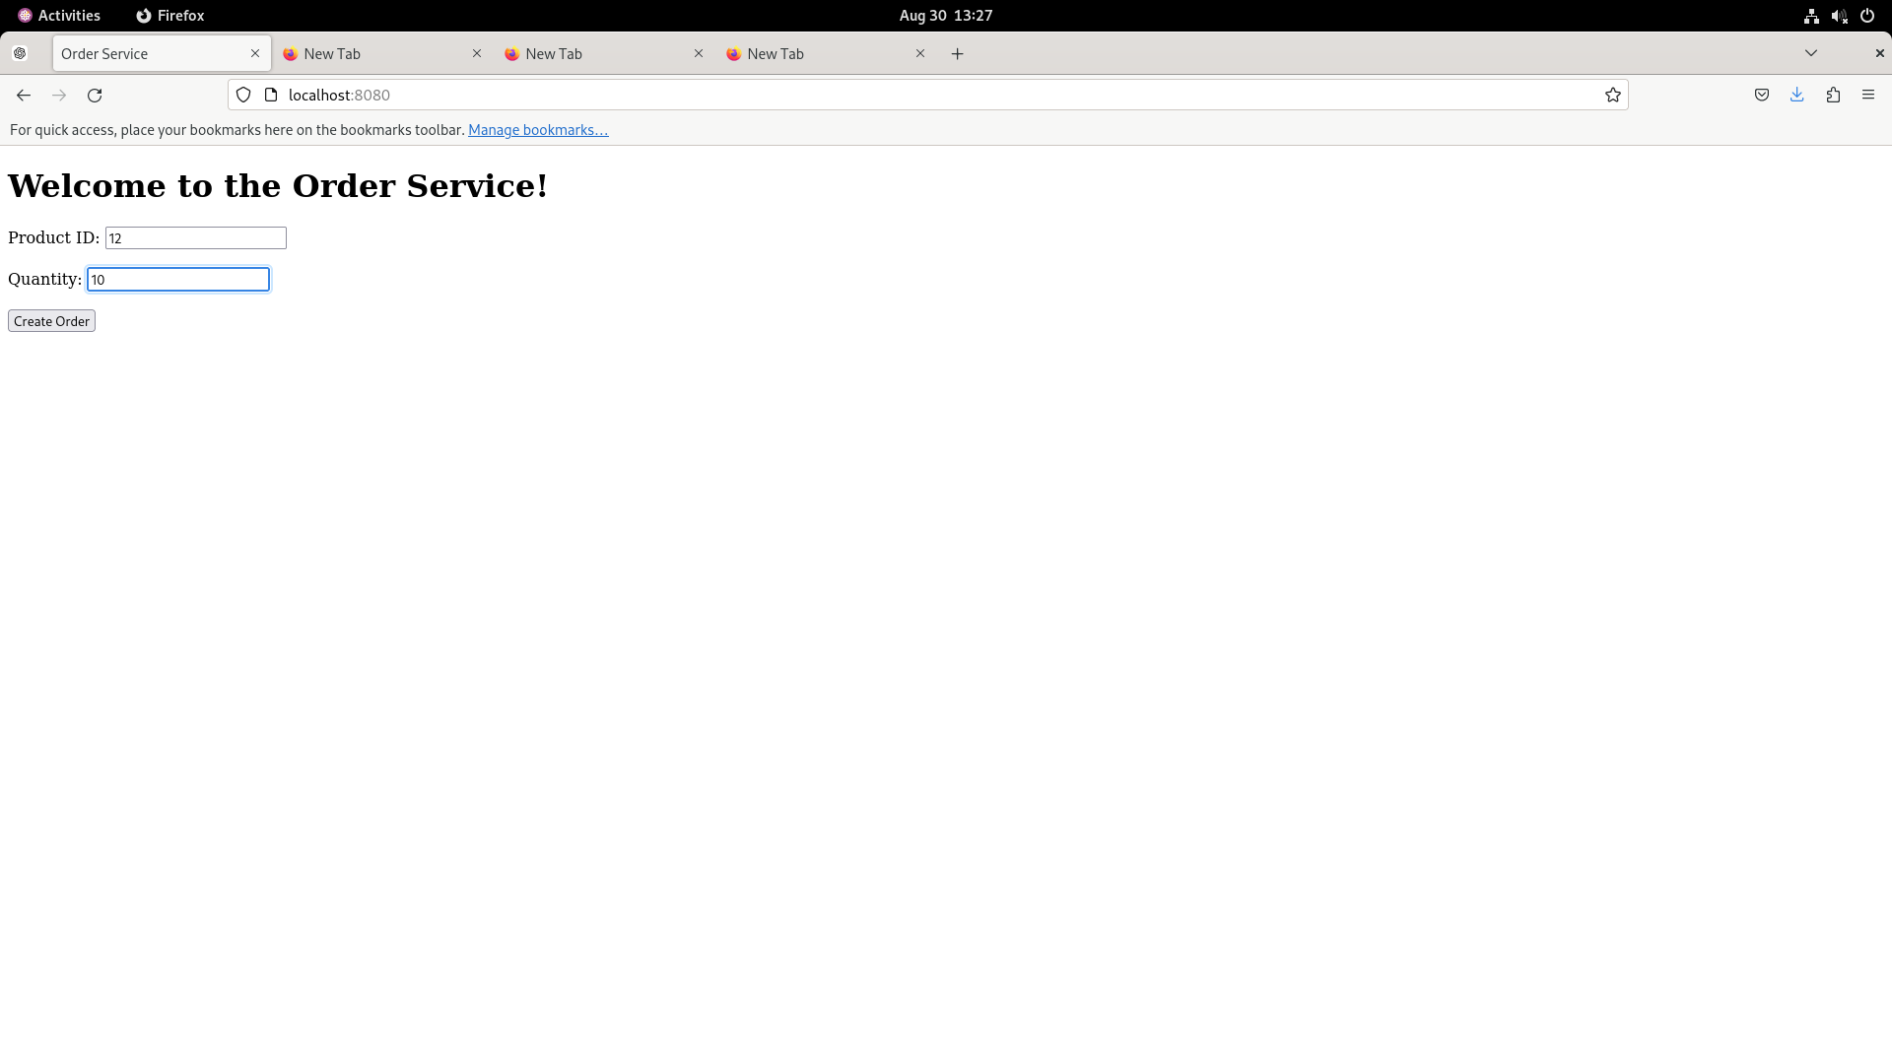


Slide 12
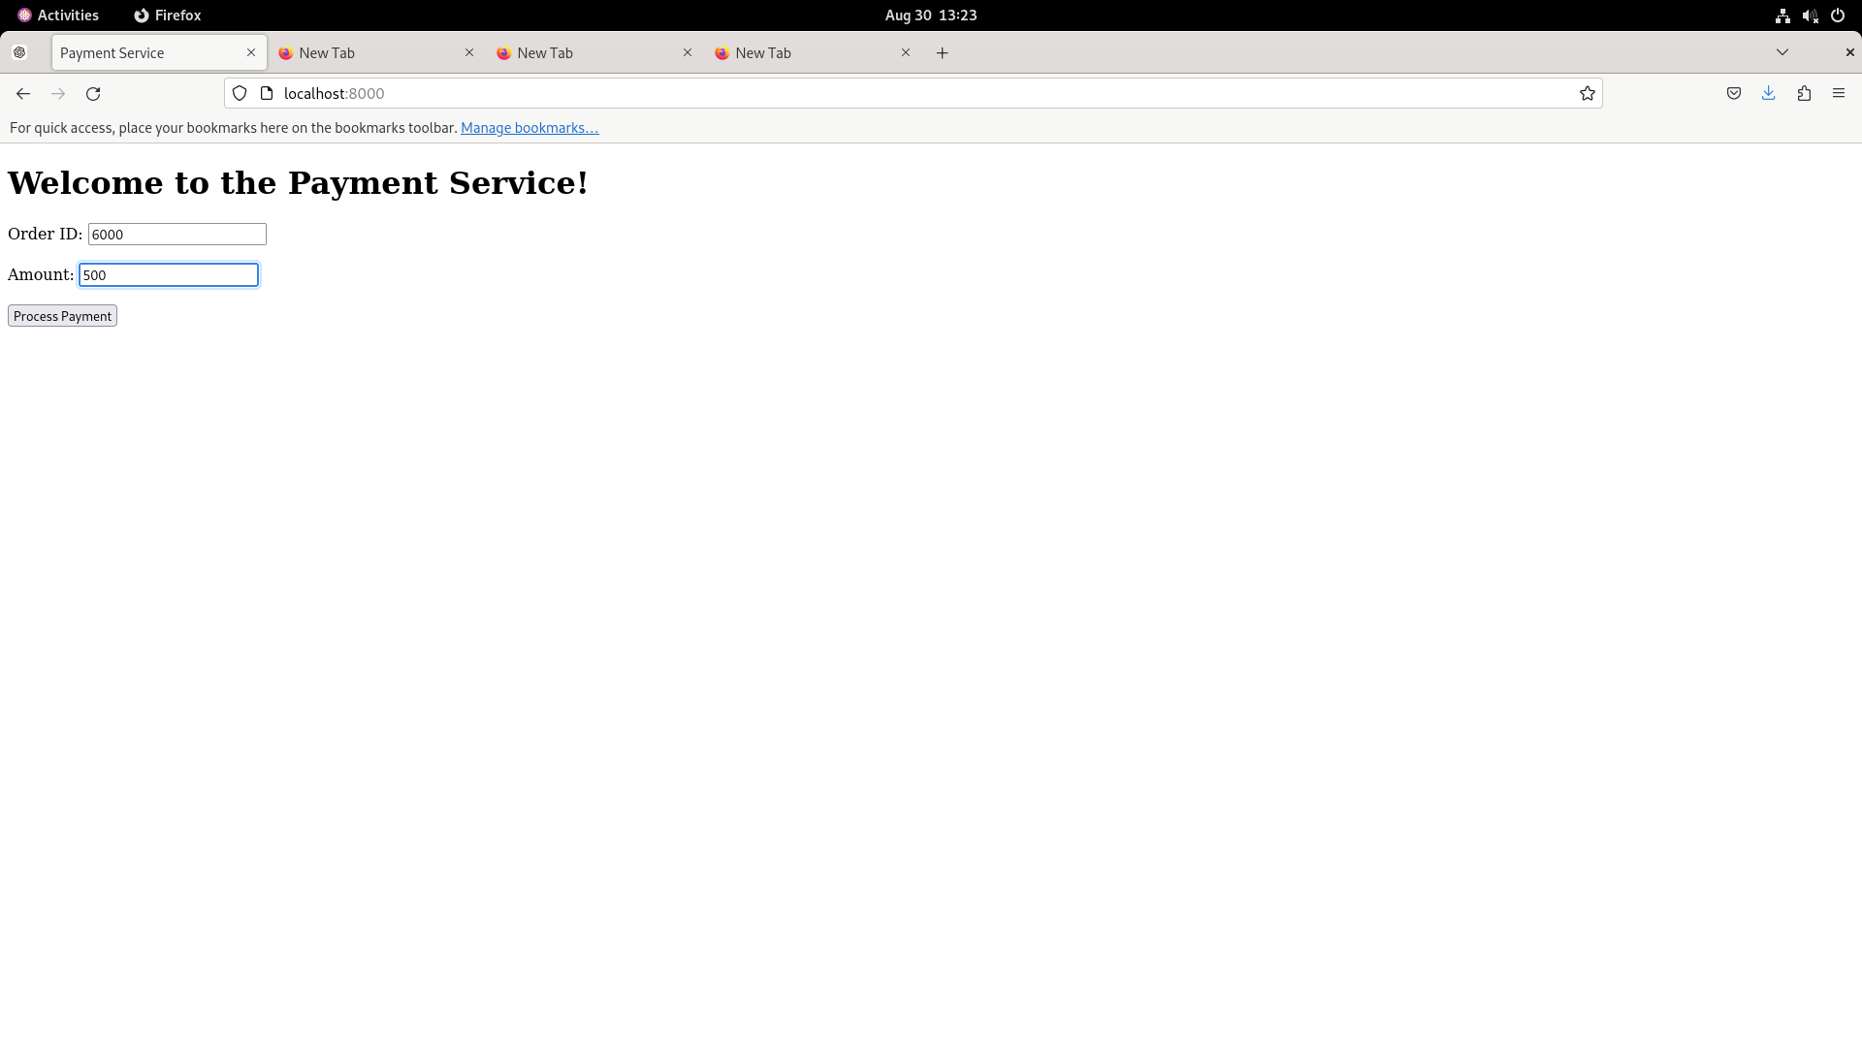
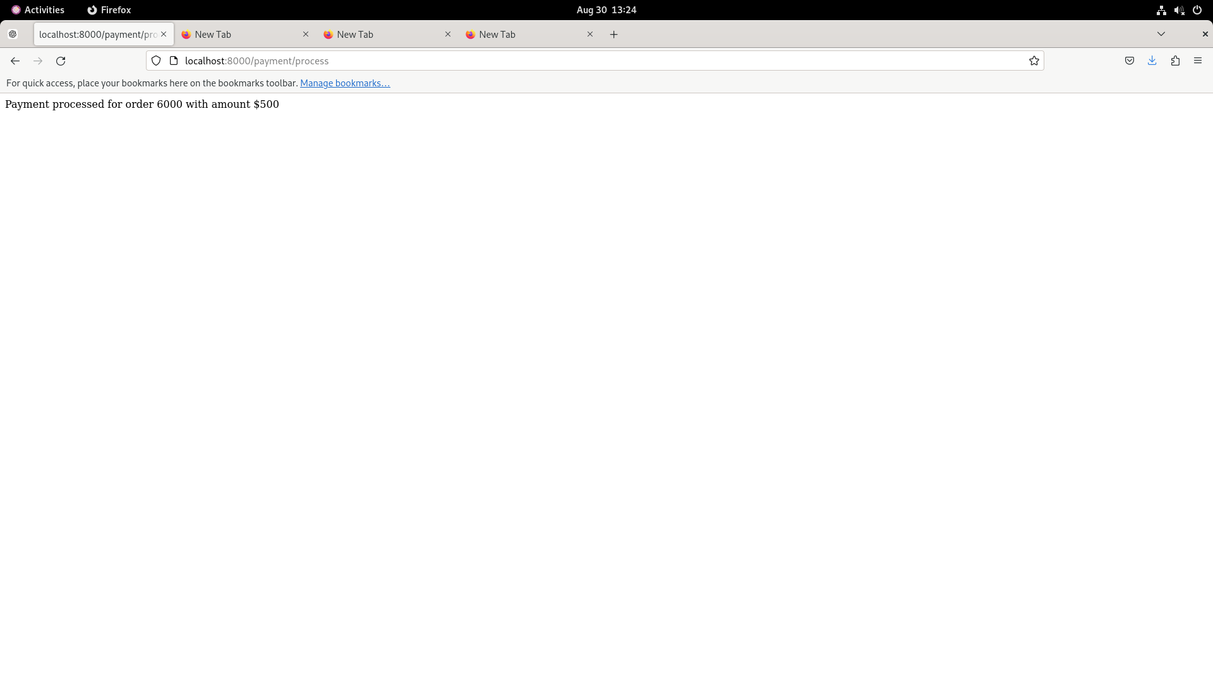
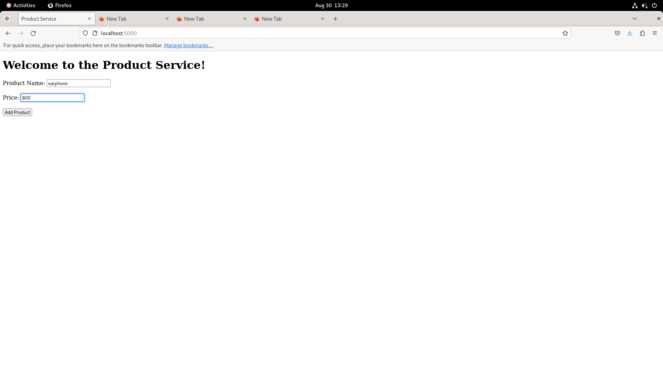


Slide 13
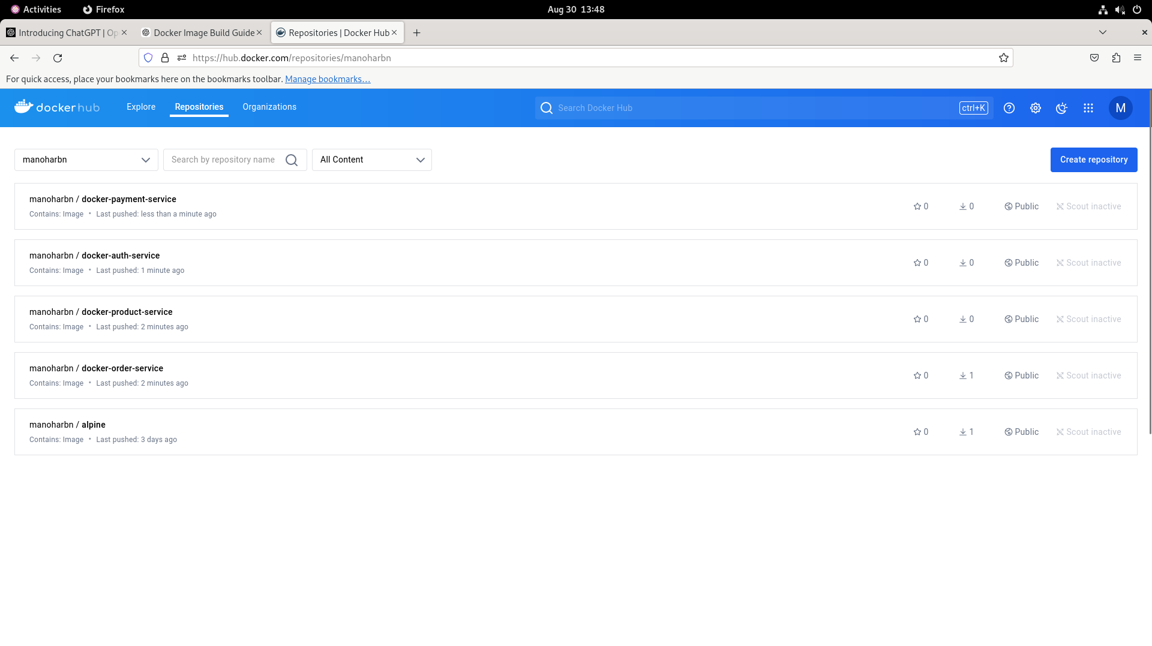
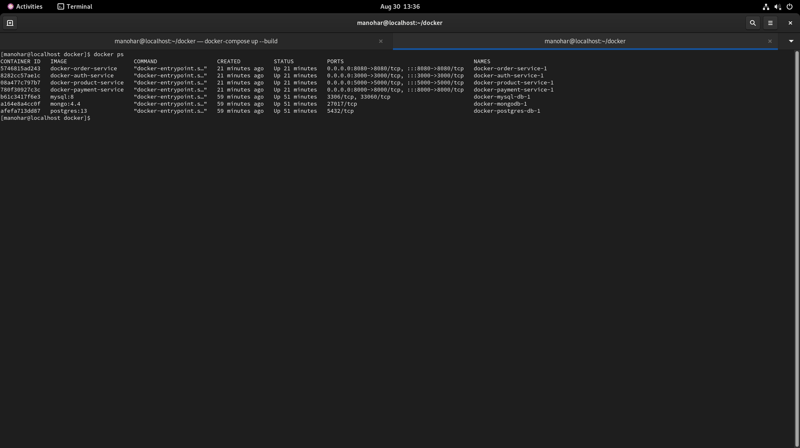
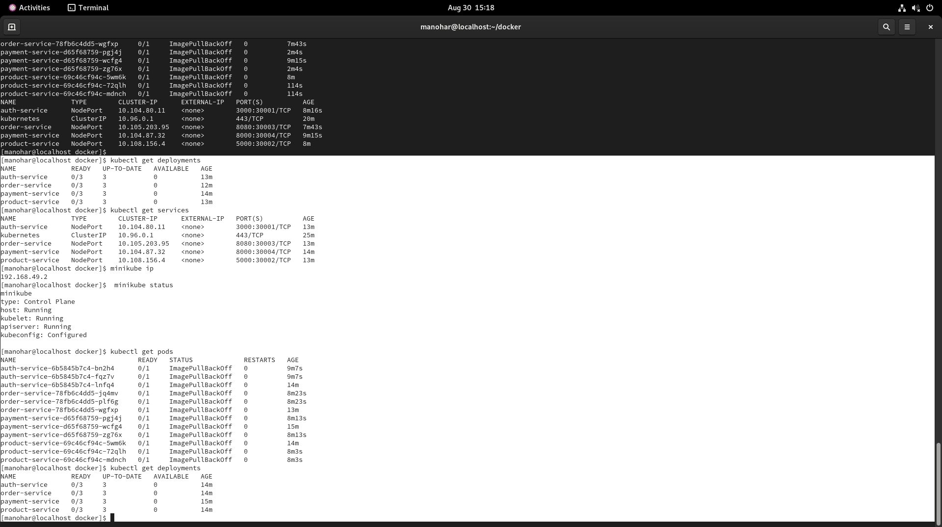
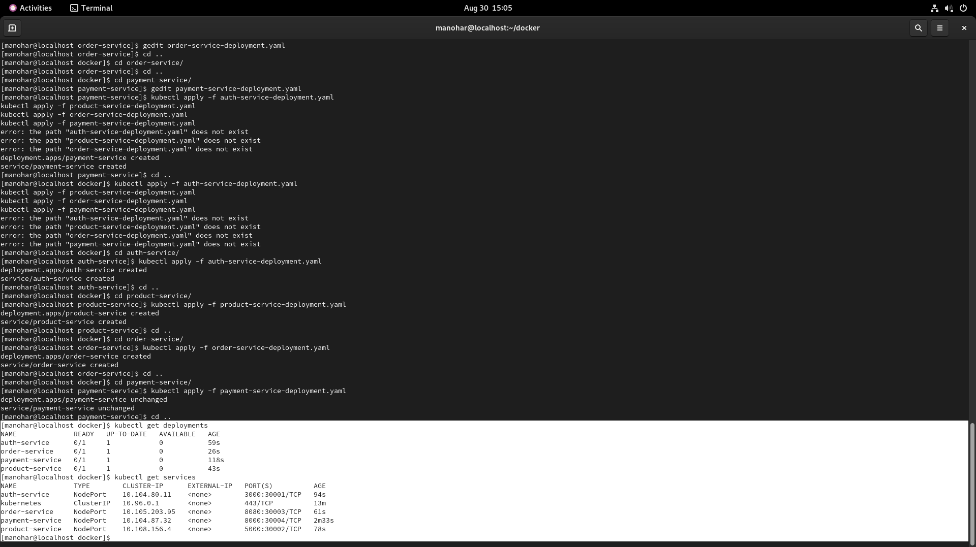

Slide 14

Thank you
Manohar B N, Graduate Trainee Engineer
Bhagyalaxmi , Graduate Trainee Engineer

