Slide 1







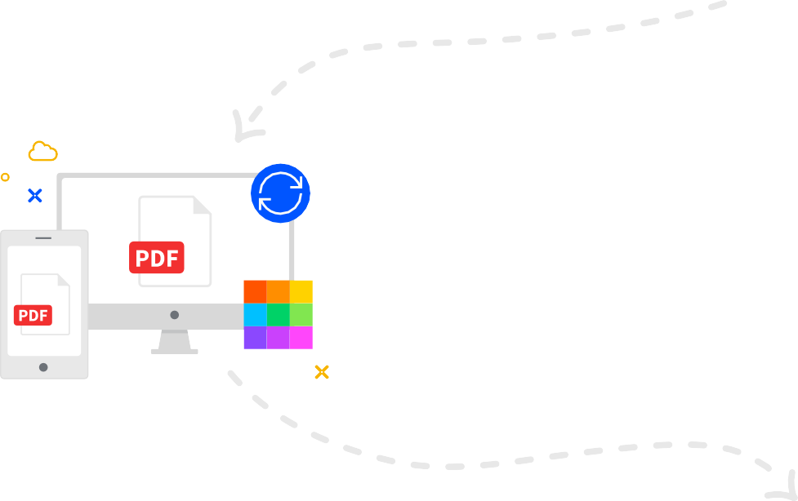
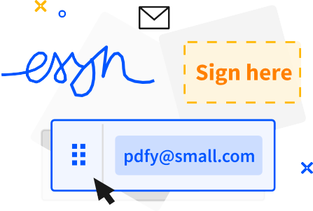
Welcome to Smallpdf
Ready to take document management to the next level?
Digital Documents—All In One Place
With the new Smallpdf experience, you can freely upload, organize, and share digital documents. When you enable the ‘Storage’ option, we’ll also store all processed files here.
Enhance Documents in One Click
When you right-click on a file, we’ll present you with an array of options to convert, compress, or modify it.
Access Files Anytime, Anywhere
You can access files stored on Smallpdf from your computer, phone, or tablet. We’ll also sync files from the Smallpdf Mobile App to our online portal
Collaborate With Others
Forget mundane administrative tasks. With Smallpdf, you can request e-signatures, send large files, or even enable the Smallpdf G Suite App for your entire organization.

