Slide 1
Cirrhosis Prediction
Project

Slide 2
Problem Understanding
Problem We are trying to Solve
Constraints
Scope
Objectives

Slide 3
Problem We are trying to Solve
Problems we generally face :
  We are not aware of Symptoms.
  We can’t decide the disease.
  Here, we are making predictions on the health of a person basis of the previous given health conditions.
  We are also making conclusion what are the factors affecting the Cirrhosis.

Slide 4
Constraints
Some form of interpretability.
Minimize RMSE and MAPE
Have to use more models for accuracy
Getting the Good model which will not overfit
Removal Of Multi Collinearity
Selection of Important Feature.

Slide 5
Scope
We got the enough data to prediction and analysis to get what we want.
We can add more feature in the future to add them in our analysis.
By using various model fittings on our data we can get the best accuracy.
In this way, We can retrain over model and there might be a possibility of getting good results.

Slide 6
Objectives
Work on the data to create the best analysis
  Key factors impacting CIRRHOSIS .
Develop a modelling framework
  To estimate weather person have cirrhosis.
  If the answer is yes then we will proceeds for further tests like stage and medications.

Slide 7
Data Preparation
From Dataset- We have gone through the given data and try to understand it and then we see some null values and unwanted data that will be remove in the next step.
Data Cleaning
  Variable transformation- Some of the variable are having type object because they contain some unwanted symbol and nan value in text format so which we replace with Numpy NaN value and then converted these columns into float data type.
  Dealing With Missing Value- As the data contains missing values so we filled the missing values using mode for categorical variables for the features Sex,Ascites,Hepatomegaly,Spiders and Edema.
  After completing the Data Cleaning we start the analysis on our data set.

Slide 8
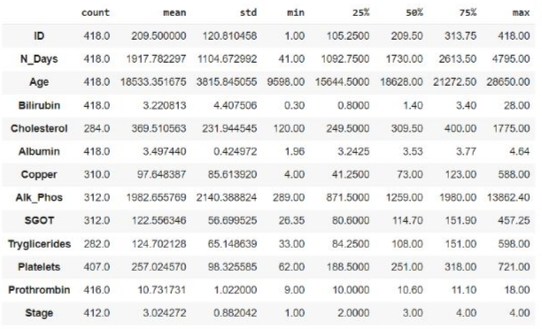
Analysis Of the Data

Slide 9
The dataset consists of following columns :
ID: unique identifier
N_Days: number of days between registration and the earlier of death, transplantation, or study analysis time in July 1986
Status: status of the patient C (censored), CL (censored due to liver tx), or D (death)
Drug: type of drug D-penicillamine or placebo
Age: age in [days]
Sex: M (male) or F (female)
Ascites: presence of ascites N (No) or Y (Yes)
Hepatomegaly: presence of hepatomegaly N (No) or Y (Yes)
Spiders: presence of spiders N (No) or Y (Yes)
Edema: presence of edema N (no edema and no diuretic therapy for edema), S (edema present without diuretics, or edema resolved by diuretics), or Y (edema despite diuretic therapy)
Bilirubin: serum bilirubin in [mg/dl]
Cholesterol: serum cholesterol in [mg/dl]
Albumin: albumin in [gm/dl]
Copper: urine copper in [ug/day]
Alk_Phos: alkaline phosphatase in [U/liter]
SGOT: SGOT in [U/ml]
Triglycerides: triglicerides in [mg/dl]
Platelets: platelets per cubic [ml/1000]
Prothrombin: prothrombin time in seconds [s]
Stage: histologic stage of disease (1, 2, 3, or 4)

Slide 10
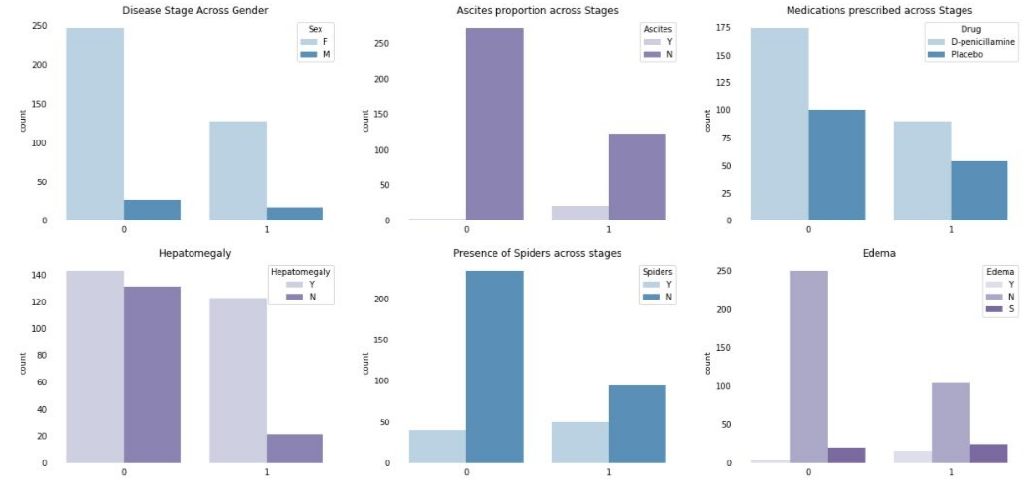
Univariate Analysis
There are some interesting insights if we observe closely. Take the case at Ascites, we observe that the rist of disease is higher with increase in Ascites. also presence of spiders has a positive relation with disease risk.
In Disease Stage Across Gender plot we can observe female are high. Coming to the medications prescribed across stage uses two types of medicines like D-penicillamine ad Placebo and that to D-penicillamine is mostly prescribed for female compared to male. Hepatomegaly and Spiders are common sign of liver disease and coming to our data we can clearly observe that Hepatomegaly and Spider are quite opposite when one is increases another is decreased.

Slide 11
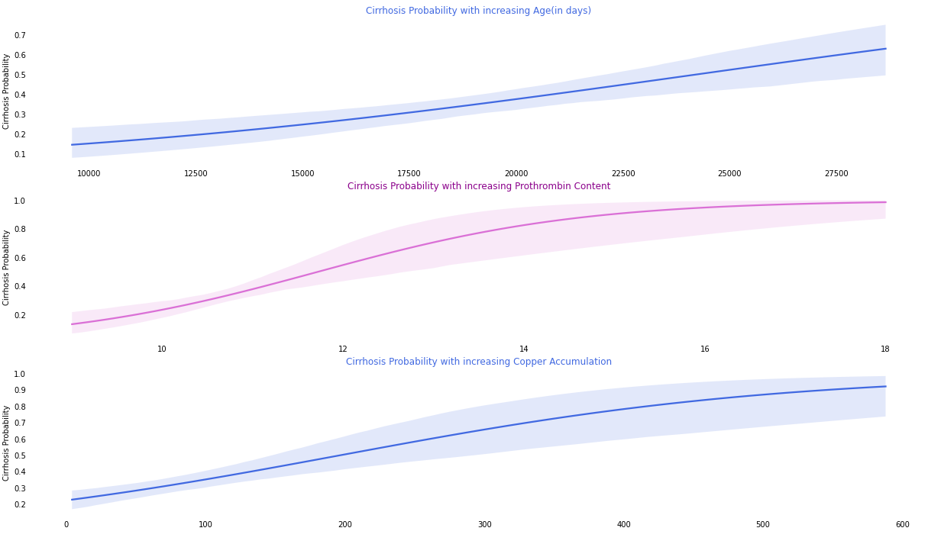
Univariate Analysis
Looks like the data checks with our intuition. These parameters indeed increase the risk of the disease.We can also observe some features such as Platelets, Albumin, Cholesterol where the probability of disease decrease with increase in feature value. Lets tally that with some more regression plots.

Slide 12
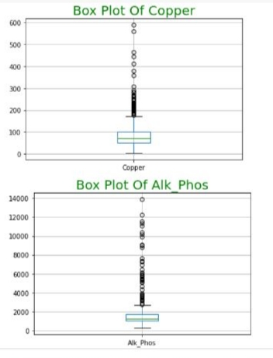
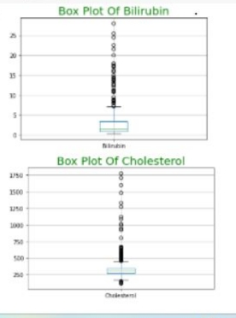
BoXplots
There are lots of feature which are having outliers.

Slide 13
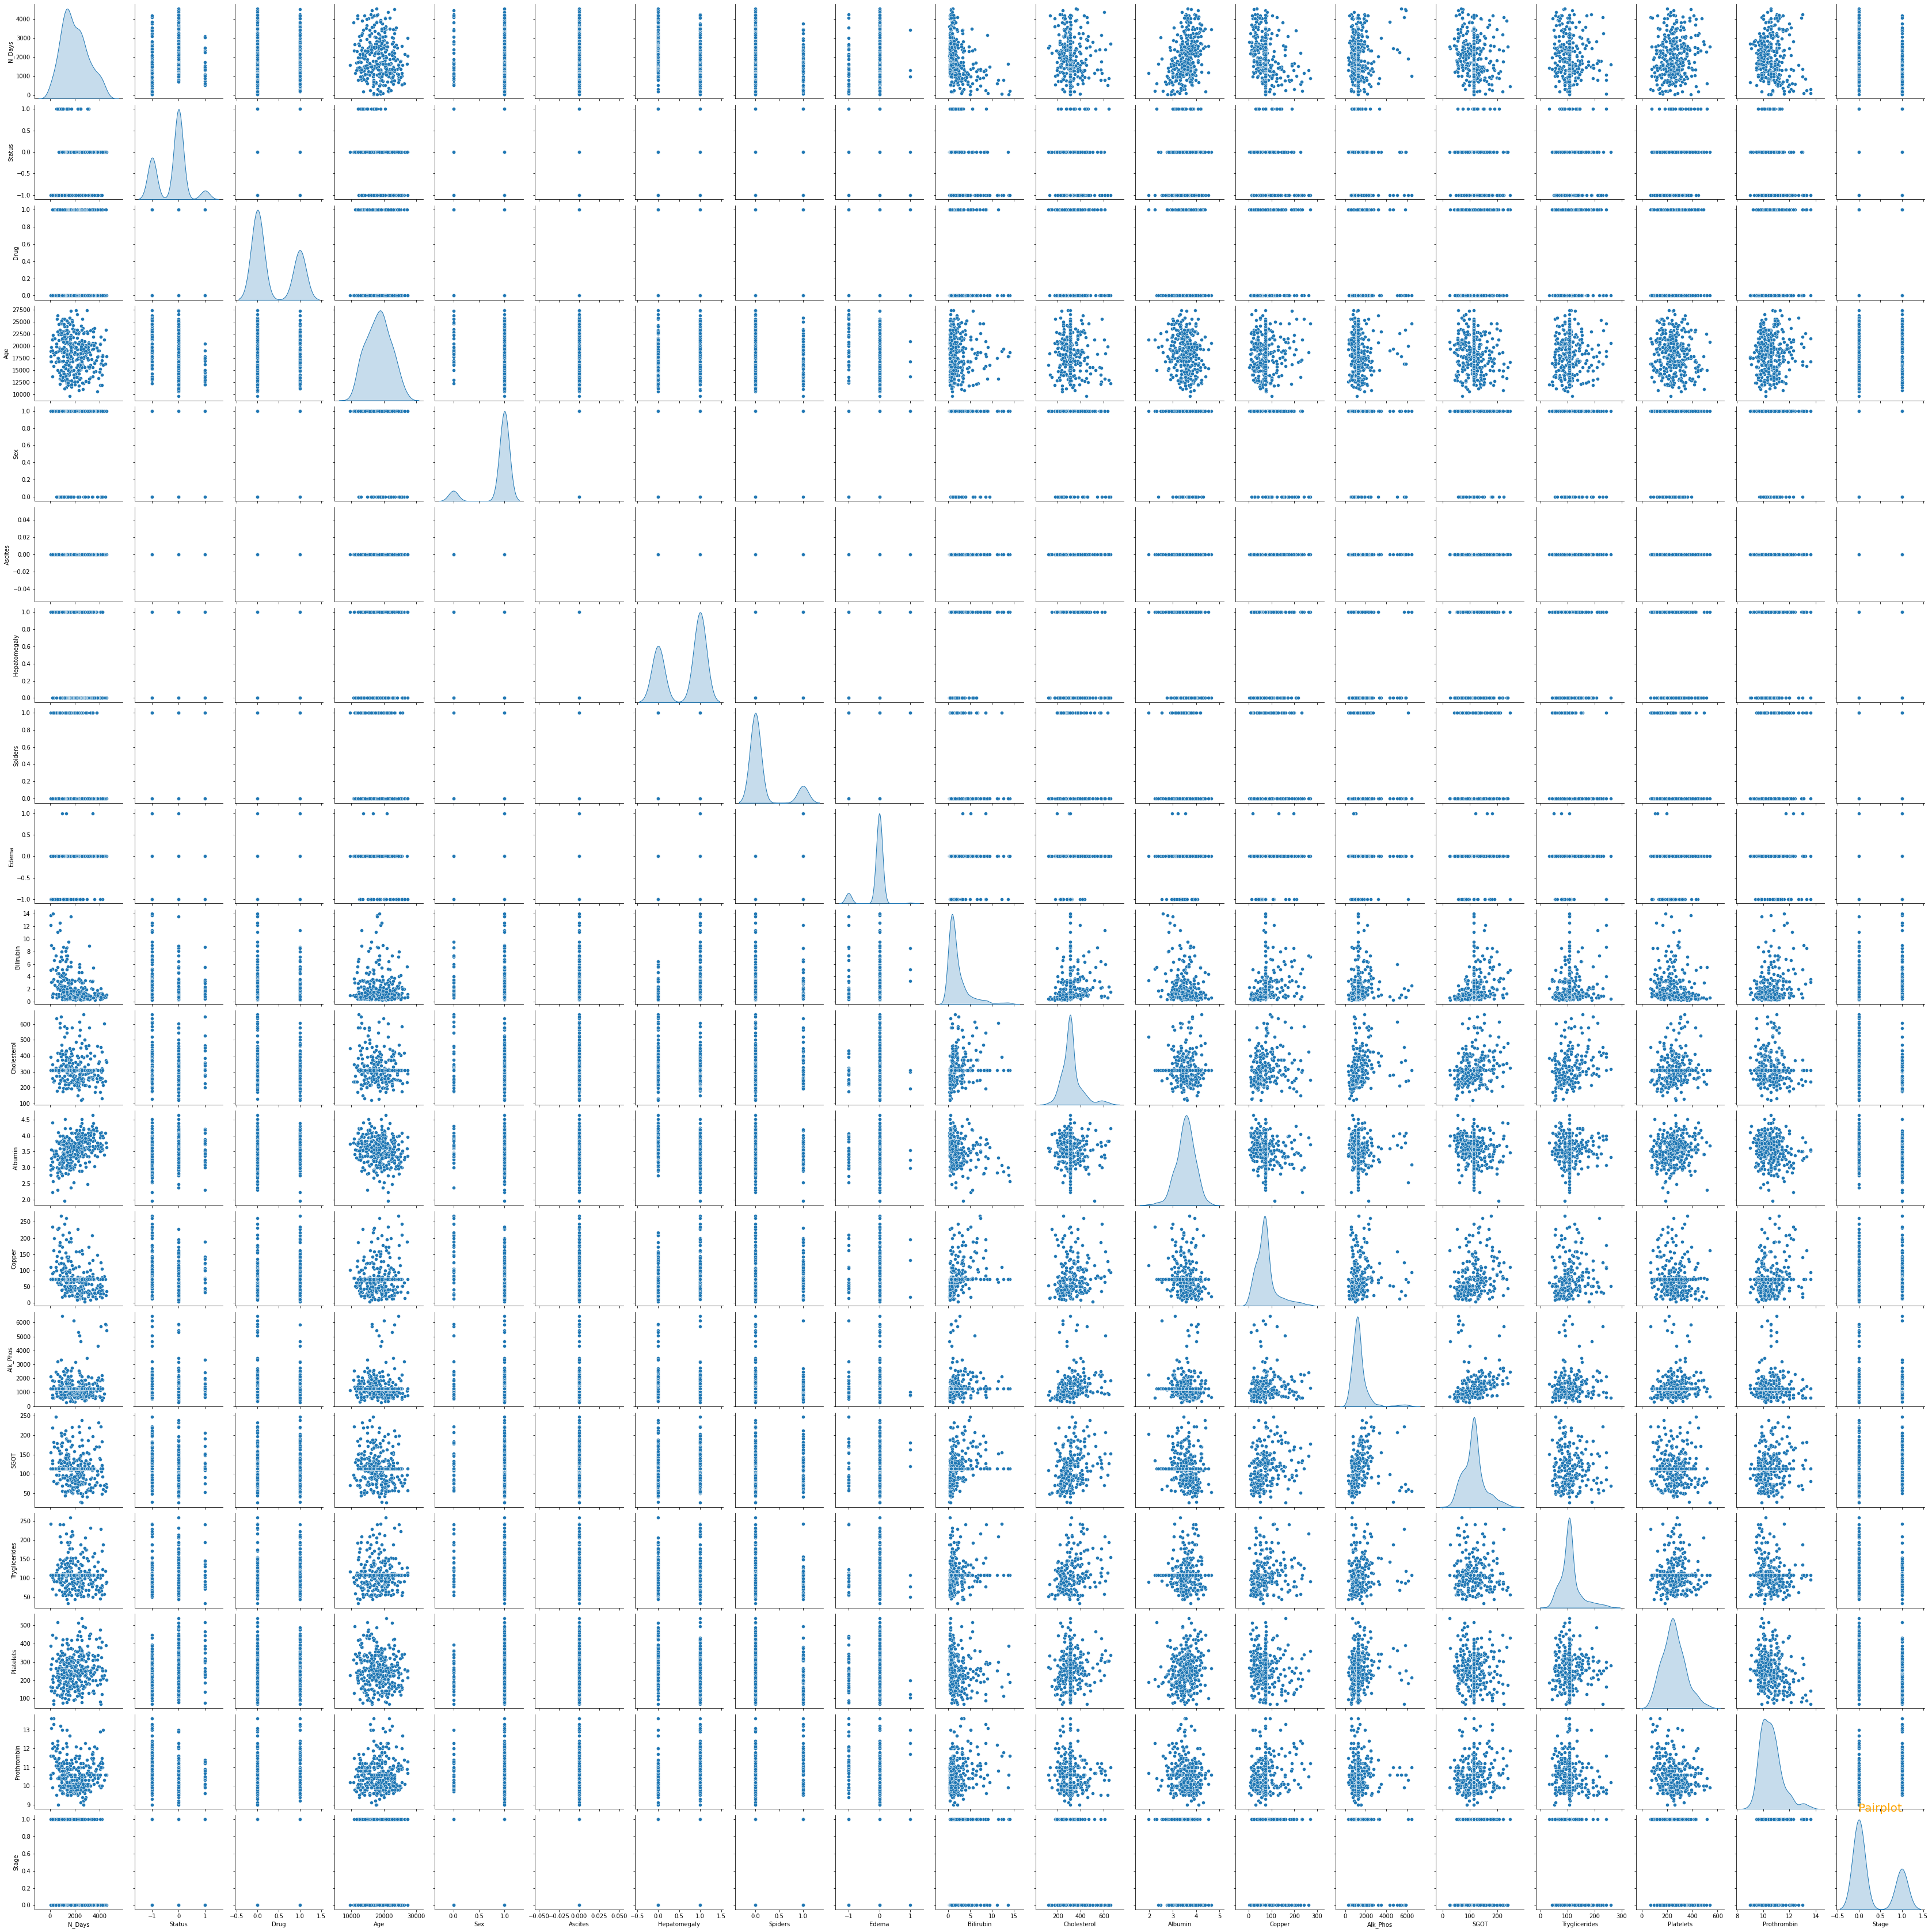
PairPlot

Slide 14
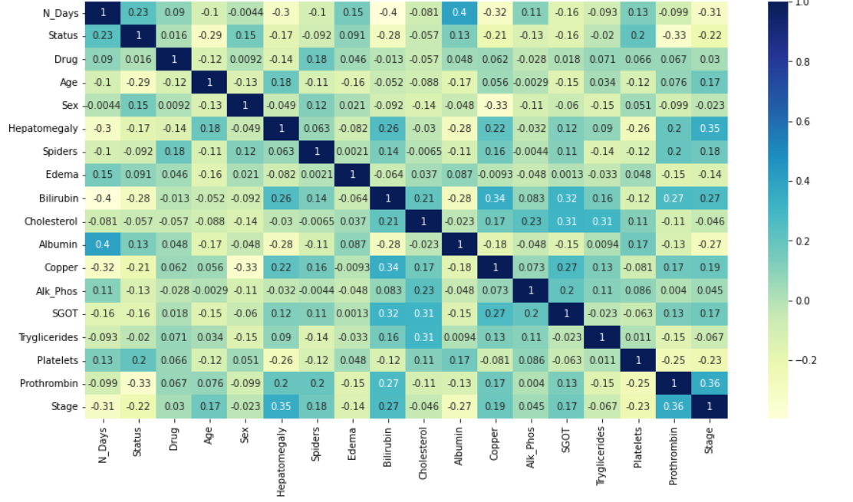
Heatmap

Slide 15
Insights -HeatMap

Slide 16
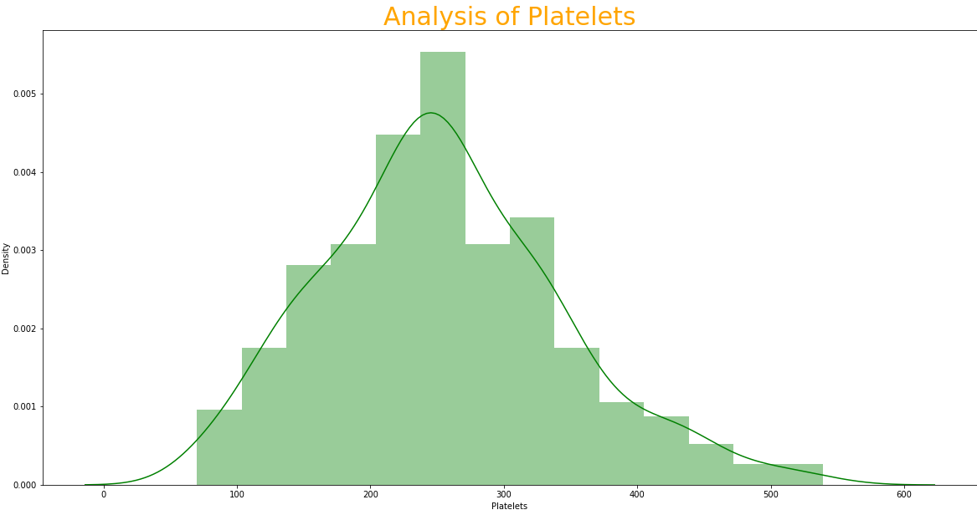
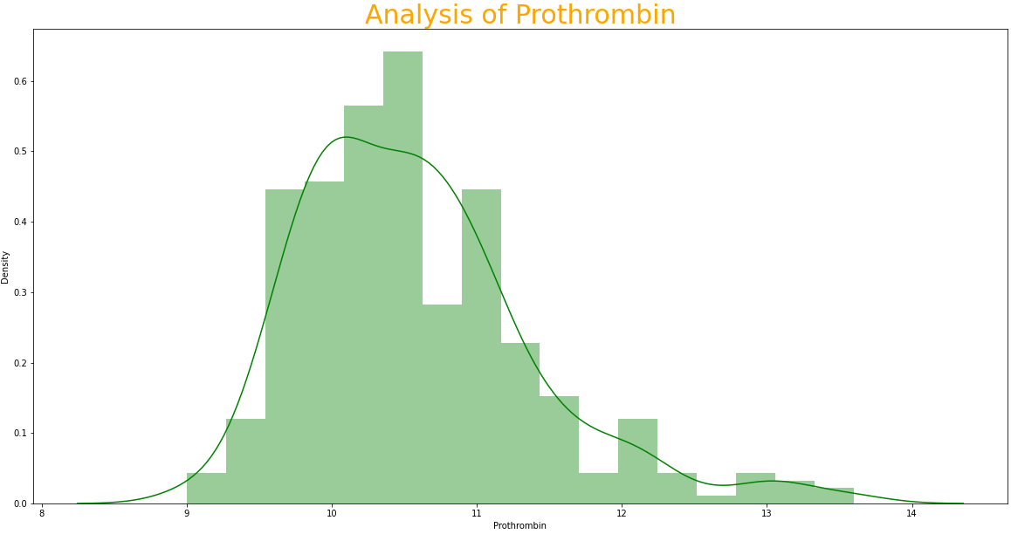
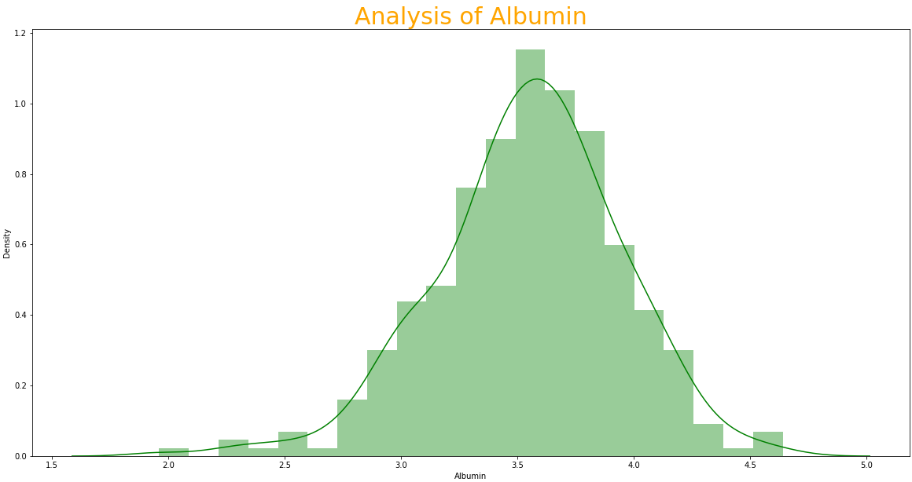
Outlier Removal

Slide 17
Model Approaches Used
LogisticRegression
RandomForestClassifier
LinearSVM
DecisionTreeClassifier
Naïve Bayes Classifier
KNearestNeighbour Classifier

Slide 18
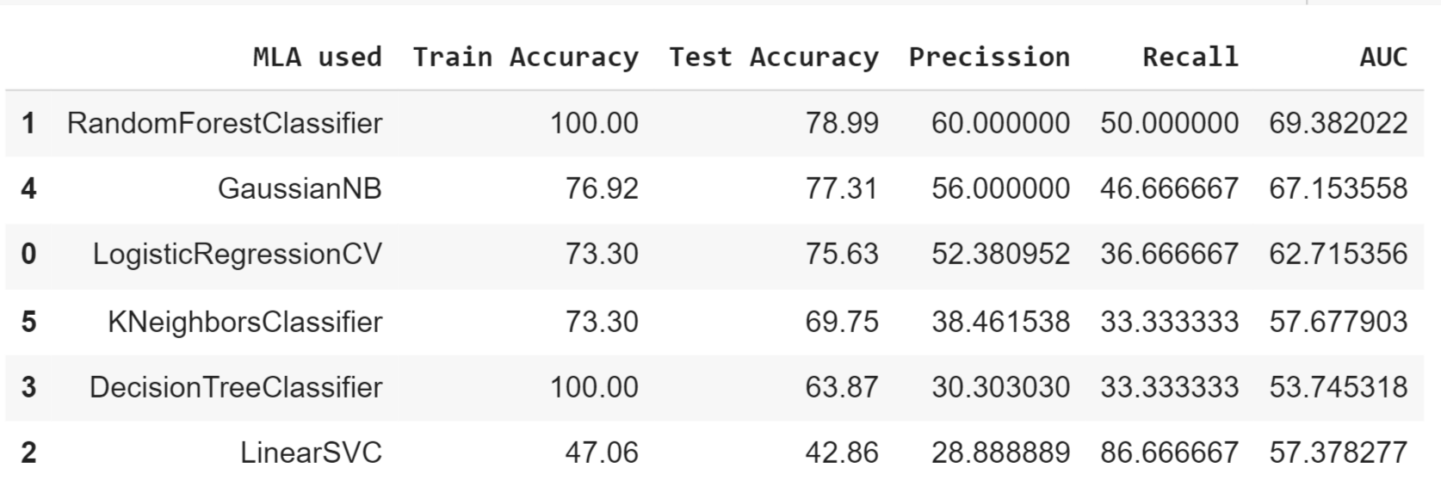
Performance Metrices

Slide 19
Model Insights
LogisticRegression :- Here as it is a regressor we can perform classification as the target variables are two.I have got more test accuracy than train accuracy
RandomForestClassifier :-It gives the highest test accuracy and train accuracy.
LinearSVM :- Linearsvm shows the lowest performance that means it is not a good model now .It may be due training and testing set differences
DecisionTreeClassifier :-As it gave 100 % train accuracy it failed at the testing test .so it cannot be considered as the best fit .
Naïve Bayes Classifier :-It is a probabilistic classifier it classifies based on the bayes theorem.
KNearestNeighbour Classifier :-It doesn’t train the model before the testing it only makes prediction when the test set is provided.
Recommendations
In my point of view I highly recommend the Random Forest Classifier to predict the output.As it shows the highest train accuracy and test accuracy

Slide 20
Conclusion
The ensemble model has performed well compared to that of linear, Decision Tree.
The best performance is given by the Random Forest model.
The top key features that effects the cirrhosis are :Age, Prothrombin, Copper
Features like Ascites and Cholestrol doesn’t show more effect on the disease.
We can conclude from above that Random Forest Classifier is giving better results compared to that of normal Methods.

