Slide 1

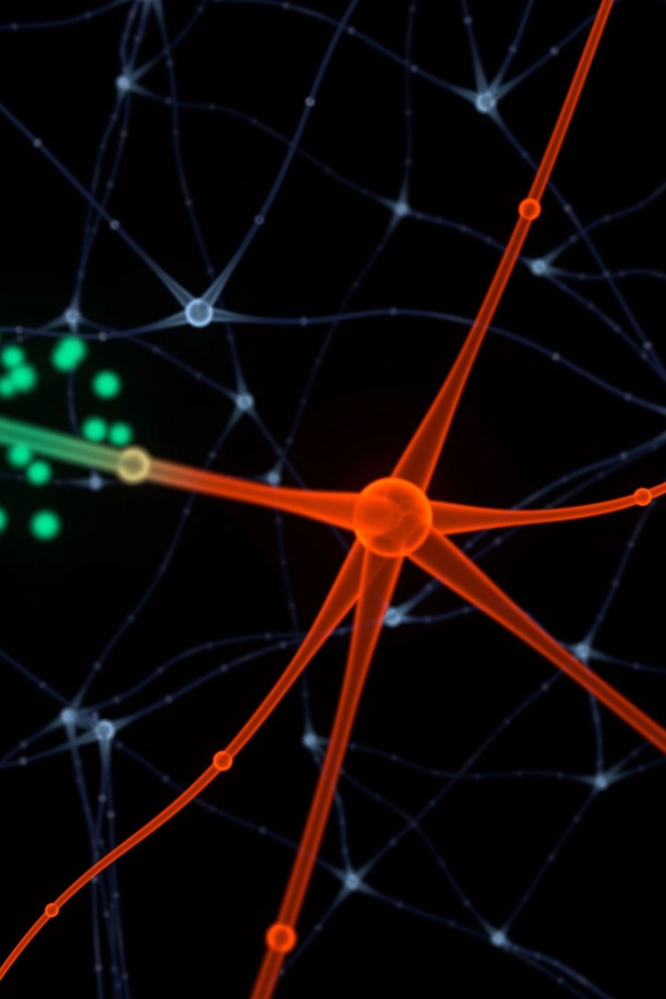

Introduction to Artificial Neural Networks
ANN (Artificial Neural Network) is a powerful computer Algorithm modelled after human brain.
It can learn complex patterns and make prediction based on that learning.
it has been used in a wide variety of fields like NLP, image processing and data analysis.
MA
by Manoj Acharya
Notes:
.The history of ANN lies deep into 1957 when Frank Rosenblat first defined the fundamental design block of the ANN known as perceptron.
Perceptron is the simplest component of a neural network which add weight and biases to the input and then create an output for the next perceptron through an activation function.
An ANN consists of input, output and might be more than one hidden network in between.
If the network contains only one hidden network, it is called shallow network.
Similarly if network contains more than one hidden network, thank it is called dense network

Slide 2
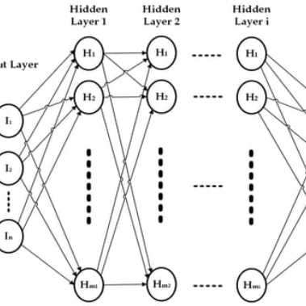
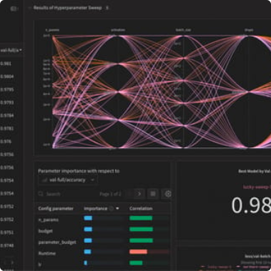
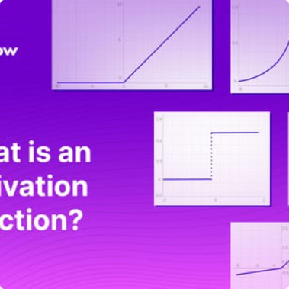
The Structure of Artificial Neural Networks
Interconnected Neurons
Weights and Biases
Activation Functions
The structure of an ANN consists of interconnected nodes called neurons. Each neuron is organized into different layers, such as input, hidden, and output layers.
Each neuron has a weight and a bias, which determine the strength and impact of their contribution to the output of the network. Adjusting these values is crucial for accurate predictions.
Activation functions introduce non-linearities and allow for complex mappings between inputs and outputs. Different activation functions are used depending on the type of problem being solved.
Notes:
A perceptron behavior mimics neurons of human brain we will call it neuron next onwards
Each neuron is connected to each other and they work in fast foreward mode only.
Each neuron consists of weights and biases and optionally an activation function
We will cover it the simplest way in next slide

Slide 3
Neuron in ANN
x1
* w1
+ b1
f(x)
y
x2
output
* w2
+ b2
+ b3
x3
* w3

Slide 4
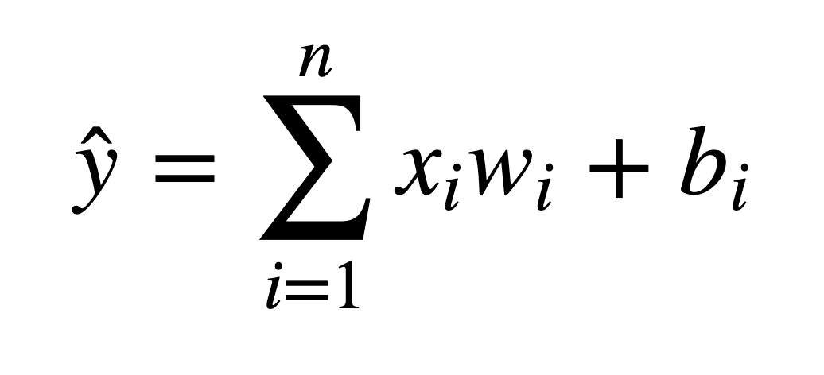
Neuron in ANN
x1
* w1
f(x)
y
x2
output
* w2
x3
* w3
B=b1 + b2 + b3 + …+bn

Slide 5
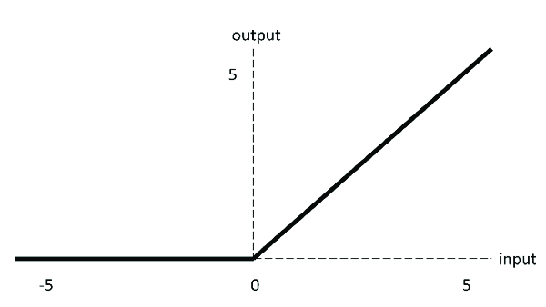
Activation Function RELU

Slide 6
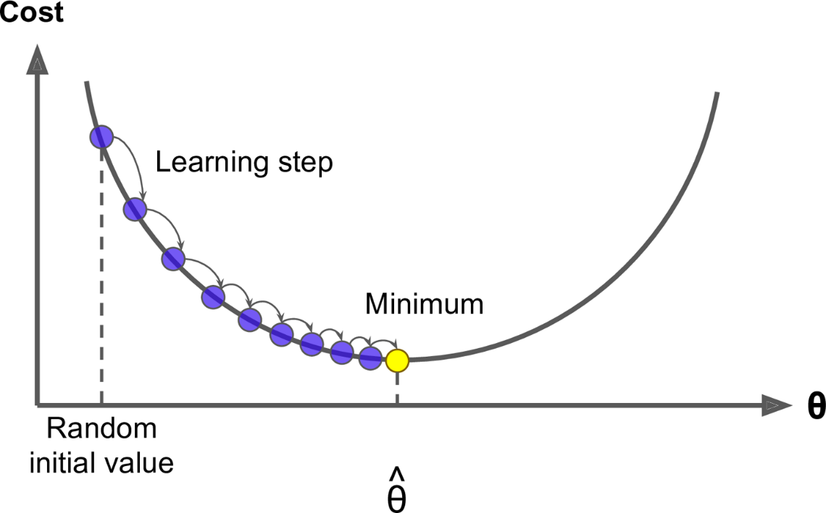
Optimizer - ADAM
Gradient descent /
Learning rate

Slide 7
Training ANNs for Real-World Applications
1
2
3
Labeled Training Data
Iterative Optimization
Loss Functions
To train an ANN, we need a lot of high-quality labeled data. This data is used to adjust the weights and biases of the neurons in the network in order to make more accurate predictions.
Training an ANN is an iterative process. We repeatedly tweak the weights and biases and test the network's performance on a validation set until we reach our desired level of accuracy.
Loss functions measure the difference between the predicted output and the true value. This metric helps us understand how well the network is performing and provides feedback on how to adjust the weights and biases.

Slide 8
Backpropagation and Other Training Techniques
1
Backpropagation
Backpropagation is a common technique used to train ANNs. It works by iteratively adjusting the weights and biases of neurons in the network in reverse order, starting from the output layer and working backward through the hidden layers.
Convolutional Neural Networks
2
CNNs are a type of ANN that's particularly good at analyzing visual data, such as images and videos. They use convolutional layers to extract features from the input data and reduce its dimensionality.
3
Recurrent Neural Networks
RNNs are designed to work with sequences of data, such as text or audio. They use feedback loops to store information about previous inputs and make predictions based on that context.

Slide 9
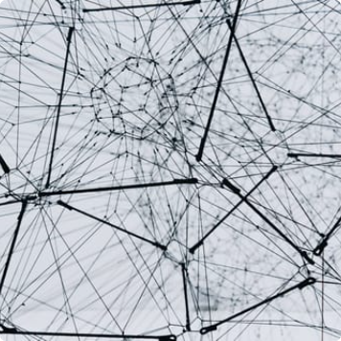
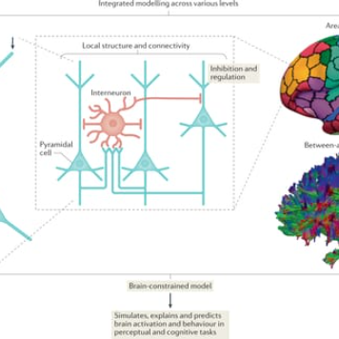
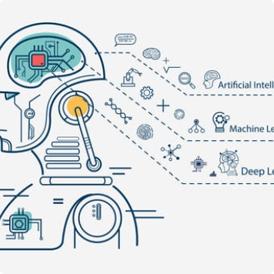
The Future of Artificial Neural Networks
New Research and Advancements
Potential for Breakthroughs
The Role of Machine Learning
Researchers are constantly exploring new architectures, algorithms, and techniques to improve the performance of ANNs and extend their capabilities. The future of ANNs is bright!
ANNs have the potential to unlock major breakthroughs in fields like medicine, climate science, and robotics. We've only scratched the surface of what's possible with these powerful tools.
ANNs are just one example of the exciting developments in machine learning. Together with other techniques like reinforcement learning and unsupervised learning, they're transforming the way we approach complex problems in all areas of life.

Slide 10

Conclusion
1
ANNs are powerful machine learning tools
2
ANNs have a wide range of applications
They're used in fields like image and speech recognition, natural language processing, and time series forecasting.
They're inspired by the human brain and can learn complex patterns from data to make predictions.
3
ANNs are continually advancing
Researchers are working to improve their performance and extend their capabilities, unlocking new breakthroughs and discoveries along the way.

