Slide 1


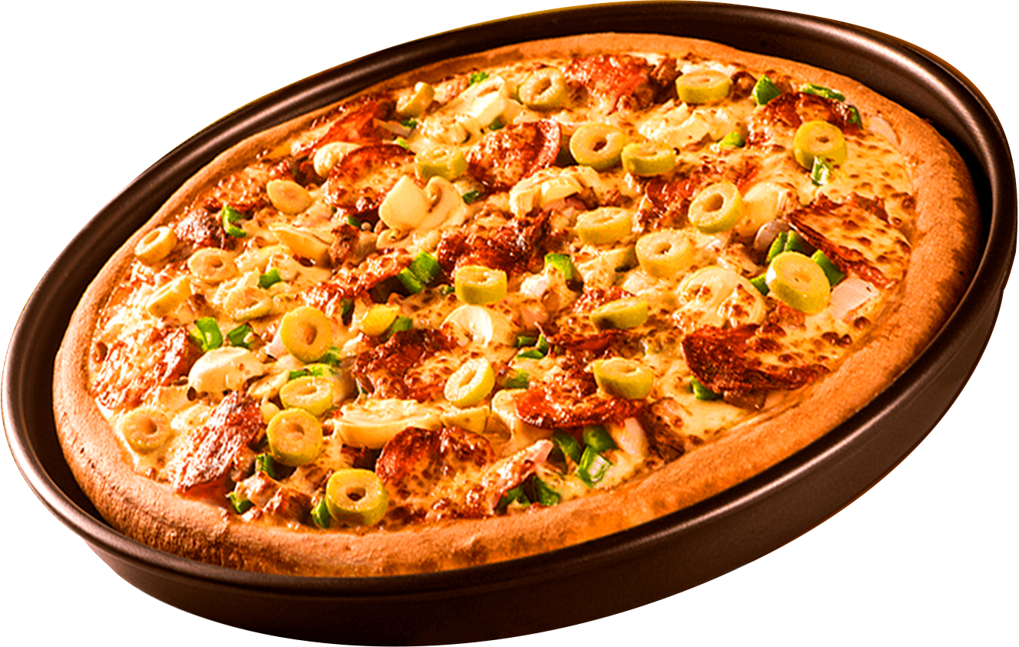
PIZZA SALES PROJECT USING SQL
by MANOJ KUMAR

Slide 2
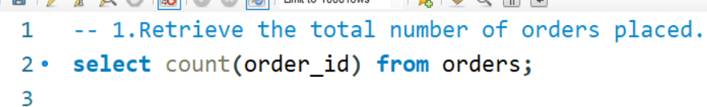
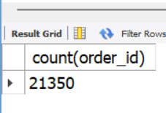
1.RETRIEVE THE TOTAL NUMBER OF ORDERS PLACED.

Slide 3
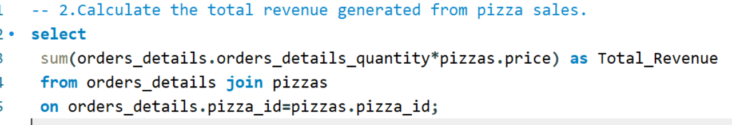
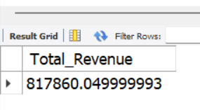
2.CALCULATE THE TOTAL REVENUE GENERATED FROM PIZZA SALES.

Slide 4
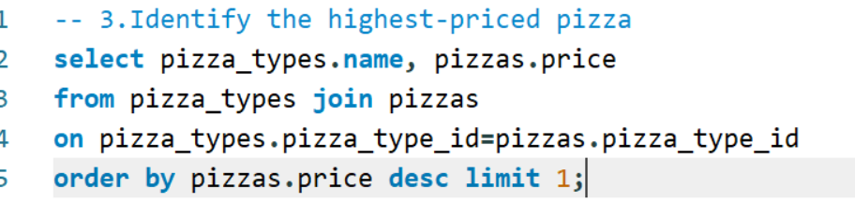
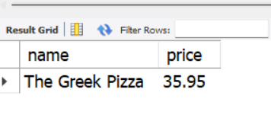
3.IDENTIFY THE HIGHEST-PRICED PIZZA

Slide 5
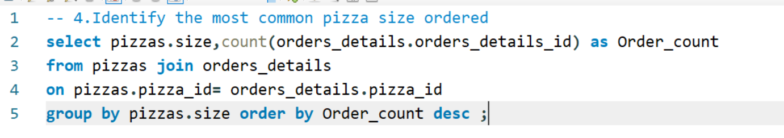
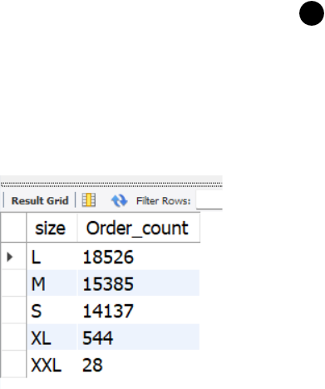
4.IDENTIFY THE MOST COMMON PIZZA SIZE ORDERED

Slide 6
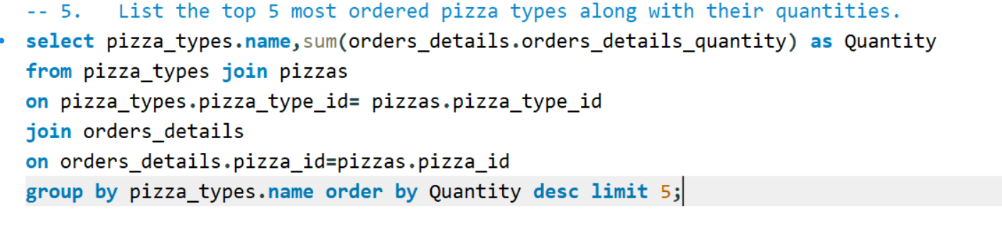
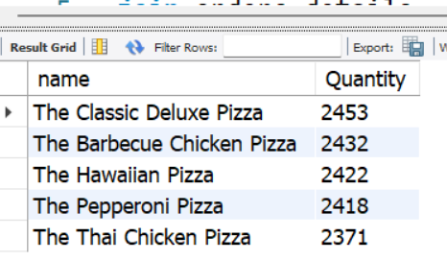
5. LIST THE TOP 5 MOST ORDERED PIZZA TYPES ALONG WITH THEIR QUANTITIES.

Slide 7
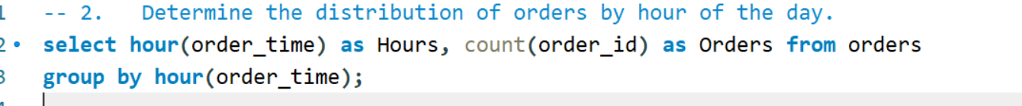
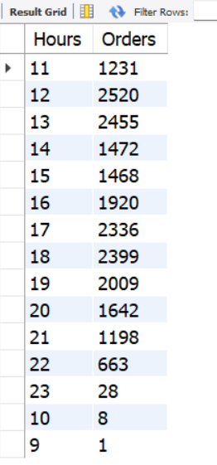

6. JOIN THE NECESSARY TABLES TO FIND THE TOTAL QUANTITY OF EACH PIZZA CATEGORY ORDERED.

Slide 8
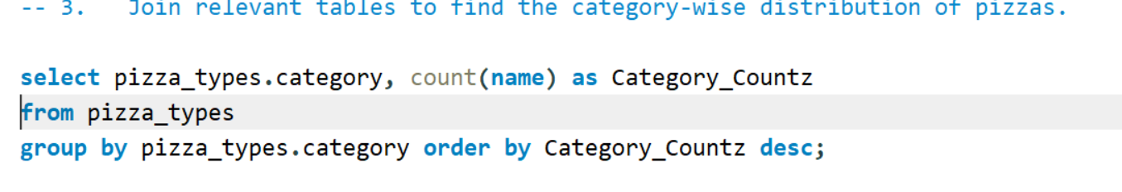
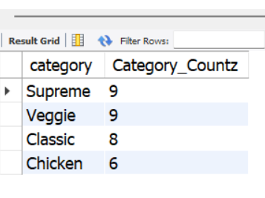
7. JOIN RELEVANT TABLES TO FIND THE CATEGORY-WISE DISTRIBUTION OF PIZZAS.

Slide 9
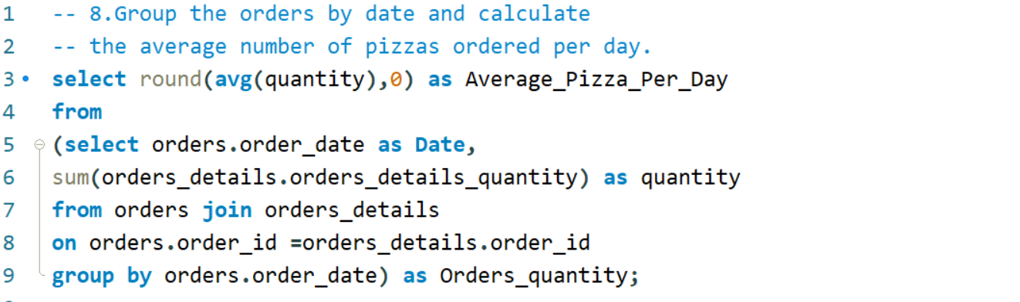
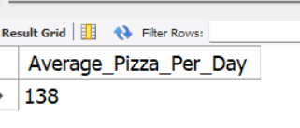
8.GROUP THE ORDERS BY DATE AND CALCULATE THE AVERAGE NUMBER OF PIZZAS ORDERED PER DAY.

Slide 10
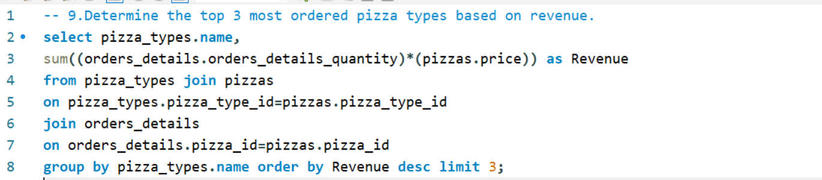
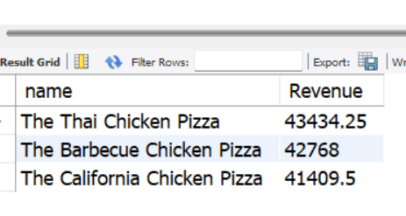
9.DETERMINE THE TOP 3 MOST ORDERED PIZZA TYPES BASED ON REVENUE.

Slide 11
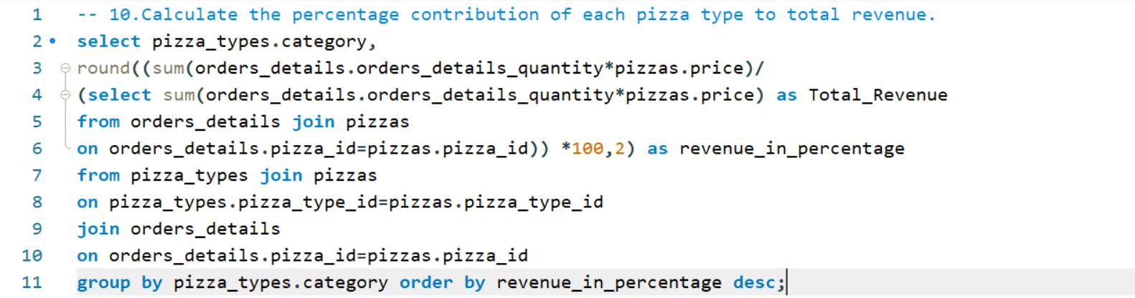
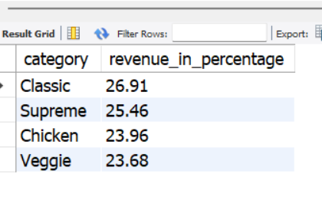

10.CALCULATE THE PERCENTAGE CONTRIBUTION OF EACH PIZZA TYPE TO TOTAL REVENUE.

Slide 12
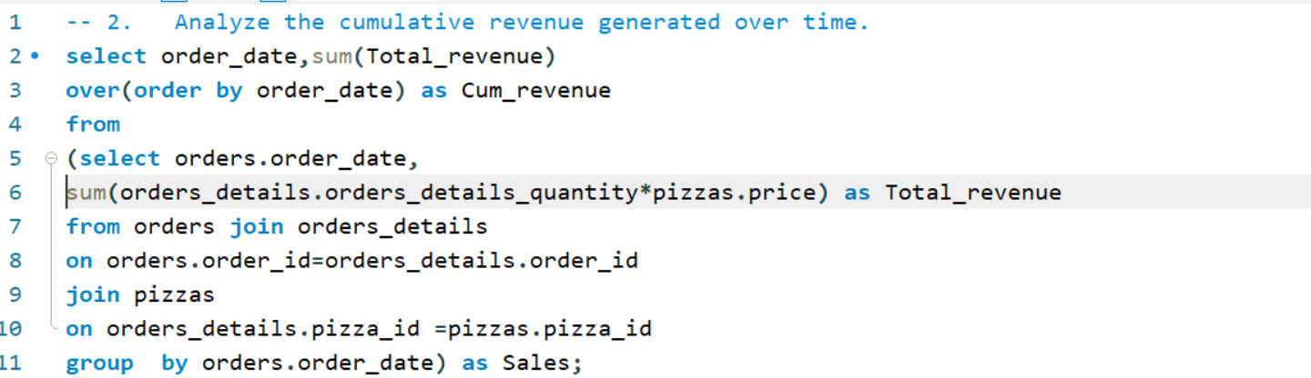
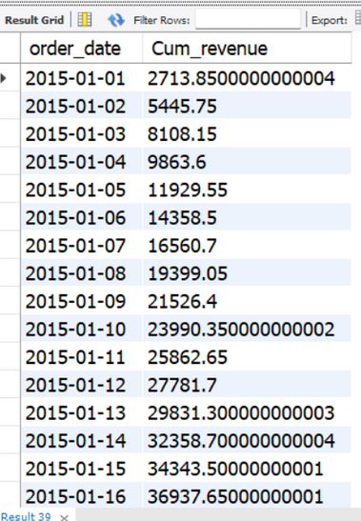
11.ANALYZE THE CUMULATIVE REVENUE GENERATED OVER TIME.

Slide 13
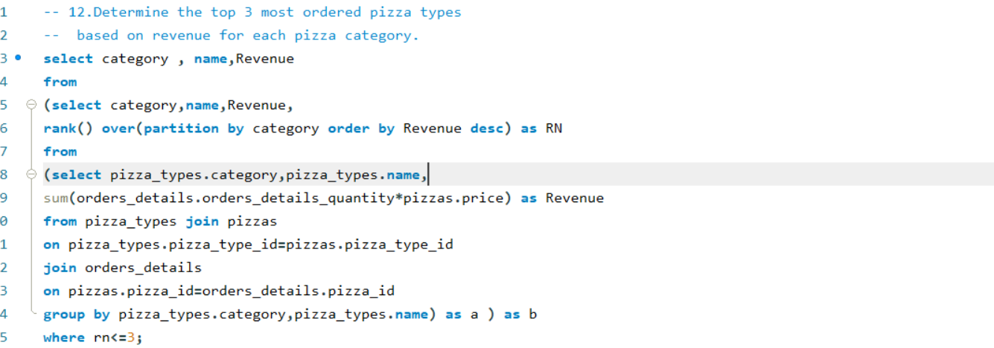
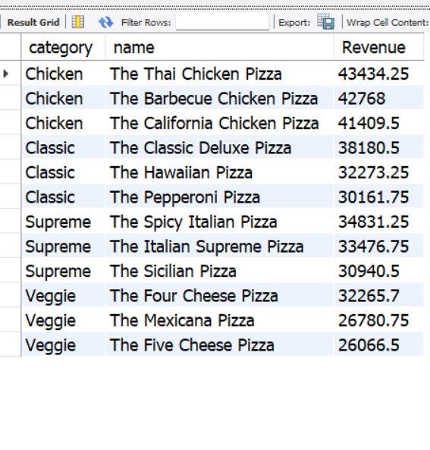
12.DETERMINE THE TOP 3 MOST ORDERED PIZZA TYPES BASED ON REVENUE FOR EACH PIZZA CATEGORY.

Slide 14
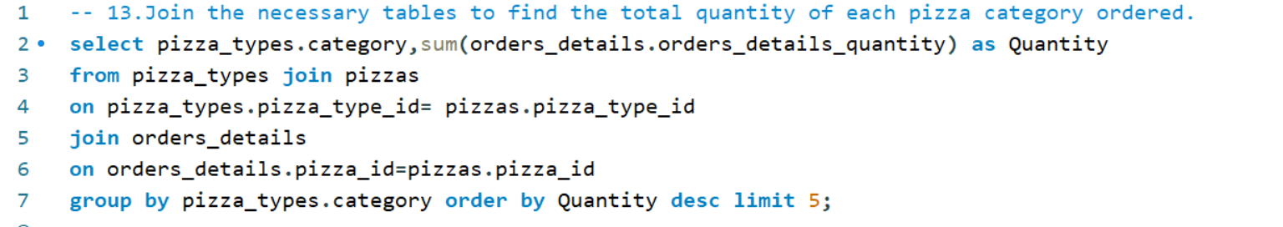
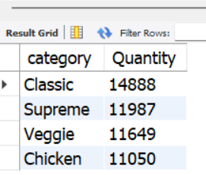
13.JOIN THE NECESSARY TABLES TO FIND THE TOTAL QUANTITY OF EACH PIZZA CATEGORY ORDERED.

Slide 15
THANK YOU
FOR ATTENTION
Contact
gmanoj1881@gmail.com

