Slide 1
Travel Booking Platform Destination Connection Graph System
Presented By:
Manoj Kumar Reddy
Kushi Baira

Slide 2
Problem statement
Problem: Managing travel routes between multiple destinations manually is difficult and inefficient. Travel agencies need a system to easily manage destinations, routes, and travel prices.
Goal: Develop a C program that manages travel destinations and routes using Graph Data Structure, supporting CRUD operations and file storage.

Slide 3
Real-world application
Real-World Applications
• Travel agency route management • Airline / bus / train route systems • City transport networks • Tourism route planning
Benefits
• Easy route search • Fast price updates • Efficient destination management

Slide 4
Data structure used
Graph Data Structure (Adjacency Matrix)
Each destination = node Each route = edge Edge weight = travel price
 | Chennai | Delhi | Mumbai
Chennai | 0 | 5000 | 3000
Delhi | 5000 | 0 | 2500
Mumbai | 3000 | 2500 | 0

Slide 5
Structure Used
typedef struct { char destinations[MAX][50]; int graph[MAX][MAX]; int destCount; } TravelGraph;
Stores:
• Destination names • Travel connections • Route prices

Slide 6
System design
Design Overview
Menu-driven console application.
Operations include:
• Add Destination • Add Route • Delete Route • Update Route • Search Route • Book Trip • Display Graph
File Handling
Data stored in:
travel.dat
Flow:
Start → Load Data → Menu → Operation → Save Data → Exit

Slide 7
algorithm
General Steps
Load travel data from file
Display menu options
Perform selected operation
Save updated data
Operations
Add Destination → store new location Add Route → connect two destinations Delete Route → remove connection Update Route → modify price Search Route → display travel cost Book Trip → calculate total cost Display Graph → show route matrix

Slide 8
Implementation
Program Implementation
Language: C
Concepts used:
• Graph Data Structure • Structures • File Handling • Menu-Driven Programming
Key Features
• Destination management • Route CRUD operations • Persistent data storage • Travel cost calculation

Slide 9
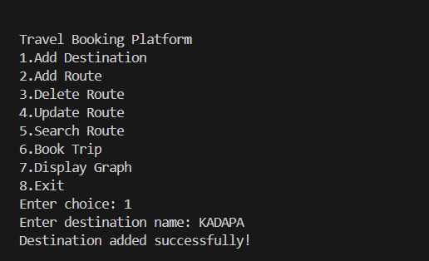
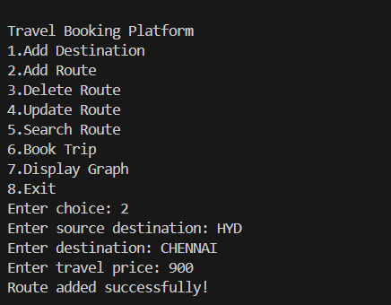
Sample output

Slide 10
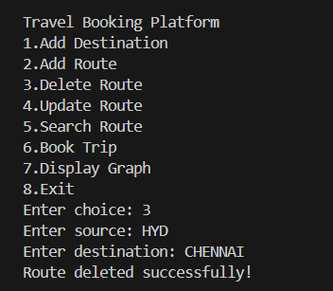
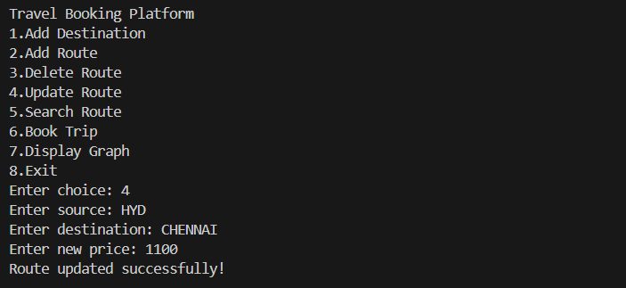

Slide 11
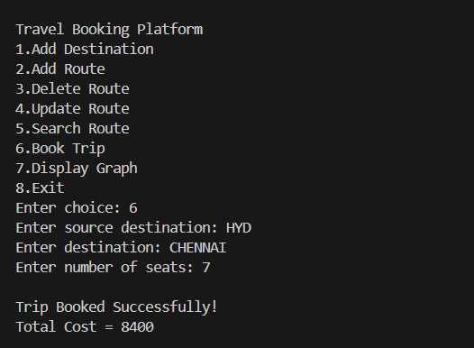
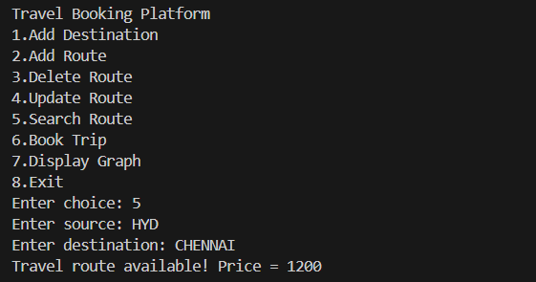

Slide 12
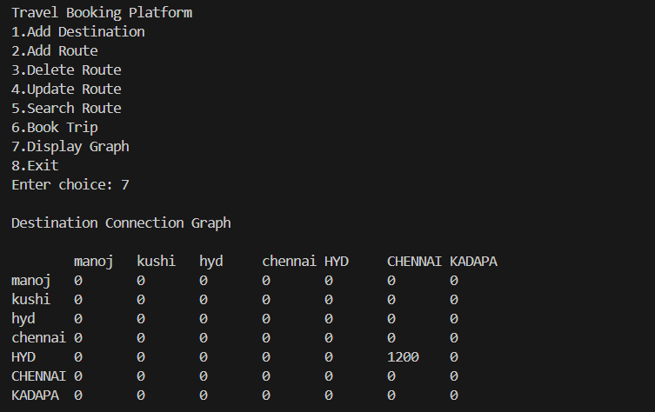
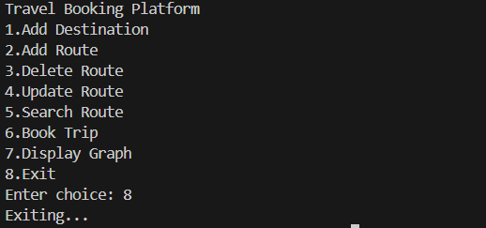

Slide 13
conclusion
Successfully implemented a Travel Booking Platform using Graph Data Structure in C.
Key Achievements
• Destination and route management • Graph representation using adjacency matrix • File handling for data persistence • Menu-driven system for easy interaction
Future Improvements
• Shortest path algorithms (Dijkstra) • Online booking system • GUI interface

