Slide 1
Data Annotation & Evaluation
Tirthankar Dasgupta
TCS Research

Slide 2
NLP and Text Processing Tasks
Recap…
Extracting Drug names, disease names, product mentions, email ids,
addresses
Extracting Events / Sentiments Who did / said What, When, How, Why
How many negative reviews – on which aspect of product / service
Risk assessment – new policy about environment / health care / education
Information Extraction
Linguistic Analysis
Statistical Analysis
Drawing Inference
What are the causes a disease?
What is the policy for Paternity leave?
Summary of Financial obligations on signing a new contract with an alliance
General Purpose Conversation - Question
Understand & Empathize
Answer / Guide /Recommend
Any language to any language
Question Answering
Summarization
Natural Language generation
Machine Translation

Slide 3
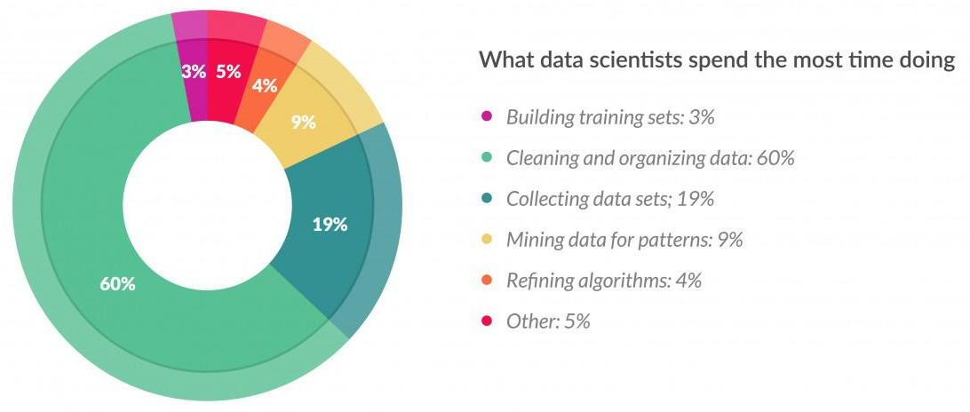
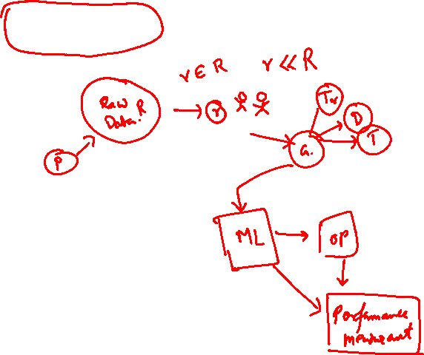
The Process Flow
Identifying the Problem
Data Collection and Labeling
Training & Debugging
Deployment and Testing

Slide 4
Types of NLP Problem
Applications
Core problems
Named entity
Sentiment analysis
Adverse Drug Effects
Hate Speech
Document classification
…
Phoneme boundary identification (Speech)
Morphological analyzer
POS tagging
Parsing
…

Slide 5
Types of Annotation
Phoneme level
Morpheme level
Word level
Phrase level
Sentence level
Document level

Slide 6
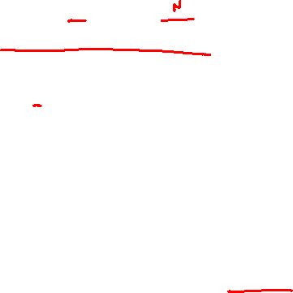
Applications
IDENTIFY PARTS OF SPEECH
John saw the Girl
POS tagging
Sentiment Analysis
Aspect Extraction
PN V DT N
“saw” is more likely to be a verb V rather than a noun N
John saw the saw
The second “saw” is a noun N because a noun N is more likely to follow a determiner.
NN
RB
VBN JJ VB
PRP VBD TO VB DT NN
She promised to back the bill

Slide 7
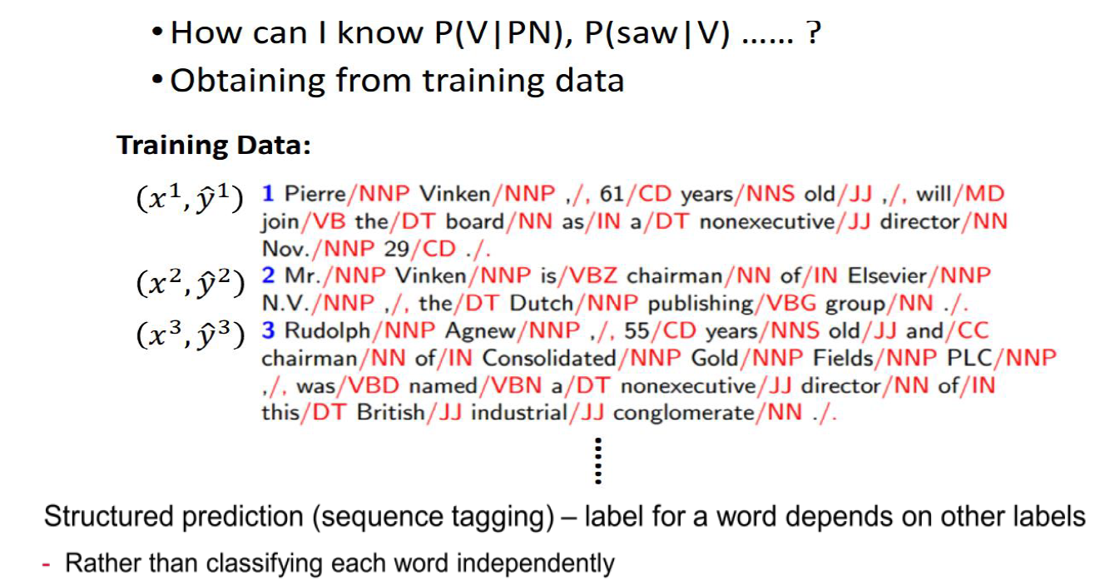

ESTIMATING THE PROBABILITIES

Slide 8
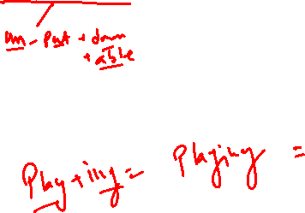
Applications
Sentiment Analysis
POS tagging
Sentiment Analysis
Aspect Extraction
This is a good book. → Positive
This book is simply unputdownable! → More Positive
This is a bad book. → Negative
The first chapter of the book is great, but the rest is a junk! → Positive & Negative

Slide 9
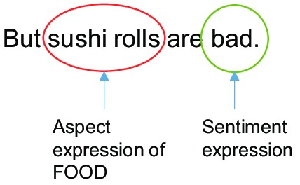

Applications
Aspect Analysis
POS tagging
Sentiment Analysis
Aspect Extraction
I was tempted to buy this product as I really like its design, but its price is not very good.
This product has a good price; the one my brother purchased has a good design.
Question 1: How would you rate our service?
Rating Answer: “10”
Question 2: Motivate your answer.
Textual Answer: “Customer care”

Slide 10

Revisiting the process flow
Raw Data
Sample raw data
Ground truth
Problem
ML Model
Output

Slide 11
Data Collection
After we define what we are going to create, baseline, and metrics in the project, the most painful of the step will begin, data collection and labeling.
Most of Deep Learning applications will require a lot of data which need to be labeled.
Time will be mostly consumed in this process.
Although you can also use public dataset, often that labeled dataset needed for our project is not available publicly.

Slide 12
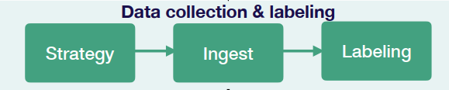
Data Collection
Strategy:
Need to plan how to obtain the complete dataset.
Multiple ways to obtain the data
The data need to align according to what we want to create in the project.
Ingest:
If the strategy to obtain data is through the internet by scraping and crawling some websites, we need to use some tools to do it.
Scrapy is one of the tool that can be helpful for the project

Slide 13
A NOTE ON DATA COLLECTION
The raw data needs to fit a certain profile.
Will also determine how much data needs to be annotated.
The ideal training corpus has the following key features:
It should be representative, covering the domain vocabulary, format, and genre of the text.
It should be balanced, containing instances of each class type that the system is supposed to extract.
For example, a system cannot learn to extract corporate entities if there are not enough mentions of corporate entities in the training data.
It should be clean.
It should be enough.
This ensures accuracy, and is crucial to the creation of a gold standard that will test your system’s performance.

Slide 14
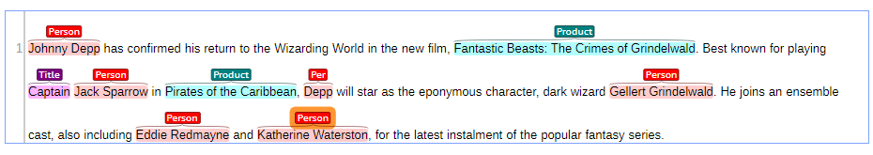
WHAT IS DATA ANNOTATION?
Annotation is the act of adding vital information to raw data.
To a supervised learning algorithm, data without tags is simply noise.
Through annotation, however, this noise can be turned into a focused training manual that has an impact all the way up.
Here’s an example of some raw text data that could be used to train the entity extractor:

Slide 15

A NOTE ON DATA Annotation
What is the problem? How complex it is?
Where is the data coming from?
Who are the annotators?
What are the tasks assign to them?

Slide 16

Annotation Tools
DocAnno
Brat
Prodigy
Tagtog
DataTurks
Label Studio
Stanford Text Annotation Tool

Slide 17
Crowdsourcing

Slide 18
Annotation through Crowdsourcing
Crowdsourcing is an emerging collaborative approach for acquiring annotated corpora and a wide range of other linguistic resources
Three main kinds of crowdsourcing platforms
Paid-for marketplaces such as Amazon Mechanical Turk (AMT) and CrowdFlower (CF)
Games with a purpose
Volunteer-based platforms such as crowdcrafting

Slide 19
Why Crowdsourcing?
Paid for crowdsourcing can be 33% cheaper than in-house employees when applied to tasks such as tagging and classification (Hoffmann, 2009)
Games with a purpose can be even cheaper in the long run, since the players are not paid.
However cost of implementing a game can be higher than AMT/CF costs for smaller projects (Poesio et al, 2012)
Tap into the large number of contributors/players available across the globe, through the internet
Easy to reach native speakers in various languages (but beware Google translate cheaters!)

Slide 20



Genre 1: Mechanized Labor
Participants (workers) paid a small amount of money to complete easy tasks (HIT = Human Intelligence Task)

Slide 21
Paid for Crowdsourcing
Contributors are extrinsically motivated through economic incentives
Carry out micro-tasks in return for micro-payments
Most NLP projects use crowdsourcing marketplaces: Amazon Mechanical Tutk and CrowdFlower
Requesters post Human Intelligence Tasks (HITs) to a large population of micro-workers (Callison-Burch and Dredze, 2010a)
Snow et al. (2008) collect event and affect annotations, while Lawson et al. (2010) and Finin et al. (2010) annotate special types of texts such as emails and Twitter feeds, respectively.
Challenges:
low quality output due to the workers’ purely economic motivation
high costs for large tasks (Parent and Eskenazi, 2011)
ethical issues (Fort et al., 2011)

Slide 22
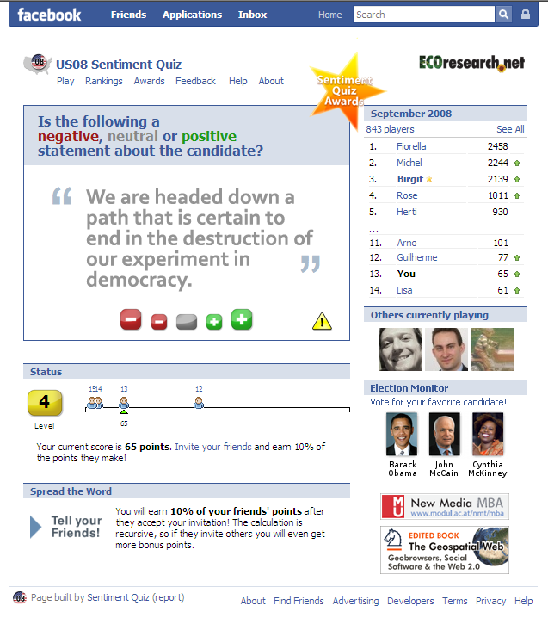
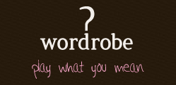
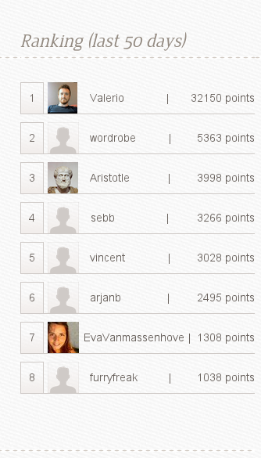
Genre 2: Games with a purpose (GWAPs)
https://www.youtube.com/watch?v=IeyZIs68AsA&t=1566s
Notes:
In 2008, the group built a FB game that required players to rate the sentiment associated to a sentence on a 5-values scale, then used this as atraining corpus for the sentiment detection module. Over 800 player played the game.
In 2009 the game has been released in a slightly different form and with the aim to gather sentiment lexicons, i.e., associations between words and their sentiment polarity (ratings from as many as 12 players were averaged to get the final value). The game ran in 7 different languages and attracted over 4000 players.
Let this be an introductory example of a crowdsourcing project, however, crowdsourcing is a not a new phenomenon.

Slide 23

Genre 3: Altruistic Crowdsourcing

Slide 24
Task Flow
Data distribution: how “micro” is each microtask?
Long paragraphs hard to digest, worker fatigue
Single sentences not always appropriate: e.g. for co-ref
Reward scheme
Granularity – per task? Per set of tasks? High scores?
What to do with “bad” work
How much to reward
No clear, repeatable results for quality: reward relation
High rewards get it done faster, but not better
Pilot task gives timings, so pay at least minimum wage
Choose the most appropriate genre or mixture of crowdsourcing genres
Trade-offs: Cost; Timescale; Worker skills
Pilot the design, measure performance, try again
Simple, clear design important
Binary decision tasks get good results

Slide 25
Evaluation and Corpus Delivery
Evaluate and aggregate contributor inputs to produce final decision
Majority vote
Discard inputs from low-trusted contributors (e.g. Hsueh et al. (2009))
MACE: a) identify which annotators are trustworthy and b) predict the correct underlying labels (Hovy 2013)
Merge individual units from the microtasks (e.g. sentences) into complete documents, including all crowdsourced markup
Tune the expert-created “gold” standard based on annotator feedback
Gold standard test questions often contain ambiguities and errors
Crowd has a broader knowledge-base than a few experts
These are a great opportunity to train workers and amend expert data
Better gold data means better output quality, for the same cost
To facilitate reuse, deliver the corpus in a widely used format, such as XCES, CONLL, GATE XML

Slide 26
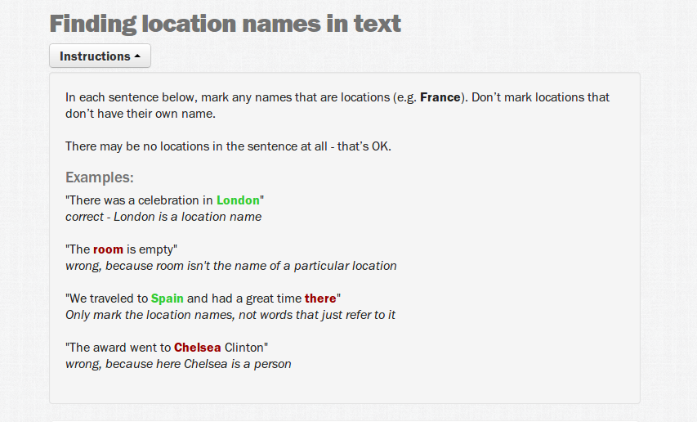
Example: CF Instructions

Slide 27
Recap…
Identifying the Problem
Data Collection and Labeling
Training & Debugging
Deployment and Testing

Slide 28
Quality of Annotation

Slide 29
Quality of Annotation
Data types:
How Data are repeated?
Categorical
Binary
Sentiment +/-
Nominal
Hepatitis
Viral A, B, C,D, E or auto immune
Continuous
Size of tumor
Blood Pressure
Quality of answers
Same input
Different observers
Inter-rater reliability
Same observer at different time
Intra-rater reliability
Inter-annotator agreement is a measure of how well two (or more) annotators can make the same annotation decision for a certain category.

Slide 30
Quality of Annotation: Some notes
From that measure, you can derive two things:
how easy was it to clearly delineate the category: if the annotators make the same decision in almost all cases, then the annotation guidelines, i.e. the definition of the category that needed to be annotated, were very clear, and this implies that it is somehow possible to give the annotator a nicely delineated view on the category.
how trustworthy is the annotation: one prefers categories that are firmly delineated — even if that is utopia for linguistics — because they make it easier to perform a quantitative analysis. If the inter-annotator agreement were low, the annotators found it difficult to agree on which items belong to the category, and which didn’t. That category might be very very interesting from a qualitative point of view, it is very difficult to incorporate it in a quantitative valorization of the data.
The calculation is based on the difference between how much agreement is actually present (“observed” agreement) compared to how much agreement would be expected to be present by chance alone (“expected” agreement). The data layout is shown in Table 1. The observed agreement is simply the percentage of all lectures for which the two residents’ evaluations agree, which is the sum of a + d divided by the total n in Table 1. In our example, this is 15+70/100 or 0.85. We may also want to know how different the observed agreement (0.85) is from the expected agreement (0.65). Kappa is a measure of this difference, standardized to lie on a -1 to 1 scale, where 1 is perfect agreement, 0 is exactly what would be expected by chance, and negative values indicate agreement less than chance, ie, potential systematic disagreement between the observers

Slide 31
Quality of Annotation : Some notes
There are basically two ways of calculating inter-annotator agreement. The first approach is nothing more than a percentage of overlapping choices between the annotators.
This approach is somewhat biased, because it might be sheer luck that there is a high overlap. Indeed, this might be the case if there are only a very limited amount of category levels (only yes versus no, or so), so the chance of having the same annotation is a priori already 1 out of 2. Also, it might be possible that the majority of observations belongs to one of the levels of the category, so that the a priori overlap is already potentially high.

Slide 32
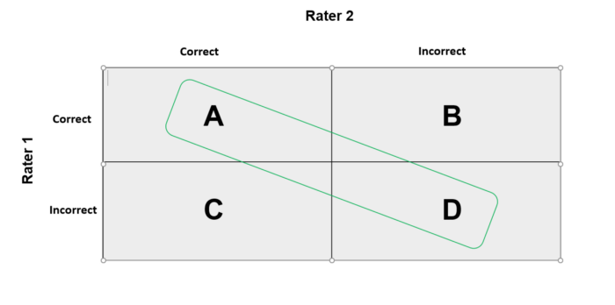
Inter-rater reliability: Cohen’s Kappa
A => The total number of instances that both raters said were correct. The Raters are in agreement.
B => The total number of instances that Rater 2 said was incorrect, but Rater 1 said were correct. This is a disagreement.
C => The total number of instances that Rater 1 said was incorrect, but Rater 2 said were correct. This is also a disagreement.
D => The total number of instances that both Raters said were incorrect. Raters are in agreement.

Slide 33


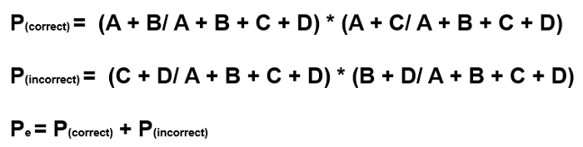
Inter-rater reliability: Cohen’s Kappa
p_{e} is the hypothetical probability of chance agreement, using the observed data to calculate the probabilities of each observer randomly seeing each category.
K=1 → Full Agreement
K=0 → Random
K<0 → No effective agreement

Slide 34
Text Classification

Slide 35
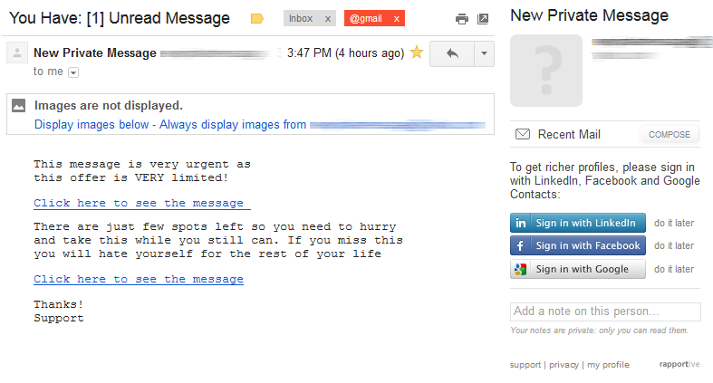
Text Classification: An Introduction
Spam Classification

Slide 36
Text Classification: An Introduction
Can we train a classifier to recognize it from the signals in text?
Can we train a classifier to recognize whether the text is about White Wine or Red Wine?
Can we train a classifier to recognize whether the review is good or bad?
"It's a dry white wine and the flavor is delicious. Great wine, fast service, what more could you ask for?"
“Aromas include tropical fruit, broom, brimstone and dried herb. The palate isn’t overly expressive, offering unripened apple, citrus and dried sage alongside brisk acidity.”
What is the object being described?
White Wine
Signals – acidity, citrus, apple

Slide 37
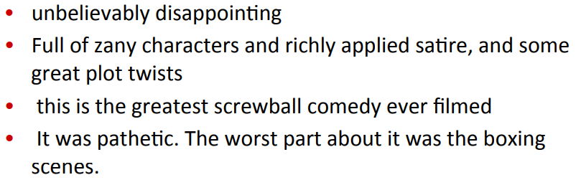
Text Classification: An Introduction
Positive or negative movie review?

Slide 38

Text Classification
Input
A document $d$
A fixed set of classes $C=\{c_{1},c_{2},$… $c_{n}\}$
Output: a predicted class $c∈C$ for $d$.
Methods:
Rule based
Supervised
Semi-supervised
Unsupervised

Slide 39
Text Classification: Methods
Rule based
Rules based on combinations of words or other features.
spam: black-list-address OR (“Congratulations!” AND “dollars” AND “have been selected”)
Accuracy can be high
If rules carefully refined by expert
But building and maintaining these rules is expensive

Slide 40
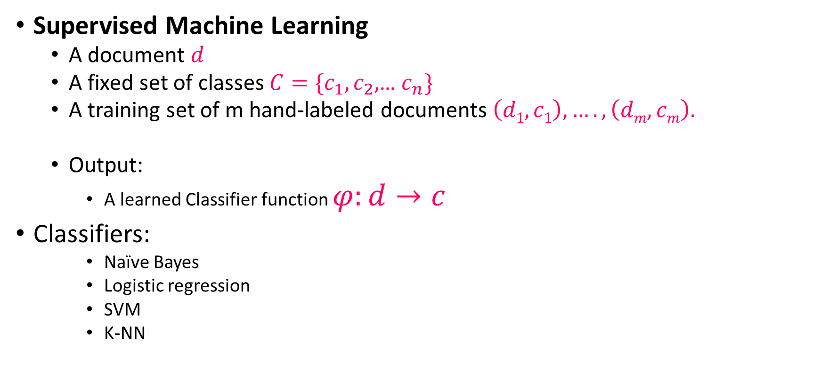
Text Classification: Methods
Supervised Machine Learning
A document $d$
A fixed set of classes $C=\{c_{1},c_{2},$… $c_{n}\}$
A training set of m hand-labeled documents $\left(d1,c1\right),….,\left(dm,cm\right).$
Output:
A learned Classifier function $φ:d→c$
Classifiers:
Naïve Bayes
Logistic regression
SVM
K-NN

Slide 41
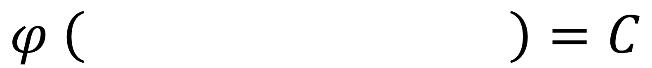
Naïve Bayes Intuition
Simple (“naïve”) classification method based on Bayes rule
Relies on very simple representation of document
Bag of words
I love this movie! It's sweet, but with satirical humor. The dialogue is great and the adventure scenes are fun… It manages to be whimsical and romantic while laughing at the conventions of the fairy tale genre. I would recommend it to just about anyone. I've seen it several times, and I'm always happy to see it again whenever I have a friend who hasn't seen it yet.
$$φ \left( \right)=C$$

Slide 42
Naïve Bayes Intuition
Simple (“naïve”) classification method based on Bayes rule
Relies on very simple representation of document
Bag of words
I love this movie! It's sweet, but with satirical humor. The dialogue is great and the adventure scenes are fun… It manages to be whimsical and romantic while laughing at the conventions of the fairy tale genre. I would recommend it to just about anyone. I've seen it several times, and I'm always happy to see it again whenever I have a friend who hasn't seen it yet.
$$φ \left( \right)=C$$

Slide 43
Naïve Bayes Intuition
Simple (“naïve”) classification method based on Bayes rule
Relies on very simple representation of document
Bag of words
I love this movie! It's sweet, but with satirical humor. The dialogue is great and the adventure scenes are fun… It manages to be whimsical and romantic while laughing at the conventions of the fairy tale genre. I would recommend it to just about anyone. I've seen it several times, and I'm always happy to see it again whenever I have a friend who hasn't seen it yet.
$$φ \left( \right)=C$$

Slide 44
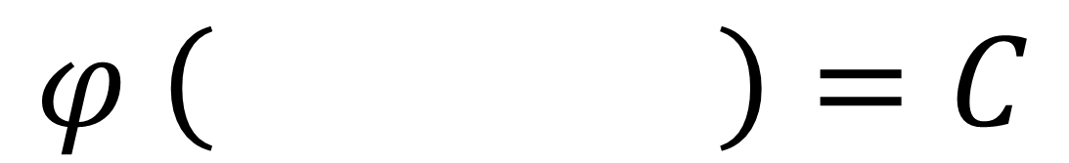
Naïve Bayes Intuition
Simple (“naïve”) classification method based on Bayes rule
Relies on very simple representation of document
Bag of words
Frequency/ TF-IDF
Love
sweet
satirical
laughing
recommend
several
Times
happy
again
humor
great
adventure
Fun
whimsical
romantic
2
1
1
2
1
1
1
1
…
…
$$φ \left( \right)=C$$

Slide 45
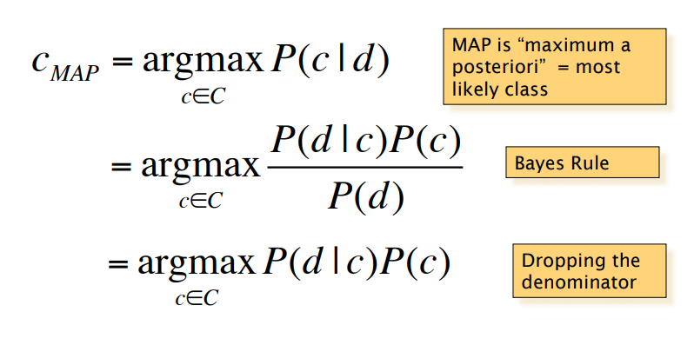
The Naïve Bayes Classifier

Slide 46
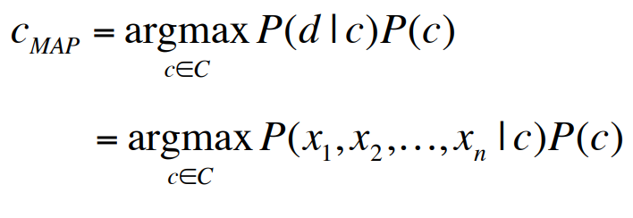
The Naïve Bayes Classifier
Document d represented in terms of features x1,x2,…xn

Slide 47
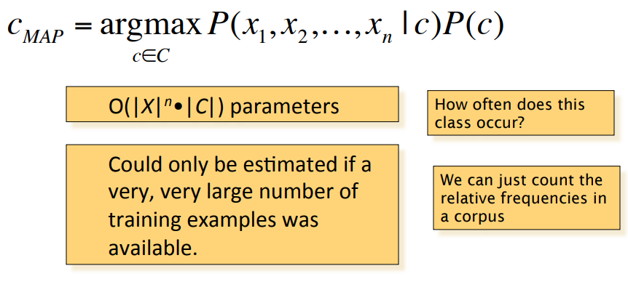
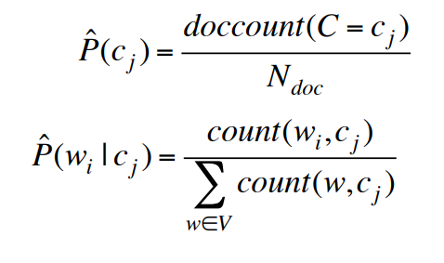
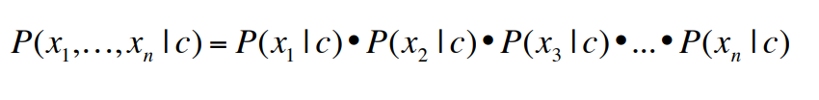
The Naïve Bayes Classifier
Bag of Words assumption:
Assume position doesn’t matter
Conditional Independence:
Assume the feature probabili1es P(xi |cj ) are independent given the class c

