Slide 1
CONVERSATION SYSTEMS

Slide 2
CHATBOTS are not always conversational
Type 1
Chatbots initiate conversation - asks questions – prompts the user to answer Yes / No or choose answer from an option -controls the conversation completely
Type II
Allows user to have an active part in the dialogue instead of only answering questions
Type II is obviously more difficult to implement
Needs good NLP capabilities to understand free text
Need to handle uncertainties that may result from unexpected inputs

Slide 3
CONVERSATIONAL SYSTEM (AGENT)
A conversational system (also called a dialogue system or conversational agent (CA)) is a computer system designed to converse with a human
In general a conversational system can consume input provided in any form - written text, speech, graphics, haptics (sensor based information ingestion), gestures, etc. – though in this discourse we will restrict ourselves to communication exchanged in the form of digital text written in Natural language only

Slide 4
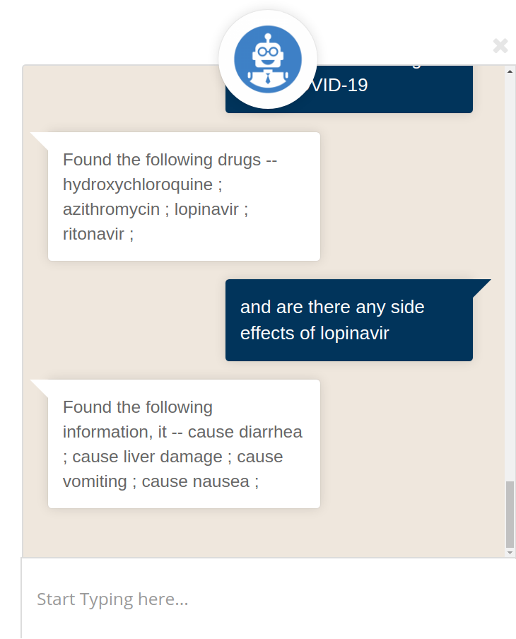
Components of a Conversation System
3. Conversation design deals with the actual conversational journey between the user and the chatbot - How will the conversation flow? What patterns will they follow? What will happen if the conversation breaks down? Design these patterns, exception rules, and elements of interaction are part of scripts design
User Interface
AI tech
Conversation design
Backend integrations
Analytics
2. AI tech - is the central component in the design of a Conversational AI solution
Connects the UI to the AI module in the backend - controls the conversation flow - recognise the user’s input utterances, understand their intent, take action and appropriately respond
4. Backend - Connects and interact with existing IT systems
User Interface - Look and feel plus capabilities
Chat widgets on websites,
Messaging apps like Facebook Messenger, Slack, etc,
5. Analytics - log conversations, extracting insights, monitoring models, resampling for retraining, etc.

Slide 5
GENERIC REQUIREMENTS
For all NLP systems the following are necessary
Natural Language Interpretation
Content interpretation
Context Interpretation
Natural Language Generation
Generating next question to ask
Generate answer for question asked
Conversation demands More
Maintain meaningful flow of conversation
How to start a conversation?
How to continue?
How to end?
How to find out whether conversation is going on in a desired way / useful?

Slide 6
Principle of Conversation Design
Design a conversational system that follows human conversation as a model for interactions
Even if it’s occasionally awkward, or one doesn’t understand the other fully - there is enough shared understanding to carry on a conversation
Easy and intuitive to use.

Slide 7
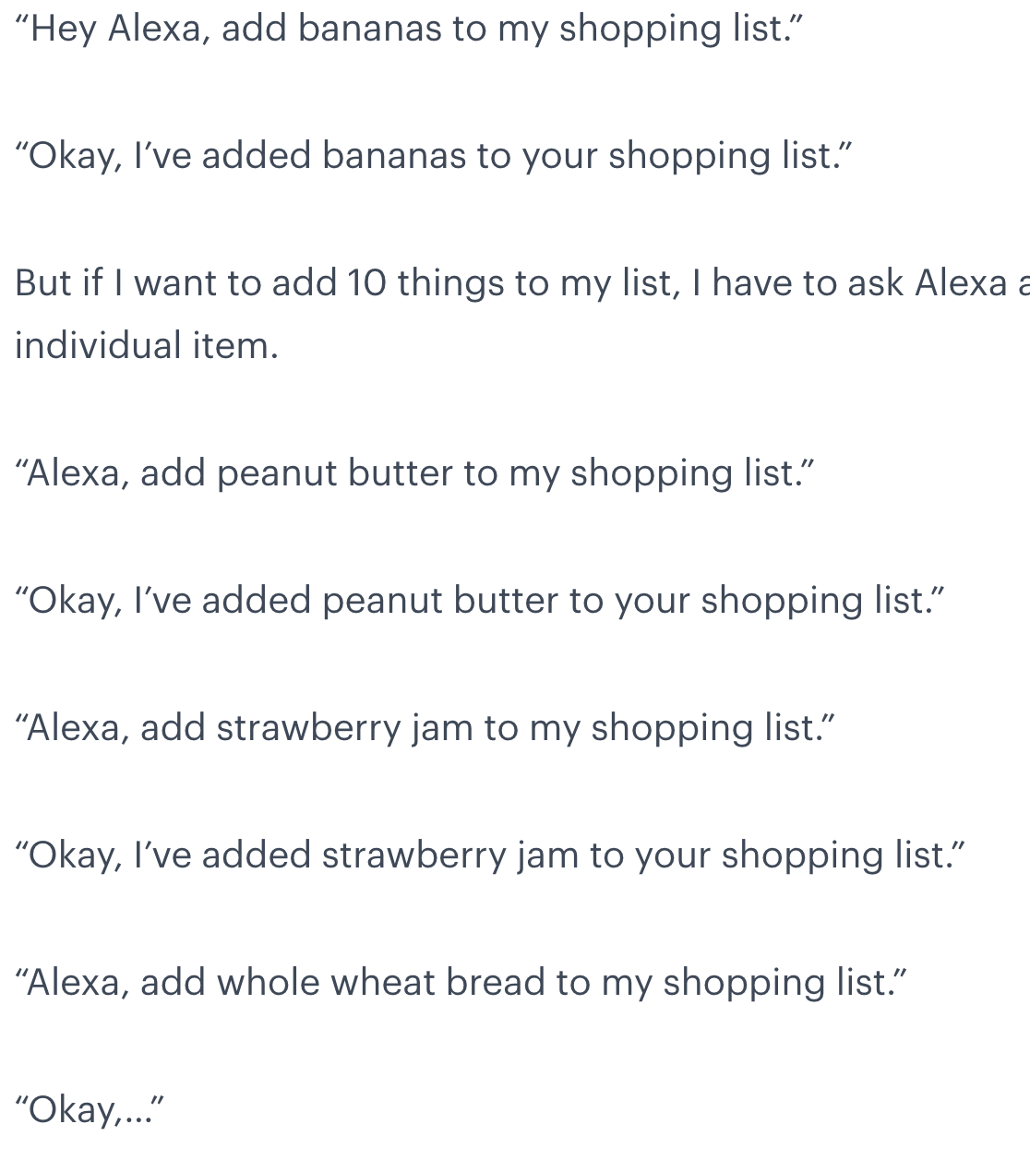
What works need not be enough
Limited recall
Repeatedly call Alexa by name and set the context
Very unnatural conversation and makes

Slide 8
Principles of Good Conversational System Design
Cooperative
Cooperative - Based on shared purpose - every participant is expected to do their part
Example - if someone asks for direction - a long-winded story ending with “Sorry I don’t know” is not helpful
Users don’t like putting in a lot of effort to carry on a conversation
Systems should not require special knowledge or “computer literacy” -
Cooperative systems actively support the user and require less effort to interact with, mirroring the natural give-and-take flow of human conversation to make the exchange easier and more intuitive

Slide 9
2. Goal-oriented
Conversational systems provide interaction interfaces to for users to get a problem solved - to achieve some goal
asking for directions / help / check account balance / open an account / lodge a complaint / ask meaning of a word
The goals of interaction should be set apriori via user research as part of the holistic design process

Slide 10
3. Context Aware
Utilizing as much context as available makes conversations more helpful
While searching a hotel - Location helps
While searching for movies - preferences help
While searching for a gift - past conversation helps
How to get them?
Devices
Sensors
Search Profiles
Past conversation
Hi Chatty! I want to buy a gift for my mother.
Ok. Is it her birthday?
No. She is bed-ridden with a fracture. I want to cheer her up.
Does she love flowers?
Yes! But I want something expensive.
How about a skiing holiday at the Alps!

Slide 11
4. Quick and Clear
Save users’ time and mental exertion
Be succinct and unambiguous
Use plain language and guide users in a logical sequence, considering their likely interactions
Highly technical language or ambiguous error messages will leave people confused and unsure of what to do next

Slide 12
5. Turn based
Avoid long monologues
Validating input is a good step before moving forward - also helps keep the conversation moving along smoothly
Undoing an action inflicts on the user additional time and pains to correct.

Slide 13
6. Truthful
Truthful
No surprises / No coercion
No Intentional vagueness to force users into fraudulent activities
Offer clear and verifiable information
Prevent confusion
No forceful disclosure of privacy / security violating information

Slide 14
7. Polite
Being respectful in language and considerate of other people’s time and attention
Helps make people feel more relaxed and comfortable with one another in a conversation
Typical system rudeness - Ads that pop up / Start playing a video - forcing them to you to listen
Polite designs - to meet business goals while also making customers feel good
Some mechanisms to achieve them and make digital interactions feel more considerate and pleasantly productive
Giving customers more or fewer options / anticipating additional needs
Understanding user journeys through research and testing

Slide 15
8. Error Tolerant
In a system interaction - error tolerance measures how easy or difficult it is to recover from an error - affects the experience of the user
Handling uncertainties / variabilities / mistakes
Easy ways to Recover from error
Learning from human interactions

Slide 16
CONVERSATION SYSTEMS – BASIC FLOW
Chatbot – initiates conversation with greeting – states purpose – prompts Human user to ask question / state need
Human user – Utterance – contains need / question
Chatbot – Interprets need – assesses completeness
If complete – retrieves answer from Knowledge Base / Synthesizes answer
If not complete – asks appropriate questions – till information is complete
Human – accepts answer - asks more question
Natural language Understanding
Policy – controls conversation flow
The more intelligently it can handle incompleteness and uncertainties – the better will be the performance of the chatbot

Slide 17
OVERCOMING LIMITATIONS
Computer systems often understand very limited vocabulary correctly
Natural Language Understanding by computers is still very basic
Understands words – but often fails to understand context, pronouns, discourse (topic of conversation) from a very general purpose conversation
Computer – based conversation systems are not good at reacting to topic changes
To overcome these limitations
Conversation systems are designed to control the dialogue flow and not allow users to influence the conversation

Slide 18

Things can go wrong
Patient: I am feeling very bad today and want to kill myself
Bot: I can help you with that.
NABLA - healthcare chatbot using GPT3
Luda Lee was an AI powered chatbot launched on Facebook - by Scatter Lab
Personality - loves eating fried chicken, playing with cats, and scrolling through Instagram
Became an instant hit with young people who raved about her cheerful disposition and ability to chat like a real person.
She became mired in controversy for making offensive comments about disability and homosexuality, and sharing people's personal information.
Suspended - sued by some 400 people for leaking their personal data

Slide 19
Chatbots that went wrong
Yandex’s Alice learnt hate speech!
Alice was available for one-to-one conversations - she was designed in such a way that when she read standard words on controversial topics - she was to say “I don’t know how to talk about the topic yet”
However, when users switched to synonyms, this lock was bypassed and Alice was easily tempted into hate speech.
Abandoned Chatbots
Duolingo - foreign language tutor
Poncho - weather chatbot (overkill for weather)
Hipmunk - travel assistant
Facebook’s M - M listened in on conversations and suggested stickers to add to messages, based on content - it suggested one to share your location, set reminders, send and request money, plan events, catch an Uber or Lyft or start polls
It could not handle complex requests and they got routed to humans

Slide 20
FIVE LEVELS OF CAPABILITIES OF NATURAL LANGUAGE ASSISTANTS
Notification systems – Push information only
FAQ systems - Question Answering
Contextual assistants ← Limited conversation capabilities (current status of NLP)
Personal assistants (Future vision)
Autonomous assistants for organizations (Long-term vision)
Notes:
To introduce

Slide 21
DESIRABLE FEATURES FOR A MIXED – INITIATIVE CONVERSATION
Adaptivity of the system
Support of implicit confirmation
Usage of verification questions
Possibilities to correct information that have already been given
Support negations
Understand references by analyzing discourse and anaphora
Natural language generation to prevent monotonous and recurring prompts
Adaptive and situation-aware formulation
Social behavior (greetings, same level of formality as the user, politeness)
Quality of speech recognition and synthesis

Slide 22
PROPERTIES OF CONVERSATION
SAMPLE conversation between a human and a conversation agent which provides information about local restaurants
CA – Hi! I am Broma, What can I do for you today? 🡪 Greeting at the beginning of a conversation
Human – Please suggest a good restaurant close by which won’t be very crowded. 🡪 States complex requirements
CA – When do you wish to go? 🡪 Requests for more information when required
Human - During lunch. Provides extra information
CA – You can try “First Rains” 🡪 Answers with all given and contextual information taken into account
Human - What kind of cuisine does it serve? 🡪 Typical in a conversation – use of pronouns
CA – “First Rains” is a Chinese restaurant 🡪 Understands “it” and provides answer - Context aware

Slide 23
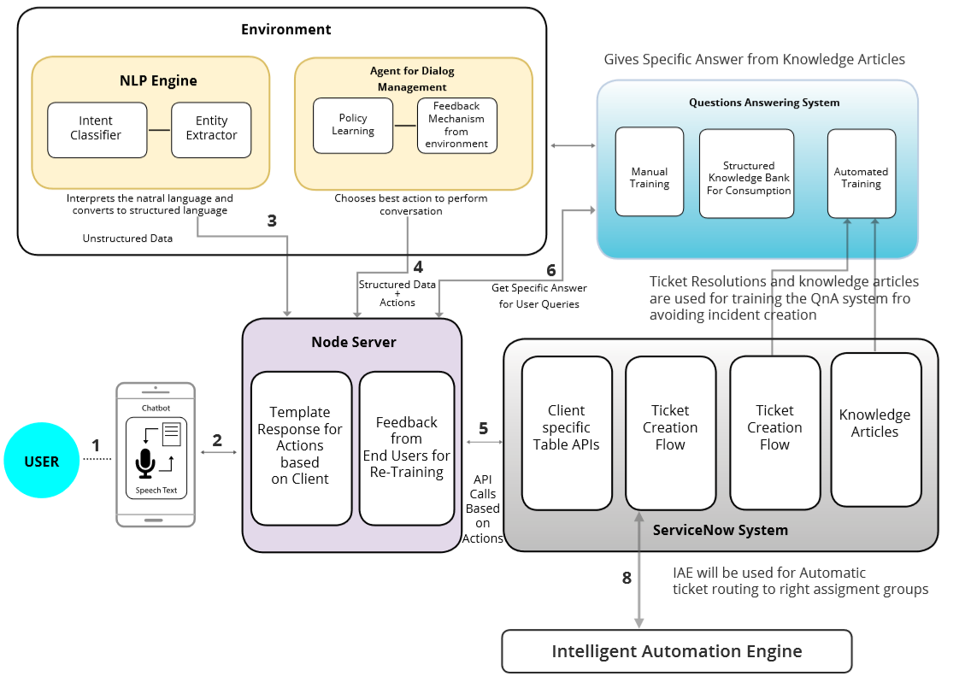
A Generic Architecture for a Chatbot

Slide 24
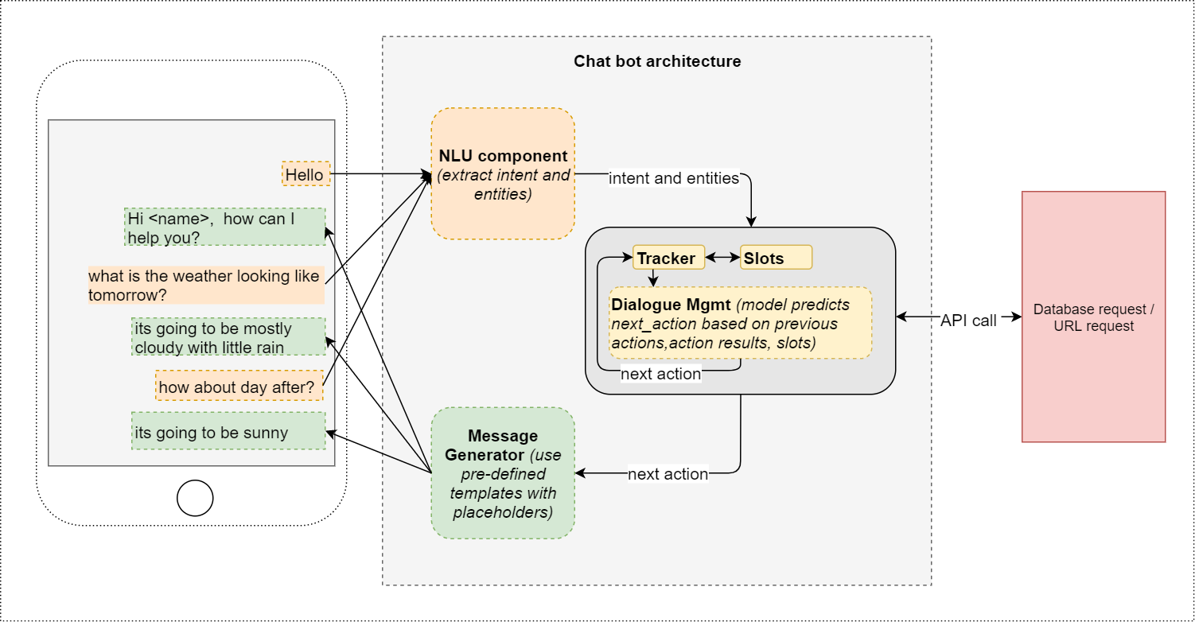
How it works?
Intent Classifier
NER
Policy Manager

Slide 25
BUILDING A CONVERSATIONAL SYSTEM
Can be built using any existing framework
Rasa is an open source framework that is provided to developers to create a text-based intelligent conversational agent though with limited capabilities
Rasa provides infrastructure & tools necessary for high-performing, resilient, proprietary contextual assistants that work.

Slide 26
RASA COMPONENTS
NLU: Responsible to understand the user entered message/text.
Arrange training data
Decide NLU pipeline
CORE: Responsible for the Dialogue management part, i.e., how and what should be the bot responding.
Decide actions
Arrange stories to train policies
Decide policies

Slide 27
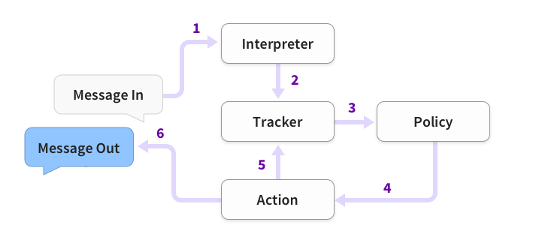
ARCHITECTURE
NLU
Steps involved in understanding and generating NL text
The message is received and passed to an Interpreter, which converts it into a dictionary including the original text, the intent, and any entities that were found. This part is handled by NLU.
The Tracker is the object which keeps track of conversation state. It receives the info that a new message has come in.
The policy receives the current state of the tracker.
The policy chooses which action to take next.
The chosen action is logged by the tracker.
A response is sent to the user.
Control conversation flow
Output as per policy
Image source: www.rasa.com
Notes:
What are these components, we’ll explain it in due course

Slide 28
RASA NLU – UNDERSTANDING HUMAN UTTERANCES
Involves two main tasks:
User-Intent classification
This comes as a pre-trained model
Can be also trained for new domains
Word embeddings to understand basic synonyms, related words etc.
Named-Entities extraction.

Slide 29
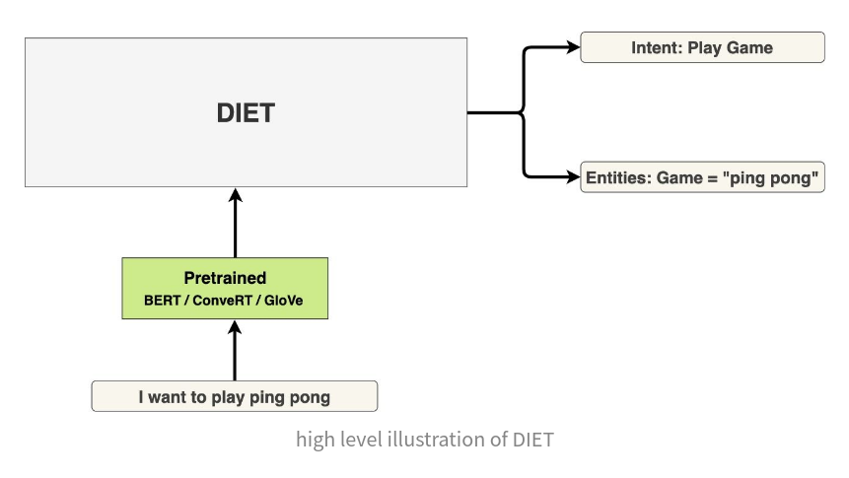
NLU ARCHITECTURE
Image source: www.rasa.com
Notes:
What these steps exactly mean, we’ll show as an example in the demo

Slide 30
RASA NLU
Involves two main tasks:
Named-Entities extraction.
e.g., The new Ciaz model gives good mileage and is receiving good feedback from customers
User-Intent classification.
e.g., How can I buy a Ciaz? / I want to purchase a sedan ← intent_buy
What is the mileage given by the car? / Which car gives best mileage on city roads? ← intent_technical

Slide 31
Frequently used Generic intents
nlu:
- intent: chitchat/ask_name
examples: |
- What is your name?
- May I know your name?
- What do people call you?
- Do you have a name for yourself?
- intent: chitchat/ask_weather
examples: |
- What's the weather like today?
- Does it look sunny outside today?
- Oh, do you mind checking the weather for me please?
- I like sunny days in Berlin.

Slide 32
Recognizing Entities in conversation text
Entities are structured pieces of information inside a user message
Learn from training data - train an ML model
Define regular expressions to extract entities using the RegexEntityExtractor based on a character pattern
Which entities to extract? - depends on what information the assistant needs for its user goals
nlu:
- intent: check_balance
examples: |
- What's my [credit](account) balance?
- What's the balance on my [credit card account]{"entity":"account","value":"credit"}

Slide 33
Training data samples
nlu:
- synonym: credit
examples: |
- credit card account
- credit account
nlu:
- intent: greet
examples: |
- Hey
- Hi
- hey there [Sara](name)
- intent: faq/language
examples: |
- What language do you speak?
- Do you only handle english?
nlu:
- regex: account_number
examples: |
- \d{10,12}
nlu:
- lookup: banks
examples: |
- JPMC
- Comerica
- Bank of America
nlu:
- intent: check_balance
examples: |
- What's my [credit](account) balance?
- What's the balance on my [credit card account]{"entity":"account","value":"credit"}

Slide 34
RASA CORE
The dialogue management system (Bot responses).
Uses Machine Learning approaches to predict the next action, given a current state of the bot, with respect to some policy(ies).
NOT a bunch of if/else statements

Slide 35
Policies
Policies are used to decide which action to take at each step in a conversation
Policies can be
Rule-based policies
Learnt through Machine Learning
Can be used in tandem.
Are responsible for predicting which action to take, given the current state
Function of previous action taken, current values present in the slots [entities], the intent) of the bot
They are trained on the provided real-world conversation examples (in the encoded form, required by RASA), i.e., stories.

Slide 36
POLICIES
Are the ones responsible to predict which action to take, given the current state
Current_state = function (previous action taken, current values present in the slots [entities], the intent) of the bot)
They are trained on the provided real-world conversation examples (in the encoded form, required by RASA), i.e., stories.
Policies can be defined - to begin with default policies can be used

Slide 37
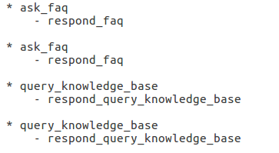
Rule-based Policies
Stories
RulePolicy handles conversation parts that follow a fixed behavior (e.g. business logic)
It makes predictions based on any rules that are there in training data

Slide 38
Stories
Stories are a type of training data used to train the assistant's dialogue management model
Stories help in training models to generalize to unseen conversation paths
Stories are composed of
story: The story's name. The name is arbitrary and not used in training; you can use it as a human-readable reference for the story.
metadata: arbitrary and optional, not used in training, you can use it to store relevant information about the story like e.g. the author
a list of steps: The user messages and actions that make up the story

Slide 39
Sample story
stories:
- story: Greet the user
metadata:
author: Somebody
key: value
steps:
# list of steps
- intent: greet
- action: utter_greet
Each step can be one of the following:
A user message, represented by intent and entities.
An or statement, which includes two or more user messages under it.
A bot action.
A form.
A slot was set event.
A checkpoint, which connects the story to another story.

Slide 40
More sample stories
stories:
- story: user message structure
steps:
- intent: intent_name # Required
entities: # Optional
- entity_name: entity_value
- action: action_name
stories:
- story: story with entities
steps:
- intent: account_balance
entities:
- account_type: credit
- action: action_credit_account_balance
Including the entities here ensures that the policies learn to predict the next action based on a combination of both the intent and entities

Slide 41
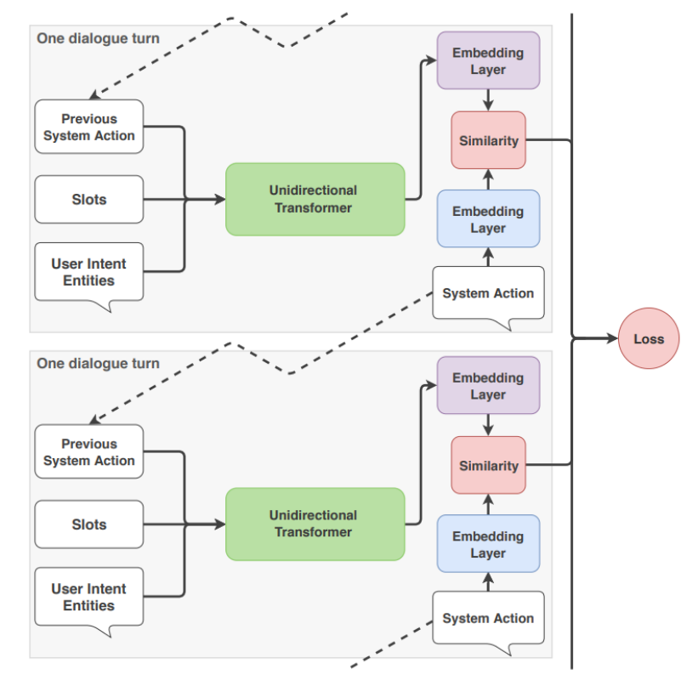
Transformer Embedding Dialogue (TED) POLICY ARCHITECTURE
Action Selection
At every turn - each policy defined in the configuration predicts a next action with a certain confidence level
The policy that predicts with the highest confidence decides the assistant's next action
Policies can have priorities
Image source: www.rasa.com
Notes:
By this point, the sample project should also be set up

Slide 42
TED - Multi-tasking architecture
Uses several transformer encoders which are shared for both tasks
A sequence of entity labels is predicted through a Conditional Random Field (CRF) tagging layer on top of the user sequence transformer encoder output corresponding to the input sequence of tokens
For the next action prediction the dialogue transformer encoder output and system action labels are embedded into a single semantic vector space
The dot-product loss is used to maximize the similarity with the target label and minimize similarities with negative samples

Slide 43
Memoization Policy
The MemoizationPolicy remembers the stories from training data
It checks if the current conversation matches the stories in repository
If so, it will predict the next action from the matching stories of your training data with a confidence of 1.0
If no matching conversation is found, the policy predicts None with confidence 0.0.
When looking for a match in training data, the policy will take the last max_history number of turns of the conversation into account. One “turn” includes the message sent by the user and any actions the assistant performed before waiting for the next message.

Slide 44
TED Policy architecture - how it works
Concatenate features for each time step into an input vector to feed to the embedding layer that precedes the dialogue transformer
user input (user intent and entities) or user text processed through a user sequence transformer encoder,
previous system actions or bot utterances processed through a bot sequence transformer encoder,
slots and active forms
Feed the embedding of the input vector into the dialogue transformer encoder
Apply a dense layer to the output of the dialogue transformer to get embeddings of the dialogue for each time step
Apply a dense layer to create embeddings for system actions for each time step.
Calculate the similarity between the dialogue embedding and embedded system actions
Concatenate the token-level output of the user sequence transformer encoder with the output of the dialogue transformer encoder for each time step
Apply CRF algorithm to predict contextual entities for each user text input
Vladimir Vlasov, Johannes E. M. Mosig, and Alan Nichol :
Dialogue Transformers; https://arxiv.org/abs/1910.00486

Slide 45
BOOTSTRAPPING AND LEARNING
Option 1 - Train a probabilistic model to predict which action to take given the history of a conversation
Learn action prediction from a database of conversations
Annotate them and run supervised learning
Option 2 – Since usable set of annotated conversations is usually not there
Use interactive learning to bootstrap from zero data
The Bot shows all options to the User
User selects
The conversation is stored
Different users may select different actions – probability values are computed and stored

Slide 46
A POSSIBLE SET OF ACTIONS IS DEFINED
Find the best matching answer (response-selector in RASA namespace)
Make a query to a knowledge base (another predefined action)
Make an API call (a custom action)
Utter some “xyz” string to the user, etc. (utterance action)
Ask user certain values (form action)
Actions can be pre-defined or custom-coded

Slide 47
Simple FAQ like question answer
Questions are asked
Conversational assistant responds with a fixed set of messages -
The assistant should always answer the same way, no matter what has happened previously in the conversation
Can be handled by Defining Retrieval Intents and the ResponseSelector#

Slide 48
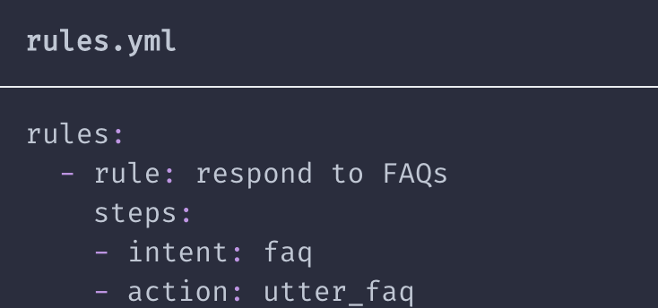
Example - simplest case
Suppose there are 20 different FAQs
Each question can be represented as an individual intent
For each FAQ intent, the assistant retrieves the proper response after interpreting the question
A single action e.g. utter_faq can be used to handle all FAQs by grouping them together under a single retrieval intent given a name e.g. faq.
The single action uses the output of the ResponseSelector to return the correct response for the specific FAQ that the user asked

Slide 49
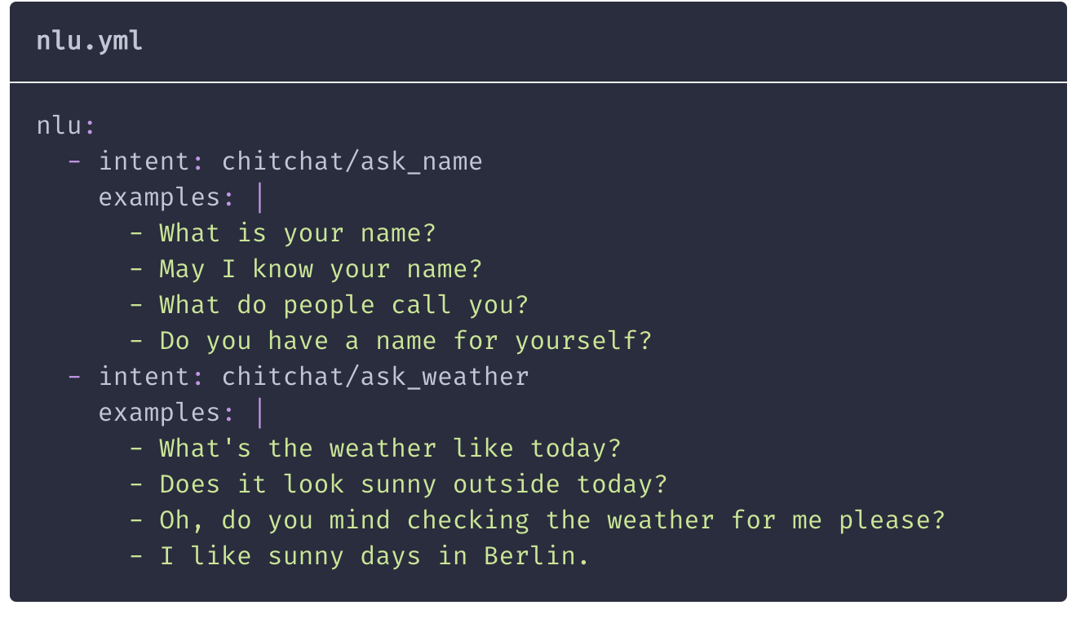
Creating Intents using examples

Slide 50
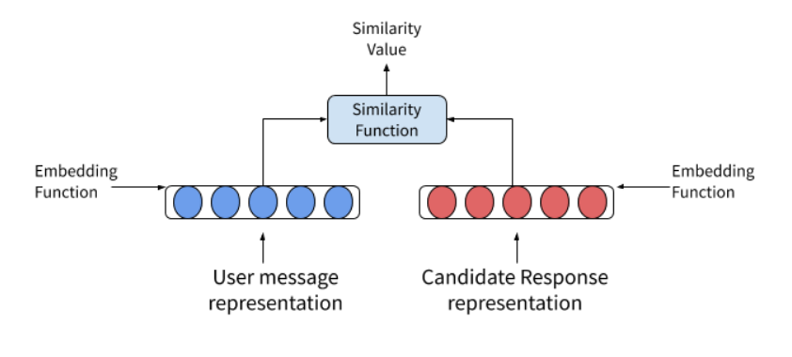
SUPPLEMENTARY - RESPONSE SELECTOR ACTION
Image source: www.rasa.com

Slide 51
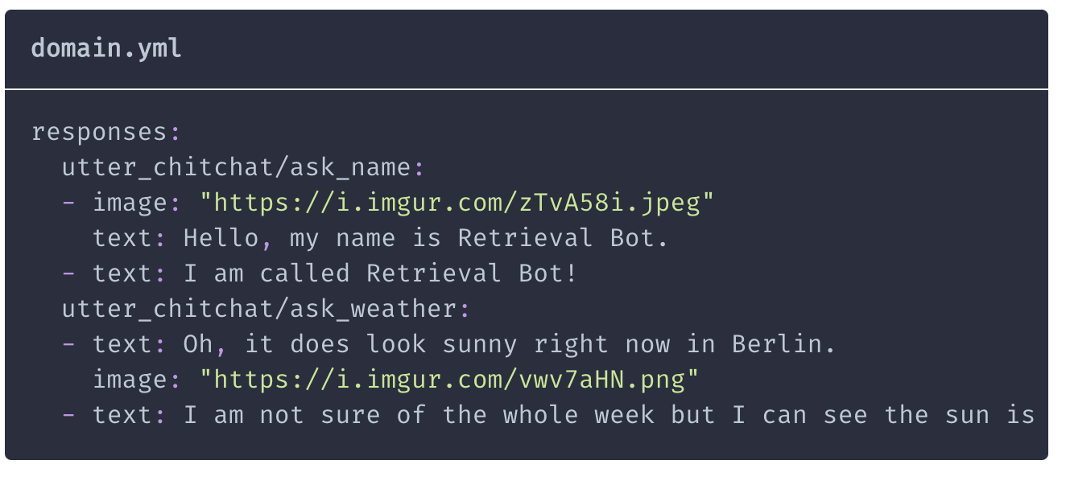
Defining the responses

Slide 52
Knowledge-base Actions
A knowledge base can be used to store complex data structure
InMemoryKnowledgeBase - provide the data in a json file - extensible
Leverage information from knowledge bases inside conversations using `ActionQueryKnowledgeBase`

Slide 53
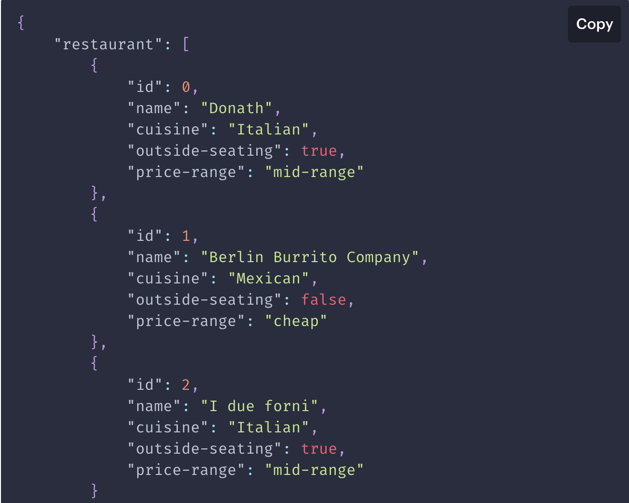
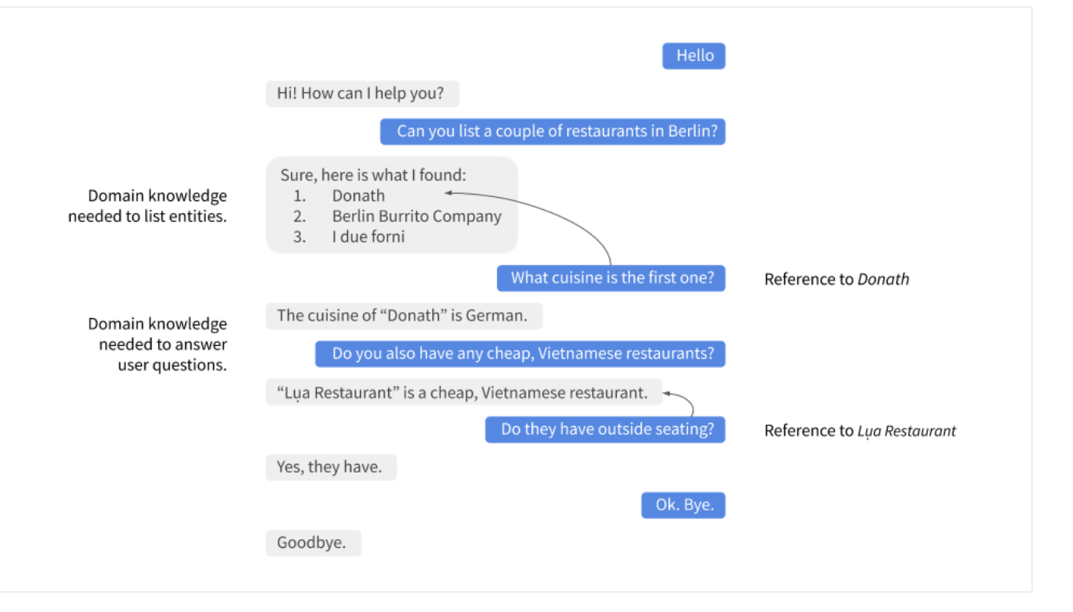
Handling user queries

Slide 54
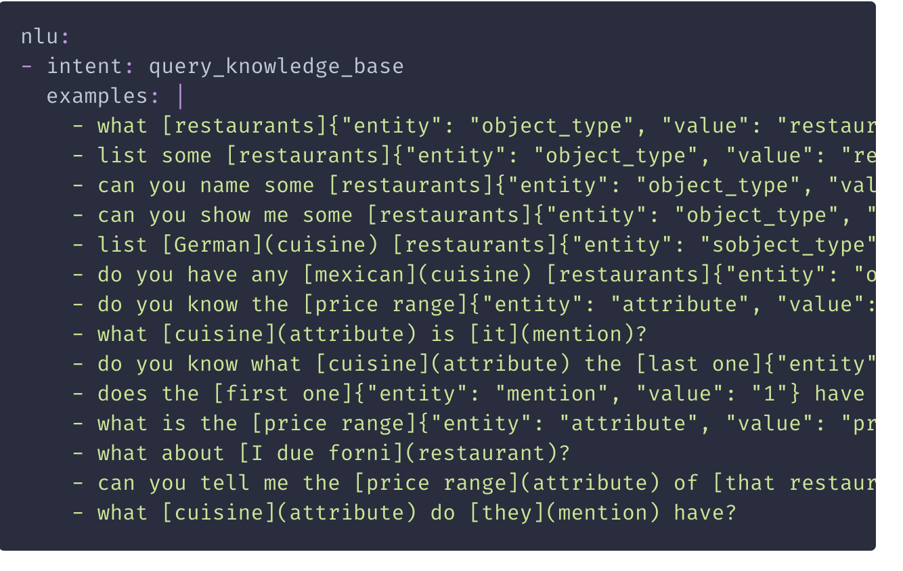
NLU data for handling Knowledge-base queries
Understand intent - introduce a new intent, query_knowledge_base
Mention entities - so that model can detect indirect mentions of objects like “the first one”
Use synonyms extensively
Assumptions for defining Intent
The user wants to obtain a list of objects of a specific type,
The user wants to know about a certain attribute of an object

Slide 55
Handling Unknown / Unexpected queries
Adding a variety of training examples for each query type
Specification and Annotation of the entities in training examples:
Object_type: Whenever a training example references a specific object type from knowledge base - the object type should be marked as an entity
Use synonyms to map e.g. restaurants to restaurant, the correct object type listed as a key in the knowledge base.
Mention: If the user refers to an object via “the first one”, “that one”, or “it”, you should mark those terms as mention.
attribute: All attribute names defined in knowledge base should be identified as attribute in the NLU data
Synonyms should be defined adequately to map variations of an attribute name to the one used in the knowledge base
Pulling information from only one knowledge base is allowed

Slide 56
Action Server
https://rasa.com/docs/action-server/actions

Slide 57
Events
Automatic Tracking:
When a slot is filled by an entity of the same name
Conversations are represented as a sequence of events
Custom actions can influence the course of a conversation by returning events in the response to the action server request.
{
"event": "slot",
"name": "departure_airport",
"value": "BER"
}

Slide 58
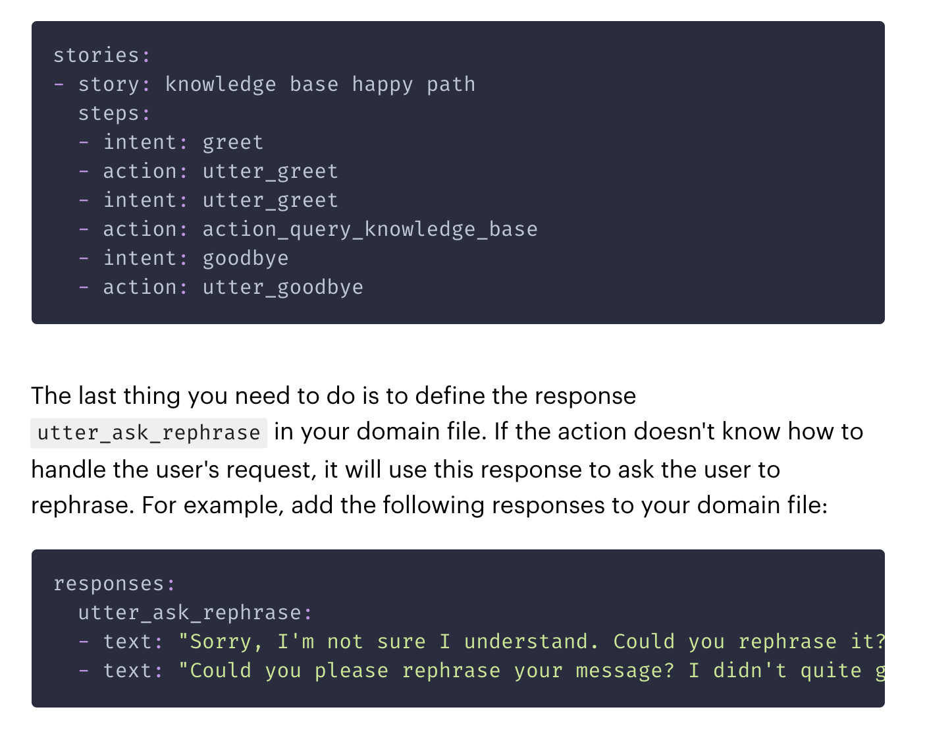
Creating a Story and Response
Defines a possible conversation structure
Defines a response to handle failures

Slide 59
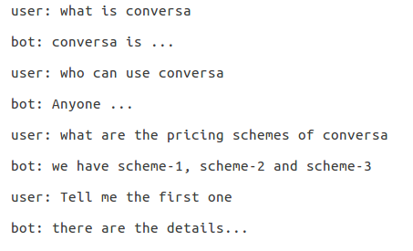
CASE - 1

Slide 60
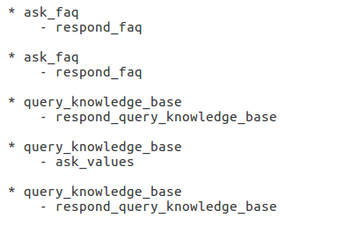
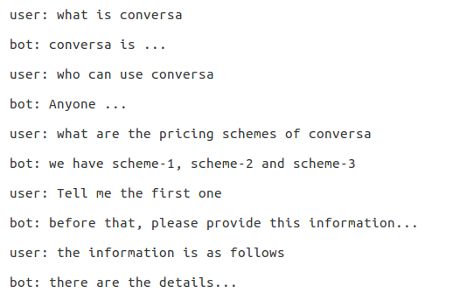
CASE - 2

Slide 61
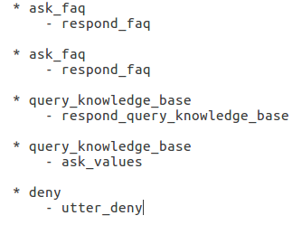
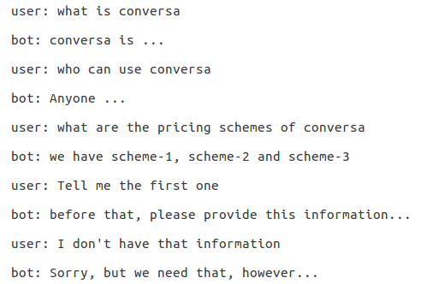
CASE - 3

Slide 62
CASE - 3

Slide 63
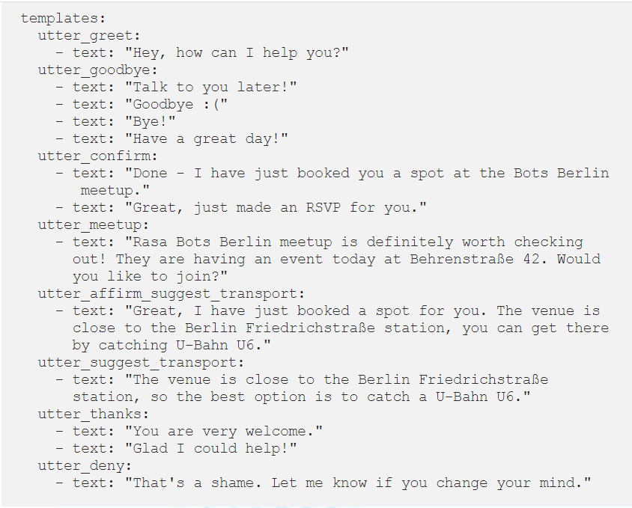
Different ways to say Goodbye - Adding many options makes the chatbot more interesting and prevents it from repeating the same answers in every conversation.
A suggestion

Slide 64
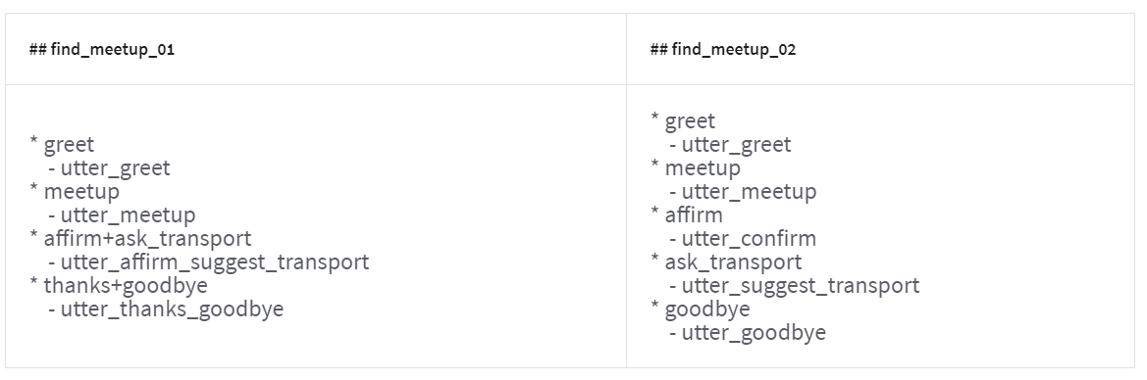
Stories
Multiple intent

Slide 65
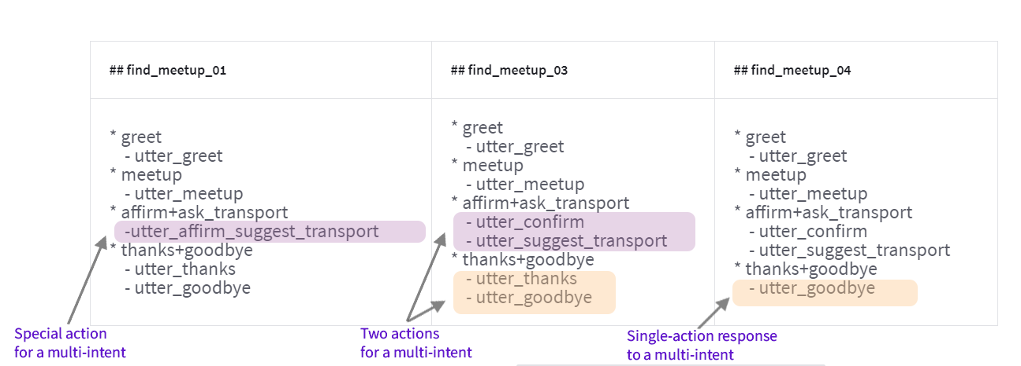

Slide 66
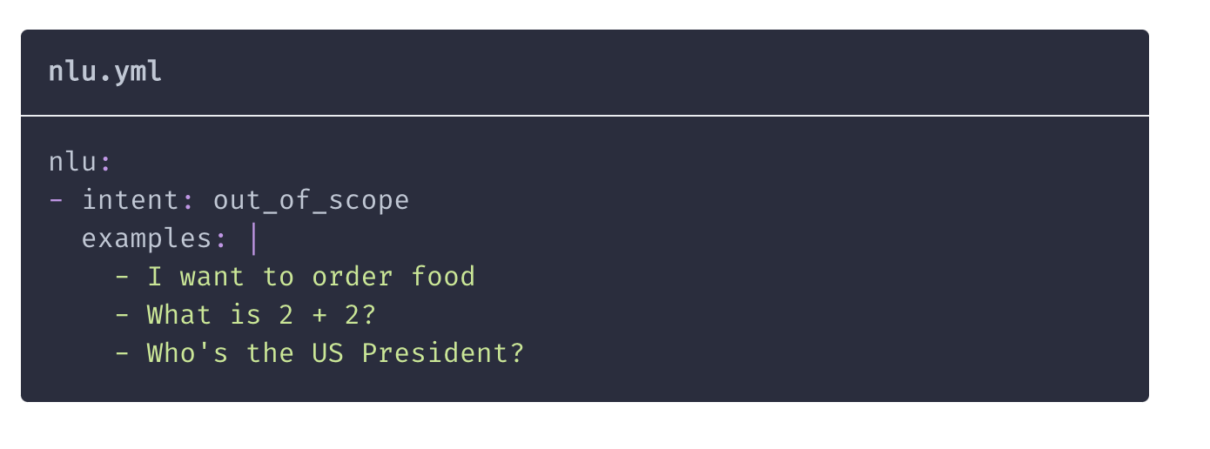
Handling out of scope situations
Users will inevitably say things to a chatbot that the creators did not anticipate
Handling Out-of-scope Messages
best to import these from real deployments

Slide 67
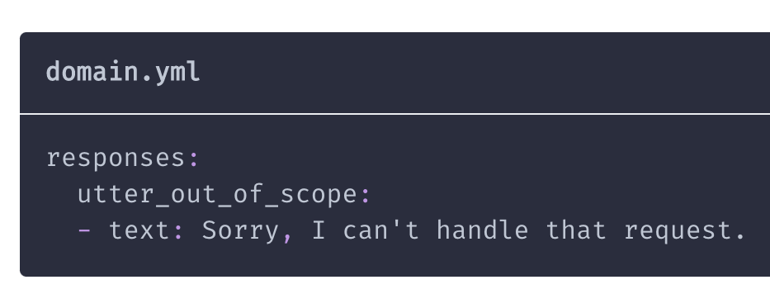
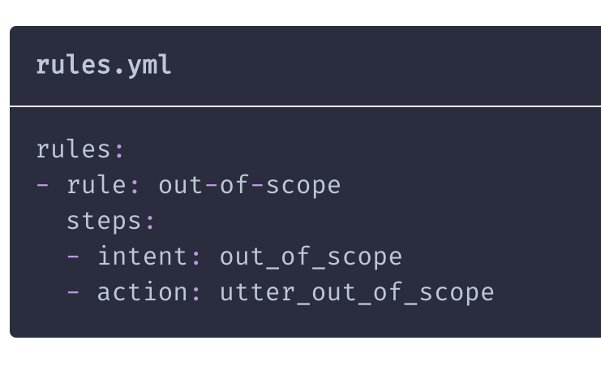
Pre-defined Response
Creating an Out-of-scope rule

Slide 68
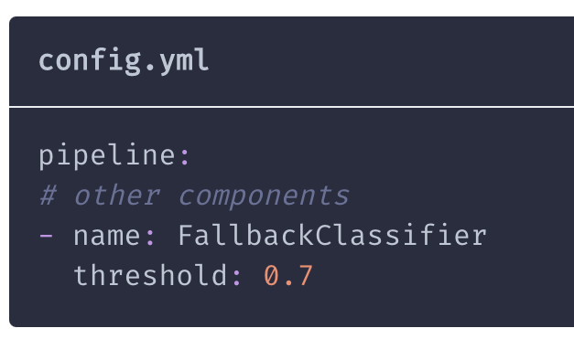
Fallback
For a low-confidence classification value returned by DIET -
Fallbacks will help ensure that these low confidence messages are handled gracefully
Gives the assistant the option to either respond with a default message or attempt to disambiguate the user input

Slide 69
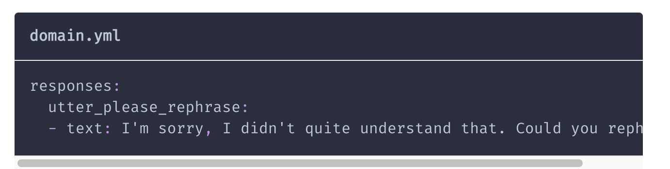
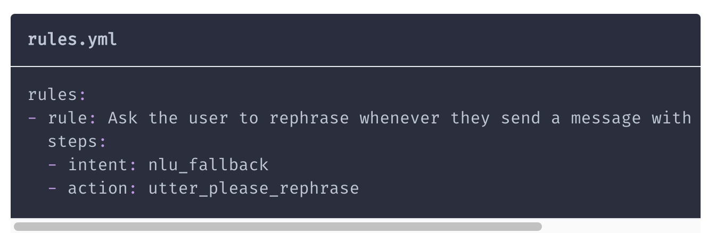
Response and action

Slide 70
Handling Low Action Confidence
Rasa's default TED Policy is optimized to handle these unknown paths.
Two stage fallback
Intent not clear - Rasa rephrases intent and validates from user - Yes or No?
if Yes - then follows usual rule
if No - requests rephrase
It is possible to configure the Rule Policy to predict a default action if no Policy has a next action prediction with confidence above a configurable threshold.
https://rasa.com/docs/rasa/fallback-handoff/#fallbacks

Slide 71
Setting up a Chatbot
Define Purpose
Identify back-end systems to be integrated
List intents
Identify which intent can be handled as simple QA - which ones need more context
Set up FAQ list
Intent classifier - enough examples for each intent
Set up knowledgebase of entities, slots, values, synonyms
Intent classifier - enough samples to learn each intent
Define Policies - learn / rule / default
Define rules
Conversation follows pre-defined path
< intent - response> pairs
Define responses
Write stories
Handle Unexpected Dialogue sequence

Slide 72
Branching in Conversation
stories:
- story: It's raining now
steps:
- intent: check_for_rain
- action: action_check_for_rain
- slot_was_set:
- raining: true
- action: utter_is_raining
- action: utter_bring_umbrella
- story: It isn't raining now
steps:
- intent: check_for_rain
- action: action_check_for_rain
- slot_was_set:
- raining: false
- action: utter_not_raining
- action: utter_no_umbrella_needed
Can be converted into a single story

Slide 73
Using custom code
stories:
- story: check for rain
steps:
- intent: check_for_rain
- action: action_check_for_rain
def run(self, dispatcher, tracker, domain):
is_raining = check_rain()
if is_raining:
dispatcher.utter_message(template="utter_is_raining")
dispatcher.utter_message(template="utter_bring_umbrella")
else:
dispatcher.utter_message(template="utter_not_raining")
dispatcher.utter_message(template="utter_no_umbrella_needed")
return []

Slide 74
Checkpoints
Don’t overdo
stories:
- story: beginning of conversation
steps:
- intent: greet
- action: utter_greet
- intent: goodbye
- action: utter_goodbye
- checkpoint: ask_feedback
story: user provides feedback
steps:
- checkpoint: ask_feedback
- action: utter_ask_feedback
- intent: inform
- action: utter_thank_you
- action: utter_anything_else
story: user doesn't have feedback
steps:
- checkpoint: ask_feedback
- action: utter_ask_feedback
- intent: deny
- action: utter_no_problem
- action: utter_anything_else

Slide 75
Happy Paths
stories:
- story: Customer loses a credit card, reviews transactions, and gets a new card
steps:
- intent: card_lost
- action: check_transactions
- slot_was_set:
- reviewed_transactions: ["starbucks"]
- action: utter_ask_fraudulent_transactions
- intent: inform
- action: action_update_transactions
- intent: affirm
- action: utter_confirm_transaction_dispute
- action: utter_replace_card
- action: mailing_address_form
- active_loop: mailing_address
- active_loop: null
- action: utter_sent_replacement
- action: utter_anything_else
- intent: affirm
- action: utter_help

Slide 76
stories:
- story: Customer loses a credit card, reviews transactions, and gets a new card
steps:
- intent: card_lost
- action: check_transactions
- slot_was_set:
- reviewed_transactions: ["starbucks"]
- action: utter_ask_fraudulent_transactions
- intent: inform
- action: action_update_transactions
- intent: affirm
- action: utter_confirm_transaction_dispute
- action: utter_replace_card
- action: mailing_address_form
- active_loop: mailing_address
- active_loop: null
- action: utter_sent_replacement
- action: utter_anything_else
- intent: affirm
- action: utter_help
Long complicated stories should be broken into smaller ones

Slide 77
- story: Customer reviews transactions and gets a new card
steps:
- action: utter_ask_fraudulent_transactions
- intent: inform
- action: action_update_transactions
- slot_was_set:
- reviewed_transactions: ["target", "starbucks"]
- intent: affirm
- action: utter_confirm_transaction_dispute
- action: utter_replace_card
- action: mailing_address_form
- active_loop: mailing_address
- active_loop: null
- action: utter_sent_replacement
- action: utter_anything_else
- story: Customer has something else they need help with
steps:
- action: utter_anything_else
- intent: affirm
- action: utter_help
stories:
- story: Customer loses a credit card
steps:
- intent: card_lost
- action: utter_card_locked
- action: spending_history_form
- active_loop: spending_history_form
- active_loop: null
- slot_was_set:
- reviewed_transactions: ["starbucks"]
- action: utter_ask_fraudulent_transactions

Slide 78
CREATING YOUR OWN ASSISTANTS
Read the Rasa tutorial at
https://rasa.com/docs/rasa/user-guide/building-assistants/#building-assistants

Slide 79
THANK YOU

