Slide 1





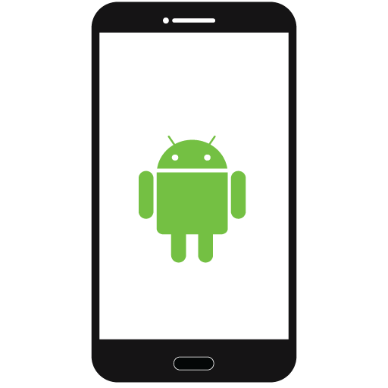

SAP HANA
XS2 Microservices

Slide 2
Outlook and google calendar events
SAP HANA
Activity Information like running, walking etc from IoT devices --fitbit
XS2 Microservices
Location Information
Low Battery Information

Slide 3
Outlook and google calendar events
SAP HANA
Activity Information like running, walking etc from IoT devices --fitbit
XS2 Microservices
Location Information
ODATA V4 calls to XS2 Microservices deployed on cloud foundry updates the user Information to SAP HANA
User’s contact information is pulled from the server when user tries to connect to any of contact and gives status information and warning based on status information
Low Battery Information

Slide 4





Running
Calling contact
Running status
User decided not to call
Notification pushed

