Slide 1

T R A Q B I R D

Slide 2

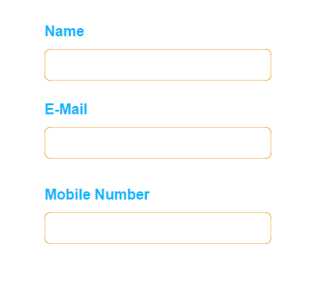

T R A Q B I R D
C A L I B R I ( Body) - 18
Helvetica – 16
efa933 - Orange
00b9ff - Blue
ffffff – White
7a7a7a - Light Grey

Slide 3

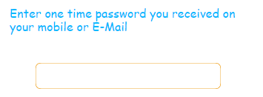

Slide 4
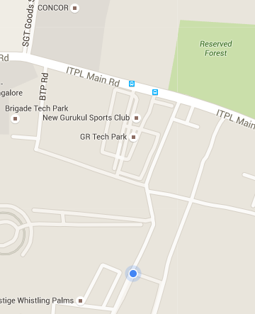


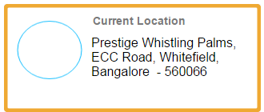
T R A Q B I R D
15
Min

Slide 5
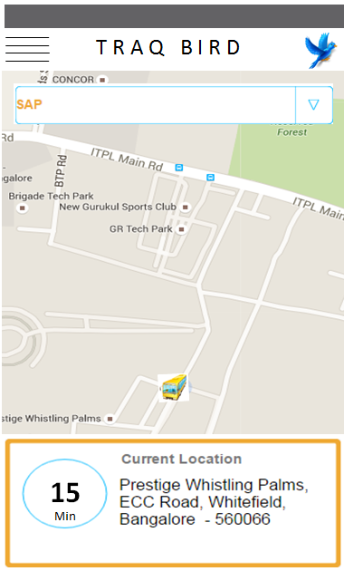

Slide 6
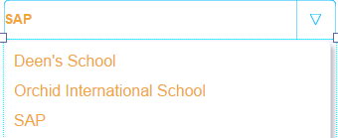

Slide 7

