Slide 1

AI Resume Analyzer
Mini Project Phase-1 Review
JNTUH - CSE Department
Team: Manisha, Manoj, Pobeer

Slide 2
Abstract
AI Resume Analyzer
The AI Resume Analyzer is a web-based tool that automates the evaluation of resumes against job descriptions.
It calculates a match percentage using NLP techniques like TF-IDF and Cosine Similarity, identifies missing skills, and provides improvement tips.
The project aims to streamline resume screening for recruiters and help applicants improve their applications.

Slide 3
Problem Statement
Manual resume screening is tedious, error-prone, and often inconsistent.
Recruiters may overlook suitable candidates due to subjective judgment or keyword mismatches.
Job applicants struggle to evaluate their resume alignment with job descriptions.
This project addresses these issues by automating the analysis and providing actionable feedback.

Slide 4
Literature Survey / Existing System
Existing tools like Jobscan, ResumeWorded, and LinkedIn provide resume analysis but often rely on exact keyword matches, missing contextual similarities and synonyms.
They may not offer direct improvement feedback or adaptability.
Our system bridges this gap using NLP-based phrase matching and skill-based scoring.

Slide 5
Proposed System
Users can upload resumes (PDF) and input job descriptions.
The system extracts text, cleans it, and applies TF-IDF-based similarity checks with a skill list to calculate a match percentage.
Missing skills are highlighted with tips for improvement, benefiting both job seekers and recruiters.

Slide 6
System Requirements
Hardware :
- Laptop with minimum 4GB RAM
- At least 500 MB of free disk space
Software : - Python 3.11+ - Flask - VS Code - NLTK - PyPDF2 - Bootstrap - Render (deployment)
Technologies used :
- Python - Flask - NLTK - PyPDF2 - TF-IDF & Cosine Similarity - Bootstrap - Render

Slide 7
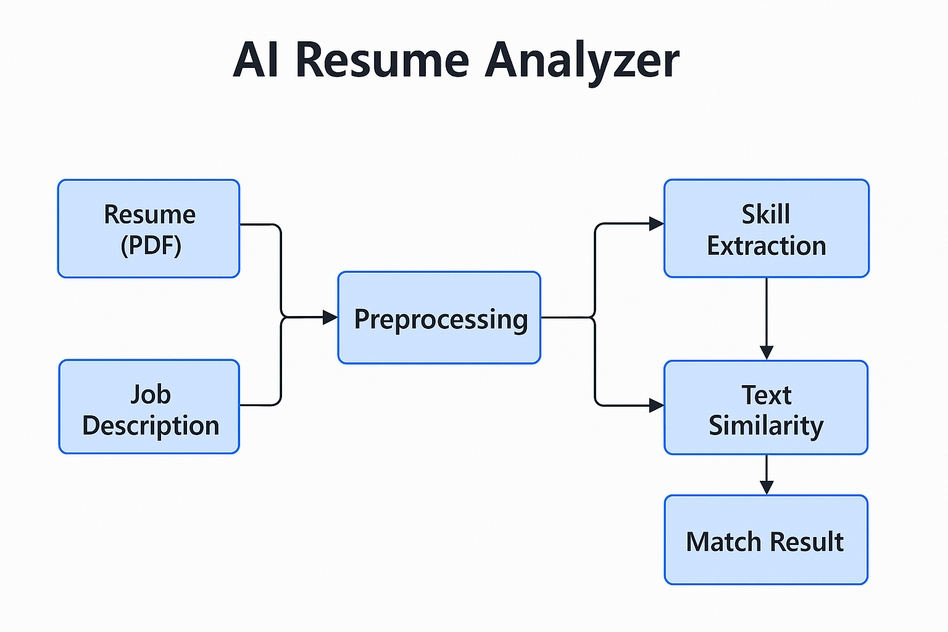
Architecture Diagram

Slide 8
Project Plan / Timeline
Phase 1: Problem Analysis and Literature Survey
Phase 2: Environment Setup and Flask Integration
Phase 3: Resume Parsing and Skill Extraction
Phase 4: Matching Logic & Output Generation
Phase 5: Frontend, Testing & Deployment
Phase 6: Documentation and Final Review

Slide 9
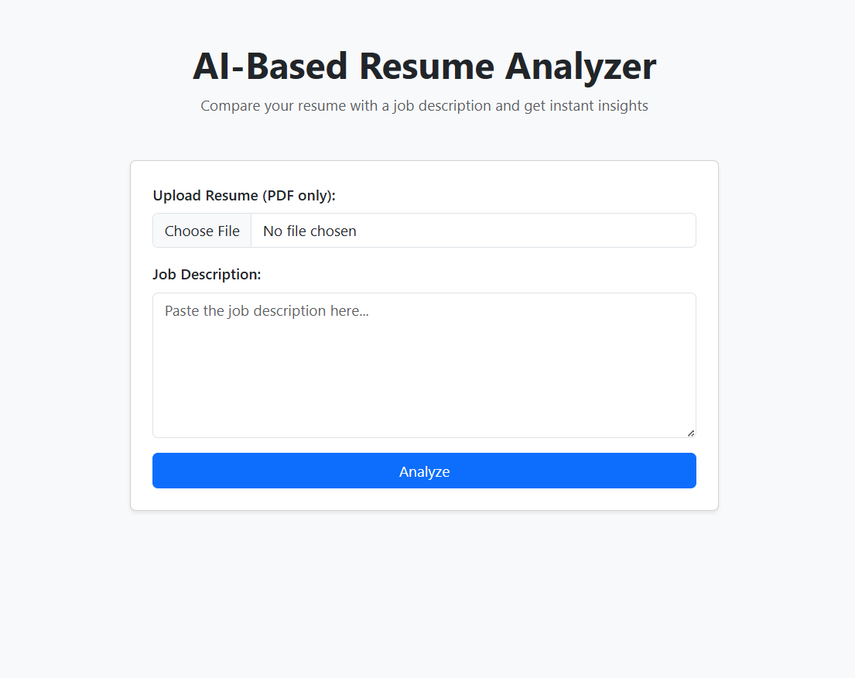
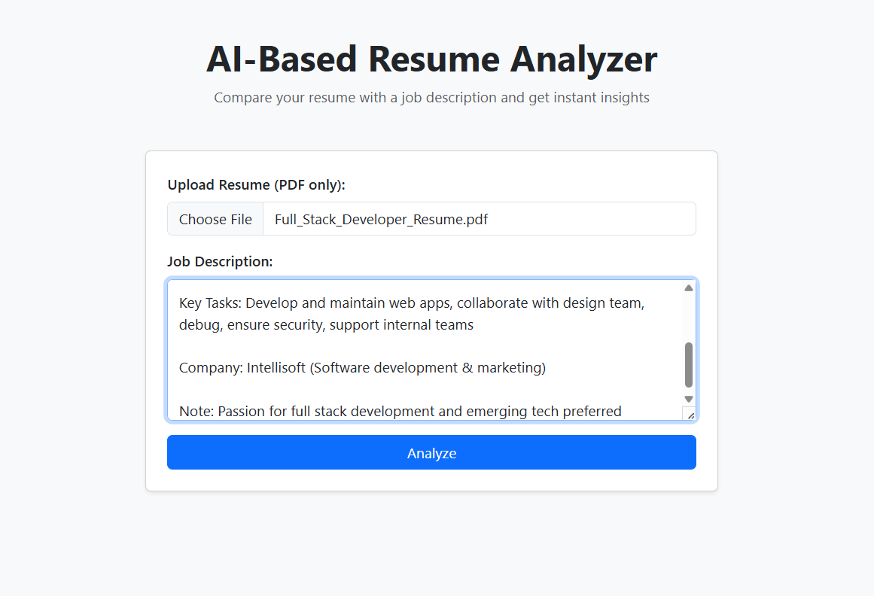
Partial Implementation / Demo

Slide 10
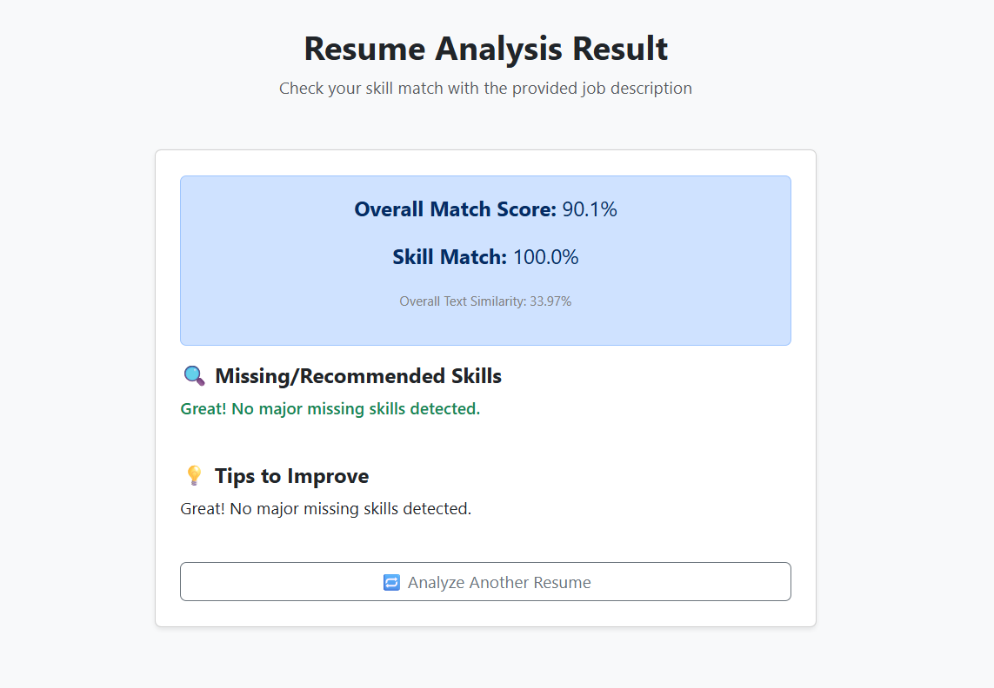
Partial Implementation / Demo (Result)

Slide 11
Team Members & Roles
Manisha: UI/UX design, testing, documentation
Manoj: Core developer (backend, testing, deployment)
Pobeer: Dataset preparation, testing, support

Slide 12
References
- https://flask.palletsprojects.com/
- https://scikit-learn.org/
- https://www.nltk.org/
- https://render.com/docs/deploy-flask
- https://jobscan.co/

Slide 13


