Slide 1
AI Resume Analyzer
Mini Project Review - Phase 1
Jawaharlal Nehru Technological University, Hyderabad

Slide 2
1. Abstract
AI Resume Analyzer is a web-based tool designed to automatically evaluate a candidate's resume against a given job description. It uses Natural Language Processing (NLP) techniques and TF-IDF based cosine similarity to extract and compare skills. The objective is to streamline resume screening, highlight missing skills, and provide actionable tips. Developed using Flask, Python, and Bootstrap, the system aims to assist both recruiters and applicants in improving hiring relevance and efficiency.

Slide 3
2. Problem Statement
Manual resume screening is time-consuming, inconsistent, and error-prone. Recruiters often miss relevant candidates due to keyword mismatches or subjective judgment. Similarly, applicants lack tools to evaluate how well their resumes align with job requirements. There is a need for an automated, intelligent system that can bridge this gap by analyzing both resumes and job descriptions semantically and skill-wise.

Slide 4
3. Literature Survey / Existing System
Several platforms like Jobscan, ResumeWorded, and LinkedIn offer resume analysis tools. However, many are commercial, lack customization, or do not use contextual matching. Some systems depend on exact keyword matching, missing out on synonymous or related skills. Others do not provide actionable feedback or highlight missing skills directly. Our system overcomes these limitations with NLP-based phrase matching and skill weighting.

Slide 5
4. Proposed System
The proposed system allows users to upload a resume and paste a job description. It extracts text, cleans and compares it using TF-IDF similarity and predefined skill lists. It outputs a skill match percentage, missing skills, and improvement tips. This helps applicants fine-tune resumes and aids recruiters in shortlisting.

Slide 6
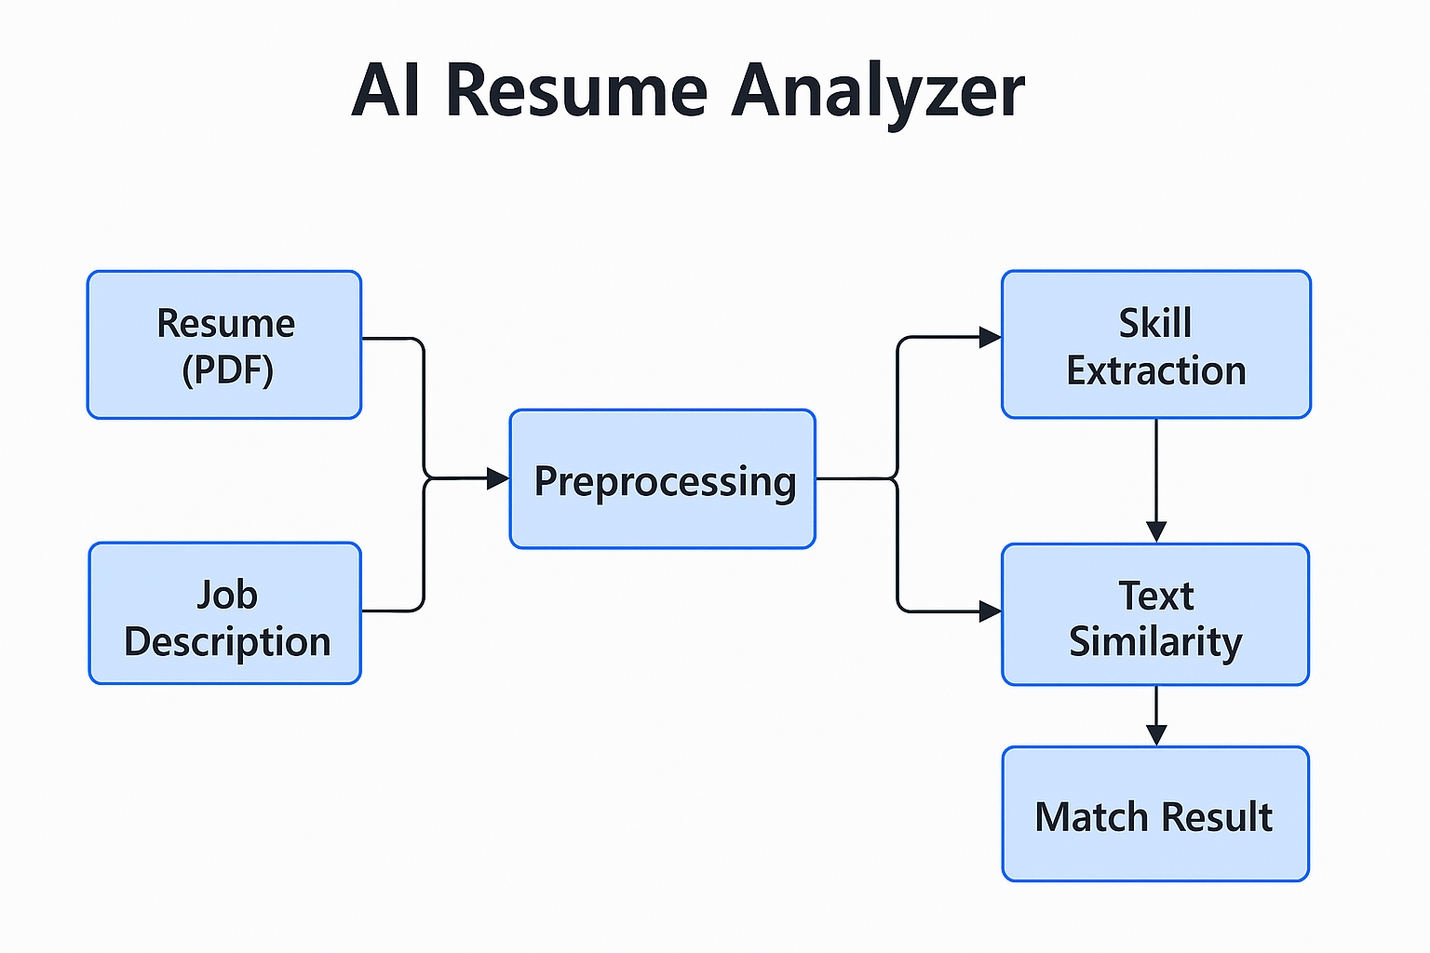
5. Architecture Diagram

Slide 7
6. System Requirements
Hardware Requirements:
- Laptop with minimum 4GB RAM
- Internet connection
Software Requirements:
- VS Code, Python 3.11+, Git
- Flask, NLTK, Scikit-learn, PyPDF2, Gunicorn
- Bootstrap, HTML/CSS

Slide 8
7. Technologies Used
- Python
- Flask (Web Framework)
- NLTK (Natural Language Processing)
- TF-IDF + Cosine Similarity
- PyPDF2 (Resume Text Extraction)
- Bootstrap (Frontend UI)
- Render (Deployment)

Slide 9
8. Project Plan / Timeline (Phase-wise)
Phase 1: Problem Analysis and Literature Survey
Phase 2: Environment Setup and Flask Integration
Phase 3: Resume Parsing and Skill Extraction
Phase 4: Matching Logic & Output Generation
Phase 5: Frontend, Testing & Deployment
Phase 6: Documentation and Final Review

Slide 10
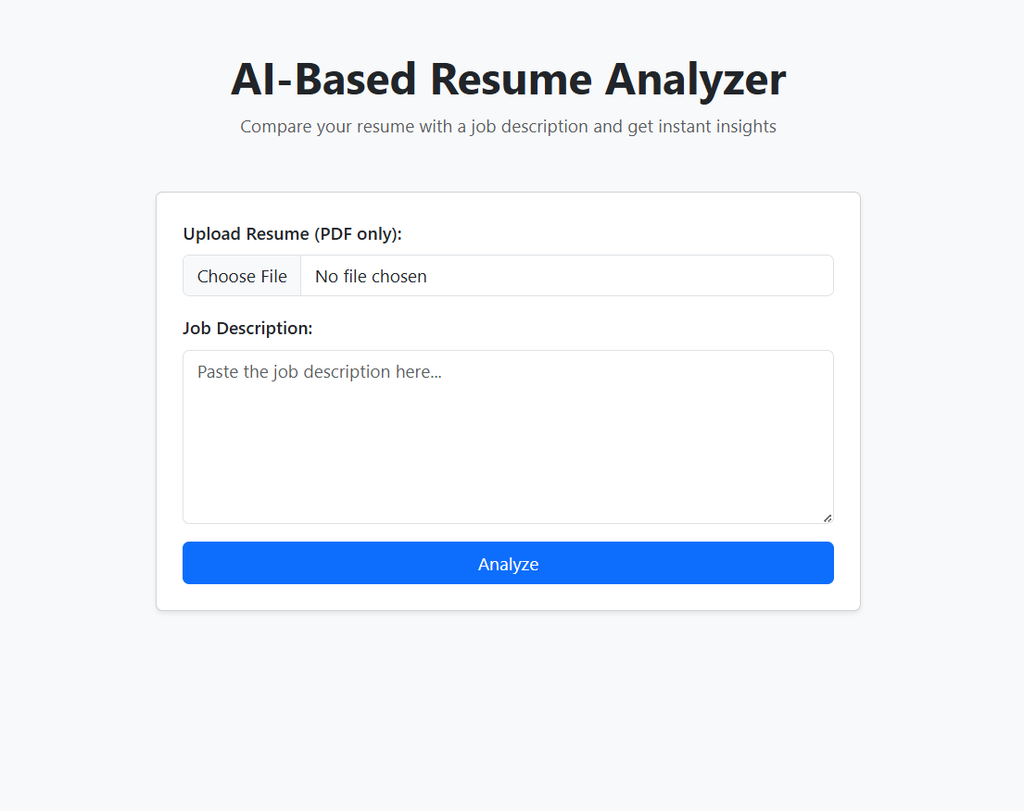
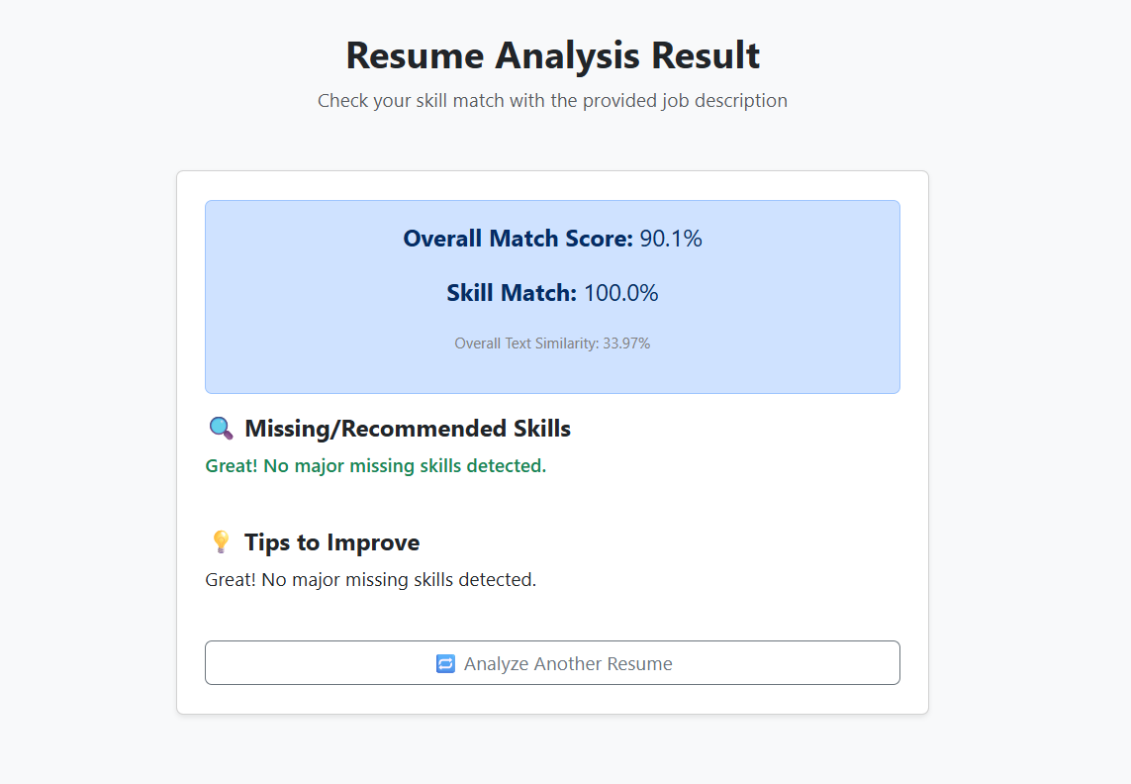
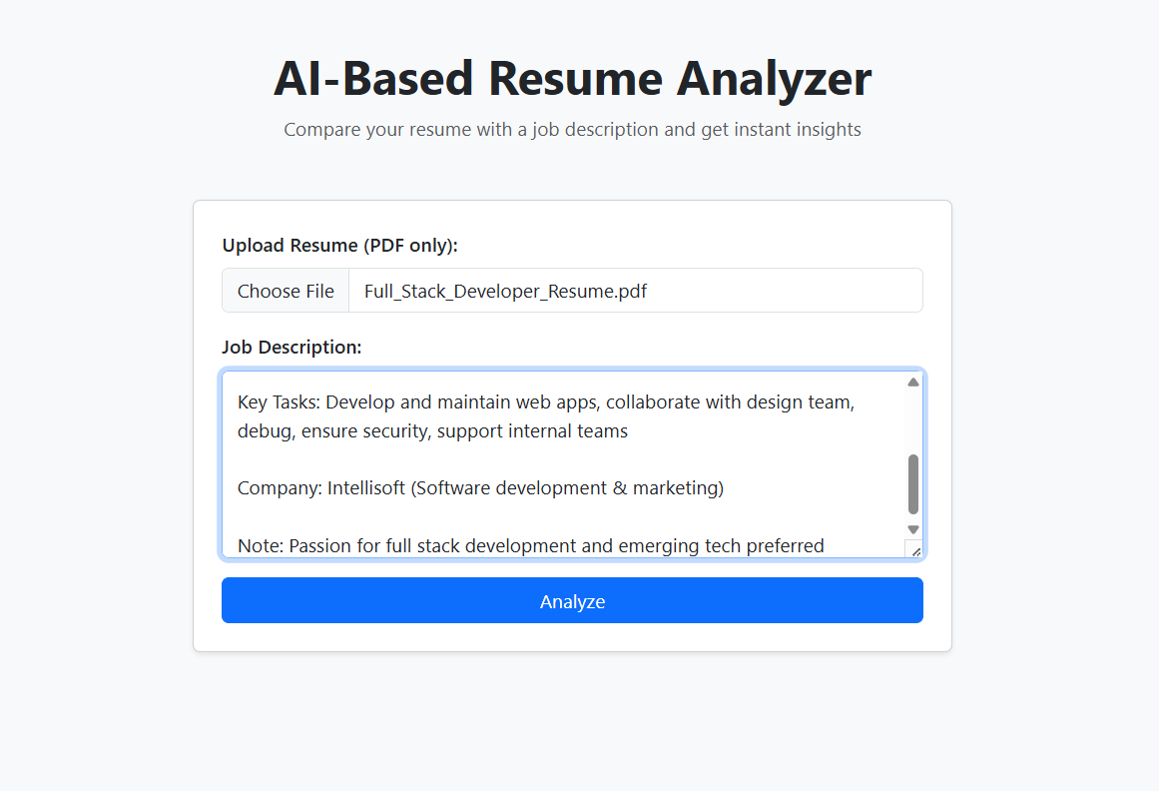
9. Implementation Screenshots

Slide 11
10. Team Members & Roles
- Manoj: Core developer (Flask app, skill logic, TF-IDF, deployment)
- Manisha: UI design, HTML/CSS/Bootstrap, testing, documentation
- Pobeer: Resume & JD dataset prep, input testing, support tasks

Slide 12
11. References
- https://flask.palletsprojects.com/
- https://scikit-learn.org/
- https://www.nltk.org/
- https://render.com/docs/deploy-flask
- https://jobscan.co/ (for comparison)
- OpenAI (for project guidance and support)

