Slide 1
AI Resume Analyzer
Mini Project Review - Phase 1
Jawaharlal Nehru Technological University, Hyderabad

Slide 2
1. Abstract
AI Resume Analyzer is a web tool that analyzes resumes against job descriptions using Natural Language Processing (NLP). It uses TF-IDF and cosine similarity along with a skill-matching algorithm to provide a match score, highlight missing skills, and offer improvement tips. It helps both recruiters and applicants enhance hiring relevance and quality.

Slide 3
2. Problem Statement
Manually screening resumes is inefficient, subjective, and error-prone. Recruiters may overlook qualified candidates, and applicants lack insight into how well their resumes align with job requirements. A system that automates this analysis using AI can greatly improve accuracy, speed, and fairness in hiring.

Slide 4
3. Literature Survey / Existing System
Platforms like Jobscan and ResumeWorded offer resume analysis tools, but are commercial and often limited. They rely on exact keyword matching and lack transparency in skill evaluation. Most tools do not provide personalized feedback or allow skill customization.
Our system addresses these gaps with an open, skill-driven approach using NLP, TF-IDF, and user-friendly design.

Slide 5
4. Proposed System
The user uploads a resume PDF and pastes a job description. The system extracts, cleans, and compares content using TF-IDF similarity and skill overlap. It outputs match percentage, highlights missing skills, and gives custom tips for resume improvement. The solution is lightweight, deployable, and user-friendly.

Slide 6
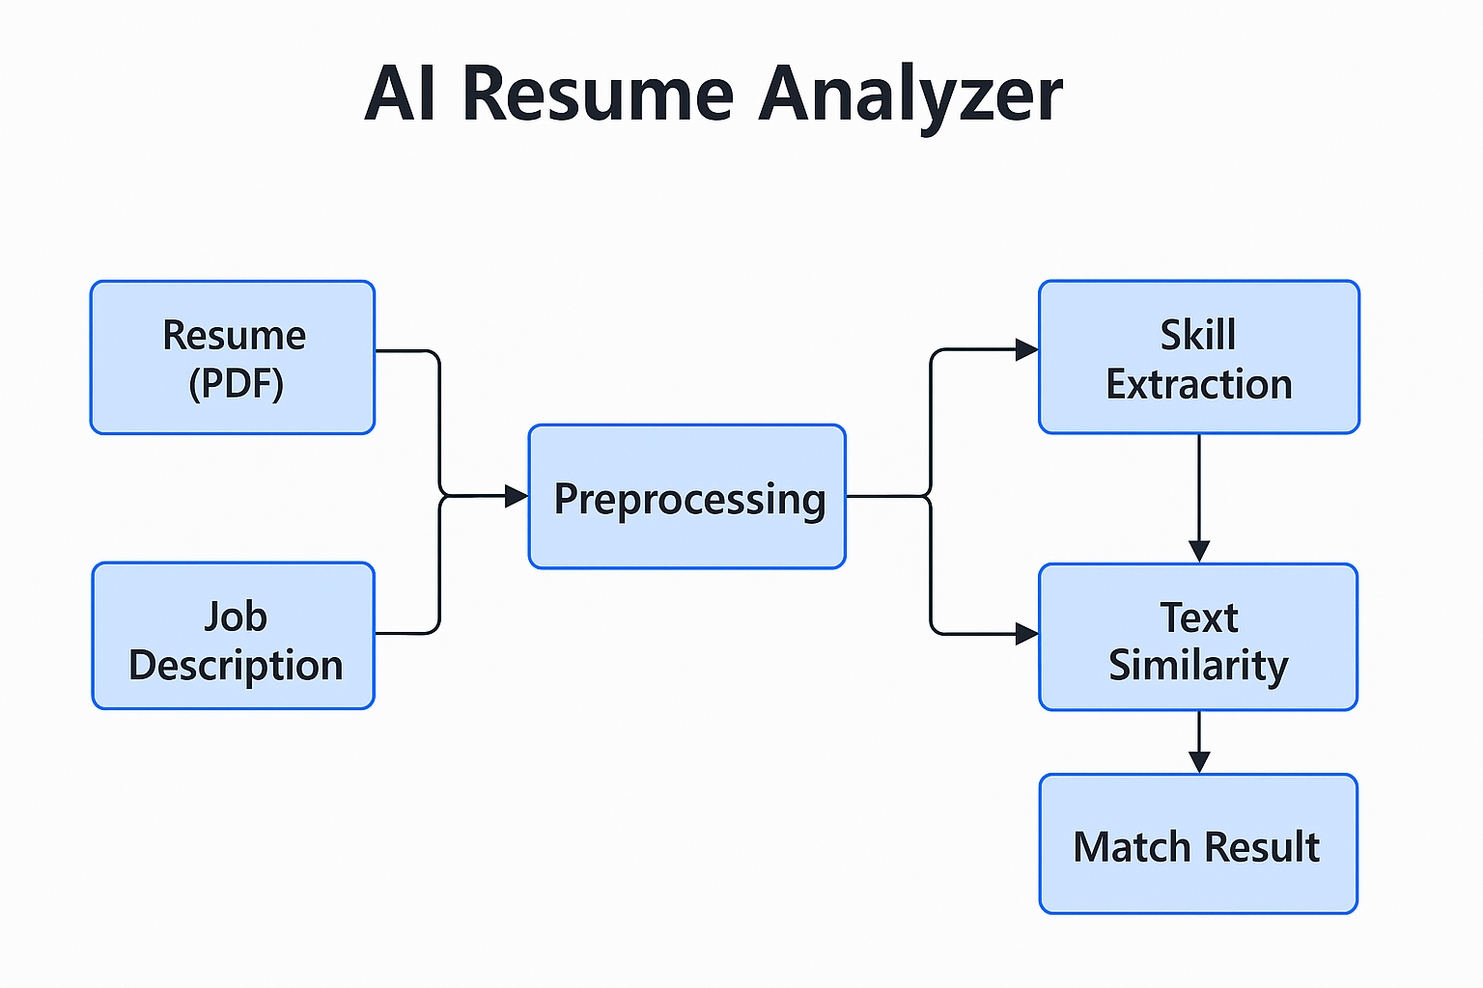
5. Architecture Diagram

Slide 7
6. System Requirements & Technologies Used
Hardware Requirements:
- Laptop with minimum 4GB RAM
- Internet connectivity
Software Requirements:
- VS Code, Python 3.11+
- Flask, NLTK, Scikit-learn, PyPDF2
- Bootstrap, HTML/CSS, Git, Render
Technologies/Stack Used:
- Python, Flask (Web Framework)
- NLTK (NLP), TF-IDF, Cosine Similarity
- Bootstrap (UI), PyPDF2 (PDF Parsing)

Slide 8
7. Project Plan / Timeline
Phase 1: Requirement Gathering & Problem Analysis
Phase 2: Flask Environment Setup & Skill Extraction Logic
Phase 3: Resume Upload & JD Matching Functionality
Phase 4: UI Design, Output Generation & Matching Score Logic
Phase 5: Deployment, Testing & Final Demo Preparation

Slide 9
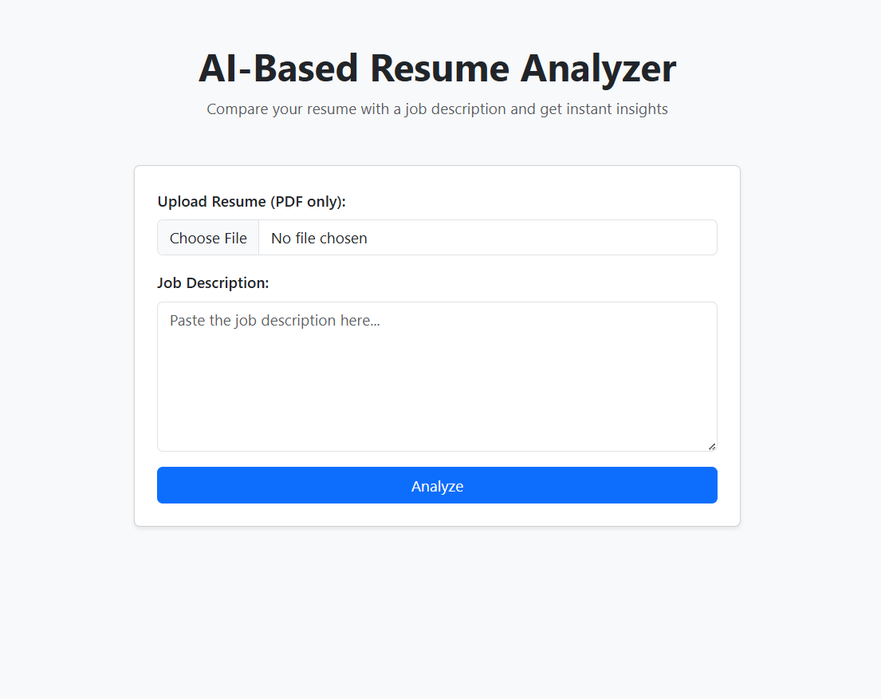
8. Resume Upload UI

Slide 10
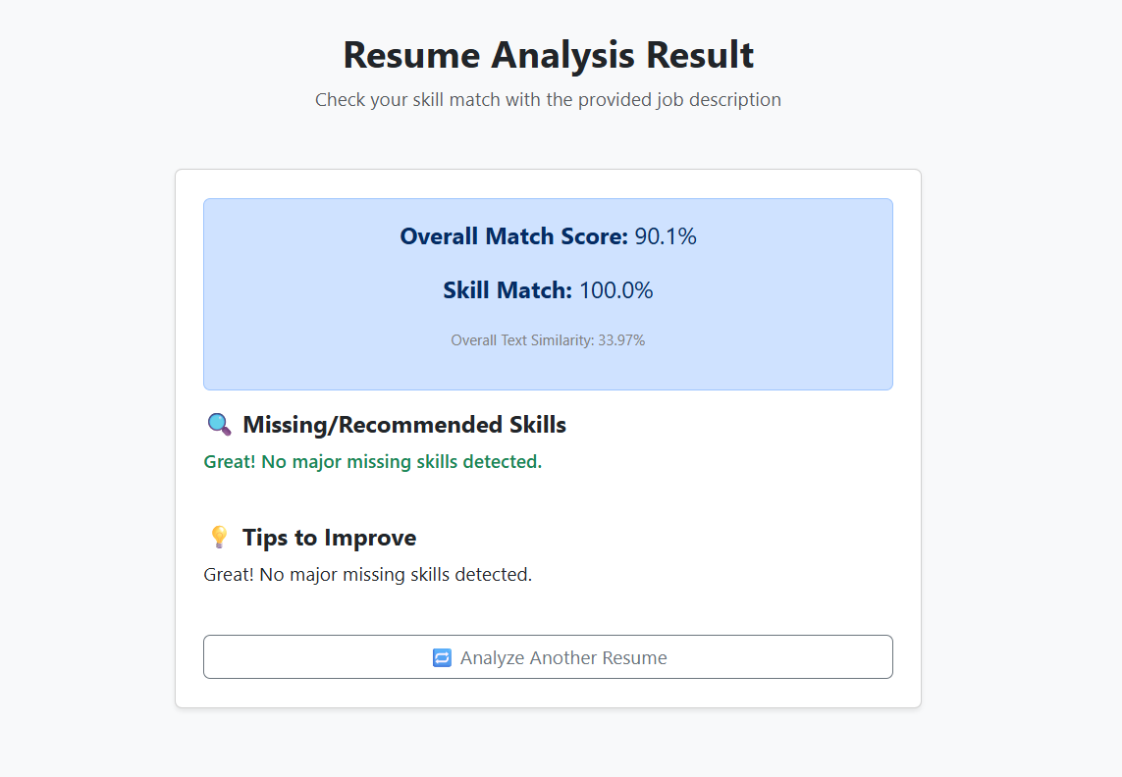
9. Analysis Result Output

Slide 11
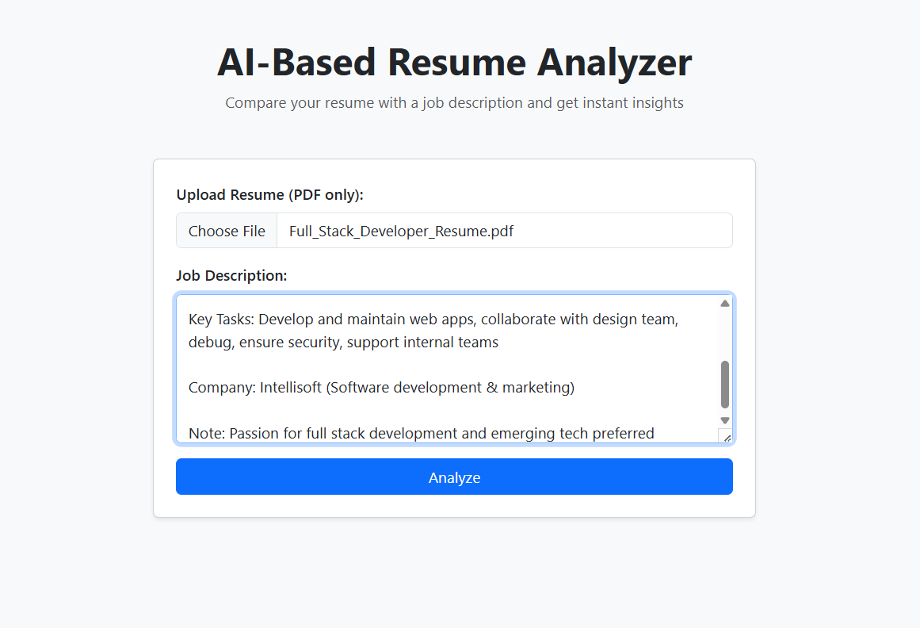
10. Job Description Input

Slide 12
11. Team Members & Roles
- Manoj: Core backend logic (Flask app, NLP, TF-IDF, Deployment)
- Manisha: Frontend design (HTML, CSS, Bootstrap, Output UI, Testing)
- Pobeer: Job description input testing, resume variations, documentation support

Slide 13
12. References
- https://flask.palletsprojects.com/
- https://scikit-learn.org/
- https://nltk.org/
- https://render.com/docs
- https://jobscan.co/
- OpenAI & ChatGPT (project planning and debugging support)

