Slide 1
1. Project Title & Abstract
Project Title: AI Resume Analyzer
Abstract:
The AI Resume Analyzer is a web-based application that compares resumes against job descriptions, identifying missing skills, measuring text similarity, and providing actionable tips.
It uses Natural Language Processing (NLP) techniques like TF-IDF and Cosine Similarity to evaluate content relevance and job fit.
This system helps job seekers tailor their resumes for better opportunities and supports HR teams in initial resume screening.
Technologies: Python, Flask, HTML/CSS, Bootstrap, NLTK, Scikit-learn

Slide 2
2. Problem Statement
Manual resume screening is time-consuming and error-prone.
Candidates often submit generic resumes that lack alignment with job requirements.
HR teams struggle to match resumes to varied job descriptions quickly.
There is no easy tool for candidates to self-check how well their resumes match specific jobs.
This project solves these challenges using NLP-based automation for better job-role matching.

Slide 3
3. Literature Survey / Existing System
Existing systems like Jobscan and SkillSyncer offer resume analysis but are often paid or limited in functionality.
They lack transparency in match score calculation and do not provide skill-based feedback in detail.
Our system improves by offering a transparent, open-source, skill-aware analysis with detailed insights and recommendations.

Slide 4
4. Proposed System
The system allows users to upload a resume and paste a job description.
It extracts text from the resume and compares it with the job description using TF-IDF + Cosine Similarity.
Predefined skill lists are used to detect missing skills.
Match score, skill match %, missing skills, and improvement tips are shown clearly.
Clean and responsive UI built with Bootstrap.

Slide 5
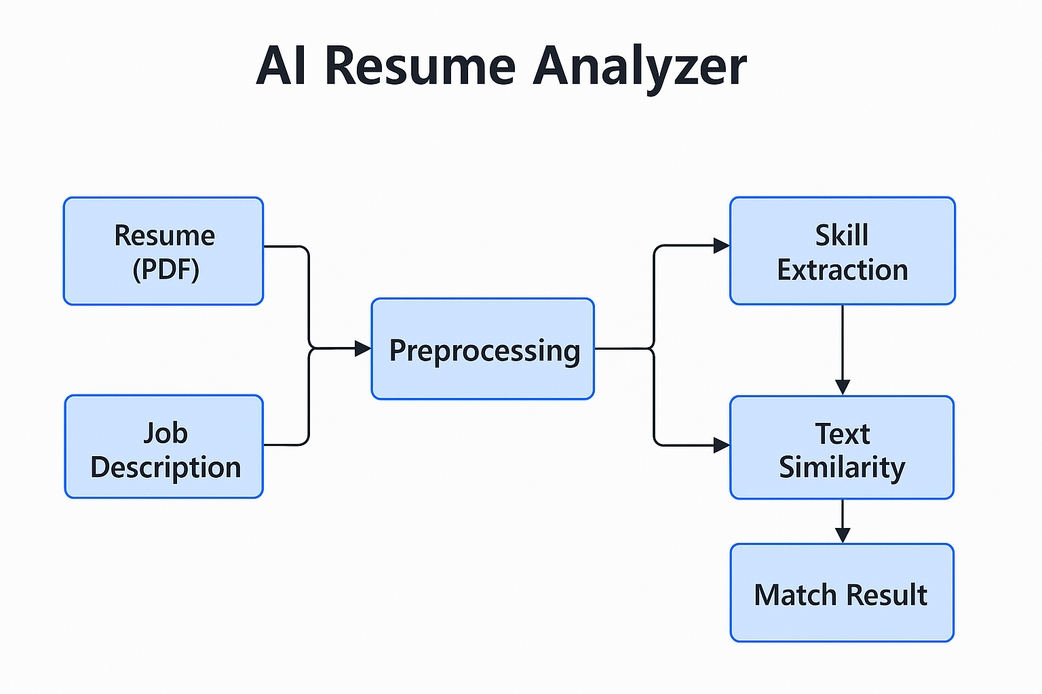
5. Architecture Diagram
The architecture involves frontend (upload, display), backend (Flask server, NLP processing),
and logic modules (PDF parsing, skill matching, similarity calculation).

Slide 6
6. System Requirements
Hardware Requirements:
- 4GB RAM Laptop
- Any modern web browser
Software Requirements:
- VS Code / Any IDE
- Python 3.10+
- Flask, NLTK, Scikit-learn, pdfminer.six
- Bootstrap 5

Slide 7
7. Project Plan / Timeline
Week 1-2: Problem definition, planning, tool research
Week 3: Skill list preparation, initial UI setup
Week 4-5: Flask backend, PDF parsing, text preprocessing
Week 6: TF-IDF + Cosine Similarity logic
Week 7: Result display UI + Match % + Skills analysis
Week 8: Deployment on Render + Testing
Review 1: Completed features = Full workflow tested locally with UI

Slide 8
8. Partial Implementation / Demo
• Resume upload (PDF) and job description input working
• Text extraction, cleaning, and tokenization implemented
• Skill list filtering + TF-IDF similarity model working
• Responsive UI pages ready (index.html, result.html)
• Tested locally, deployment completed

Slide 9
9. Team Members' Roles
Manoj: Lead Developer (Flask Backend, NLP Logic, Deployment)
Manisha: UI/UX Developer, Skill Extraction & Match Logic
Pobeer: Testing, Content Writing, Data Entry, Debugging

Slide 10
10. References
• NLTK documentation – https://www.nltk.org/
• Scikit-learn TF-IDF Vectorizer – https://scikit-learn.org/
• Flask Web Framework – https://flask.palletsprojects.com/
• Bootstrap – https://getbootstrap.com/
• Stack Overflow & Medium Blogs – for implementation guides

