Slide 1

Mini project - Food Price Prediction:
Abstract :
Food prices are crucial in influencing household budgets and economic policies. This project, titled 'Food Price Prediction', aims to forecast the prices of essential food commodities such as rice, wheat, sugar, onion, milk, and oil. Using historical pricing data, the project implements a machine learning model to predict future prices and visualize trends.
Developed using Python, the system utilizes libraries like Pandas, Matplotlib, and Scikit-learn for data processing, visualization, and modeling. Streamlit is used to create an interactive web application. The expected outcome is a deployed web app that allows users to select a food item and a date to view the predicted price along with historical trends.
This tool is intended for use by students, researchers, farmers, and small retailers who need better price insights to make informed decisions.

Slide 2
Problem Statement:
The volatility of food prices makes it difficult for consumers and vendors to plan budgets and manage inventory.
Traditional forecasting methods are either manual or not easily accessible.
A machine learning-based prediction tool can provide users with price estimates and help them plan better.
There is a lack of affordable and user-friendly tools that offer localized food price forecasting in real-time, especially for small retailers and students.

Slide 3
Literature Survey / Existing System:
Existing systems primarily use statistical tools or fixed datasets without real-time prediction.
Many platforms lack interactivity and user-friendliness.
Most existing tools are not open-source or customizable by students or local businesses.
Our system aims to fill these gaps by offering a modular, user-driven prediction tool with visualizations.

Slide 4
Proposed System:
The proposed system allows users to select a food item and date to get a price prediction.
It features an interactive web interface, historical price trend charts, and a lightweight machine learning model trained on cleaned data.
The entire project is modular and easily deployable.

Slide 5
System Requirements:
Hardware Requirements:
- PC or Laptop with at least 4 GB RAM
Software Requirements:
-Python 3.10+
-Thonny IDE / VS Code
Technologies Used:
- Python,
-Pandas,
-Matplotlib,
-Scikit-learn,
-Github,
-Streamlit

Slide 6
Project Plan / Timeline:
Phase | Tasks Completed
Review 1 | Problem definition, dataset creation, preprocessing
Review 2 | Model training, UI integration
Final Review | Deployment, testing, documentation

Slide 7
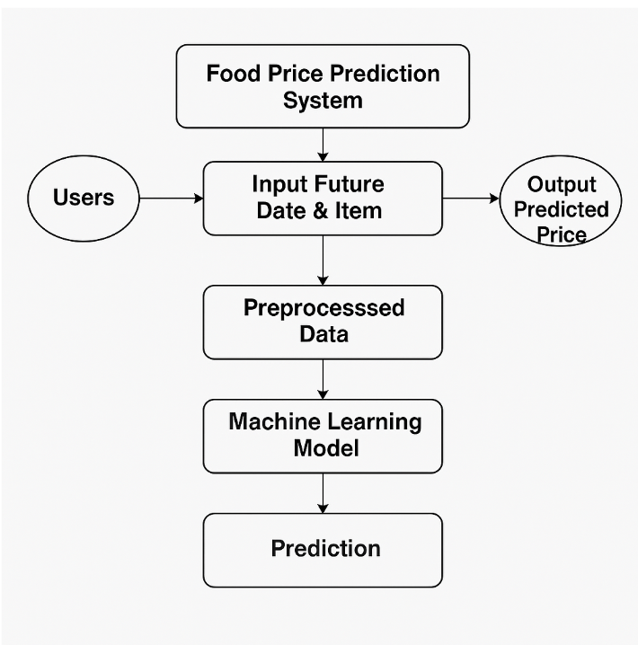
Architecture:

Slide 8
Partial Implementation :
The following components of the project have been successfully implemented so far:
Dataset Preparation & Cleaning A synthetic dataset was created containing food prices for multiple essential items. Date formatting issues and missing values were handled, and new features like Day, Month, and Year were extracted.
Feature Engineering The cleaned dataset was enriched with time-based features, and food item names were prepared for use in machine learning models.
Basic Machine Learning Model A Linear Regression model was trained using the processed data. The model predicts prices based on the selected item and date, and it was serialized using joblib for use in the app.
Initial Streamlit App Setup A basic user interface was built using Streamlit. It includes:
Dropdown for selecting a food item
Date input for the prediction
A predicted price display
A line chart showing historical price trends

Slide 9
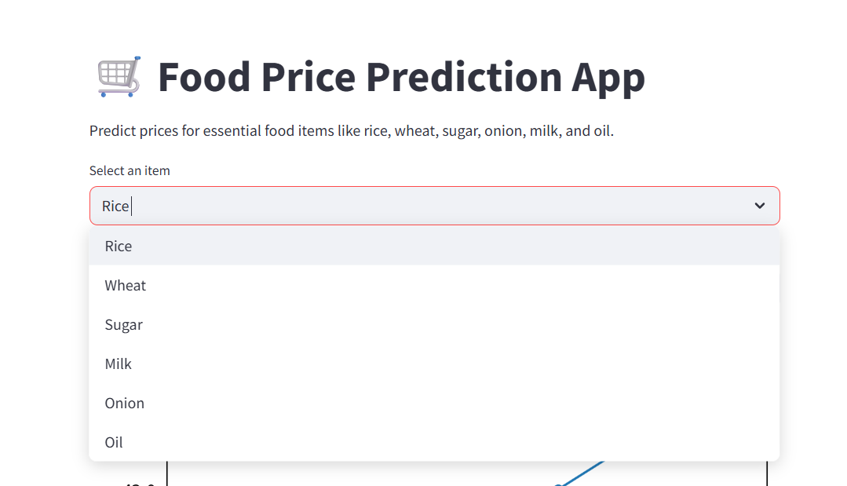
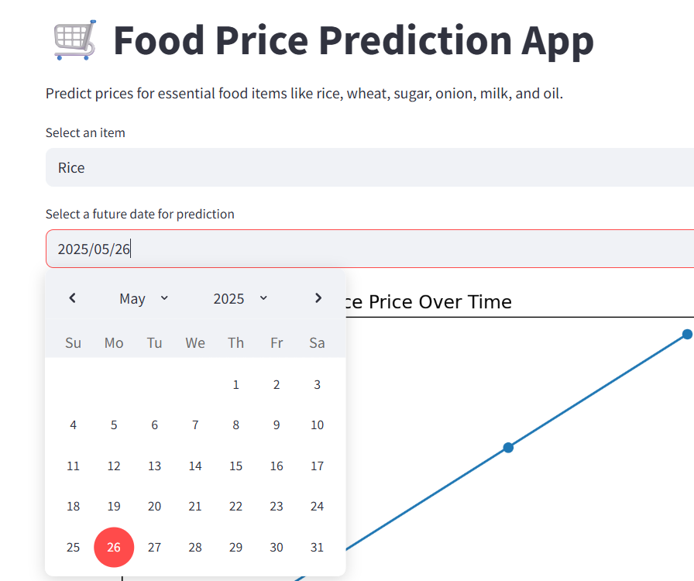
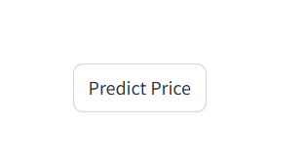
Features:
Item selection
Date selection
Predict price button

Slide 10
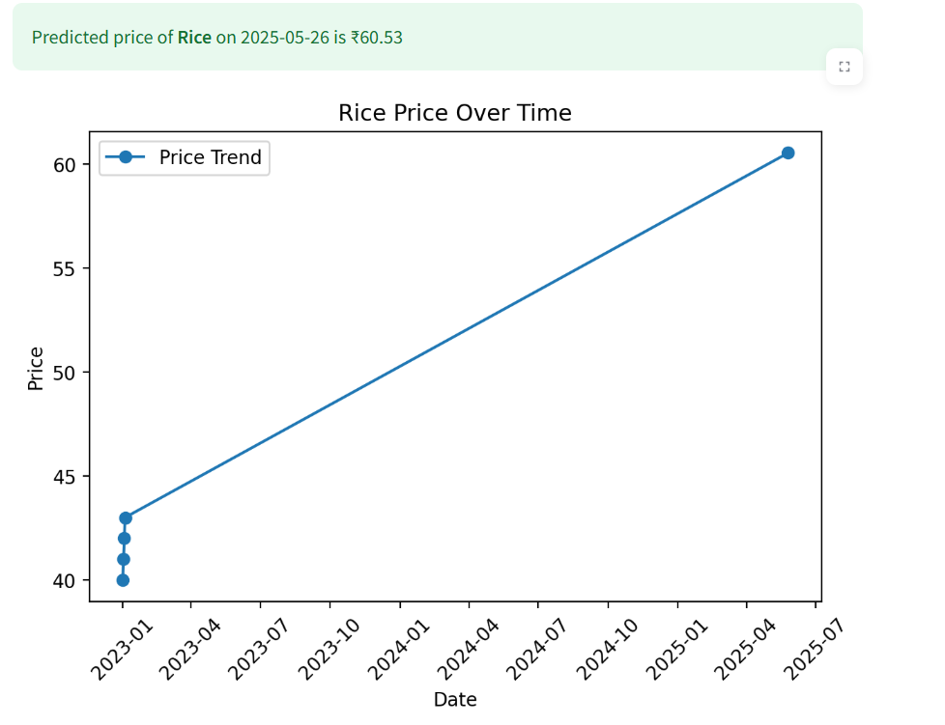
Output:
Predicted price with price visualization over time

Slide 11
Conclusion:
Successfully developed and deployed a real-time food price prediction tool
Built an end-to-end pipeline: Data → Model → App → Deployment
Useful for learning, research, and small-scale forecasting

Slide 12
Team members & their roles:
Name | Role
Mohammed Idris | Model development, Streamlit UI, deployment
Naveen Kumar | Data preprocessing, EDA, backend integration
Praneetha | Documentation, app testing, enhancements

Slide 13
References:
- https://scikit-learn.org
- https://pandas.pydata.org
- https://docs.streamlit.io
- Research papers and online tutorials on food price forecasting

Slide 14
THANK YOU

