Slide 1

WIRELESS AND MOBILE COMMUNICATION (EC 751)
Presented by:
Dr Dhiraj Kumar Patel
DoECE, IIIT Surat

Slide 2
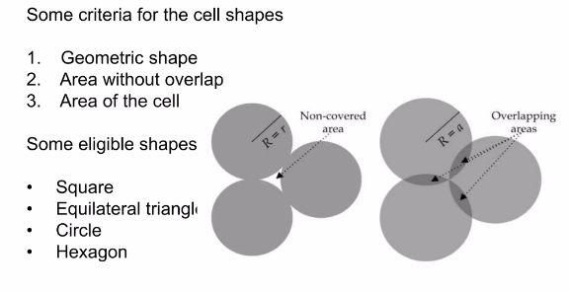
Shape of cell

Slide 3
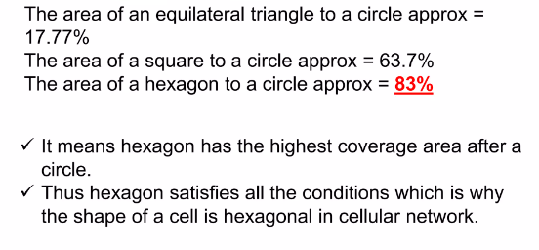
Area comparison

Slide 4
Why Hexagonal cell shape?
The Hexagonal cell shape is universally adapted since it permits easy and manageable analysis of system. The actual shape is known as foot print and is determined from field measurements or propagation prediction models.
Circles cannot be selected as cell shape because adjacent circles cannot be overlaid upon a map without leaving gaps or creating overlap regions.
Other choices – polygons like a square, an equilateral triangle and a regular hexagon.
A cell site must be designed to serve the weakest mobile within the footprint and these are typically located at the edge of the cell. For a given distance between the centre of the polygon and its farthest perimeter points, the hexagon has the largest area of the three.
So, by using hexagonal geometry the fewest no. of cells can cover a geographic region and also hexagon closely approx. a circle
Also, if omni directional antenna is used by a base station then its radiation pattern is circular. So hexagon is the suitable choice. The actual footprint is determined by the contour in which a given transmitter serves the mobile successfully.

Slide 5
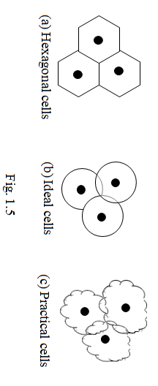
CELL
Theoretically (for analysis purpose) the cell shape is considered as hexagonal with no overlapping between adjacent cells as shown in fig. 1.5(a).
Such a shape cannot be generated in a real world. It will simplify the design and planning of this system. Ideally we require circular overlapped cells as shown in fig. 1.5(b)
But this makes the drawing unclear.
The real shape of a cell is as shown in fig. 1.5(c)
The cell size depends on traffic density and geographical features.

Slide 6
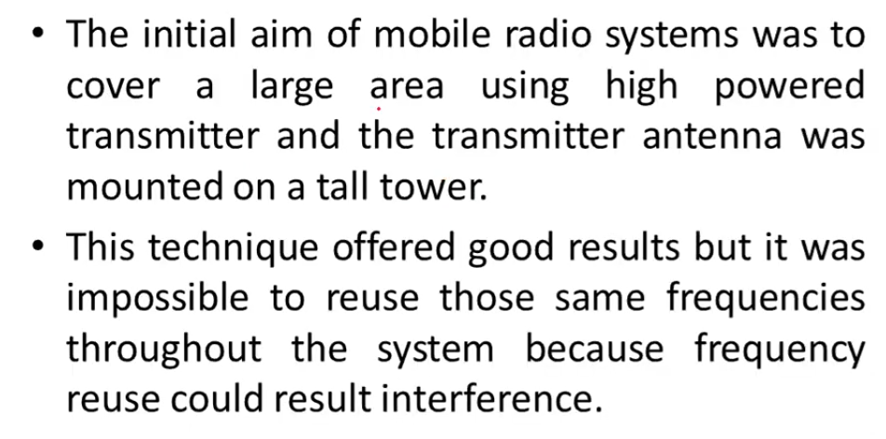
INTRODUCTION TO CELLULAR CONCEPT

Slide 7
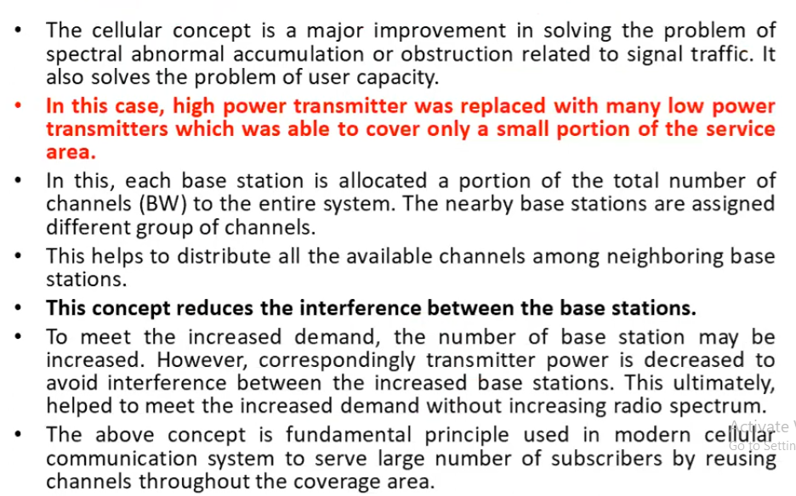

Slide 8
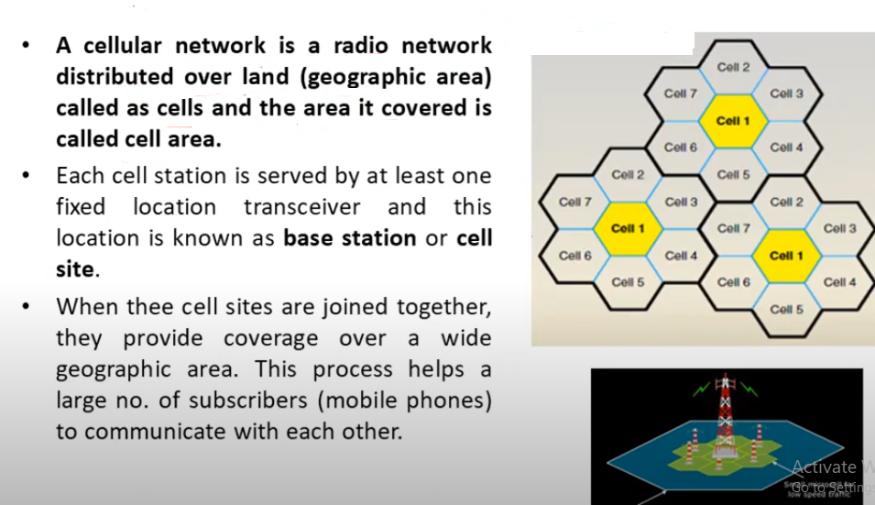
CELL AREA

Slide 9
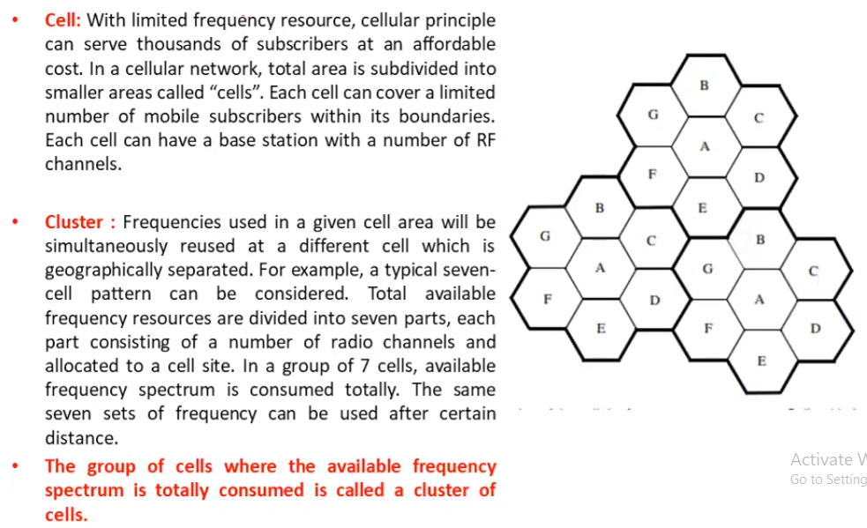
CELLS AND CLUSTER

Slide 10
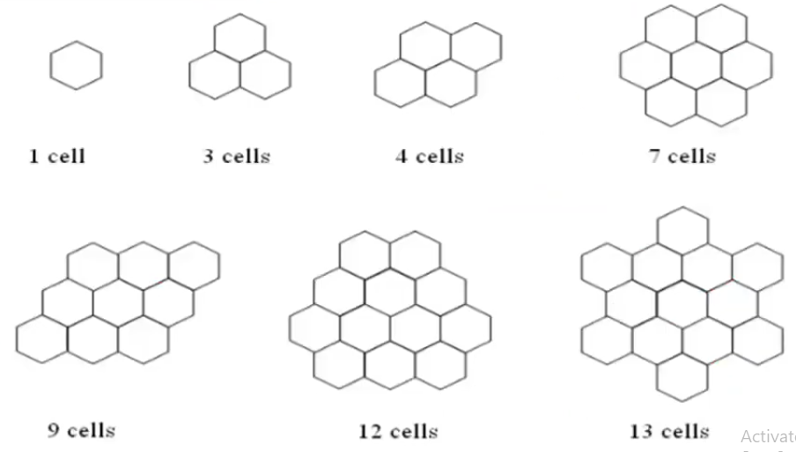
CLUSTER PATTENS

Slide 11
Concept of Frequency Reuse
In frequency reuse, a group of local cells use different frequencies to transmit/receive signals in their cell. This group of local cells is referred to as a cluster.
Total spectrum allocated to the service provider is broken up into smaller bands. Neighboring cells are assigned a different frequency band. This ensures that nearby transmissions do not interfere with each other.
The same frequency band is reused in another cell that is far away. This large distance limits the interference caused by this co-frequency cell. Cellular relies on the intelligent allocation and re–use of radio channels throughout a coverage area. Each base station is allocated a group of radio channels to be used within the small geographic area of its cell. Neighbouring base stations are given different channel allocation from each other

Slide 12
Concept of Frequency Reuse
Frequency reuse is the technique of using the same radio frequencies across several cell sites in a cellular network. The cells are organized so that the same frequencies can be reused in non-adjacent cells, which leads to reducing interference and increasing spectrum efficiency.
Frequency Reuse is the scheme in which allocation and reuse of channels throughout a coverage region is done. Each cellular base station is allocated a group of radio channels or Frequency sub-bands to be used within a small geographic area known as a cell. The shape of the cell is Hexagonal.
The process of selecting and allocating the frequency sub-bands for all of the cellular base stations within a system is called Frequency reuse or Frequency Planning.

Slide 13
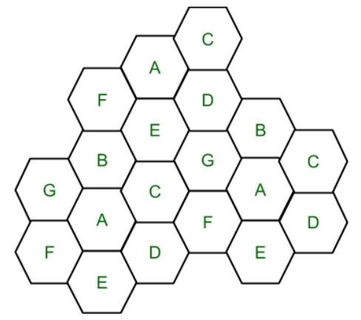
Features Frequency Reuse
Frequency reuse improves spectral efficiency and signal Quality (QoS).
The frequency reuse classical scheme proposed for GSM systems offers protection against interference.
The number of times a frequency can be reused depends on the tolerance capacity of the radio channel from the nearby transmitter that is using the same frequencies.
Cell with the same letter uses the same set of channels group or frequencies sub-band.
To find the total number of channel allocated to a cell:
S = Total number of duplex channels available to use
k = Channels allocated to each cell (k<S)
N = Total number of cells or Cluster Size
Then Total number of channels (S) will be,
S = kN Frequency Reuse Factor = 1/N

Slide 14
In the above diagram cluster size is 7 (A,B,C,D,E,F,G) thus frequency reuse factor is 1/7. N is the number of cells which collectively use the complete set of available frequencies is called a Cluster.
The value of N is calculated by the following formula: N = I² + I*J + J²
Where I,J = 0,1,2,3… Hence, possible values of N are 1,3,4,7,9,12,13,16,19 and so on. If a Cluster is replicated or repeated M times within the cellular system, then Capacity, C, will be,
C = MkN = MS

Slide 15
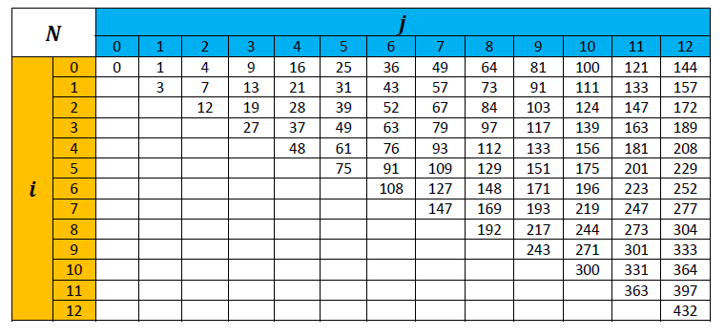

Slide 16
In Frequency reuse there are several cells that use the same set of frequencies. These cells are called Co-Channel Cells. These Co-Channel cells results in interference. So to avoid the Interference cells that use the same set of channels or frequencies are separated from one another by a larger distance. The distance between any two Co-Channels can be calculated by the following formula:
D = R * (3 * N)^{1/2}
Where, R = Radius of a cell N = Number of cells in a given cluster

Slide 17
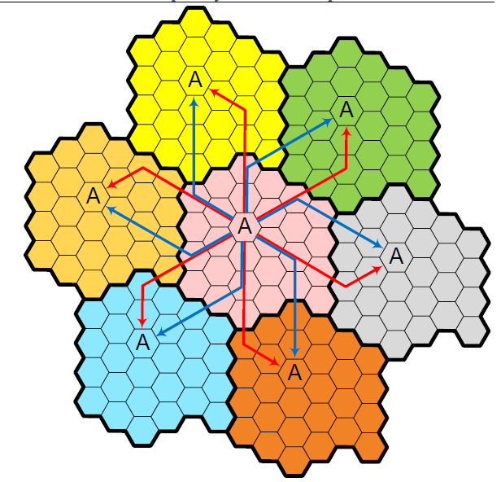
We see that the nearest cells with the same channel group A (Called Co‐Channel Cells) can be located by:
1. Moving perpendicular to any of the 6 surfaces of the original cell and passing over i=4 cells then rotating 60° counter‐clock wise and moving along j=2 cells to reach all adjacent cochannel cells (RED Arrows),
2. Moving perpendicular to one of the surfaces of the original cell and passing over j=2 cells then rotating 60° clock wise and moving along i=4 cells to reach all adjacent co‐channel cells (BLUE Arrows).

Slide 18
Example 1
If a total of 33 MHz of bandwidth is allocated to a particular FDD cellular telephone system which uses two 25 kHz simplex channels to provide full duplex voice and control channels, compute the number of channels available per cell if a system uses (a) four-cell reuse, (b) seven-cell reuse, and (c) 12-cell reuse. If 1 MHz of the allocated spectrum is dedicated to control channels, determine an equitable distribution of control channels and voice channels in each cell for each of the three systems.
Solution:
Given: Total bandwidth = 33 MHz
Channel bandwidth = 25 kHz × 2 simplex channels = 50 kHz/duplex channel
Total available channels = 33,000/50 = 660 channels
(a) For N = 4, total number of channels available per cell = 660/4 ≈ 165 channels.
(b) For N = 7, total number of channels available per cell = 660/7 ≈ 95 channels.
(c) For N = 12, total number of channels available per cell = 660/12 ≈ 55 channels.

Slide 19
A 1 MHz spectrum for control channels implies that there are 1000/50 = 20 control channels out of the 660 channels available. To evenly distribute the control and voice channels, simply allocate the same number of voice channels in each cell wherever possible. Here, the 660 channels must be evenly distributed to each cell within the cluster. In practice, only the 640 voice channels would be allocated, since the control channels are allocated
separately as 1 per cell.
(a) For N = 4, we can have five control channels and 160 voice channels per cell. In practice, however, each cell only needs a single control channel (the control channels have a greater reuse distance than the voice channels).
Thus, one control channel and 160 voice channels would be assigned to each cell.
(b) For N = 7, four cells with three control channels and 92 voice channels, two cells with three control channels and 90 voice channels, and one cell with two control channels and 92 voice channels could be allocated. In practice, however, each cell would have one control channel, four cells would have 91 voice channels, and three cells would have 92 voice channels.
(c) For N = 12, we can have eight cells with two control channels and 53 voice channels, and four cells with one control channel and 54 voice channels each. In an actual system, each cell would have one control channel, eight cells would have 53 voice channels, and four cells would have 54 voice channels.

Slide 20
Advantages of Frequency Reuse
Improved Spectral Efficiency: By reusing the same frequency in different geographic areas, spectral efficiency can be improved, enabling more efficient spectrum usage.
Better Quality of Service: With the ability to reuse the same frequency in different cells, the interference between cells can be minimized, leading to better quality of service.
Cost-Effective: Frequency reuse can reduce the cost of building a cellular network since fewer frequency bands are required.
Increased Network Capacity: Frequency reuse allows more cells to be served with the same amount of spectrum, resulting in increased network capacity.
Scalability: Frequency reuse enables the network to be easily scaled by adding more cells as needed.

Slide 21
Disadvantages of Frequency Reuse
Increased Interference: Frequency reuse can result in increased interference, particularly in areas where cells are closely spaced. This can reduce the quality of service and network capacity.
Implementation Complexity: Frequency reuse requires careful planning to ensure that cells are appropriately spaced and that interference is minimized. This can make the implementation process more complex and time-consuming.
Reduced Coverage: With the use of smaller cells to achieve higher capacity, the coverage area of each cell is reduced, requiring more base stations and infrastructure.
Increased Power Consumption: Due to the use of smaller cells, more base stations are required, leading to higher power consumption and operational costs.
Increased Network Cost: The cost of implementing a frequency reuse system may be higher due to the need for additional infrastructure and careful planning to ensure proper frequency reuse.

Slide 22
Effect of Cell Size – Trade offs
Pluses of Smaller Cell Size:
Higher M (More Replications of Cell Cluster) Higher System Capacity
Negatives of Smaller Cell Size:
Additional base stations required
More frequent handoffs
Extra possibilities for interference

Slide 23
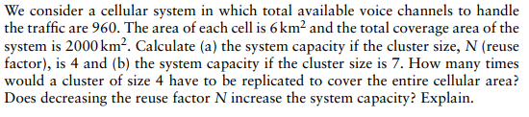
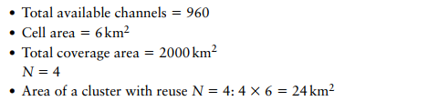
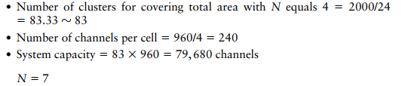
Question1

Slide 24
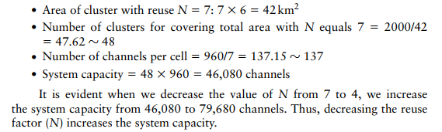

Slide 25
Interference
The additional unwanted signal to a useful signal is called as interference. Co-channel interference is not actually an interference but more a sort of congestion when more than one device is operating on the same frequency channel. It interrupts performance by increasing the wait time as the same channel is used by different devices.
Sources of interference are as follows:
Another mobile in the same cell.
Ongoing call in neighbor’s cell
When a different Base Station operates on the same frequency.

Slide 26
Types of channels on which interference is present are-
On Voice Channel: leads to crosstalk which is an interference or background noise while we are talking to another person on mobile. Crosstalk is unwanted interference that should be minimized.
On Control Channel: It can lead to problems in creating a connection between the sender and receiver during a call which leads to missed calls. Calls may terminate abruptly known as blocked calls.
Interference causes the above two problems because it reduces the channel capacity and thus, affects the performance.
Types of Interference in Mobile Communication
Co-Channel Interference
Adjacent Cell Interference

Slide 27
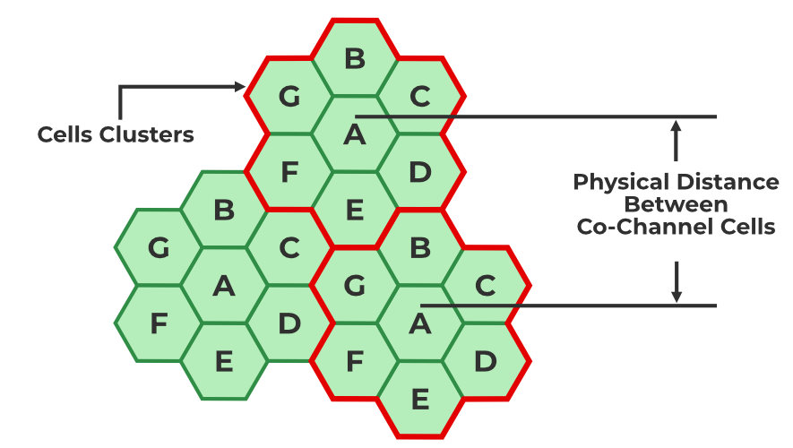
Co-Channel Interference
Co-channel cells are those cells that use the same frequency in a given coverage area. Interference from these cells is called co-channel interference. In co-channel interference, the cells are clustered as close together as possible to reduce the co-channel interface and provide sufficient isolation.
The reasons behind Co-channel interference are:
Bad weather condition
Poor frequency planning
Ways we can reduce co-channel interference are:
Proper planning and implementation.
The frequency reuse technique increases overall system capacity.

Slide 28
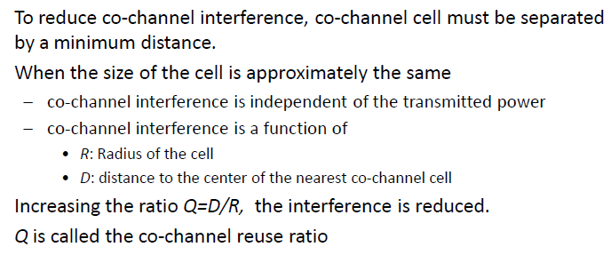
Co-Channel Interference

Slide 29
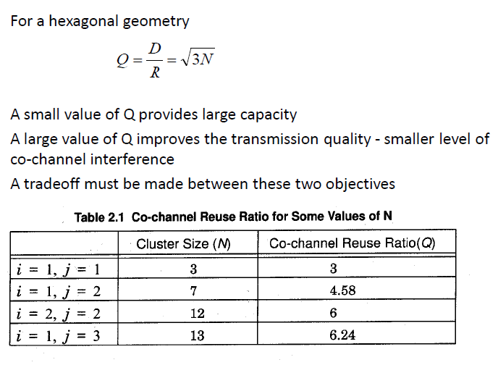
Co-Channel Interference

Slide 30
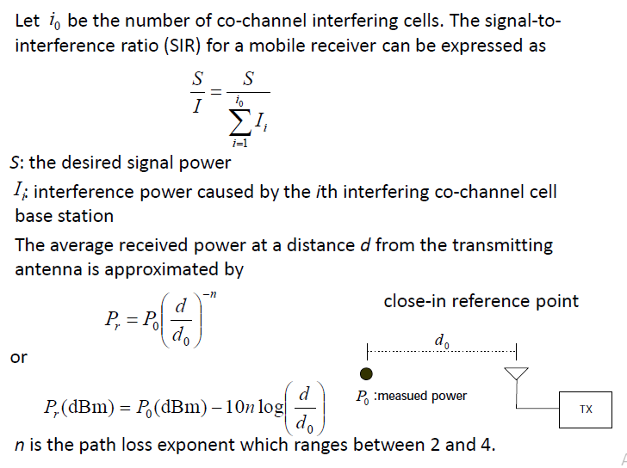

Slide 31
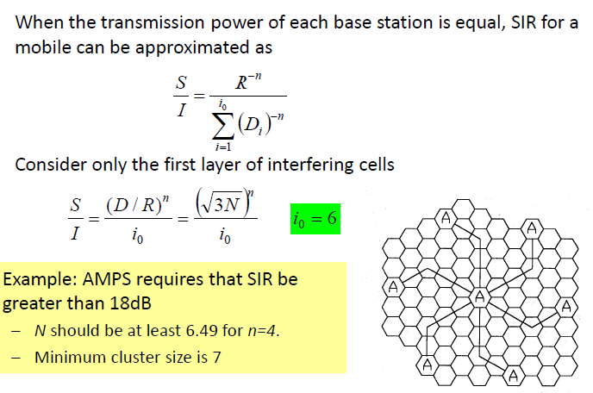

Slide 32
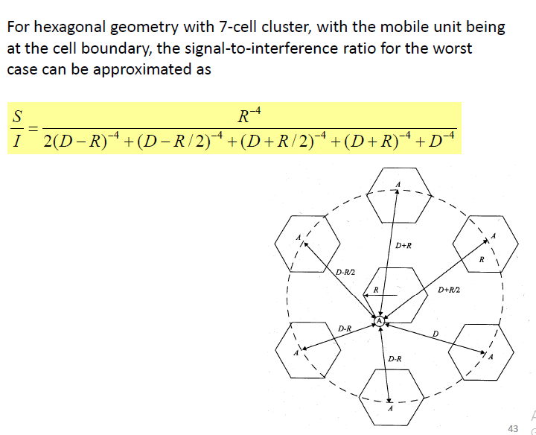

Slide 33
Example: If a signal to interference ratio of 15 dB is required for satisfactory forward channel performance of a cellular system, what is the frequency reuse factor and cluster size that should be used for maximum capacity if the path loss exponent is (a) n = 4 , (b) n = 3? Assume that there are 6 co-channels cells in the first tier, and all of them are at the same distance from the mobile. Use suitable approximations.
(a) n = 4
First, let us consider a 7-cell reuse pattern.
the co-channel reuse ratio D/R = √ (3N) = 4.583.
the sigal-to-noise interference ratio is given by
S/i = (I/6)x(4.583)^4 = 75.3 = 18.66 dB.
Since this is greater than the minimum required S/I, N = 7 can be used.

Slide 34
b) n = 3
First, let us consider a 7-cell reuse pattern.
the sigal-to-interference ratio is given by
S/I = (1/6)x(4.583)^3 = 16.04 = 12.05 dB.
Since this is less than the minimum required S/I, we need to use a larger N.
The next possible value of N is 12, (I = j = 2).
The corresponding co-channel ratio is given by as D/R = √ (3N) = 6.0.
S/I = (1/6) x 6^3 = 36 = 15.56 dB.
Since this is greater than the minimum required S/I, N = 12 can be used.

Slide 35
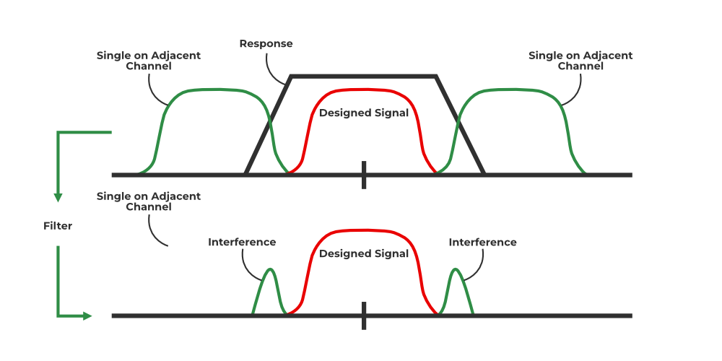
Adjacent Channel Interference
It is the interference caused to the signal which is adjacent in frequency to the desired signal. Imperfect receiver side filters allow the neighboring signal to mix with the actual pass band. if adjacent channel signal strength becomes strong, it will be difficult for Base Station to differentiate the actual mobile signal from the strong mobile signal. One of the main problems with adjacent channel interference is the near-far effect. It occurs when a mobile close to a base station transmits on a channel close to one being used by a weak mobile.

Slide 36
The reasons behind adjacent channel interference are as follows:
Due to multiple channels close to each other communicating using similar frequencies.
Irrelevant power emission from an adjacent channel.
Factors for reducing Adjacent Channel Interference are as follows:
Proper filtering
Careful Channel Assignments
By managing the space between two adjacent cells which should remain constant.

