Slide 1

DataCleanAI
DATA SCIENCE (24AD3107) Project Review-1
17 September 2026
 | Under the Guidance of Ms. Bonagani Prathusha Guide, Department of Computer Science and Engineering, KLH CSE Bowrampet Campus
Team Members 2420030234 Yakkala Guna Veera Sri Amith 2420030381 BVS Jayadeep 2420030245 K Manoj

Slide 2
Outline of Project Work
Project Focus
Introduction & Problem
Literature Survey
Data Quality Challenges
Research Objectives
Solution & Future Work
Technologies & Workflow
Project Plan

Slide 3
Problem Statement
Real-world datasets frequently contain quality issues that can reduce the reliability of analysis and machine-learning outcomes.
• Missing values and duplicate records require repeated manual preprocessing.
• Inconsistent categorical values and incorrect data types can distort analysis.
• Numerical outliers may affect statistical results and downstream models.
• Users need a simple way to profile a dataset and understand its quality before cleaning.
• Cleaning, validation, visualization, and before/after comparison are often handled as separate steps.
DataCleanAI addresses these issues through an automated, reusable data-quality workflow.

Slide 4
Objectives
The project aims to automate the key stages of structured-data quality improvement.
• Accept datasets in CSV or Excel format and automatically profile their structure and characteristics.
• Identify data types, missing values, unique values, and statistical properties.
• Evaluate completeness, uniqueness, validity, and consistency to generate a data-quality score.
• Apply suitable cleaning methods: median/mode imputation, duplicate removal, IQR-based outlier treatment, and text standardization.
• Provide interactive visualizations and before/after comparisons, with the cleaned dataset available for download.

Slide 5
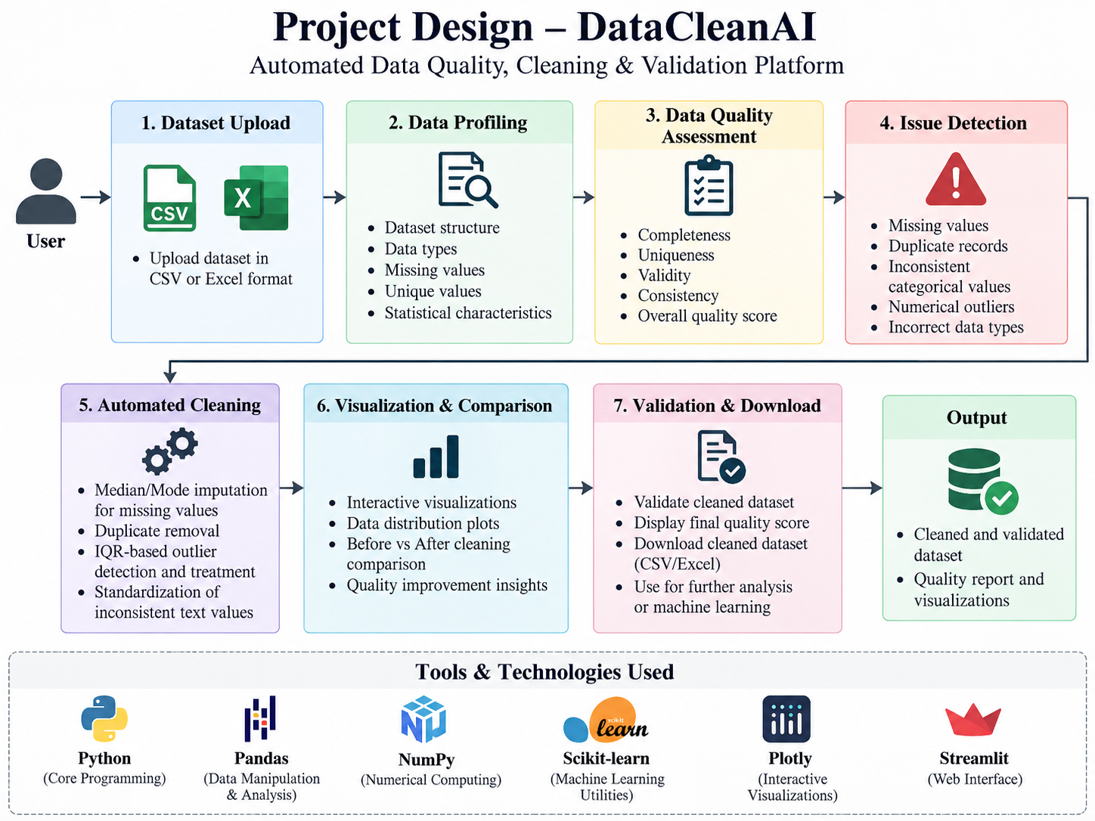

Slide 6
Literature Survey
Authors | Title of the Paper | Methodology | Inferences | Limitation/Future work
Fox, Levitin & Redman (1994) | The Notion of Data and Its Quality Dimensions | Identifies key data-quality dimensions such as accuracy, completeness, consistency and currency. | Provides a foundation for defining and evaluating data quality before preprocessing. | Conceptual framework; does not provide an integrated automated cleaning platform.
Van den Broeck et al. (2005) | Data Cleaning: Detecting, Diagnosing, and Editing Data Abnormalities | Systematic process for detecting, diagnosing and editing abnormalities in datasets. | Supports the need for structured data-cleaning and validation workflows. | Focuses on the cleaning process rather than an interactive end-to-end quality platform.
Rekatsinas et al. (2017) | HoloClean: Holistic Data Repairs with Probabilistic Inference | Uses probabilistic inference to detect and repair errors and inconsistencies in data. | Demonstrates the potential for automated data-error detection and repair. | More complex computational approach; DataCleanAI targets common structured-data issues with simpler, user-friendly methods.

Slide 7
Problem Gap Identification
Gap identified from the abstract
Data preparation can involve multiple manual tasks—profiling, identifying quality issues, cleaning inconsistent records, treating outliers, and validating the result.
Proposed project response
DataCleanAI brings profiling, quality scoring, automated cleaning, interactive visualization, before/after comparison, and cleaned-data download into one Streamlit-based workflow.
Core gap: fragmented preprocessing steps → integrated, user-friendly data-quality workflow

Slide 8
Innovation, Creativity, and Novelty
Key project innovation described in the abstract
1. Profile
Dataset structure, types,
missing & unique values
2. Score
Completeness, uniqueness,
validity & consistency
3. Clean
Imputation, duplicates,
IQR outliers & text
4. Visualize
Interactive views and
before/after comparison
5. Deliver
Download cleaned data
for downstream use
Technology stack: Python • Pandas • NumPy • Scikit-learn • Plotly • Streamlit
The combination is intended to reduce manual preprocessing effort and improve the quality and reliability of structured datasets.

Slide 9
Feasibility and Project Plan
Feasibility: Python-based stack + Streamlit interface support a lightweight interactive implementation.
Proposed Phase Sequence
Phase 1
Dataset input
Phase 2
Profiling
Phase 3
Quality scoring
Phase 4
Cleaning
Phase 5
Visualization & comparison
Phase 6
Validation & download
→
→
→
→
→
Intended output
A cleaned, validated dataset plus quality insights and visual comparisons that can be used for statistical analysis, visualization, or machine-learning applications.
Downstream use described in the abstract: statistical analysis, visualization, and machine-learning applications.

