Slide 1
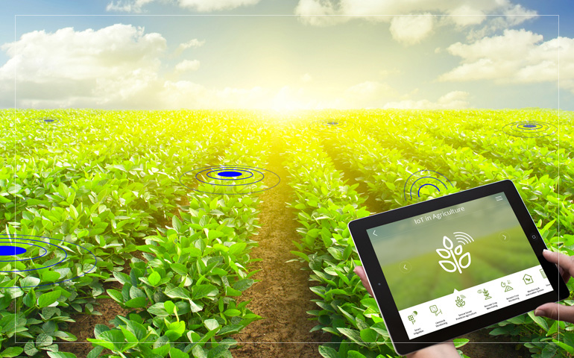
Agriculture IoT Solution
An Open Source Solution For Everyone
To Be Urban Farmer

Slide 2
Why Be An Urban Farmer?
Conventional Produce are high in Pesticides
Increasing cost of living
Lack of time to shop
Becomes Friend of Earth (FoE)

Slide 3
Challenges To Be An Urban Farmer
Time constrain
Lack Of farming Knowledge
New concept – used to buying instead of planting

Slide 4
Solution’s Goal
R
E
C
E
P
I
Data
Software
Global Community
(Testers, Developers)
Hardware
Sensing
Farmer
Plate

Slide 5
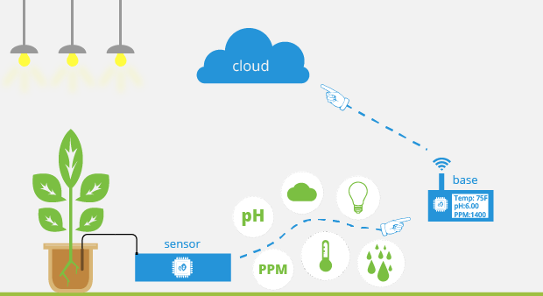
Overview IoT

Slide 6
Potential Achievement
Precision Agriculture
-Reduce Resource Consumptions
Real time Data Analytics
-Event Detections → Alert & Notifications
Predictive Data Analytics
- Predict Events
- Suggestions
Collaboration with academician and researchers

Slide 7
How It’s Possible
Strong collaboration team(Experts)
Open source Middlewares,libraries and tools
Integration between studies, research, and experience from various background/discipline person.

Slide 8
About Me
A Full-stack embedded system developer both experienced in Firmware and Hardware development.
Had build various sensor nodes either wired or wirelessly communicating. Build various solution in the past for Jaavin Electronic Solutions Sdn Bhd & RS Network Solution and many more clients.
Looking forward to delve Into open-source tech and produce High Social value solution with a team of like minded person locally and globally.
View my linkedin, Click here

Slide 9
Sponsor / Grant Provider
This is a open-sourced project thus sponsors can take an advantage of putting their brand as the supporter of this project.
Successful deployment of this project will make a remarkable green revolution in Malaysia.

Slide 10
Summary Of Budget
For Proof of concept (POC)
LoRa Gateway (Transmission)
5x Sensor Nodes (Monitoring)
Agriculture Prototyping Sensors (Sensing)
1x Weather Station (Sensing)
Agriculture Tool (Gardening)

Slide 11
Project Timeline
Ver1 Initial Prototype (based on Educational sensors) – 2-3 months (Ready for OpenIoT Competition/Any exhibition)
Ver 2 Enhanced Prototype (industrial sensors/OwnPCB) – 2-3 months (Field Testing)
Ver 3 Feature addition(Machine Vision/TBD)

Slide 12
Estimated Budget for Ver1
For Proof of concept
No | Item (Hyper-link) | Qty: | Unit Price (RM) | Total (RM)
1 | Soil Temp & Humidity | 5 | 80.00 | 400.00
2 | Drip Irrigation tubes | 2 | 55.00 | 110.00
3 | Solenoid valve DN15, 2 way | 5 | 67.50 | 337.5
4 | Complete Weather Station kit | 1 | 338.00 | 338.00
5 | STM32 + LoRa MCU Board | 2 | 320.00 | 640.00
6 | HisingRF LoRa Gateway | 1 | 1200.00 | 1200.00
7 | RFM95 Lora Transceiver | 5 | 54.24 | 271.2
8 | STM32F7, Audio+ETH+uSD | 1 | 270.00 | 270.00
 |  |  | Total | 4566.50

