Slide 1
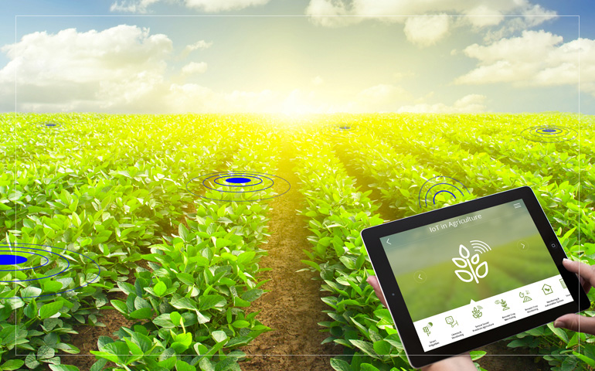
Agriculture IoT Solution
By : Manojkumar Subramaniam

Slide 2
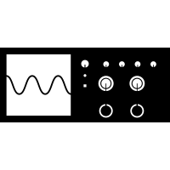
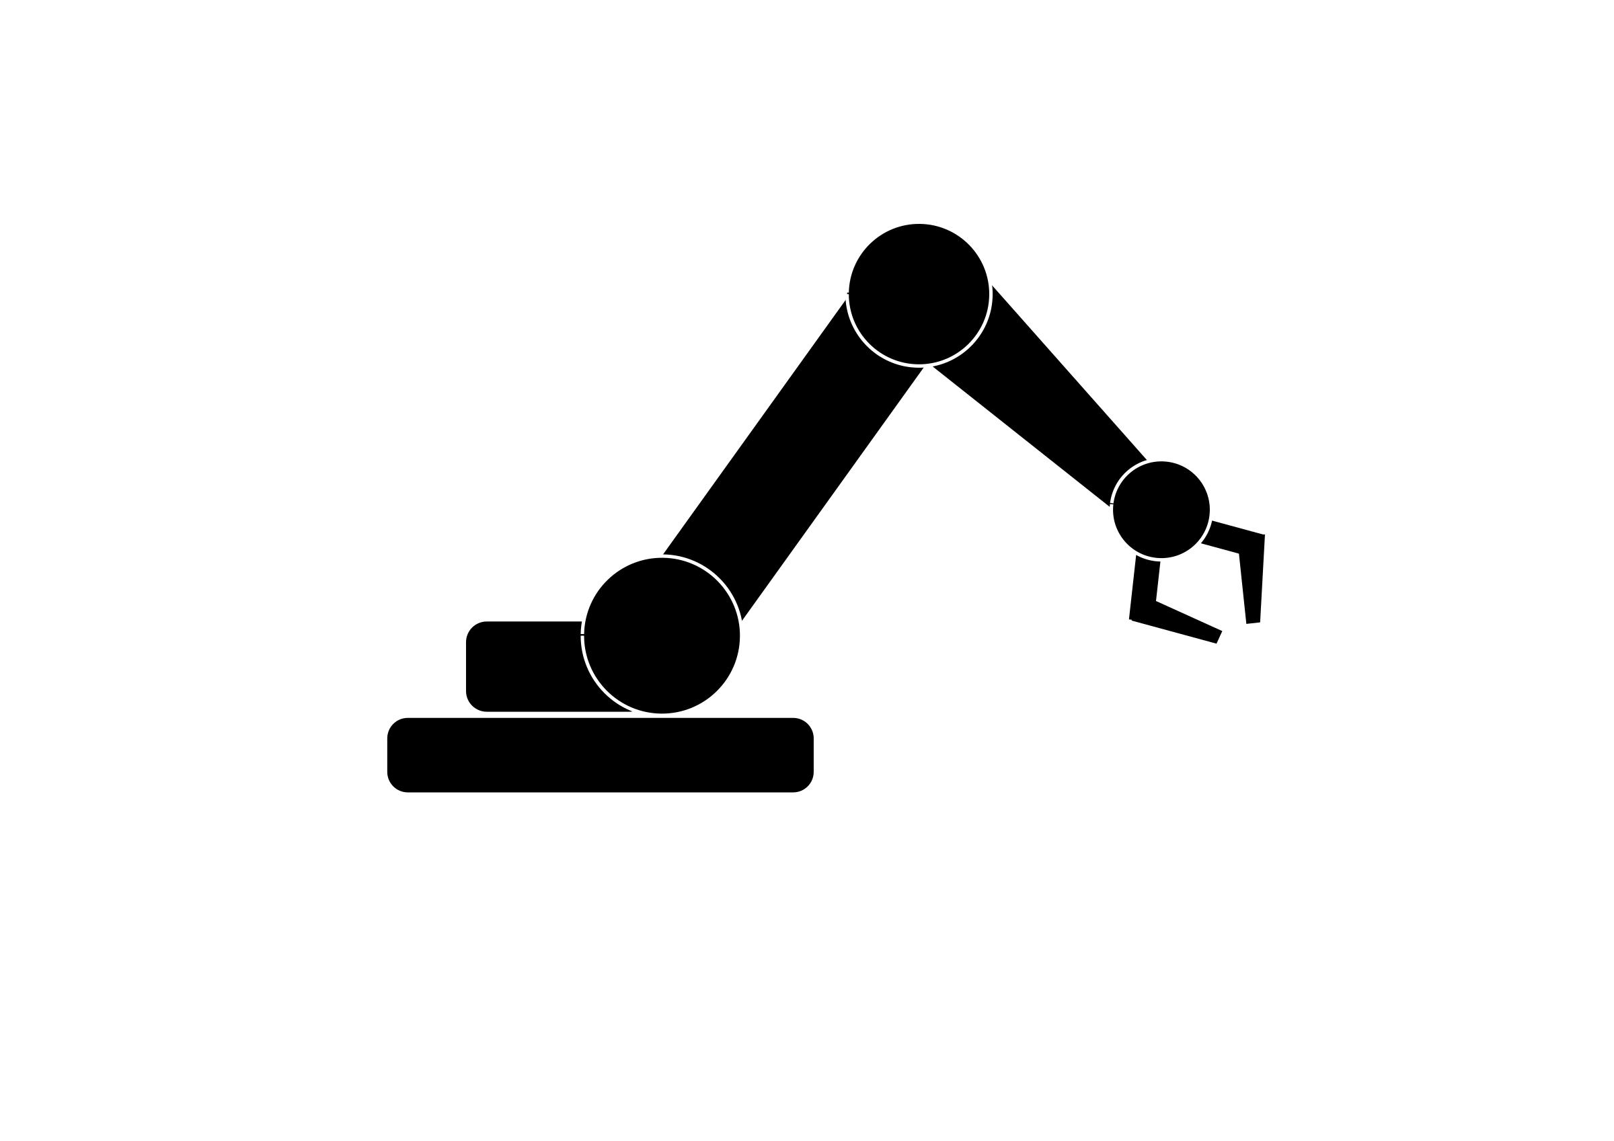
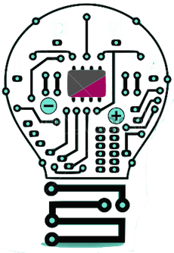


Introduction

Slide 3

What’s IoT
Thing’s that provides information (DATA)
Thing’s that accepts
instruction (command)
Notes:
1) Sense 2)Controlled Remotely

Slide 4
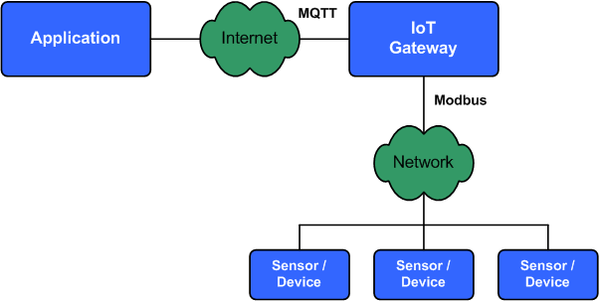

How & Where does the Data goes ?

Slide 5
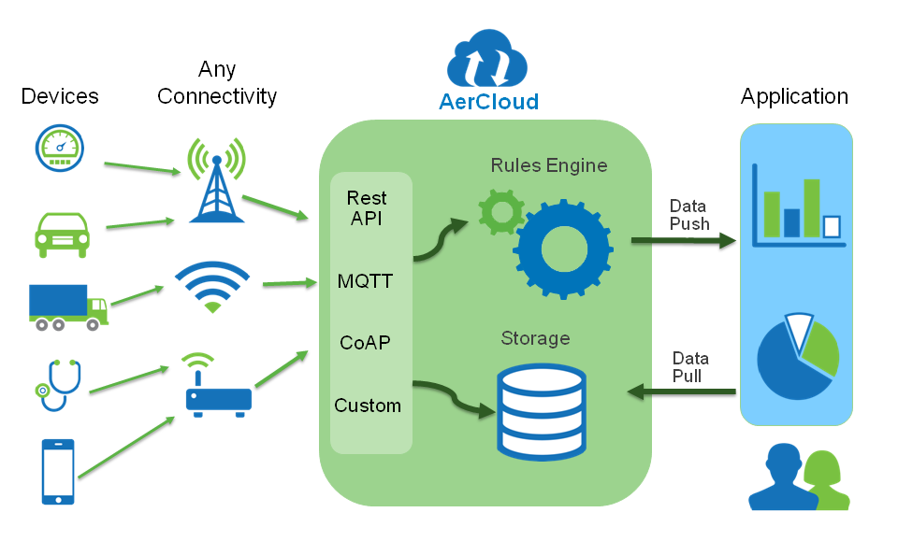
Where

Slide 6
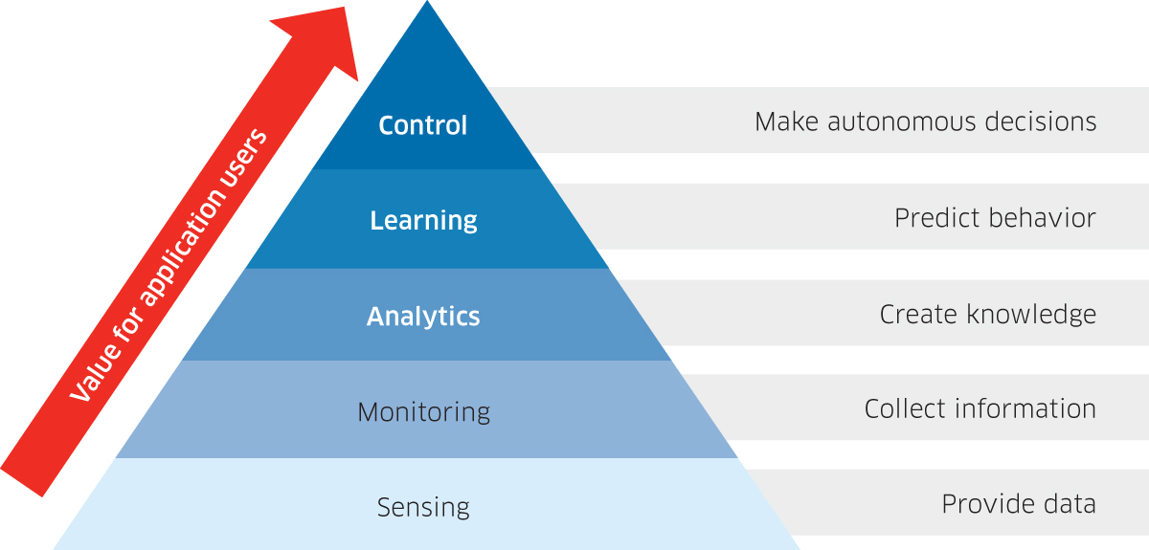
How gathered data benefits ?

Slide 7
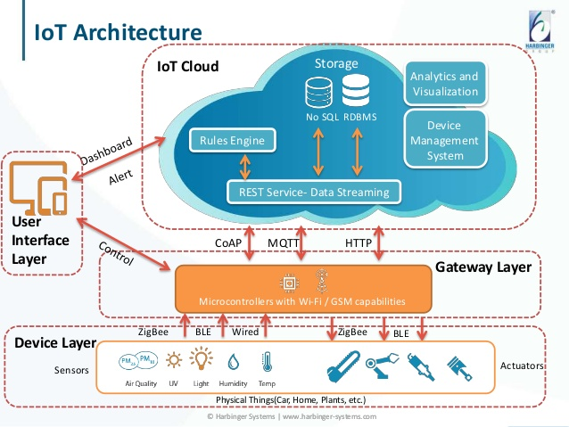
IoT Architecture

Slide 8
IoT Chanllenges
Resource Constrain Device
Low power
Cloud Services Pricing
Cloud Services
Human Usability

Slide 9
Agriculture IoT Solution
Open Source Solution For Environment, Coders, & Plantsman

Slide 10
Problem
Time constrain
Lack Of Knowledge
Lacks Urban Farmers
Conventional Produce are high in Pesticides

Slide 11
Solution’s Goal
R
E
C
E
P
I
Data
Software
Global Community
(Testers, Developers)
Sensing
Hardware
Farmer
Plate

Slide 12
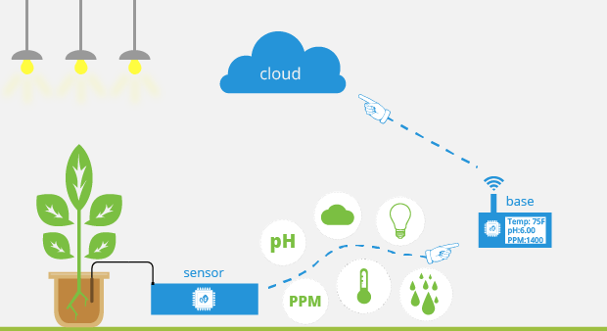
Overview IoT

Slide 13
Potential Achievement
Precision Agriculture
-Reduce Resource Consumptions
Real time Data Analytics
-Event Detections → Alert & Notifications
Predictive Data Analytics
- Predict Events
- Suggestions

Slide 14
How It’s Possible
Strong collaboration team
Open source Middleware and tools
Integration between studies, research, and experience from various background/discipline person.

Slide 15
About Me
A Full-stack embedded system developer both experienced in Firmware and Hardware development.
Had build various sensor nodes either wired or wirelessly communicating. Build various solution in the past for Jaavin Electronic Solutions Sdn Bhd & RS Network Solution and many more clients.
Looking forward to delve Into open-source tech and produce High Social value solution with a team of like minded person locally and globally.
View my linkedin, Click here

Slide 16
Sponsor / Grant Provider
This is a open-sourced project thus sponsors can take an advantage of putting their brand as the supporter of this project.
Successful deployment of this project will make a remarkable green revolution in Malaysia.

Slide 17
Budget Proposal
LoRa Gateway
- RisingHF 8channel 915mhz.
5x Sensor Nodes (Monitoring)
1x Weather Station
Agriculture Tool

Slide 18
Detailed Orient Budget
No | Item (Hyper-link) | Qty: | Unit Price (RM) | Total (RM)
1 | Soil Temp & Humidity | 5 | 80.00 | 400.00
2 | Drip Irrigation tubes | 2 | 55.00 | 110.00
3 | Solenoid valve DN15, 2 way | 5 | 67.50 | 337.5
4 | Complete Weather Station kit | 1 | 338.00 | 338.00
5 | STM32 + LoRa MCU Board | 2 | 320.00 | 640.00
6 | HisingRF LoRa Gateway | 1 | 1200.00 | 1200.00
7 | RFM95 Lora Transceiver | 5 | 54.24 | 271.2
8 | STM32F7, Audio+ETH+uSD | 1 | 270.00 | 270.00
 |  |  | Total | 3566.50

