Slide 1
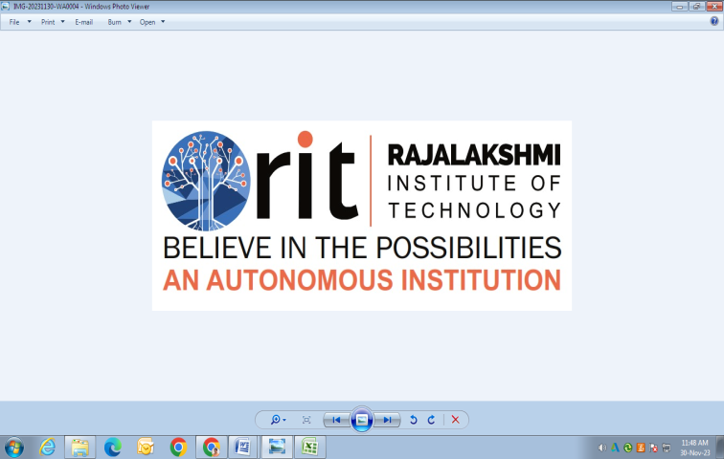
DEPARTMENT OF
ARTIFICIAL INTELLIGENCE AND DATA SCIENCE
ACADEMIC YEAR 2025 - 2026
SEMESTER III
ARTIFICIAL INTELLIGENCE LABORATORY
MINI PROJECT REVIEW
<Flappy Bird with AI Agent using Reinforcement Learning>
REGISTER NUMBER | 2117240070030
NAME | Aswin Ananth S
YEAR | Second
SECTION | A
FACULTY IN-CHARGE | Mrs. M. Divya

Slide 2
PROBLEM STATEMENT
Artificial Intelligence allows machines to learn and make decisions like humans.
In this project, we use Reinforcement Learning (RL), where an agent learns by trial and error using rewards and penalties.
The aim is to make an AI agent play the Flappy Bird game automatically.
It learns when to flap to avoid pipes and increase its score.
This problem is important because it shows how a computer can learn by itself without manual programming.
We use the PPO (Proximal Policy Optimization) algorithm to train the agent for better gameplay.
Expected Result:
The AI will learn the correct flapping timing and gradually achieve higher scores.
Possibilities:
This idea can be used in real-life systems like robots, drones, or self-driving vehicles that learn from experience.

Slide 3
THEORETICAL BACKGROUND
The game is modeled as a Markov Decision Process (MDP).
State: Bird’s position, speed, and distance from the next pipe.
Action: Whether to flap or do nothing.
Reward: +1 for passing a pipe, −1 for hitting one.
The algorithm used is Proximal Policy Optimization (PPO) —
a stable and efficient RL method for training game agents.
🧩 Idea: The AI learns the right time to flap to stay alive longer.

Slide 4
IMPLEMENTATION AND CODE
Link to code in Git-hub Repository
List | Git-hub Repository Links
Implementation of Code Link | Github
Word Document Report Link | Github
PPT Link | Github

Slide 5
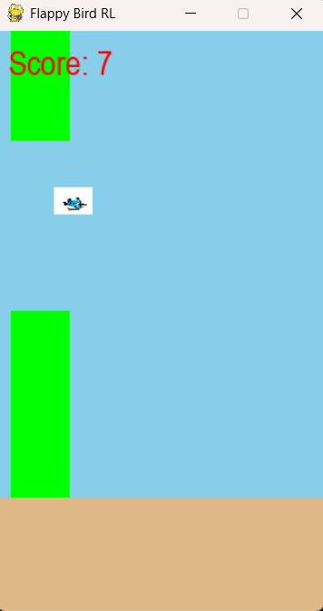
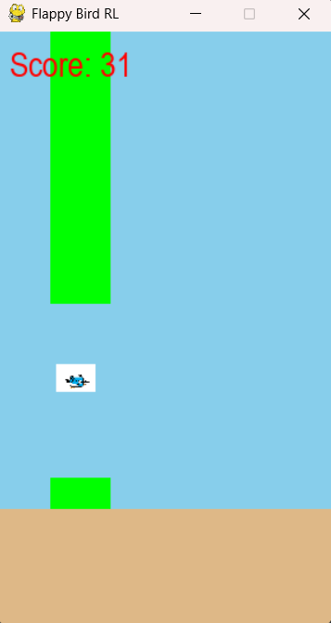
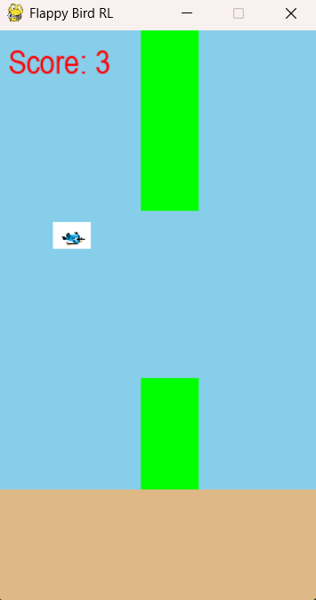
OUTPUT AND RESULTS

Slide 6
OUTPUT AND RESULTS
After training with the PPO algorithm, the AI agent plays the Flappy Bird game automatically.
It learns when to flap and when to stay still to avoid pipes.
The game shows the bird, pipes, and live score on the screen.
When the bird crashes, the game restarts and the agent continues learning
Results
The AI gradually improves its gameplay after training.
It learns the correct timing and survives longer.
The final model achieves scores above 20+ consistently.
The agent behaves almost like a human player.
Future Enhancements
Try other algorithms like DQN or A3C.
Use CNNs for visual-based learning.
Add more levels, obstacles, and animations.
Improve visuals and sound effects for a better game experience.

Slide 7
REFERENCES
Sutton, R. S., & Barto, A. G. (2018). Reinforcement Learning: An Introduction (2nd Edition). MIT Press.
https://www.andrew.cmu.edu/course/10-703/textbook/BartoSutton.pdf
Schulman, J., Wolski, F., Dhariwal, P., Radford, A., & Klimov, O. (2017). Proximal Policy Optimization Algorithms.
arXiv preprint https://arxiv.org/abs/1707.06347
Stable-Baselines3 Documentation, Open Source Reinforcement Learning Library for PyTorch. https://stable-baselines3.readthedocs.io
Gymnasium (formerly OpenAI Gym) – Reinforcement Learning Environment Toolkit. https://gymnasium.farama.org/
Pygame Official Documentation – Game Development Library for Python.
https://www.pygame.org/docs/

