Slide 1
Code Refactoring And Bug Fixing

Slide 2
Problem statement
Refactor the existing codebase and ensure the proper functioning of the Note Taking Application. Document all identified bugs during the debugging process. Remember, the task is not about recreating the app from scratch. Your goal is to fix the already existing codebase and make the application work as intended.

Slide 3
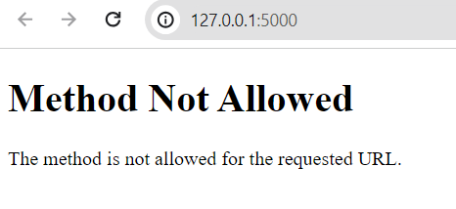
Running the Code as it is given :
Output for the given code
Identified Bugs :
i. Incorrect method in routing definition, configured only for post requests
ii. Incorrect form submission method
iii. Incorrect request argument retrieval
iv. Unused form action attribute
v. Missing type attribute to add note button

Slide 4
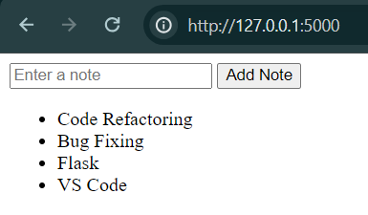
After Fixing the bugs :
Output After Debugging the Errors
Adding delete and modify options to the notes
Styling with CSS

Slide 5
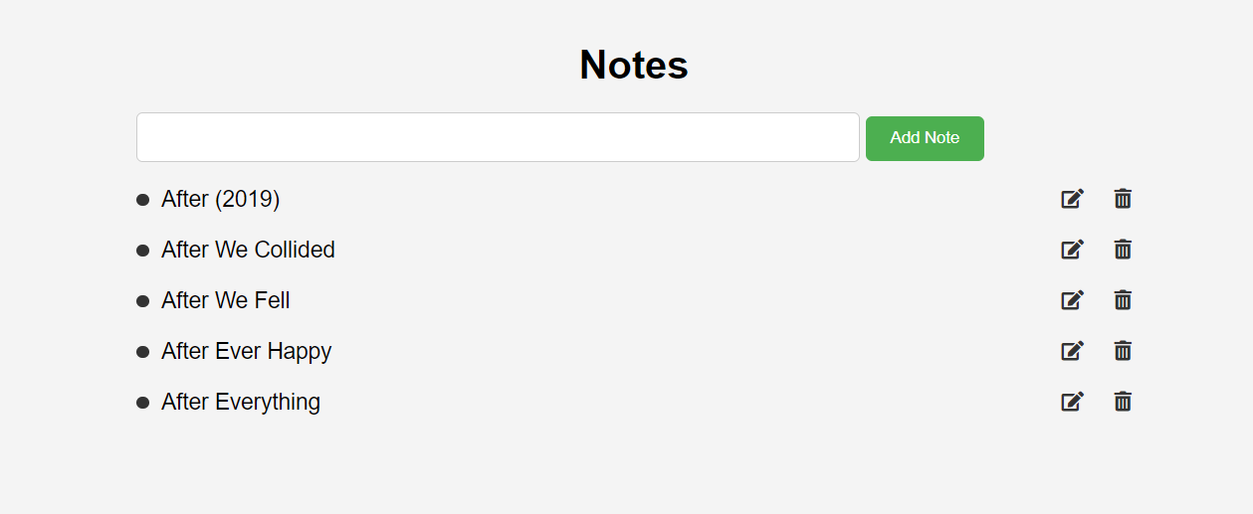
After adding delete and modify options and some styling with CSS :
By tapping on the bullet point of the note you will be enabled with edit and delete options

