Slide 1

Cold Storage Commodity and Chamber Management System
Academic DBMS project: a clean, efficient system for tracking customers, commodities, chambers, allocations, logs, billing, and compliance.

Slide 2





Problem: Manual Processes
Record Keeping
Time & Errors
2
Slow retrieval, time loss, and error-prone entry hurt operations.
1
3
Operational Impact
Inefficient allocations and billing delays reduce revenue accuracy.
Manual or basic records cause fragmentation and loss.
This system is framed as the solution to these core issues.

Slide 3
System Scope
Customers
Commodities & Lots
Chambers & Locations
Allocations, Receipts, Releases
Temperature & Inspection Logs
Rates, Invoices, Payments

Slide 4




Objectives
Digitize Records
Centralize entities and history for reliable access.
Reduce Errors
Structured CRUD and validations to cut entry mistakes.
Optimize Space
Better allocation logic to use chamber capacity efficiently.
Faster Retrieval
Indexed search and clear location tracking for quick access.

Slide 5

Users & Functional Requirements
Primary Users
Key Functions
Admin (system mgmt), Staff (operations), Accounting, Inspectors
CRUD for Customers, Commodities, Chambers, Lots
Allocate / Deallocate space
Record Receipts, Releases, Inspections, Temp Logs
Generate Rates, Invoices, Payments, Reports

Slide 6

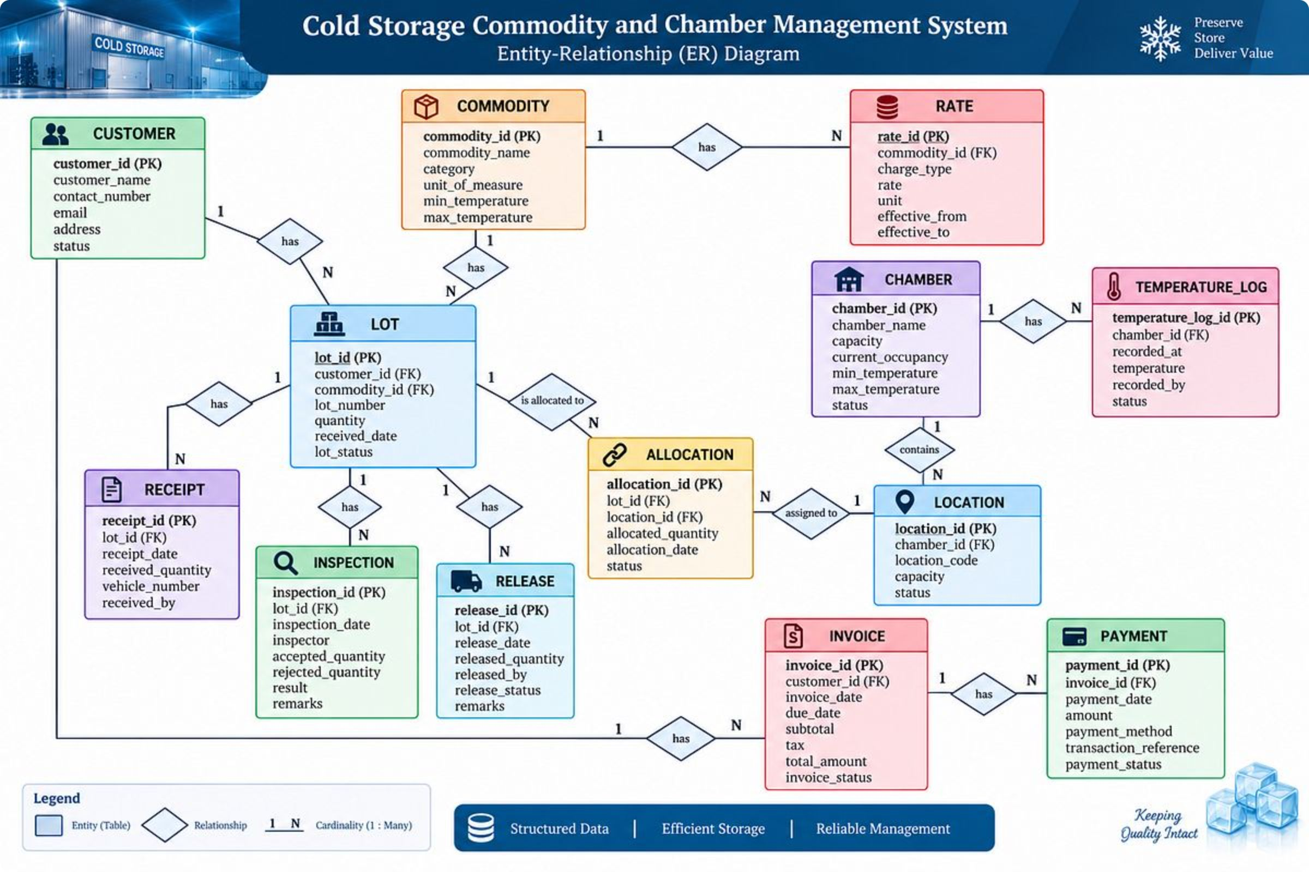


Conceptual Design Summary
Entities
Customer, Commodity, Lot, Chamber, Location, Allocation
Transactions
Receipt, Release, Inspection, Temperature Log
Financial
Rate, Invoice, Payment

Slide 7

ER Diagram (Conceptual)
Billing & Payments
Lot & Commodity
Chamber & Location
Customer
Operations Logs
Diagram shows entities and cardinalities (crow's foot) for operational and billing flows.

Slide 8


Initial Relational Schema
1
2
3
Customers
Commodities & Lots
Chambers & Locations
PK: customer_id · attributes: name, contact, address
PK: commodity_id, lot_id · FK: customer_id, commodity_id
PK: chamber_id, location_id · attributes: capacity, temp_range
4
5
Allocations & Transactions
Billing
Tables: rate (rate_id PK), invoice (invoice_id PK, FK customer_id), payment (payment_id PK, FK invoice_id)
PKs: allocation_id, receipt_id, release_id · FKs linking lots ↔ locations; logs reference lot_id

Slide 9

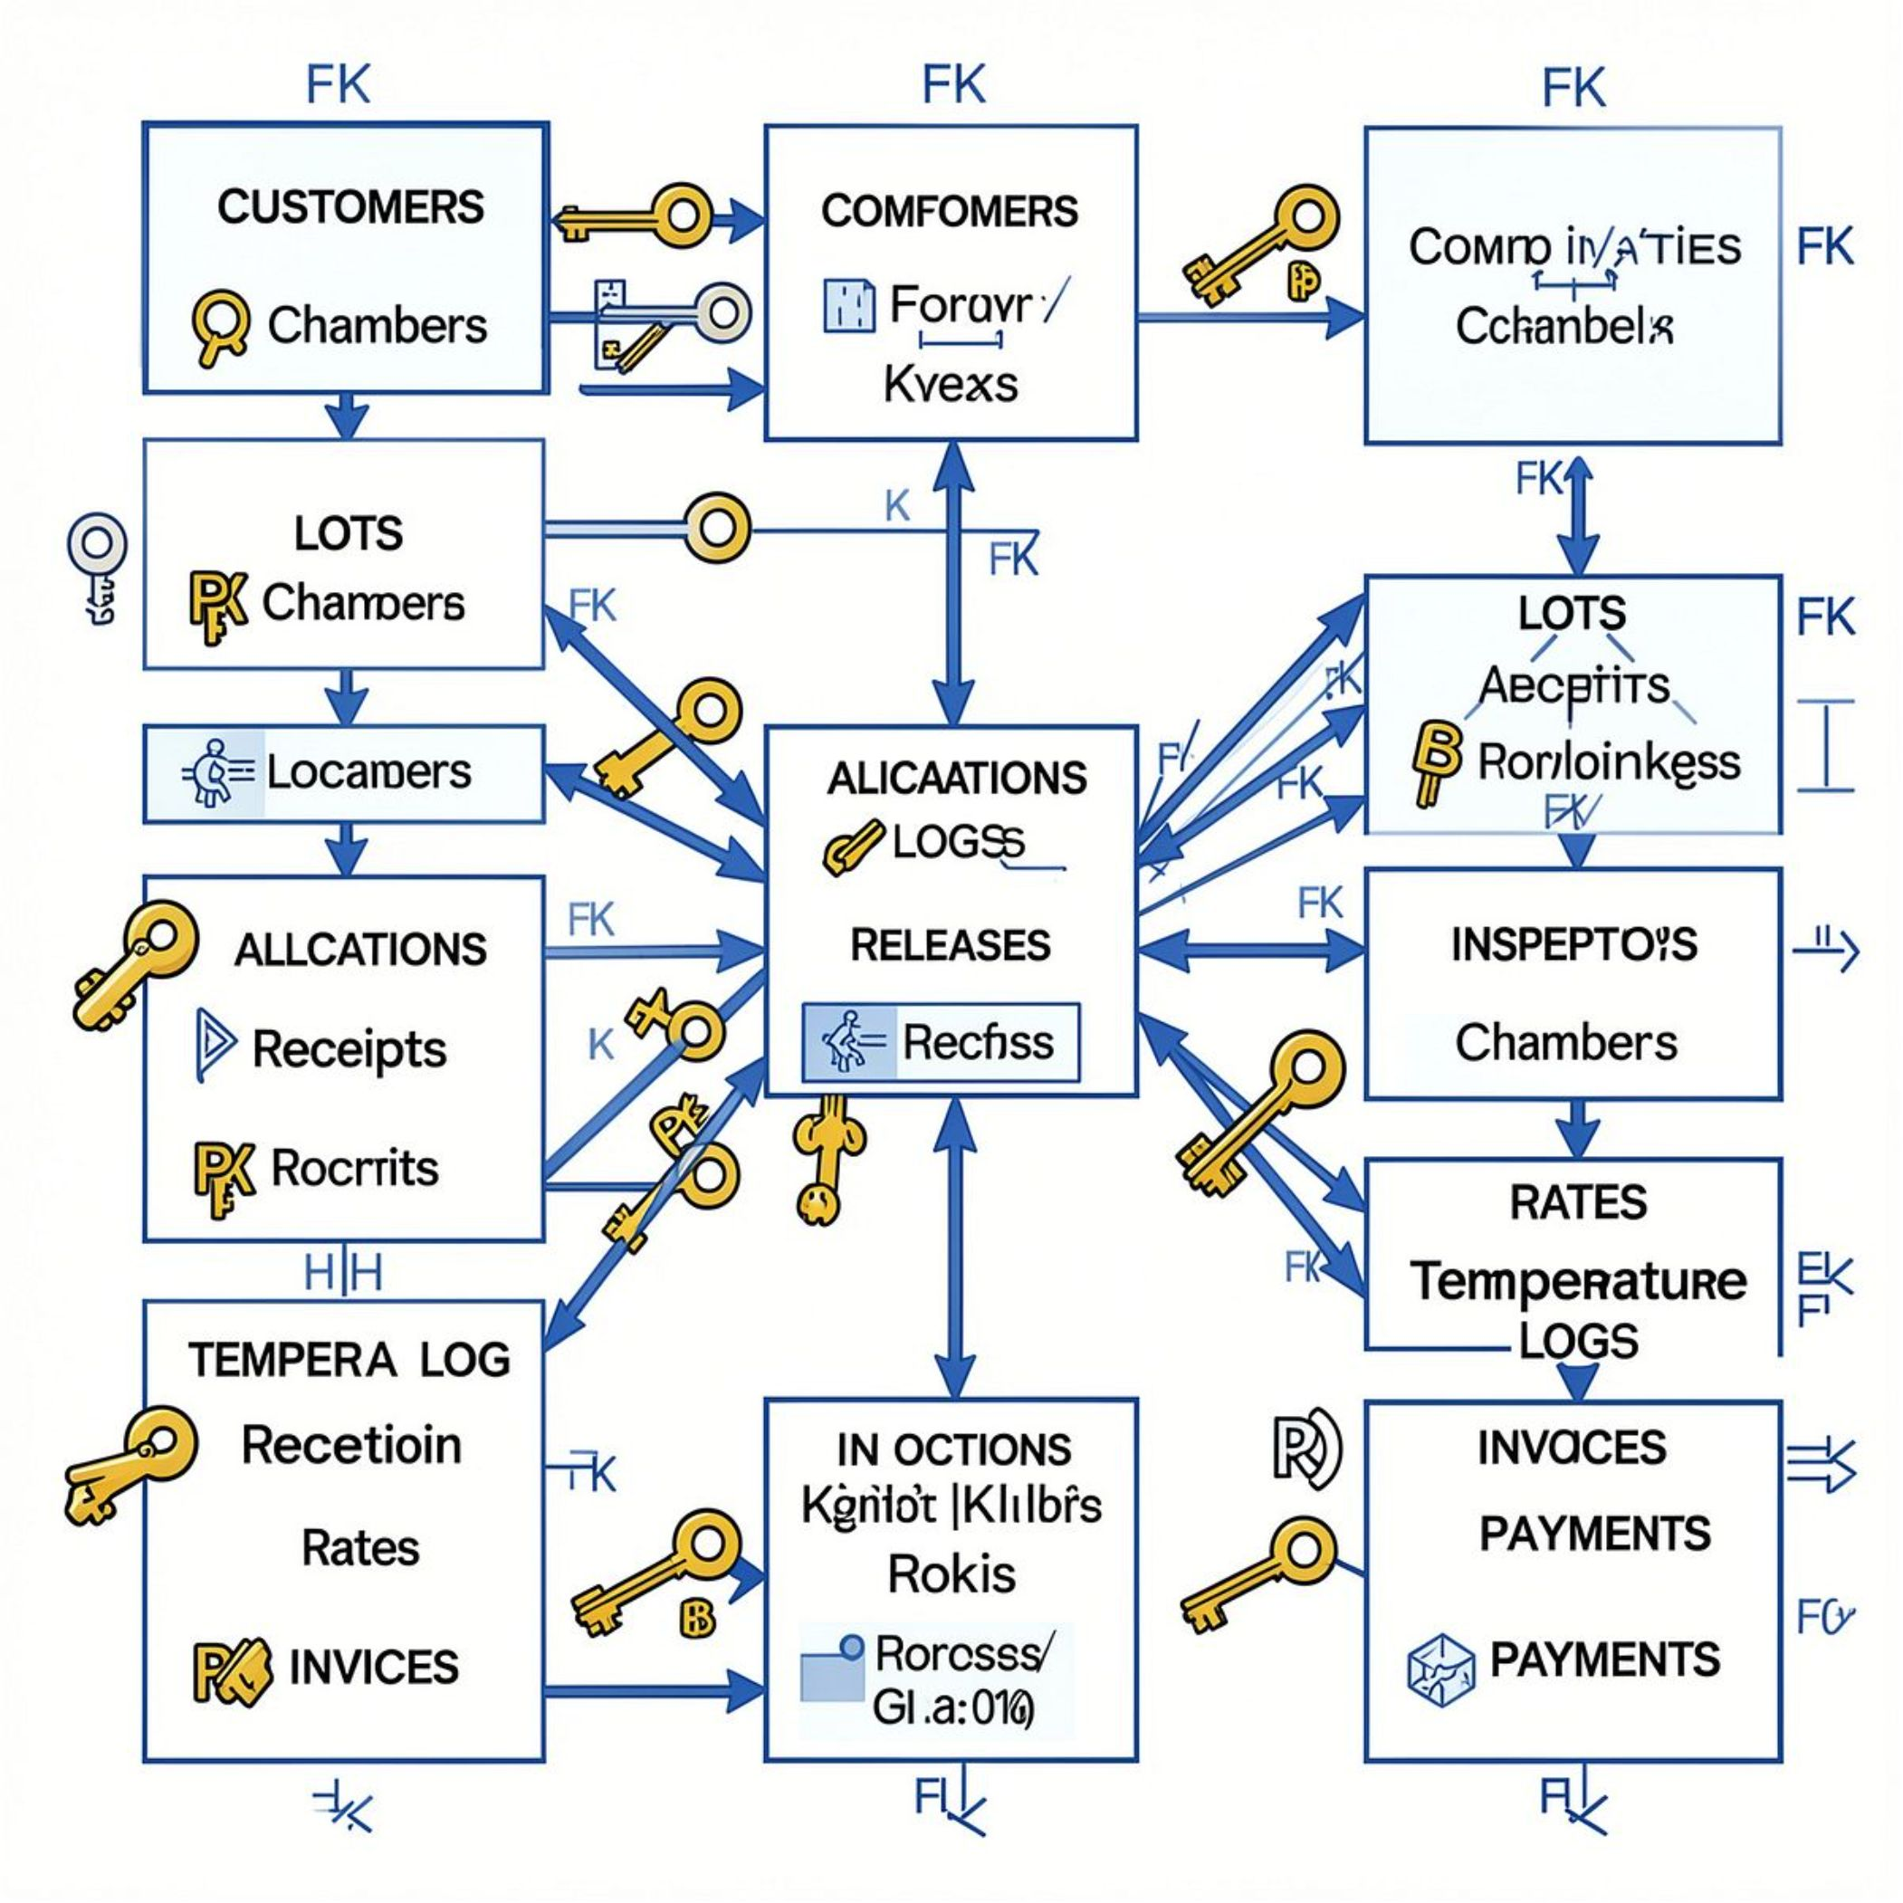
Schema Details (PK / FK highlights)
Primary Keys
Foreign Keys
customer_id, commodity_id, lot_id
chamber_id, location_id, allocation_id
receipt_id, release_id, inspection_id, temp_log_id
lot.customer_id → customers.customer_id
lot.commodity_id → commodities.commodity_id
allocation.lot_id → lots.lot_id
allocation.location_id → locations.location_id
invoice.customer_id → customers.customer_id

