Slide 1

MINI-PROJECT REVIEW-1
Team Leader : 22691A05H5
Team Members : 22691A05H6
22691A05H7
22691A05H8
22691A05H9
22691A05I0

Slide 2
Project Title
Predicting Air Quality Index using Machine Learning - use Linear Regressor and Adaboost Regressor
Air pollution is a major global health concern, impacting millions of people worldwide. Predicting air quality is crucial for mitigating its impact on public health and the environment. In this presentation, we will explore the use of machine learning, specifically linear regression and AdaBoost, to predict air quality levels.

Slide 3
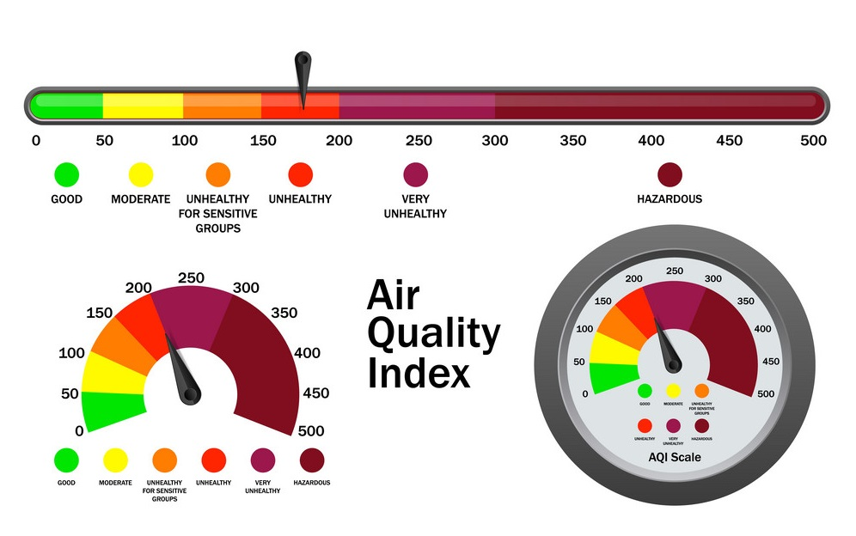
What Is the Air Quality Index?
The Air Quality Index, or AQI, is the system used to warn the public when air pollution is dangerous. The AQI tracks ozone (smog) and particle pollution (tiny particles from smoke, power plants and factories, vehicle exhaust, and other sources), as well as four other widespread air pollutants. Newspapers, radio, television, and websites report AQI levels year-round. Keeping track of the current air quality information in your area can help you take steps to protect yourself, children, and others from unhealthy levels of air pollution.

Slide 4
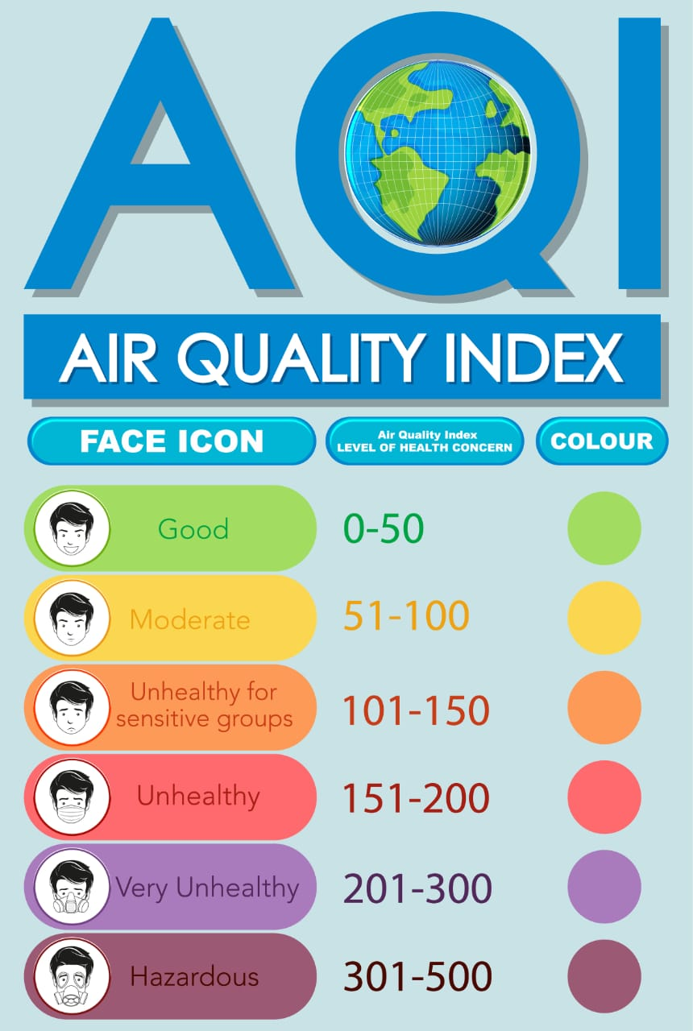
How Does the Air Quality Index Work?
Air pollution levels are measured daily and ranked on a scale of 0 for perfect air all the way up to 500 for air pollution levels that pose an immediate danger to the public. The AQI breaks air pollution levels into six categories, each of which has a name, an associated color, and advice to go along with it. AQI values at or below 100 are considered satisfactory for almost everyone. When AQI values are above 100, air quality is unhealthy. The higher the number, the more people are at risk of health harm.

Slide 5
Data Collection and Preprocessing Data Sources
Air quality data is gathered from various sources, including government monitoring stations, personal sensors, and satellite imagery.
These sources provide valuable information about pollutants, weather conditions, and geographical location.
Data Cleaning and Transformation
Preprocessing involves cleaning the data, removing missing or erroneous values, and transforming variables into a suitable format for modeling.
This step ensures the data is accurate, consistent, and ready for analysis.
Dataset Link:
kaggle datasets download -d rohanrao/air-quality-data-in-india

Slide 6
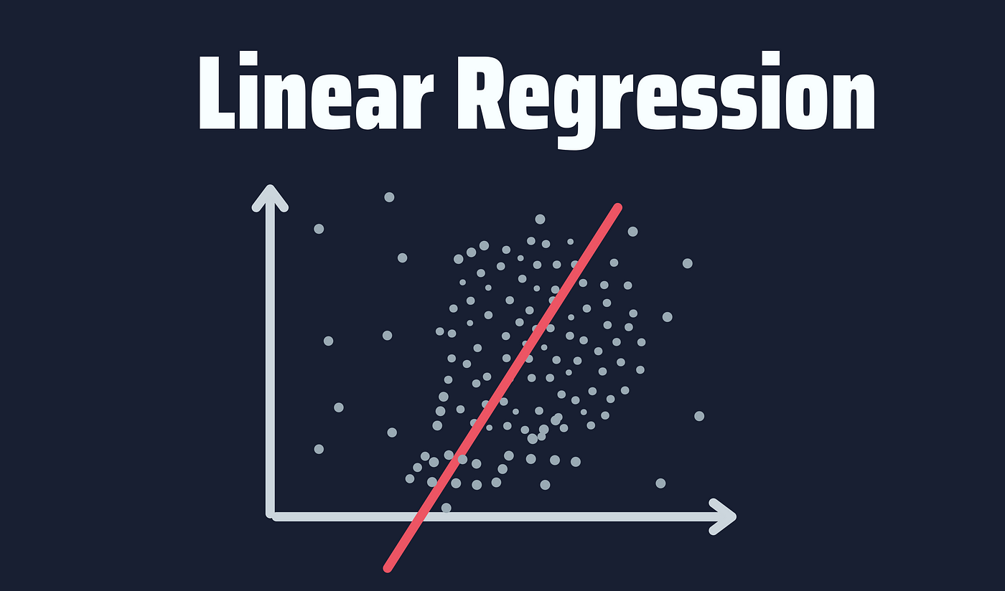
Linear Regression for AQI Prediction
Linear Relationship
Linear regression assumes a linear relationship between the independent and dependent variables, meaning a change in one variable directly affects the other.
Air Quality Prediction
Linear regression can be used to model the relationship between air quality parameters and influencing factors, such as weather conditions or traffic volume.

Slide 7
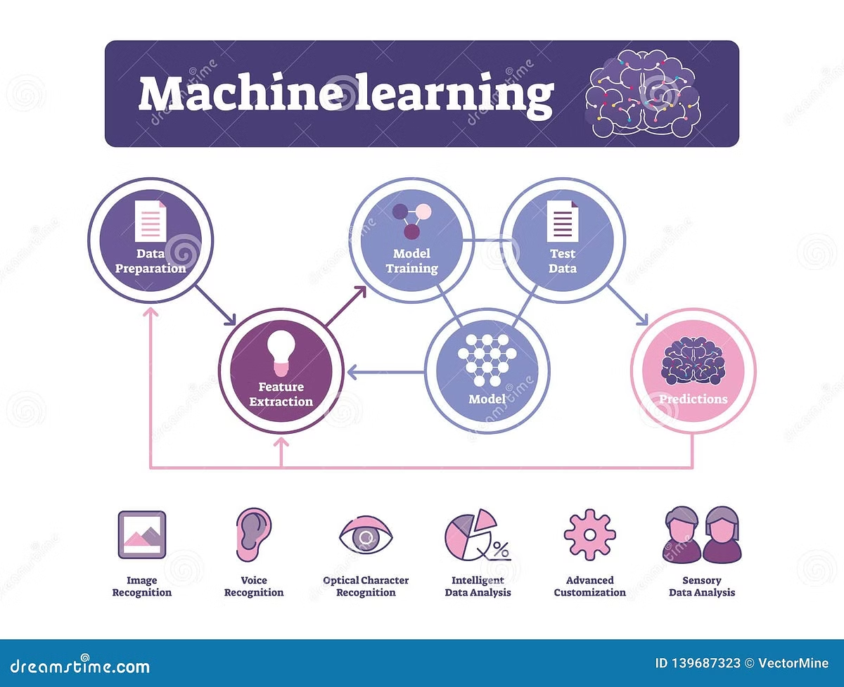
AdaBoost Regressor Model
Base Learners
AdaBoost employs multiple base learners, typically weak learners, to make predictions.
Weighted Data
Data points are weighted based on the performance of previous learners, focusing on misclassified instances.
Ensemble Learning
The predictions of all base learners are combined through a weighted average, resulting in a more robust prediction.
.

Slide 8

Comparison of Model Performance
R-squared
Linear regression model demonstrates a strong correlation with actual air quality data.
R-squared
AdaBoost regressor model achieves a higher correlation with actual air quality data, indicating improved accuracy.
RMSE
Linear regression model has a lower root mean squared error, signifying smaller prediction errors.
RMSE
AdaBoost regressor model achieves a lower RMSE, demonstrating a more accurate prediction of air quality levels.

Slide 9

Real-World Applications and Future Considerations
Urban Planning
Predicting air quality helps city planners optimize traffic flow, manage industrial emissions, and create green spaces.
Smart Agriculture
Air quality data can inform farmers about potential risks to crops, leading to better agricultural practices.
Public Health Alerts
Forecasting air quality helps issue timely alerts to vulnerable populations, enabling them to take precautions.
Future considerations include enhancing model accuracy by incorporating data from more sources, integrating sensor networks, and improving data quality.

Slide 10

Conclusion:
Accurate Predictions
Both models achieved high accuracy in predicting air quality levels, highlighting the power of machine learning in environmental monitoring.
Diverse Applications
These insights can inform urban planning, public health initiatives, and environmental policies.

Slide 11


