Slide 1
CAPSTONE PROJECT
OPENING A SUPERMARKET IN COLOMBO
Manoj Wickramasinghe
25/05/2020

Slide 2
Business Problem
Location of the supermarket is one of the most important decisions that will determine whether the supermarket will be a success or a failure.
Objective : To analyze and select the best locations in the city of Colombo, Sri Lanka to open a new supermarket.
This project is timely as the city is currently suffering from oversupply of supermarkets.
Business question
In the city of Colombo, Sri Lanka, if a property developer is looking to open a new supermarket, where would you recommend that they open it ?

Slide 3
Data
Data required
List of neighborhoods in Colombo
Latitude and longitude coordinates of the neighborhoods
Venue data, particularly data related to supermarket
Sources of data
Wikipedia page for neighborhoods
(https://en.Wikipedia.org/wiki/Category:Suburbs_of_Colombo)
Geocoder package for latitude and longitude coordinates
Foursquare API for venue data

Slide 4
Methodology
Web scraping Wikipedia page for neighborhoods list
Get latitude and longitude coordinates using Geocoder
Use Foursquare API to get venue data
Group data by neighborhood and taking the mean of the frequency of occurrence of each venue category
Filter venue category by Supermarket
Perform clustering on the data by using k-means clustering
Visualize the clusters in a map using Folium

Slide 5
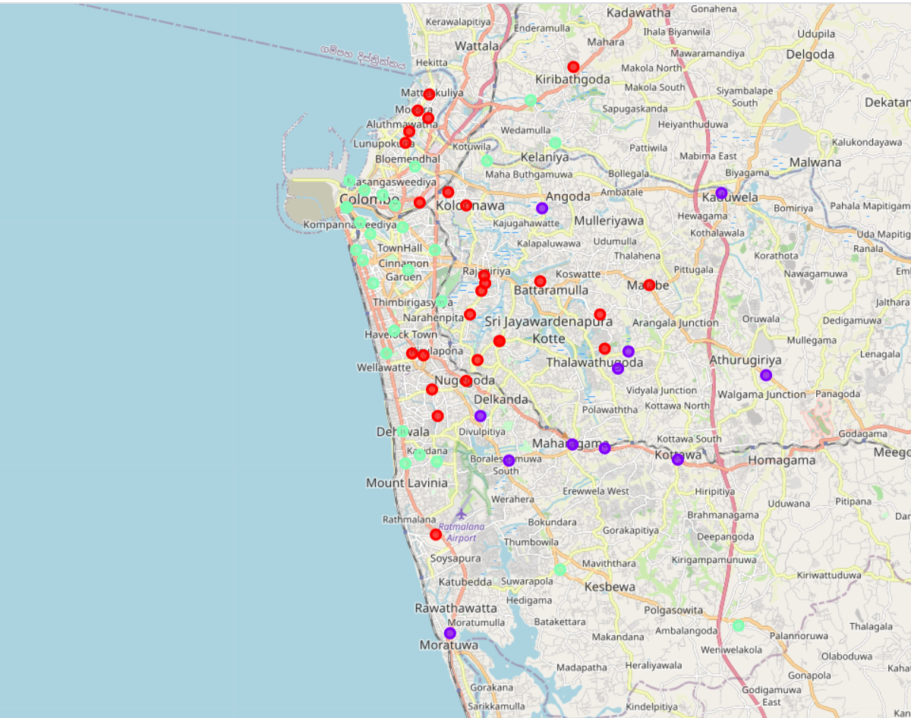
Results
Categorized the neighborhoods into 3 clusters:
Cluster 0 : Neighborhoods with moderate number of
supermarkets
Cluster 1 : Neighborhoods with high concentration
of supermarkets
Cluster 2 : Neighborhoods with low number or no
supermarkets

Slide 6
Discussion
Most of the supermarkets are concentrated in the central part of the city.
Highest number in cluster 1 and moderate number in cluster 0.
Cluster 2 has a very low number to no supermarket in the neighborhoods.
Oversupply of supermarkets mostly happened in central part of the city, with the coastal area of the city having a few supermarkets.

Slide 7
Recommendations
Open new supermarkets in neighborhoods in cluster 2 with little to no competition.
Can also open in neighborhoods in cluster 0 with moderate competition if the markets have unique selling propositions to stand out from the competition.
Avoid neighborhoods in cluster 1, which is already in high concentration of supermarkets and intense competition.

Slide 8
Conclusion
Answer to business question : The neighborhoods in cluster 2 are the most preferred locations to open a new supermarket.
Findings of this project will help the relevant stakeholders to capitalize on the opportunities on high potential locations while avoiding overcrowded areas in their decisions to open a new supermarket.

Slide 9
THANK YOU Manoj Wickramasinghe 2020

