Slide 1

Presentation of azure-class : 16/09/2022 by parameshwar

Slide 2
NETWORKING
INTRODUCTION

Slide 3
MEANING OF NETWOKING
Netwoking is a connection between two system
Like A has a Samsung galaxy A-32 -123456789 and B has a same model of Samsung galaxy A-32 – 123456789
For each and every drawback there will be a different unique address allocate .
IP ADDRESS – Internet protocol
There are two types of ip address
1. static ip
2. Dynamic ip

Slide 4
TYPES OF NETWOKS
Basically networks are two types :-
NETWORK-1- IP -10.0.0.0
NETWORK-2-IP- 10.0.0.0
When two networks are connected with same ip address there will be a conflict between each other
It will make a conflicts issue

Slide 5
IPV4
IPV4 IS 32 BIT IP ADDRESS
TYPES OF NUMBERING SYSTEM
1binary-0 and 1
2 decimal- 0and 9
3hexa-0to9 and atof
4octane-0to7
Total number of ip address in ipv4 is 4billion

Slide 6
Ipv6
Ipv6 is mostly used in the telecom industry now a days
It is a 128 bit ip address
TYPES OF DISTRIBUTION METHOD:-
There are two types of distribution methods
1. class full distribution method
2 .class less distribution method
Example of these methods are as follow
Class A- 0-126-nhhh- 256*256*256=for example1.23crores

Slide 7
Creation of virtual network and creation of virtual machine
Vnet
Subnets
Dns
Ip address
Creation of vetual machine
Creation of virtual machine
Creation of peerings

Slide 8
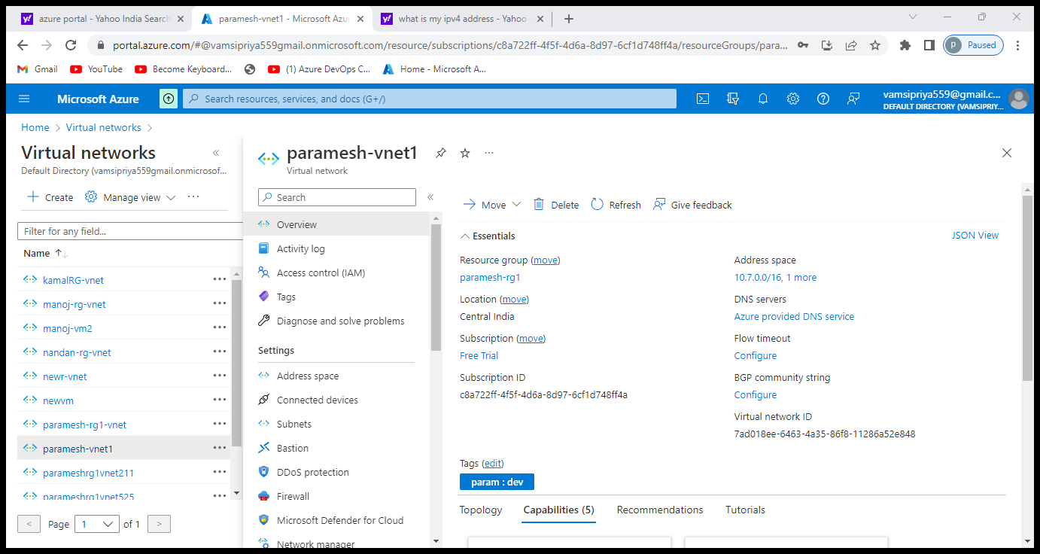
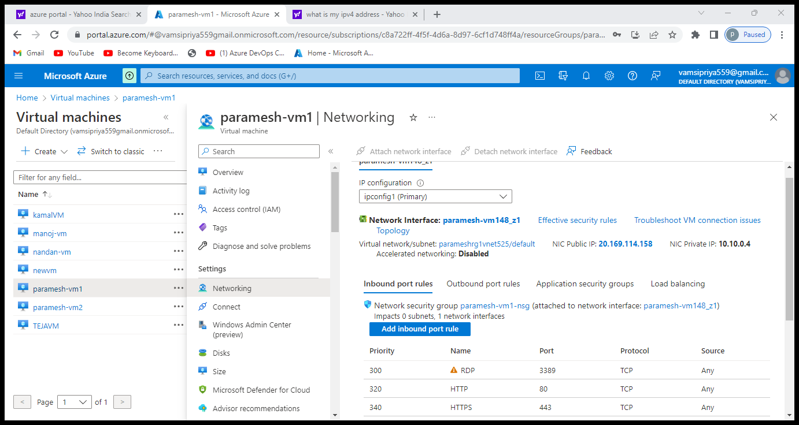
CIDR RANGES
It’s a block of ip address
A,b,c,d/n
N=value of cidr
Standard ip address 2power x
Standard ip will be equal to 2power

Slide 9
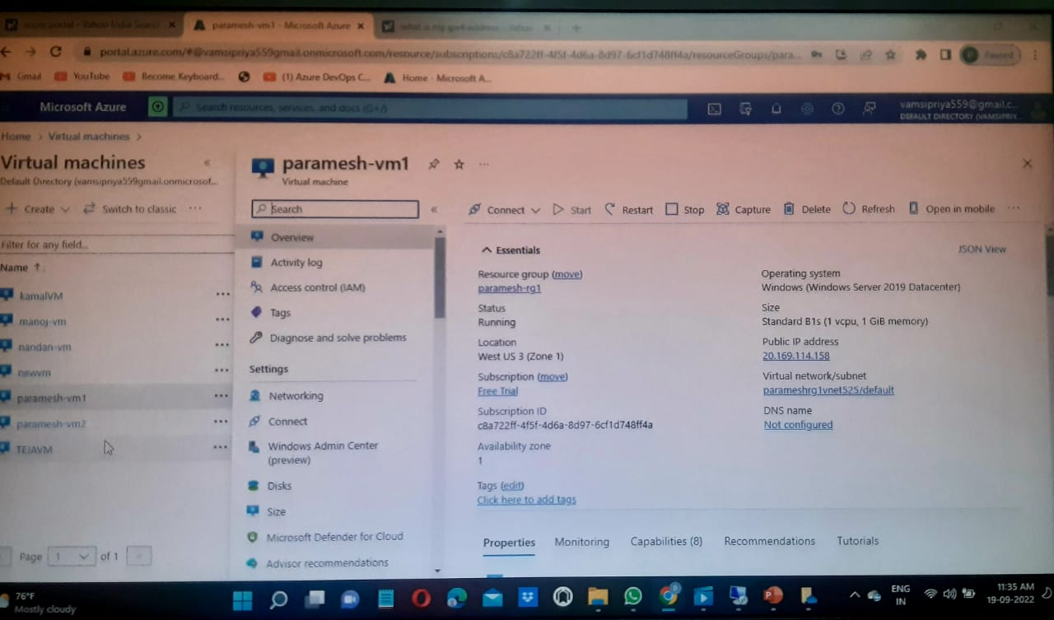
Vertual machine

Slide 10
