Slide 1
Creating VNET,VM and installing a demo website

Slide 2
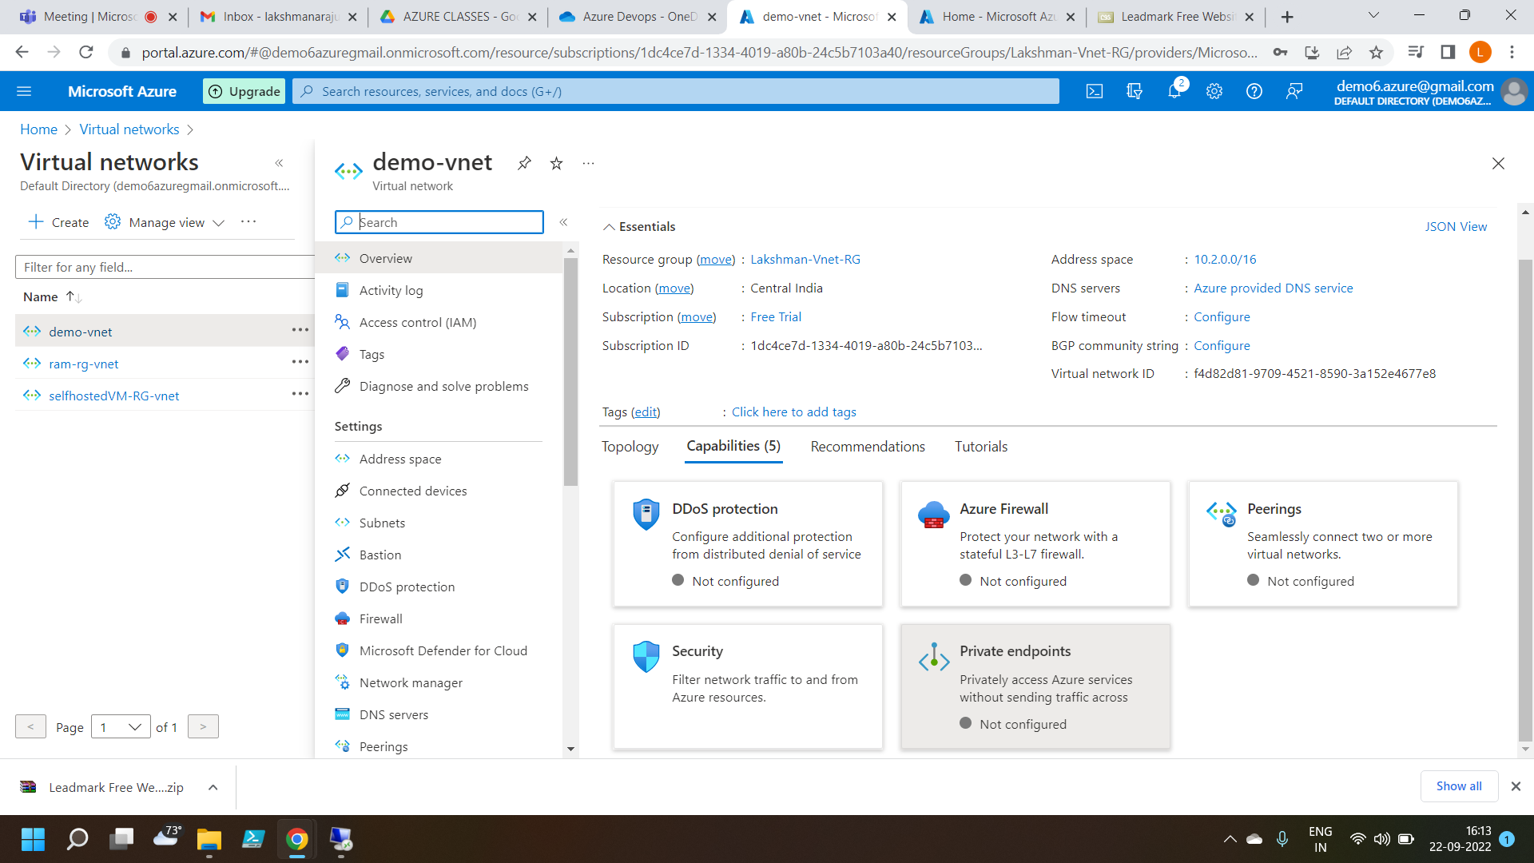
Creating a Virtual network

Slide 3
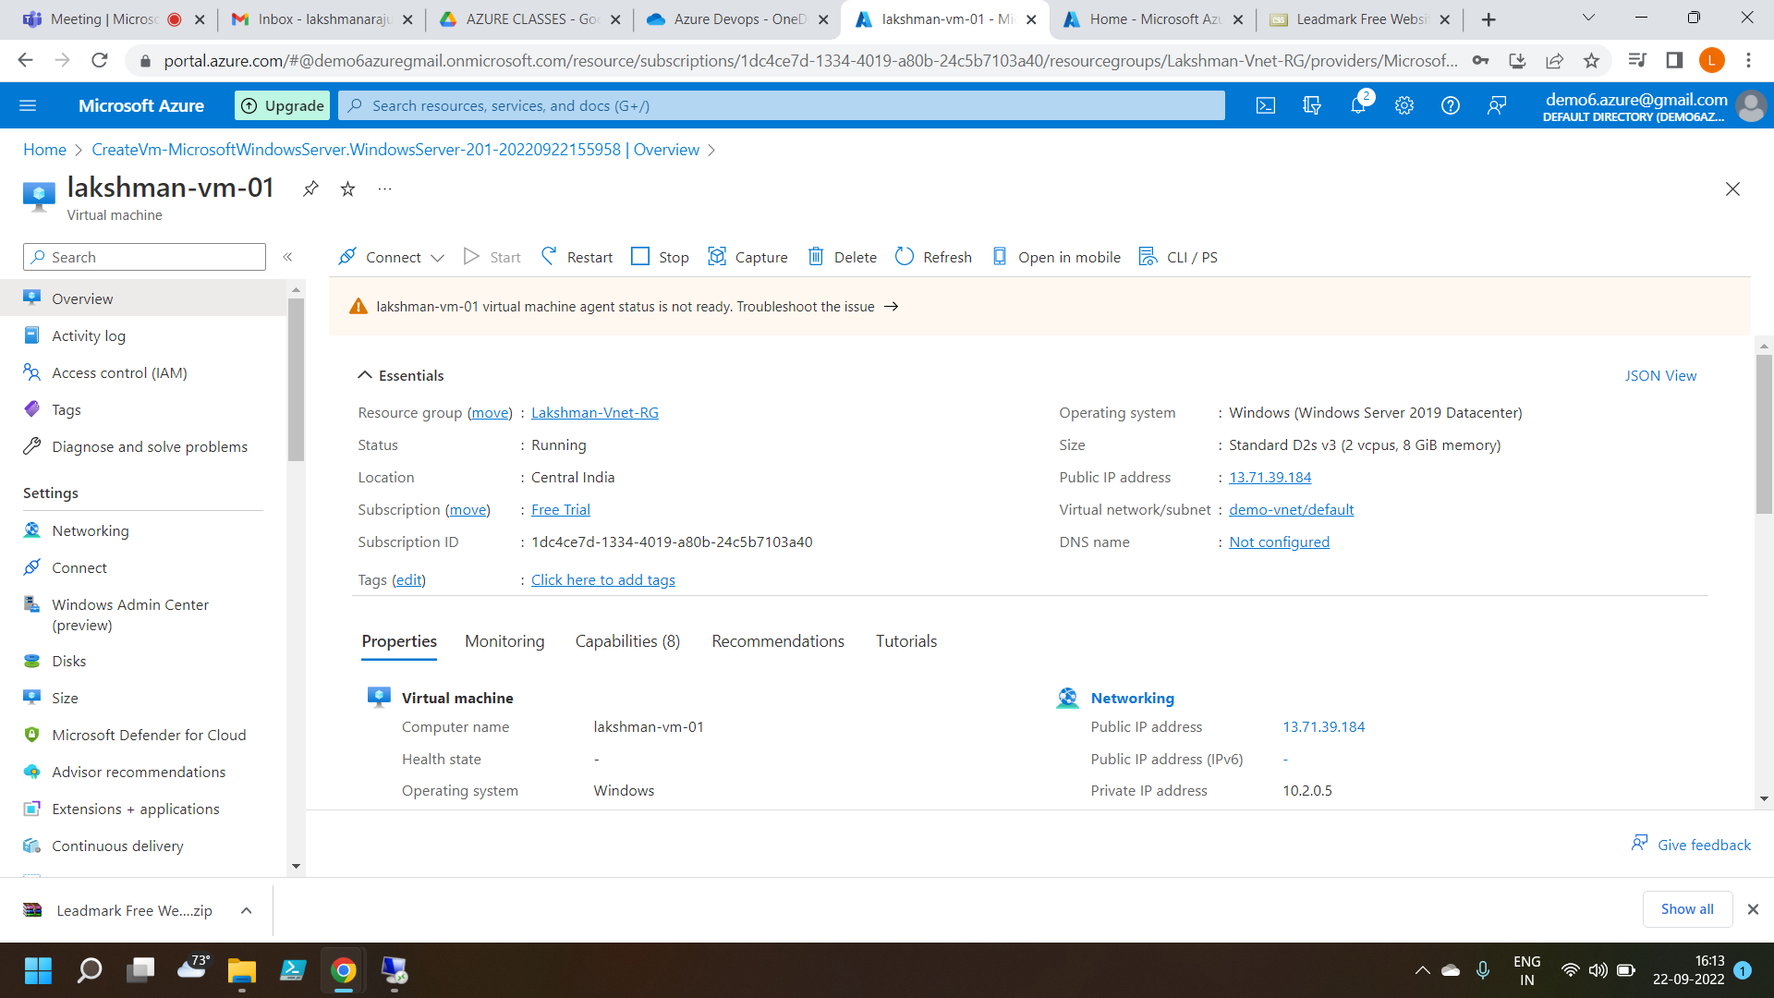
Creating a Virtual Machine

Slide 4
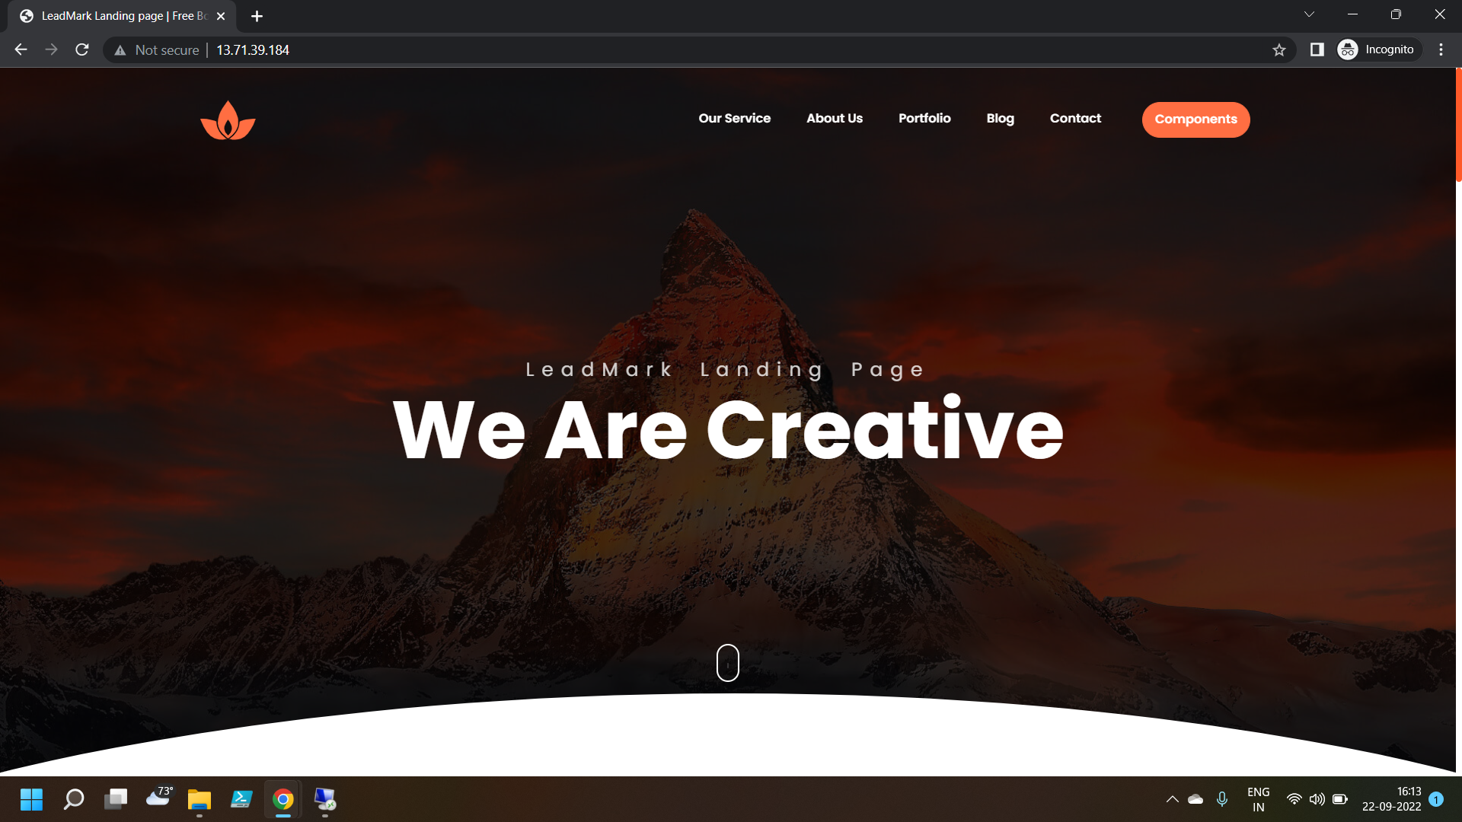
Successfully hosted a website on VM

