Slide 1
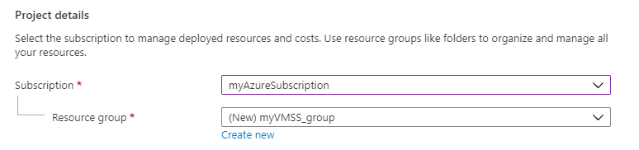
Virtual machine scale set
Azure virtual machine scale sets let you create and manage a group of load balanced VMs. The number of VM instances can automatically increase or decrease in response to demand or a defined schedule. Scale sets provide the following key benefits: Easy to create and manage multiple VMs.
To create a Virtual machine scale set.
Open the Azure portal.
Search for and select Virtual machine scale sets.
Select Create on the Virtual machine scale sets page. The Create a virtual machine scale set will open.
Select the subscription that you want to use for Subscription.
For Resource group, select Create new and type myVMSSRG for the name and then select OK.

Slide 2
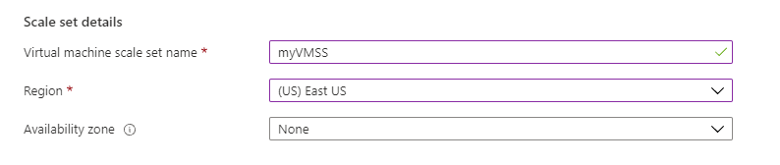
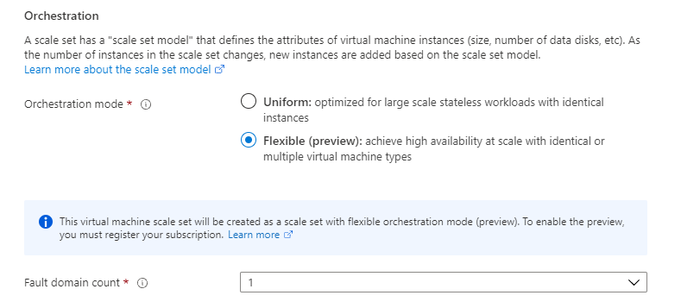
6.For Virtual machine scale set name, type myVMSS.
7.For Region, select a region that is close to you like East US.
8.Leave Availability zone as blank for this example.
9.For Orchestration mode, select Flexible.
10.Leave the default of 1 for fault domain count or choose another value from the drop-down.

Slide 3
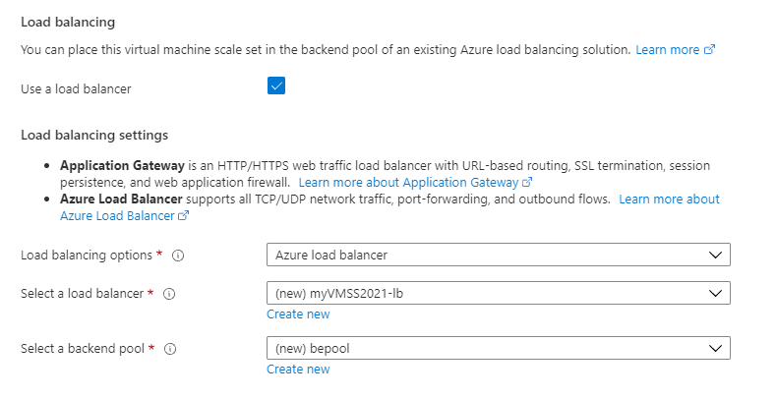
11.For Image, select Windows Server 2019 Datacenter - Gen 1.
12.For Size, leave the default value or select a size like Standard_E2s_V3.
13.For Username, type the name to use for the administrator account, like azureuser.
14.In Password and Confirm password, type a strong password for the administrator account.
15.On the Networking tab, under Load balancing, select Use a load balancer.
16.For Load balancing options, leave the default of Azure load balancer.
17.For Select a load balancer, select Create new.

Slide 4
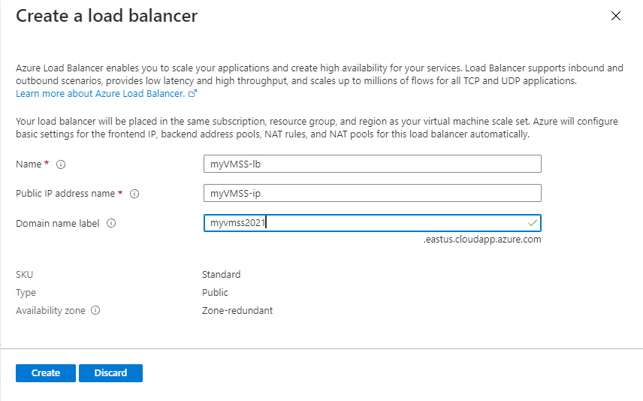
18.On the Create a load balancer page, type in a name for your load balancer and Public IP address name.
19.For Domain name label, type in a name to use as a prefix for your domain name. This name must be unique.
20.When you are done, select Create.
21.Back on the Networking tab, leave the default name for the backend pool.
22.On the Scaling tab, leave the default instance count as 2, or add in your own value. This is the number of VMs that will be created, so be aware of the costs and the limits on your subscription if you change this value.
23.Leave the Scaling policy set to Manual.

Slide 5
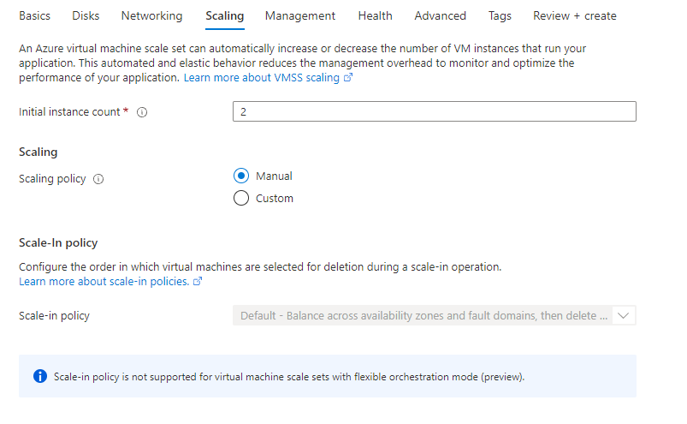
Table of information about the scale set instances.
24.When you are done, select Review + create.
25.Once you see that validation has passed, you can select Create at the bottom of the page to deploy your scale set.
26.When the deployment is complete, select Go to resource to see your scale set.

Slide 6
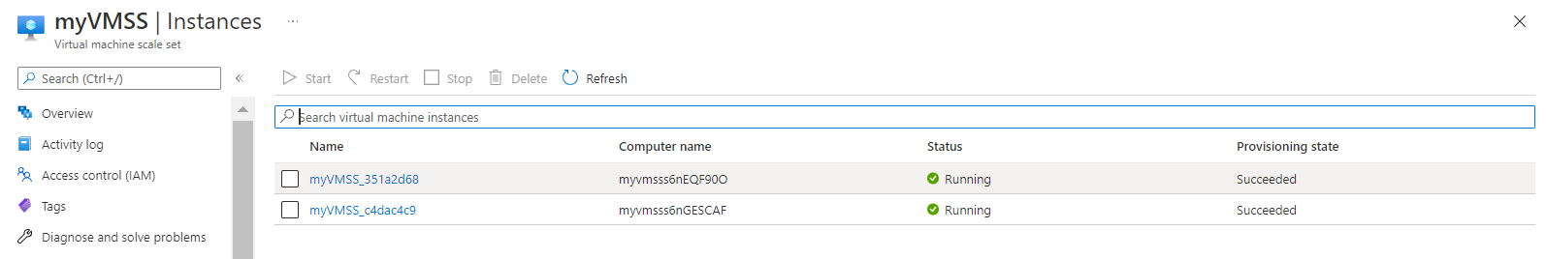

Slide 7
THANK YOU

