Slide 1
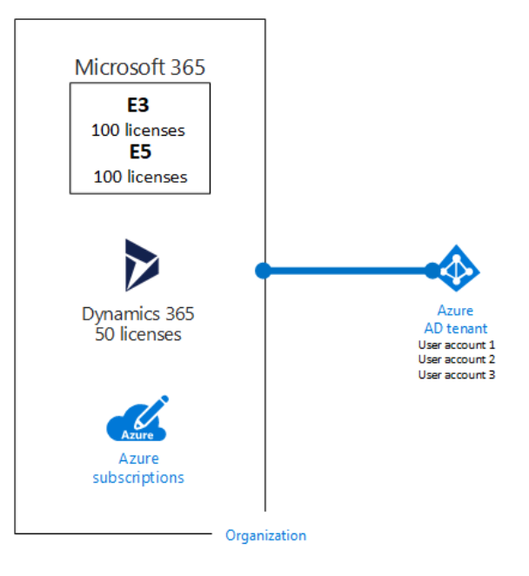
Tenant and Subscription in Azure
a tenant is associated with a single identity (person, company, or organization) and can own one or several subscriptions. a subscription is linked to a payment setup and each subscription will result in a separate bill. in every subscription, you can add virtual resources (VM, storage, network, ...)

Slide 2
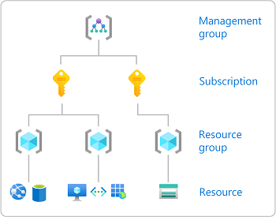
Identity and access management (IAM)
Secure access to your resources with Azure identity and access management solutions. Protect your applications and data at the front gate with Azure identity and access management solutions.

Slide 3
Role-Based Access Control (Azure RBAC)
Azure role-based access control (Azure RBAC) helps you manage who has access to Azure resources, what they can do with those resources, and what areas they have access to. Azure RBAC is an authorization system built on Azure Resource Manager that provides fine-grained access management to Azure resources.
This allows systems administrators and security personnel to more easily manage roles. Azure broadly defines three different roles: Reader, Contributor, and Owner

Slide 4
Load Balancer
An Azure load balancer is a Layer-4 (TCP, UDP) load balancer that provides high availability by distributing incoming traffic among healthy VMs. A load balancer health probe monitors a given port on each VM and only distributes traffic to an operational VM.
There are three load balancers in Azure:
1.Azure Load Balancer,
2.Internal Load Balancer (ILB), and
3.Traffic Manager.

Slide 5
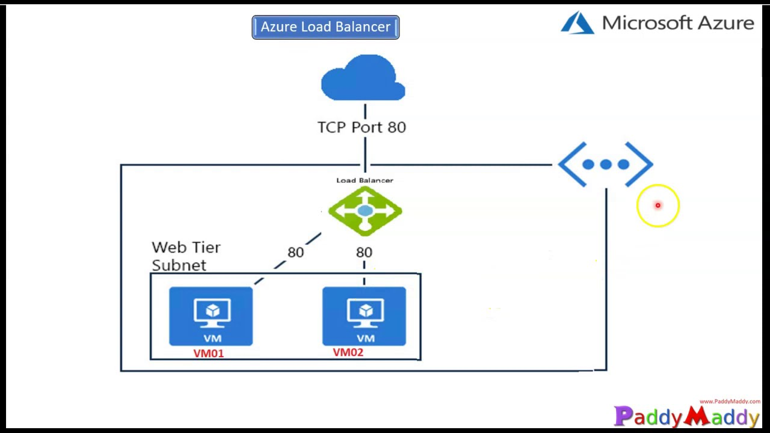
Load Balancer Image View

Slide 6
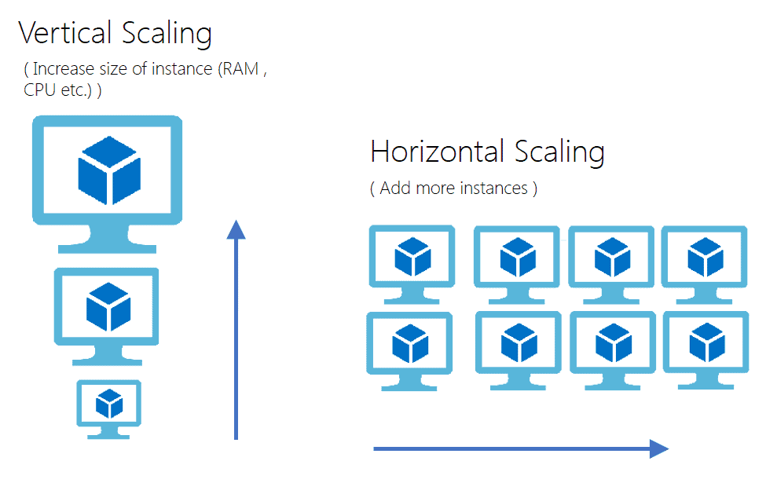
Virtual Machine Scale Sets (VMSS)
Virtual Machine Scale Sets (VMSS), an interesting service offered by Microsoft Azure, helps to create and manage a set of identical, auto-scaling Virtual Machines (VMs). The number of VM instances can automatically increase or decrease based on scheduled conditions.

Slide 7
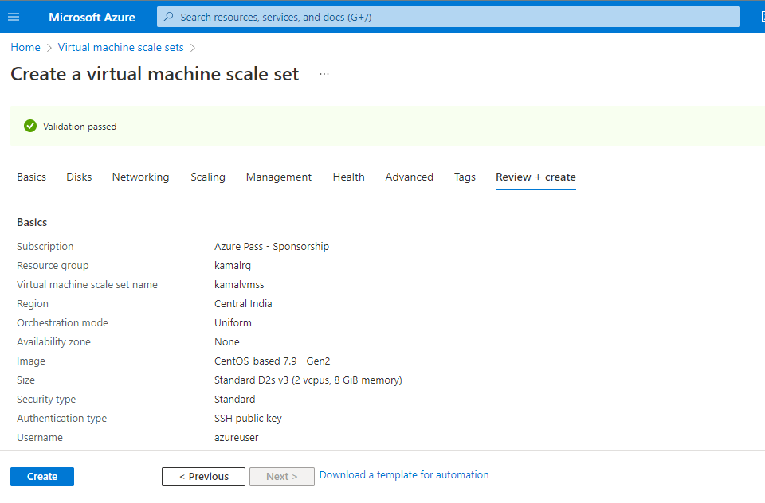
VMSS creation page

Slide 8
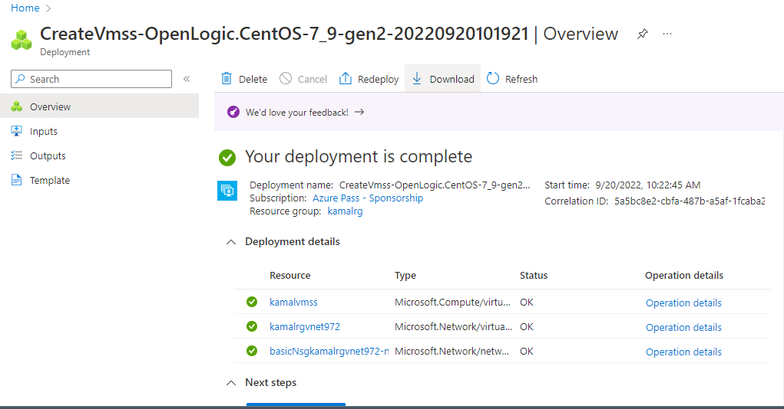
VMSS created successfully

