Slide 1
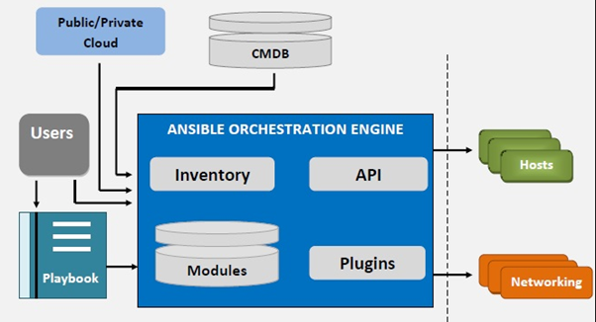
Ansible
Ansible is an open source IT automation engine that automates provisioning, configuration management, application deployment, orchestration, and many other IT processes.

Slide 2
Ansible
Ansible is a tool written in Python, and it uses the declarative markup language YAML to describe the desired state of devices and configuration.
Ansible works by connecting to your nodes and pushing out small programs, called "Ansible modules" to them. These programs are written to be resource models of the desired state of the system. Ansible then executes these modules (over SSH by default), and removes them when finished.

Slide 3
Ansible installation and Setup
Check python3 version
Pip3 library version needs to update
#pip3 install pip –upgrade
Installing Ansible through pip3 library
#pip3 install ansible
We setup the ansible host machine and remote server environment for test purpose.

Slide 4
Ansible Remote and Host machines setup:
On remote server
enable the password authentication - #vi /etc/ssh/sshd_config - PasswordAuthentication yes
Assign password to the user - #sudo passwd root
restart the sshd service - #systemctl restart sshd
On host server
generate the ssh key - #ssh-keygen
copy the ssh key to remote machine - #ssh-copy-id root@ip

Slide 5
Ansible Adhoc commands
Ad hoc commands are commands which can be run individually to perform quick functions. These commands need not be performed later. For example, you have to reboot all your company servers. For this, you will run the Adhoc commands from '/usr/bin/ansible'.
Ad hoc commands are commands which can be run individually to perform quick functions. These commands need not be performed later. For example, you have to reboot all your company servers. For this, you will run the Adhoc commands from '/usr/bin/ansible'.

Slide 6
Examples of Adhoc commands
ansible all -a "free -m"
ansible all -m ping
ansible all -m yum -a "name=httpd state=installed"
ansible all -m service -a "name=httpd state=started enabled=yes"

Slide 7
Ansible Playbooks
Ansible Playbooks are lists of tasks that automatically execute against hosts. Groups of hosts form your Ansible inventory. Each module within an Ansible Playbook performs a specific task. Each module contains metadata that determines when and where a task is executed, as well as which user executes it.
A playbook is a text file that contains a list of one or more plays to run in order. In the previously given example, you can see we are running all the tasks against a single host group named webservers this is called A PLAY. If I want to run a different set of tasks against different host group.
Method1: Specify Localhost in your hosts directive of your playbook.
Method2: Using local_action clause in the ansible playbook.
Method3: Add an entry in your Inventory.
Method4: Specify in the Ansible Command line.

Slide 8
Example of playbook to install httpd webserver
--- - name: Playbook hosts: webservers become: yes become_user: root tasks: - name: ensure apache is at the latest version yum: name: httpd state: latest - name: ensure apache is running service: name: httpd state: started

Slide 9
