Slide 1
BLOOD DONAR FINDER
NAME : MANOJ.B
REGISTER NUMBER : 25024U09021
NAAN MUDHALVAN ID : astvu25025024u09021
DEPARTMENT : BCA
COLLEGE NAME : SKP ARTS AND SCIENCE COLLEGE
UNIVERSITY NAME : THIRUVALLUVAR UNIVERSITY

Slide 2
AGENDA
PROJECT TITLE
PROBLEM STATEMENT
PROJECT OVERVIEW
SCOPE OF THE PROJECT
END USERS
TOOLS AND TECHNOLOGY
ADVANTAGES OF THE PROJECT
8. PROJECT DESIGN & LAYOUT
9. FEATURES AND FUNCTIONALITY
10. WELCOME PAGE
11. REGISTER PAGE
12. RESULTS AND SCREENSHOTS
13. CONCLUSION
14. GITHUB LINK

Slide 3
1. PROJECT TITLE
Blood Donar Application is an interactive web application using Frontend Development ( HTML, CSS, JavaScript)

Slide 4
2. PROBLEM STATEMENT
Emergency situations often require immediate blood donation.
People face difficulty in Finding suitable donors quickly.
Lack of centralized and easily accessible donor information.
Need for a simple system to register, search, and connect with donors.

Slide 5
3. PROJECT OVERVIEW
A Web- based application to connect blood donors with recipients.
Provides donor registration, search, filters(Blood group, City), and Contact option with Google option.
Works with local browser storage; lightweight and user-friendly.
Ensure quick accessibility and help in saving lives.

Slide 6
4. SCOPE OF THE PROJECT
Centralized Donor Information
User Friendly Design
Quick Search
Accessibility
Scalability
Community Building

Slide 7
5. END USERS
Patients
Clinics
Blood Banks
Community
Donors
Families
Hospitals
Volunteers
NGOs

Slide 8
6. TOOLS AND TECHNOLOGY
HTML
JS
CSS

Slide 9
7. ADVANTAGES OF THE PROJECT
Saves time in emergencies.
Easy to use interface.
Works offline with local storage.
No complex installation needed.

Slide 10
8. Project Design And Layout
Welcome Page
Register Tab
Search Section
Donor List
Footer

Slide 11
9. FUTURE AND FUNCTIONALITY
Donor Registration with photo upload.
Search and filter donors by blood group & city.
Mark donor as Available / Busy.
Import & Export Donor list in JSON.
Local storage support (no server needed).
Sample seeding (test data).

Slide 12
10. Welcome Page
Attractive intro screen with gradient background.
Title : 🩸 BLOOD DONAR FINDER 🩸
Tagline : “Find and connect with life-saving donors easily”.
Simple GET STARTED button to enter the app.
Creates a Positive first impression for users.

Slide 13
11. REGISTER PAGE
1. Purpose : Collect Donor information and save in the system.
2. Details Collected :
FULL NAME 👤
BLOOD GROUP 🩸
PHONE NUMBER ☎
CITY / LOCATION 📍
LAST DONATION DATE 📅
PHOTO UPLOAD 🖼
3. Features :
Add Donor Button ➕
Clear All Option
Data stored in Local Storage (Browser)

Slide 14
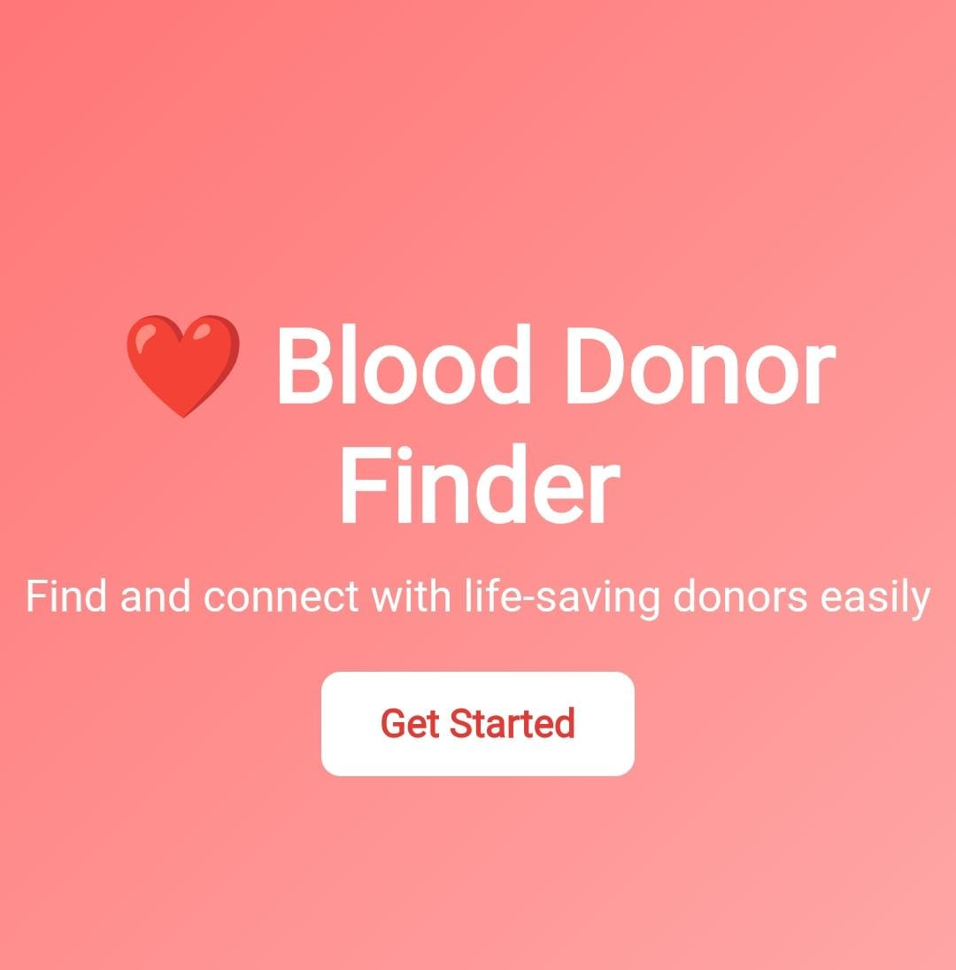
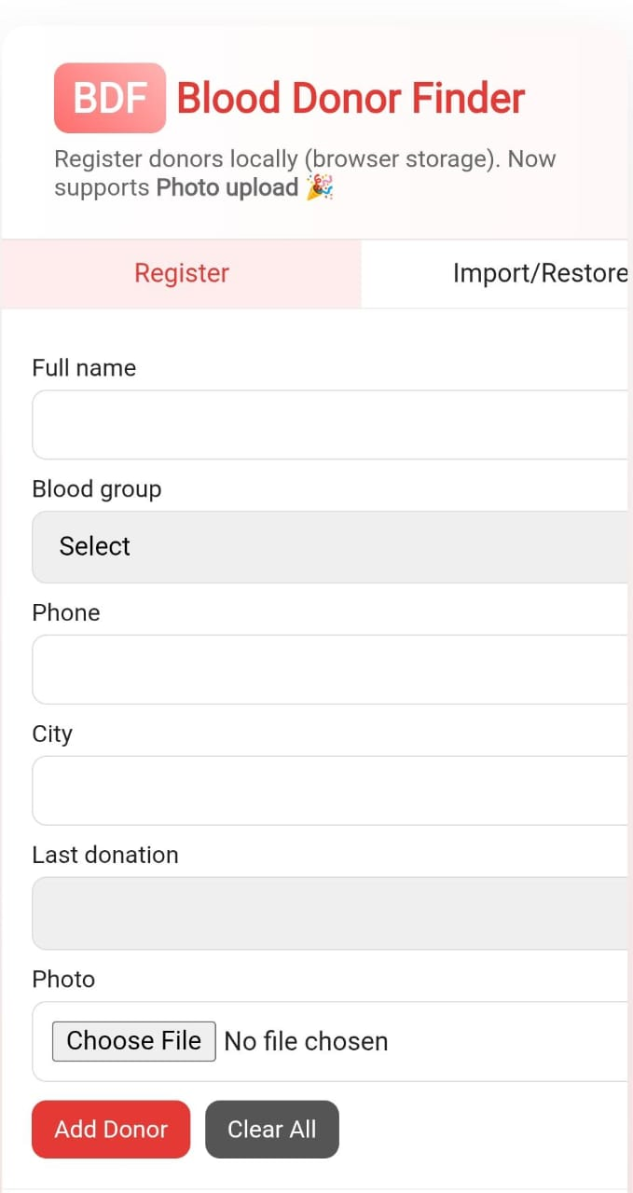
12. SCREENSHOTS
1. WELCOME PAGE
2. REGISTER FORM PAGE

Slide 15
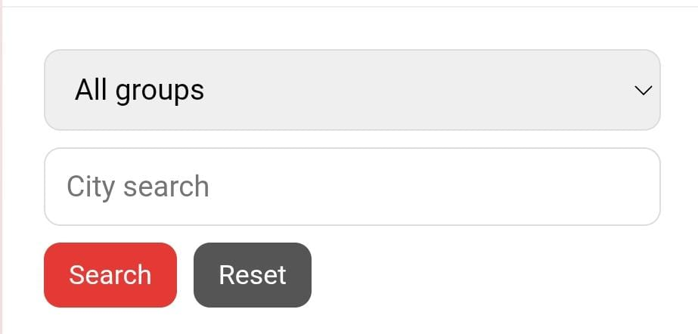
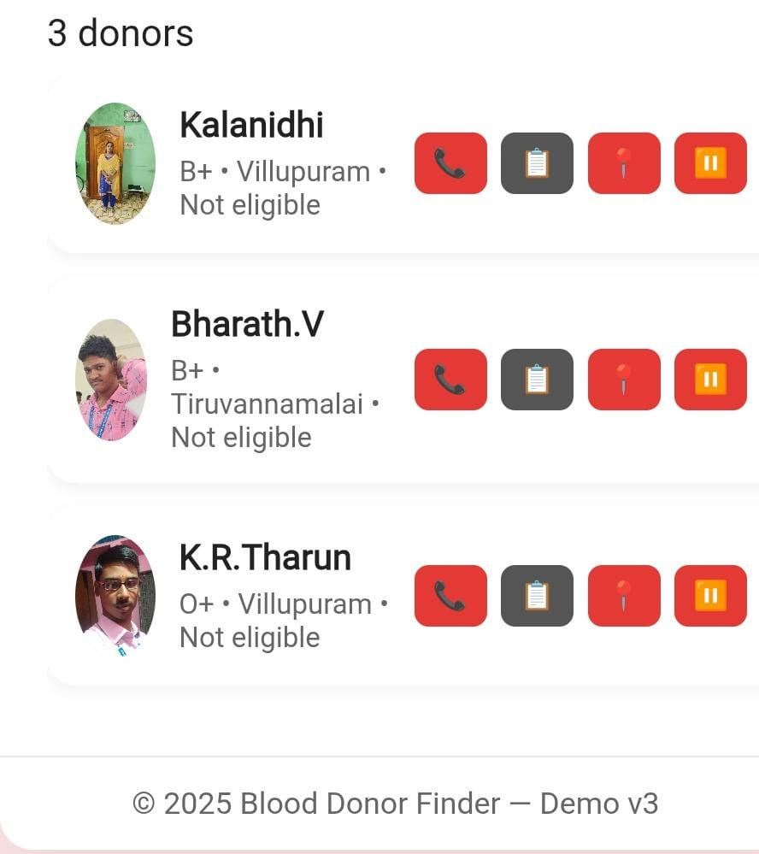
3. SEARCH OPTION
4. DONORS PAGE

Slide 16
13. CONCLUSION
The Blood Donor Finder project provides an innovative and reliable solution to one of the most critical problems faced during medical emergencies – finding suitable blood donors quickly. With its simple and user-friendly interface, the system enables people to register as donors and allows recipients to search and connect with them based on blood group and location. By storing data efficiently in the browser, it ensures quick access without the need for complex installations. This project not only saves valuable time but also encourages community participation in blood donation, thereby strengthening the healthcare support system. In the future, the application can be extended into a mobile app or cloud-based platform for real-time donor availability and wider reach. Overall, it is a practical, life-saving tool that promotes social responsibility and helps save countless lives.

Slide 17
14. GITHUB LINK
https://github.com/manojbabu358/Manoj.git

Slide 18
🙏THANK YOU ALL 🙏
PRESENTED BY B.MANOJ
DEPARTMENT OF COMPUTER APPLICATION

