Slide 1
Data Mining Project Assignment Shark Attack Analysis

Slide 2
Agenda
Introduction
Domain Knowledge
Approach
Data preprocessing
Data transformation
Assumptions
Algorithm
Result
Future Study

Slide 3
Introduction
Spike in shark attacks on the North Carolina Coast in 2015
Attempt to understand, analyze and predict Shark attacks
Analyze various aspects
Oceanographic
Atmospheric
Moon related
Human
Prey population
Basic factors leading shark attacks : Increase in temperature, salinity, reduction in rainfall, prey population and moon phases.
However these are recurring reasons.
But, why increase in the number of shark attacks in 2015?

Slide 4
Domain Knowledge
Shark migration influence by Magnetoception, ocean current variation and bait fish movement
Weaker Gulf Stream and Labrador currents variation this year (Artic ice shifts)
Closeness of Gulf Stream and associated coastal floods.
18% increase in state tourism with an average of 6.5 million visitors since 2010
Lunar effects

Slide 5
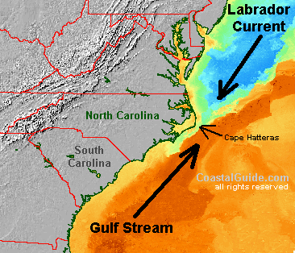

Slide 6
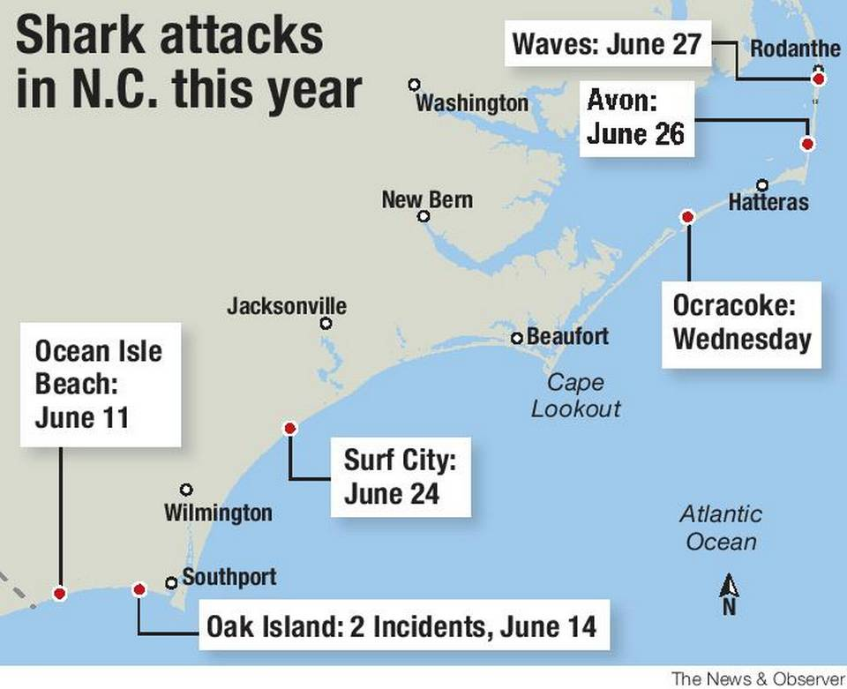

Slide 7
Approach
Think in shark perspective
Gathered all information and aspects of attack from 2010 as old data seems to reduce focus of results
Possible reasons and why it is coming closer to shores compared to similar place California
Started with 21 attributes and using Weka kept on fine tuning with feature selection algorithms.
Based on domain knowledge created related group of attributes and did data mining on them.

Slide 8
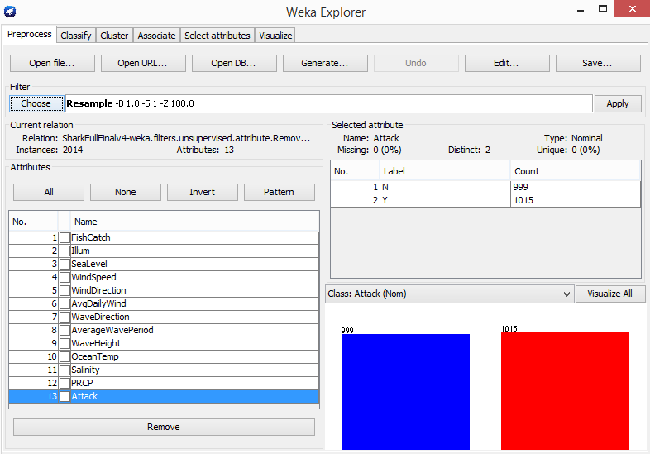

Slide 9
Datasets Used
Shark Attack File
NOAA Oceanographic data
NOAA Meteorological data
timeanddate.com – Lunar data
Blue Crab Landings
Cape Hatteras National Data Buoy Center

Slide 10
Data Preprocessing
Data Cleansing
Handle missing data
Identify irrelevant, outliers and smoothen noisy data
Data Integration
Using google refine joined based on Date attribute
Feature Selection
“Select Attribute” tab with attribute evaluator as “weka.attributeSelection.ReliefFAttributeEval” and search method as “weka.attributeSelection.Ranker”

Slide 11
Data Transformations
Integrated data resulted over fitting
weka.filters.unsupervised.attribute.Discretize
number of bins to 4 & 6 and set useEqualFrequency=True
More bias towards “SharkAttack=No” instances
weka.filters.supervised.instance.Resample
biasToUniformClass=1 with seed as 13 for clearing the bias

Slide 12
Assumptions
Missing values were replaced with mean of previous observations from the same time period.
Anomalies in ocean currents are not accounted

Slide 13
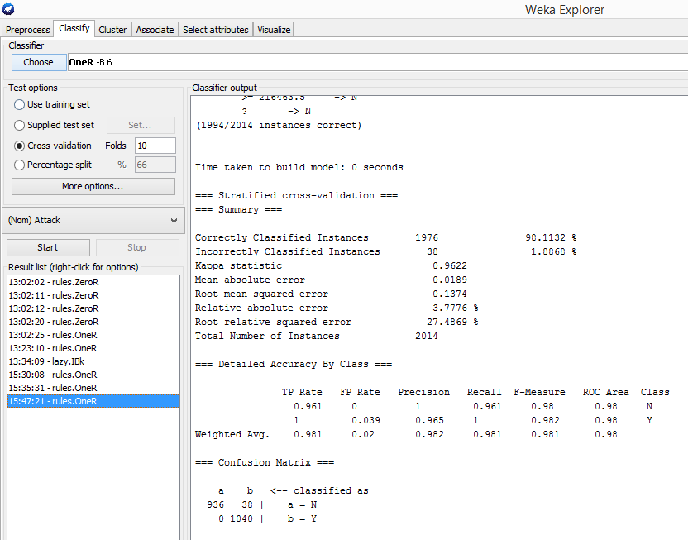
Algorithms
1R – Simple classification (98.11% accuracy)

Slide 14
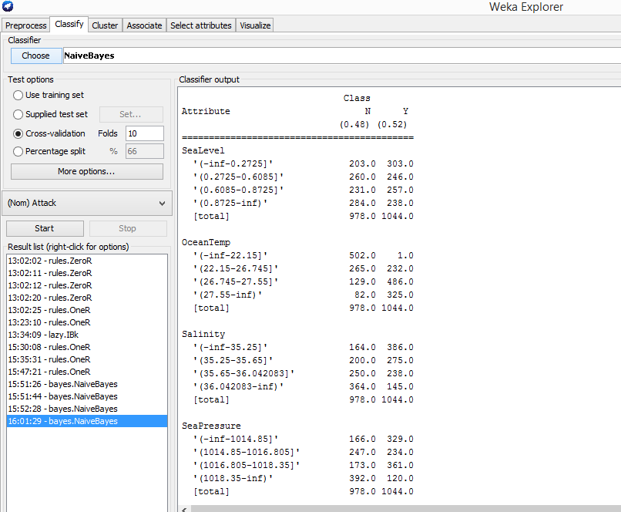
Algorithms
Naïve Bayes – Based on probability found value interval (Current)

Slide 15
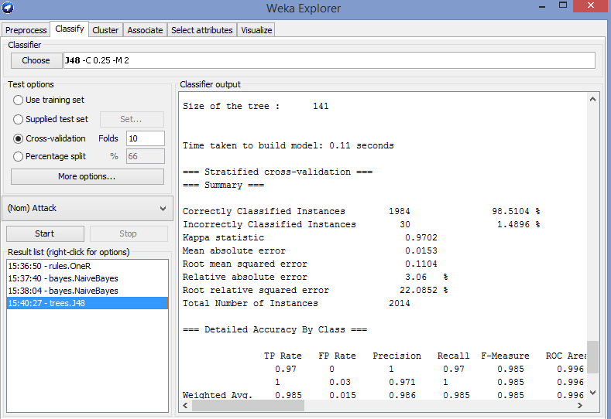
Algorithms
J48 – Results through decision trees

Slide 16
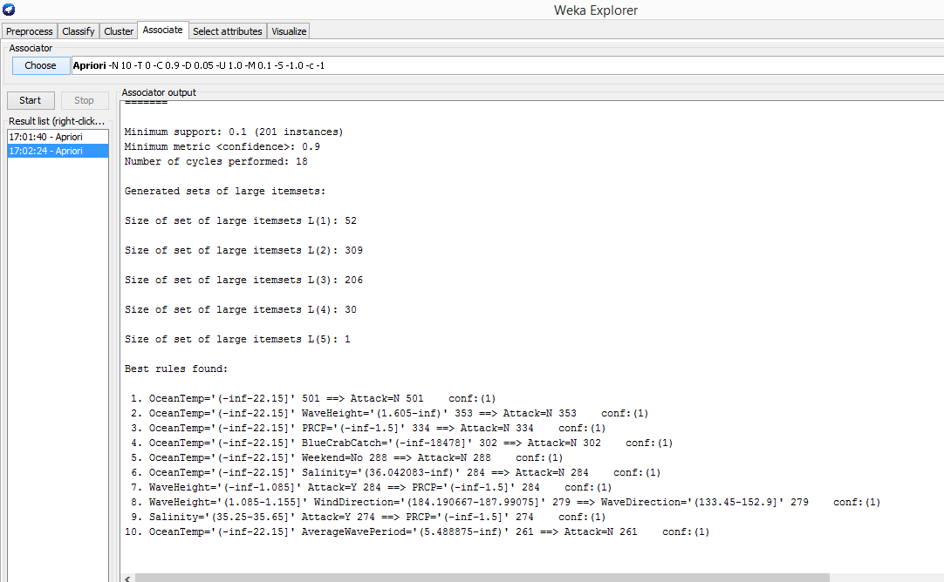
Algorithms
Apriori – Found new associations (associated attributes)

Slide 17
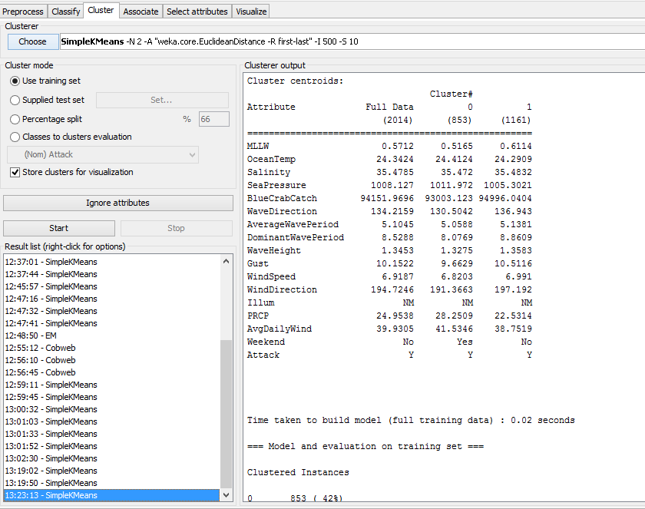
Algorithms
SimpleKMeans – Found basic clusters and nominal attribute

Slide 18
Algorithms
EM – Found clusters with highest probabilities (Lunar)
Scheme:weka.clusterers.EM -I 100 -N -1 -M 1.0E-6 -S 100
Relation: SharkFullFinalv3-weka.filters.unsupervised.attribute.Remove-R1-weka.filters.supervised.instance.Resample-B1.0-S1-Z100.0-weka.filters.unsupervised.attribute.Discretize-F-B4-M-1.0-Rfirst-last-weka.filters.unsupervised.attribute.Remove-R1,3-13
Cluster
Attribute 0 1 2
(0.48) (0.25) (0.27)
=======================================
Illum
FM 712.9185 7.1091 8.9725
FQ 128.5622 10.0543 101.3835
LQ 125.0541 10.0712 94.8747
NM 7.9965 475.7572 343.2463
[total] 974.5313 502.9917 548.477
Attack
N 431.4569 7.9326 537.6105
Y 541.0744 493.0591 8.8664
[total] 972.5313 500.9917 546.477

Slide 19
Results
Lower Low water level (sea level) in combination with sudden rise of temperature marks inflow of Gulf Stream and increases the chances of the shark attack.
OceanTemp > 27.95 Celsius & SeaLevel in 0.8875-1.1825 m
When wave direction is from South East and wind direction is south, wind speed is maximum and ocean temperature is high we get maximum attacks.
WindDirection in 174.10425-185.690667
Wave Direction in 133.45-138.65
Wind Speed > 9.204167 m/s

Slide 20
Results
The warmer ocean, nearer moon, less precipitation, presence of bait fish near shore leads to shark attack
With new moon and full moon days, attacks are more.
BlueCrabCatch > 149870
Illum = FM / NM
Precipitation < 1.5 mm
Weaker Gulf and Labrador current from year to year.
Wave direction variation from other years signify Labrador volatility

Slide 21
Future Study
Access Data of observatory near to Cape Hatteras with more attributes of the ocean currents
Predict closeness of Gulf Stream to coast and thereby Bait fish movement in its Front which increases shark attack

Slide 22
THANK YOU!

