Slide 1
COMP4139 Machine Learning (MLE) - Mathematics
Direnc Pekaslan Shreyank Narayana Gowda
Assistant Professor
School of Computer Science
University of Nottingham

Slide 2
Key Maths Skills
Linear Algebra
All data/features are represented as vectors, matrices and tensors.
Vectors and matrices for solving linear equations easily and quickly.
Differentiation
Calculating rate of changes.
Extremely useful in optimisation algorithms, e.g., neural networks.
Probability theory
The likelihood of an event to occur.
Most machine learning applications are to predict a future event.
Notes:
Vote on Matlab and Python

Slide 3
Linear Algebra- Notation
The notation in Machine Learning tends to vary a lot. In this module, we will use commonly used and consistent notations for mathematical representations.
• Scalars: mixed case italic, e.g. X, y.
• Vectors: lower case bold, e.g. v.
• Colum vectors: v=[x, y]^{T} or v=(x, y).
• Matrices: upper case bold, e.g. M.

Slide 4
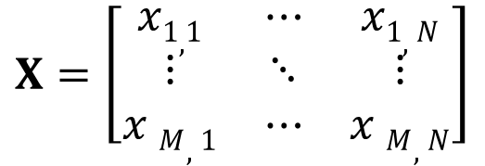
Linear Algebra- Scalar, Vector & Matrix
In real life, many quantities are scalars e.g. the price x of a product, or the mark x you will get for a module. We denote scalars taking values from the set of real numbers as x∈ R.
In ML, we are dealing with vectors a lot. For example, a set of features to describe a person (e.g. weight, height, etc.). We denote a (column) vector with N elements as x = [x₁, x₂,…, x_{N}]^{T}∈ R^{N}
Matrix in ML is frequently used to represent features (N) of observations (M), as in the form of
$$X=\left[\begin{matrix}x1,1 & ⋯ & x1,N \\ ⋮ & ⋱ & ⋮ \\ x M,1 & ⋯ & x M,N\end{matrix}\right]$$

Slide 5
Linear Algebra- Linear Equations
One dimensional case:
E.g., to estimate the average speed v of a car, we measure the distance s that the car did in time t. The relationship is s = vt, then v = s/t.
Note that 1 measurement is sufficient to solve v.
In general case: xw= y and then w can be solved as w = y/x, where x and y are known.
The condition for this to be valid is x ≠ 0.

Slide 6
Linear Algebra- Linear Equations
N-dimensional case:
For the case of vectors: if w = [w₁, w₂,…, w_{N}]^{T}, then 1 measurement is:
x_{1,1} w₁ + x_{1,2} w₂ +…+ x_{1,N} w_{N} = y₁
where x_{1,1,} …, x_{1,N,} and y₁ are all given. Can we solve all values in w?
For a vector with N elements, 1 measurement can not be sufficient:
x_{1,1} w₁ + x_{1,2} w₂ +…+ x_{1,N} w_{N} = y₁
x_{2,1} w₁ + x_{2,2} w₂ +…+ x_{2,N} w_{N} = y₂
…
x_{N,1} w₁ + x_{N,2} w₂ +…+ x_{N,N} w_{N} = y_{N}

Slide 7
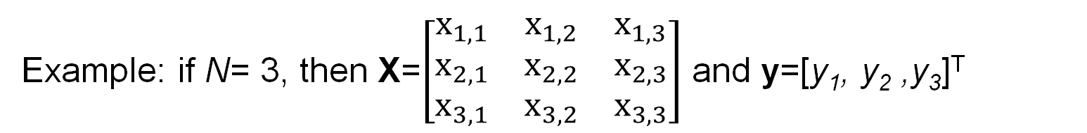
Linear Algebra- Linear Equations
Take all values of x and put them in a matrix X with N×N elements. Take all values of y and put them in a vector y with N elements. Then the above equations can be compactly written as:
Xw = y
Example: if N= 3, then X=$\left[\begin{matrix}x_{1,1} & x_{1,2} & x_{1,3} \\ x_{2,1} & x_{2,2} & x_{2,3} \\ x_{3,1} & x_{3,2} & x_{3,3}\end{matrix}\right]$ and y=[y₁, y₂ ,y₃]^{T}
To solve w, we use the inverse of X and multiply by y as
w = X⁻¹y.
The calculation of the inverse is possible if the determinant of X is non-zero.

Slide 8
Linear Algebra- Least Squared Estimation
For a vector w with N elements, N measurements are sufficient to find w. In practice, more measurements might be available which makes the estimation more robust to noise. Noise arises if for some reason the measurements in X and y are imperfect.
Suppose that we have M measurements with M > N. Then, X has dimension of M×N. In this case, X cannot be inverted as it's not a square matrix. To solve w, we need a small trick as follows:
Xw = y
Multiply X^{T} on both sides, we have
X^{T}Xw = X^{T}y
Then X^{T}X is a square matrix, which is invertible.
w = (X^{T}X)⁻¹X^{T}y
This is equivalent to minimise mean squared error: ||Xw-y||² , called least squared

Slide 9
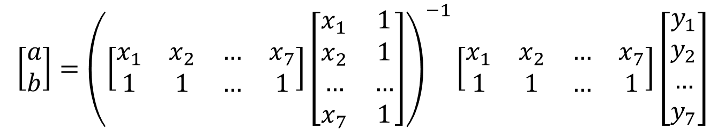
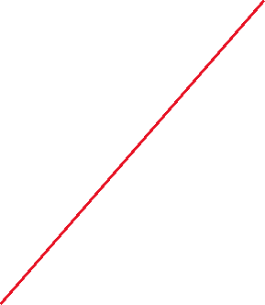
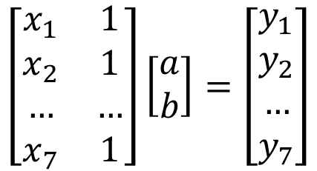
Least Squared Line Fitting Example
Line fitting: y=ax+b
Matrix form:
$$\left[\begin{matrix}x_{1} & 1 \\ x_{2} & 1 \\ … & … \\ x_{7} & 1\end{matrix}\right]\left[\begin{matrix}a \\ b\end{matrix}\right]=\left[\begin{matrix}y_{1} \\ y_{2} \\ … \\ y_{7}\end{matrix}\right]$$
Solve a and b:
$$\left[\begin{matrix}a \\ b\end{matrix}\right]={\left(\left[\begin{matrix}x_{1} & x_{2} & … & x_{7} \\ 1 & 1 & … & 1\end{matrix}\right]\left[\begin{matrix}x_{1} & 1 \\ x_{2} & 1 \\ … & … \\ x_{7} & 1\end{matrix}\right]\right)}^{−1}\left[\begin{matrix}x_{1} & x_{2} & … & x_{7} \\ 1 & 1 & … & 1\end{matrix}\right]\left[\begin{matrix}y_{1} \\ y_{2} \\ … \\ y_{7}\end{matrix}\right]$$

Slide 10
Differentiation
A derivative f’(x) of a function f(x) is a function or a value that describes how fast f(x) changes (decrease or increase). The process of finding the derivative is differentiation.
If the derivative is a constant value, it indicates that the original function f(x) consistently increases or decreases at any point of x. E.g. f(x)=3x, then f’(x)=3
If the derivative is a function, f can increase or decrease at different point of x which is represented by a function. E.g. f(x)=3x², then f’(x)=6x.
Review how to perform differentiation of different functions (need to know what chain rule is, f(x)=h(g(x)), then f’(x)= h’(g(x)) g’(x) : e.g. f(x)=(5x+1)².

Slide 11
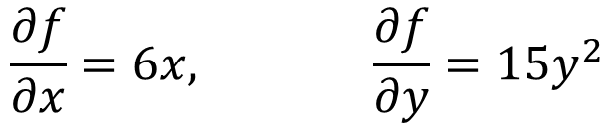
Partial Derivatives
Instead of x, we may have more than one variable or a vector of variables. E.g., f(x, y)= 3x²+5y³+10.
Partial derivative is used here to calculate the changes with respect to each of the variables.
When calculating derivative for one variable, treating others as constant values.
A vector of partial derivatives is also called gradient.
$$\frac{∂f}{∂x}=6x, \frac{∂f}{∂y}=15y^{2}$$
The gradient of function f is denoted as ∇f, given by the vector [∂f/∂x, ∂f/∂y ]. The chain rule can also be used for partial derivatives.

Slide 12
Why do we need to optimise a function?
A function f(w) in machine learning is normally used to measure the error between the estimated values and the corresponding target values.
Optimisation can be used to find the best variable value w* that generates the minimum function value f(w*) (minimum error).

Slide 13
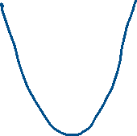
Why do we need to optimise a function?
A function f(w) in machine learning is normally used to measure the error between the estimated values and the corresponding target values.
Optimisation can be used to find the best variable value w* that generates the minimum function value f(w*) (minimum error).

Slide 14

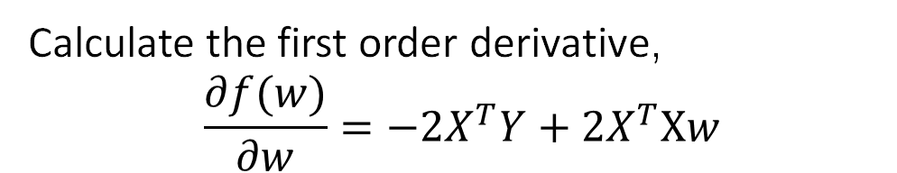

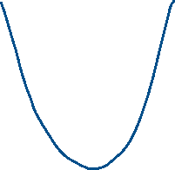
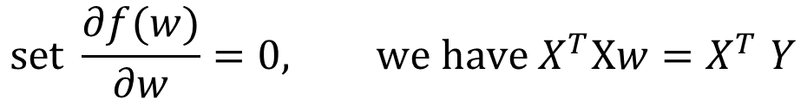
Least Square Estimation (closed form solution)
$$f\left(w\right)={\left\|Y−Xw\right\|}^{2}$$
$$={\left(Y−Xw\right)}^{T}\left(Y−Xw\right)$$
$$=Y^{T}Y−Y^{T}Xw−w^{T}X^{T}Y+w^{T}X^{T}Xw$$
Calculate the first order derivative,
$$\frac{∂f(w)}{∂w}=−2X^{T}Y+2X^{T}Xw$$
y | ∂Y/∂W​
Aw​ | Aᵀ​
wᵀA​ | A​
wᵀAw​ | Aw + Aᵀw​
$$set \frac{∂f(w)}{∂w}=0, we have X^{T}Xw{=X}^{T}Y$$
$$We can obtain: w={\left(X^{T}X\right)}^{−1}X^{T}Y$$

Slide 15
Gradient Descent Optimisation
Gradient descent is an iterative optimisation algorithm used to find a local minimum or maximum of a given function. This is one of the mostly used optimisation methods in machine learning.

Slide 16
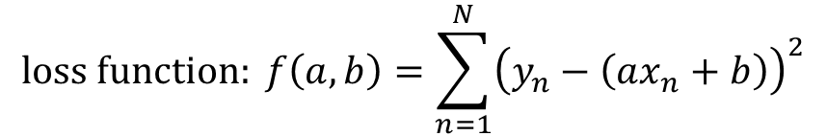

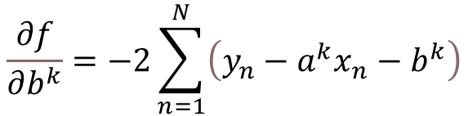
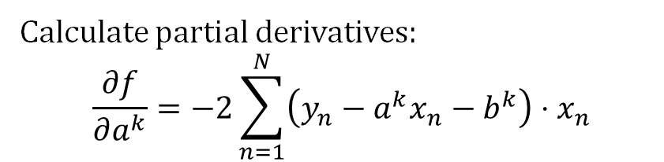
Demo (Gradient Descent based Line Fitting)
Aim: to find parameter w*=[a*,b*] for a line that best fit these points (x, y)
a, b : parameter to be estimated k : iteration N : number of data samples $α:learning rate$
$$loss function: f\left(a,b\right)=\sum_{n=1}^{N}{{\left(y_{n}−\left(ax_{n}+b\right)\right)}^{2}}$$
y
Calculate partial derivatives:
$$\frac{∂f}{∂a^{k}}=−2\sum_{n=1}^{N}{\left(y_{n}−a^{k}x_{n}−b^{k}\right)}⋅x_{n}$$
$$\frac{∂f}{∂b^{k}}=−2\sum_{n=1}^{N}{\left(y_{n}−a^{k}x_{n}−b^{k}\right)}$$
Initialise a, b, $α$ when k=1
x
${Iteratively updat a and b: a}^{k+1}=a^{k}−α\frac{∂f}{∂a^{k}}$, ${ b}^{k+1}=b^{k}−α\frac{∂f}{∂b^{k}}$
Iterate until f(a^{k},b^{k}) is small enough or k>max iteration

Slide 17
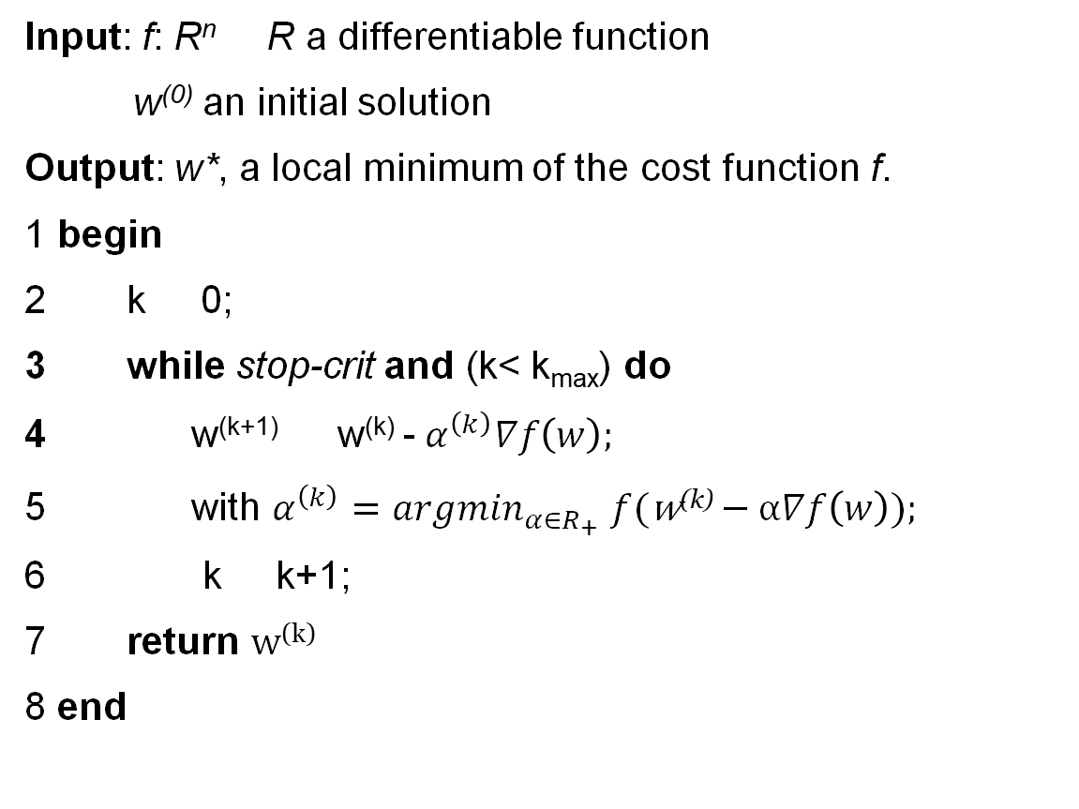
How gradient descent works?
This is generalised to multiple variables rather than only one variable w.
Input: f: R^{n} R a differentiable function
w⁽⁰⁾ an initial solution
Output: w*, a local minimum of the cost function f.
1 begin
k 0;
while stop-crit and (k< k_{max}) do
w^{(k+1)} w^{(k)} -${ α}^{\left(k\right)}∇f\left(w\right);$
with $α^{\left(k\right)}=arg\min_{α∈R_{+}}$ $f(\text{w}\text{(}\text{k}\text{)}−α∇f\left(w\right));$
k k+1;
return $\text{w}\text{(}\text{k}\text{)}$
8 end

Slide 18
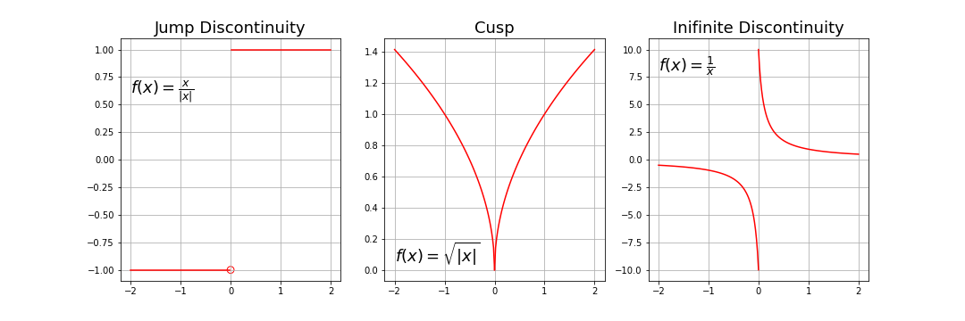
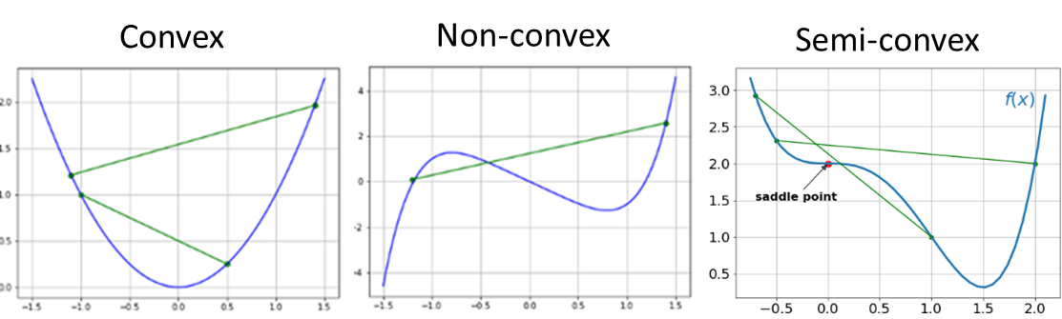
Requirements and Limitations of Gradient Descent
The function to be optimised is differentiable at each point of x (no discontinuity).
The function is convex: the line segment connecting two function’s points lay above the curve (does not cross it).

Slide 19
Learning Objectives
Introductions (i.e., get to know each other)
Module overview
ML intro: What is it
Toy examples
Mathematics
Toy examples
Decision whether to continue or not

