Slide 1
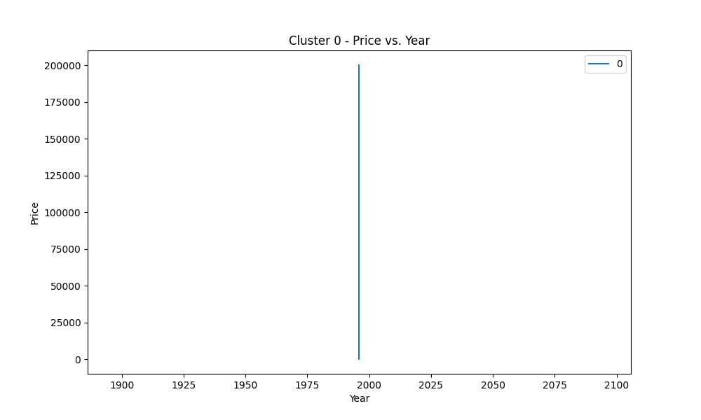
Context 0
pen van
pen van

Slide 2
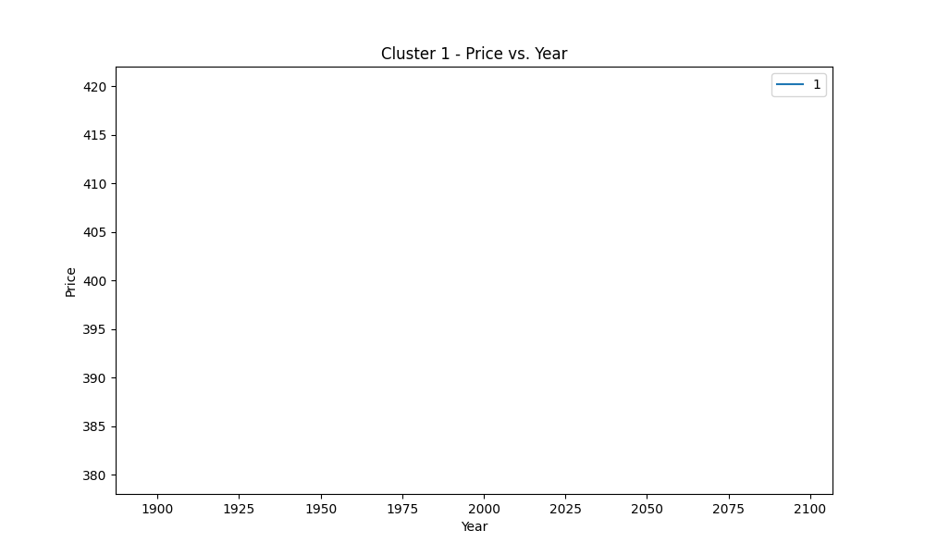
Context 1
fare
fare

Slide 3
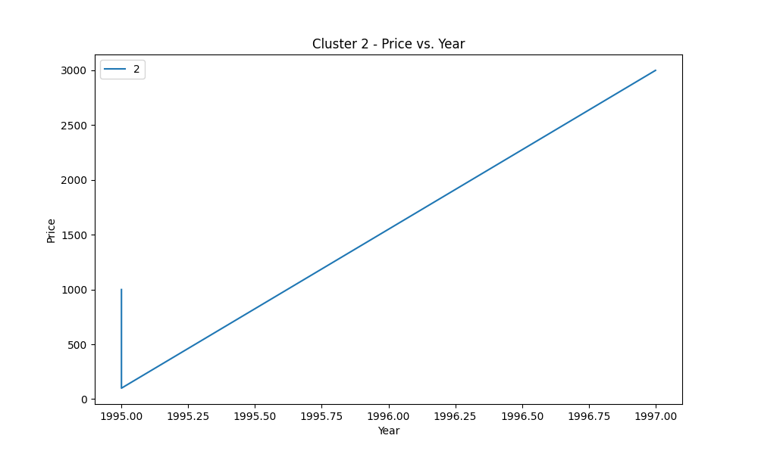
Context 2
Glass book clothes
Glass book clothes

Slide 4
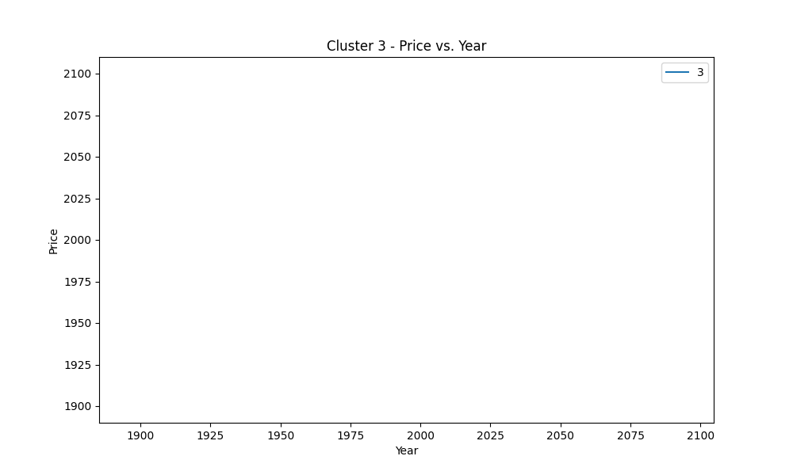
Context 3
Jeans
Jeans

Slide 5
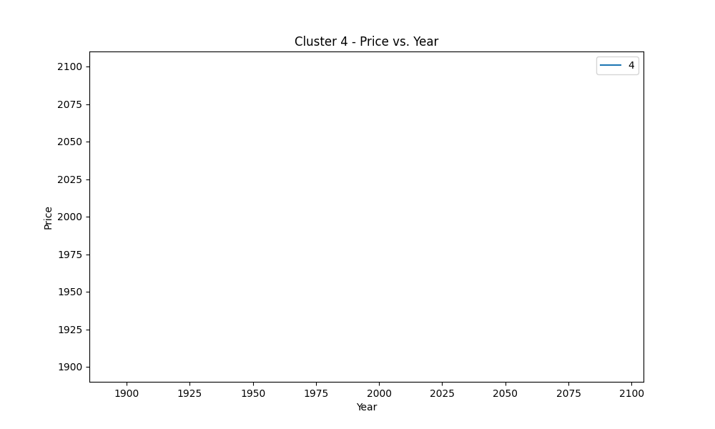
Context 4
Shop
Shop

