Slide 1
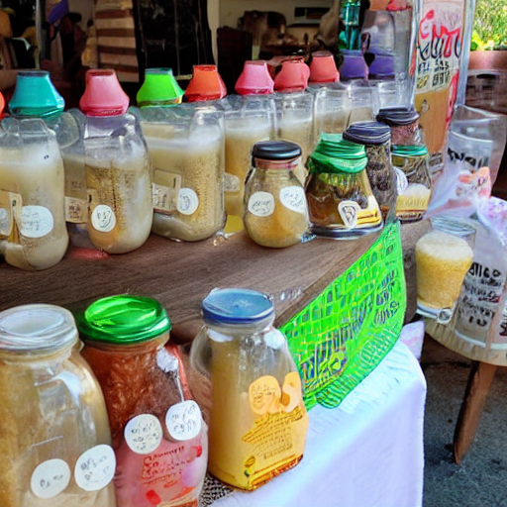
Went molly milk market make
the milkmaid's job was to milk the cows and sell the milk at the market . while walking to the market, she spotted a chicken and thought that she could earn more money by buying a bird and selling its eggs . she started to skip in excitement, and soon the milk spilled over .

