Slide 1
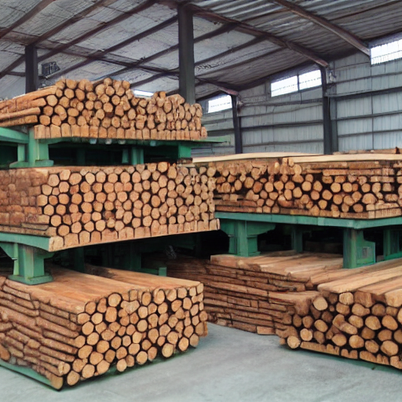
Wood compound industry including hydroxide
sodium hydroxide is a white, waxy, solid compound that is highly alkaline . it is used in the production of paper, soap, detergents, and textiles . caustic soda is also known as sodium chloride .

