Slide 1

Capstone Project Presentation
GDP Forecasting
Piyush Saraogi
Krishna Punyakoti
Manoj Kumar
Bhanu Gotluru
Dinakar Naik

Slide 2
Contents
Project Background
Project Objective
Dataset
Missing Values Treatment
Modelling
Visualization

Slide 3
Project Background - GDP and Its Importance
GDP is the total market value of final goods and services produced in an economy in a given period of time
It is one of the key macro-indicators that measure the health of the economy
Nominal GDP is the value of final goods and services at the current prices, whereas Real GDP is the value of final goods and services at constant prices
GDP forecasting is important because the strategies of major industries and economic policies of the government are dependent on the forecasted GDP

Slide 4
Project Objective
The objectives of the project are:
Missing Value Treatment: Imputation of the missing GDP values
Time Series Forecasting: Forecasting the GDP values of the next few years
Visualization: Visualization of the data in a visualization tool (Tableau/PowerBI)

Slide 5
Dataset
Dataset was shared by Jigsaw Academy.
State-wise Nominal GDP data were available for the years from 1980 to 2014
There were some gaps in the data; GDP data was missing for some of the years for few states - Telangana, Jharkhand, Chhattisgarh Uttarakhand (all of these states were carved out from some other state)
GDP data of the states - Andhra Pradesh, Bihar, Madhya Pradesh and Uttar Pradesh - which got divided required adjustment for the years prior to the year in which they got divided.

Slide 6
Missing Values Treatment
Some years’ data was missing for Telangana, Jharkhand, Chhattisgarh and Uttarakhand. All these are the states which were created from another state. To arrive at the historical GDP values of these states, following methodology was used (illustrating it with the help of Andhra Pradesh and Telangana):
GDP values of Telangana was available from the year 2004 onwards. If we look at the GDP values of Andhra Pradesh, we would see a considerable, sudden drop in GDP in the year 2004 as compared to the year 2003, which can be assumed to be because of the split in from the year 2004 onwards
The ratio of GDP value of Andhra Pradesh to Telangana in the year 2004 was calculated
Using this ratio, the earlier GDP values of Andhra Pradesh was split between Andhra Pradesh and Telangana
Same methodology was applied to other states as well

Slide 7
MODELLING

Slide 8
Stationarity - Conditions
Before performing time series forecasting on a data series (collected over a period of time), we need to ensure that the series is stationary.
Following conditions need to be met for a time series to be called stationary:
Constant mean
Constant variance
The covariance of the i^{th} term and the (i+m)^{th} term should not be a function of time.
Intuitively, we can say that the GDP data won’t be stationary because it isn’t expected to have either constant mean or constant standard deviation

Slide 9
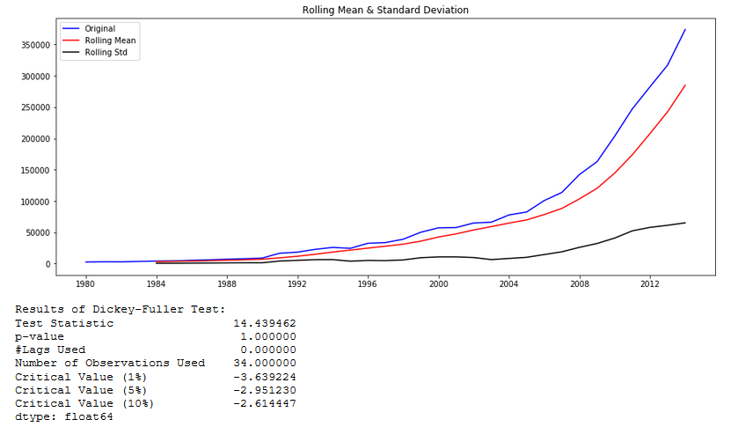
Stationarity - Check
Following graph shows the actual values, rolling mean and rolling standard deviation of the state of Bihar
Clearly, both the mean and standard deviation are increasing over time, and hence the series isn’t stationary
The null hypothesis of Dickey-Fuller test is that time series is not stationary (has some time-dependent structure)
The p-value is > 0.05, which means the time series is not stationary

Slide 10
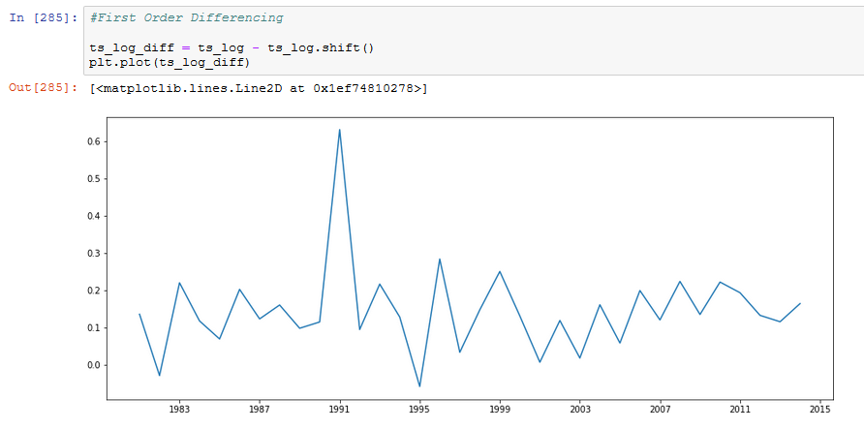
Transforming the Series
We need to make the time series stationary through transformation before performing ARIMA on it. In this case, the data clearly has only trend and no seasonality, and hence we need to eliminate the trend. To do so, we would first take the log of it and perform first order differencing on it, followed by check for stationarity
The trend seems to have been eliminated. However, to confirm the same, we need to perform Dickey-Fuller test again

Slide 11
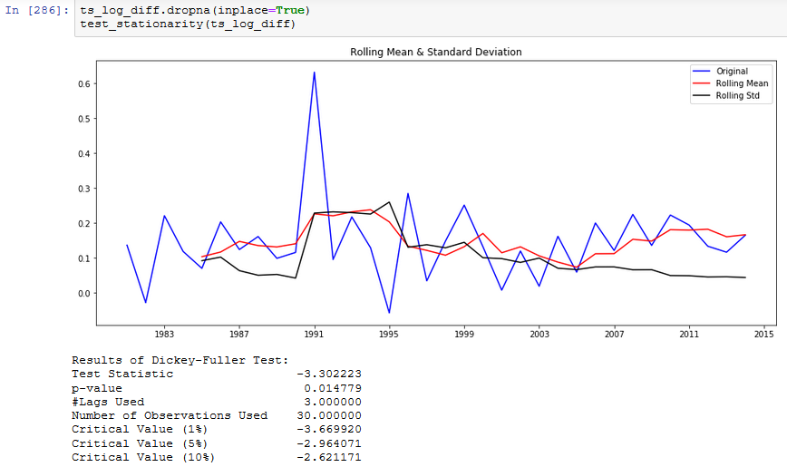
Stationarity Check – Post Transformation
The Series is now Stationary. We can now do time series forecasting on it

Slide 12
AR and MA Values – PACF and ACF Charts (1/2)
ARIMA (Auto Regressive Integrated Moving Average) is one of the most popular models used in time series forecasting.
To perform ARIMA, values of 3 parameters – p (no. of autoregressive (AR) terms), d (number of differences) and q (number of moving average (MA) terms) – need to be passed as input
To determine the optimal values of ‘p’ and ‘q’, we need to plot PACF (Partial Autocorrelation Function) and ACF (Autocorrelation Function) graphs
ACF is a measure of the correlation between the Time Series with a lagged version of itself
PACF measures the correlation between the Time Series with a lagged version of itself but after eliminating the variations already explained by the intervening comparisons.

Slide 13
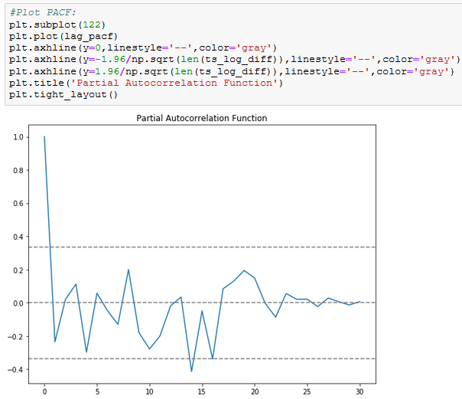
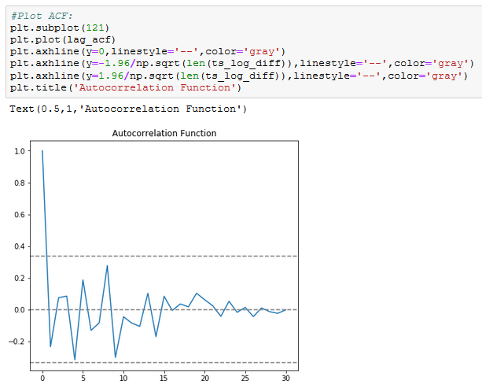
AR and MA Values – PACF and ACF Charts (2/2)
p value is the lag value where the PACF chart crosses the upper confidence interval for the first time. It can be noticed that in this case p=1.
q value is the lag value where the ACF chart crosses the upper confidence interval for the first time. It can be noticed that in this case q=1.

Slide 14
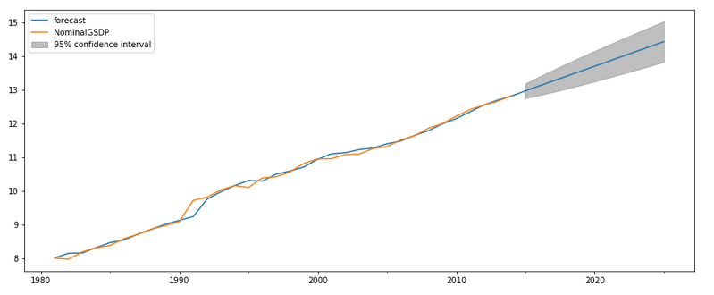
Fitting the Model and Forecasting
Post determination of p and q values, the data is fitted in ARIMA model. The model thus obtained is then used to forecast the data for the next few years
As can be seen in the above visual, the model is fitting the data quite well
Note: The data is in log scale

Slide 15
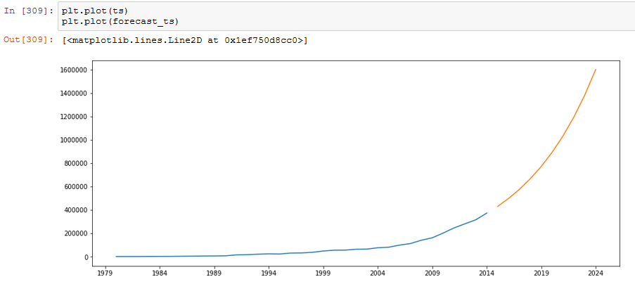
Bringing the Output to the Original Scale
Post forecasting using the fitted model, a series of steps are performed to bring the output to the original scale. Following is the final output:

Slide 16
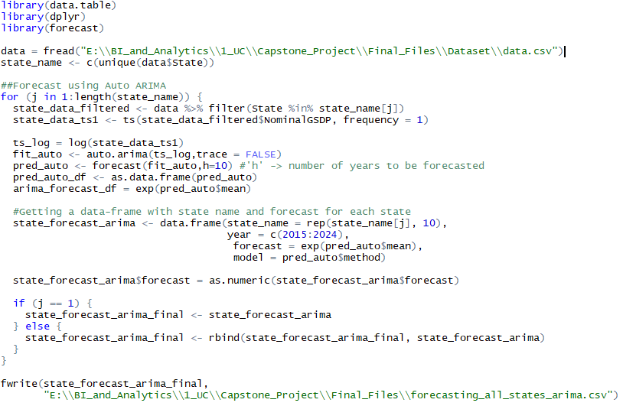
Auto ARIMA
Since it may be cumbersome to manually determine the values of p, d and q for each state, we can automate the same using Auto ARIMA and loop it. Following is the code used to perform the same in R:

Slide 17
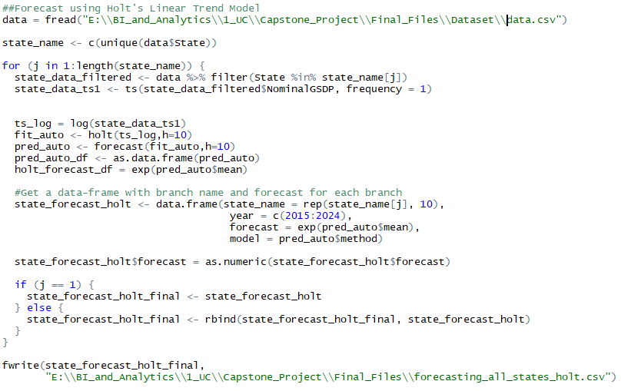
HOLT
HOLT’s linear trend model is another popular model for time series forecasting in cases without seasonality. Following is the code used to perform time series forecasting using HOLT:

Slide 18
Visualization

Slide 19
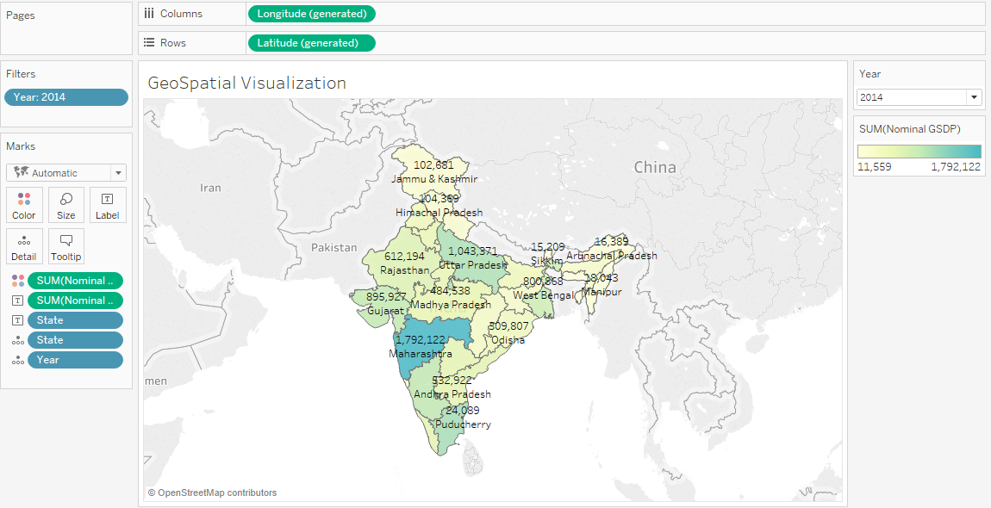
Geospatial Visualization
The following visual captures the distribution of GDPs across various states. Clearly, Maharashtra is the epicentre of commercial activity in India, with Tamil Nadu and Uttar Pradesh being distant 2nd and 3^{rd.}
By changing the year in the ‘Year’ filter, we can visualize the change across different years

Slide 20
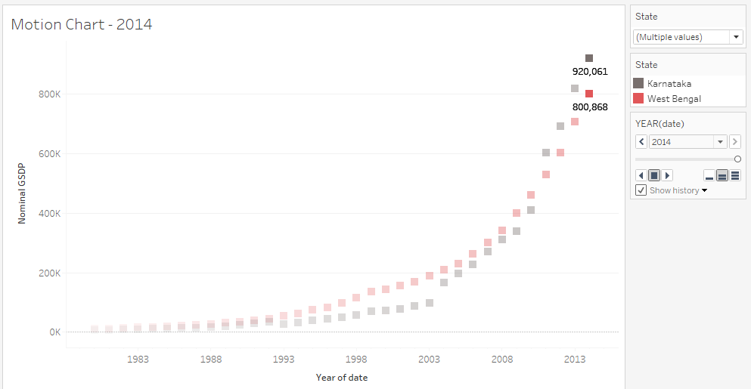
Motion Chart
Motion Chart is a very useful visual to compare the movement of multiple states across years.
Multiple states can be selected for comparison
Clicking on the play button will start it from the year 1980 and move it to the year 2014

Slide 21
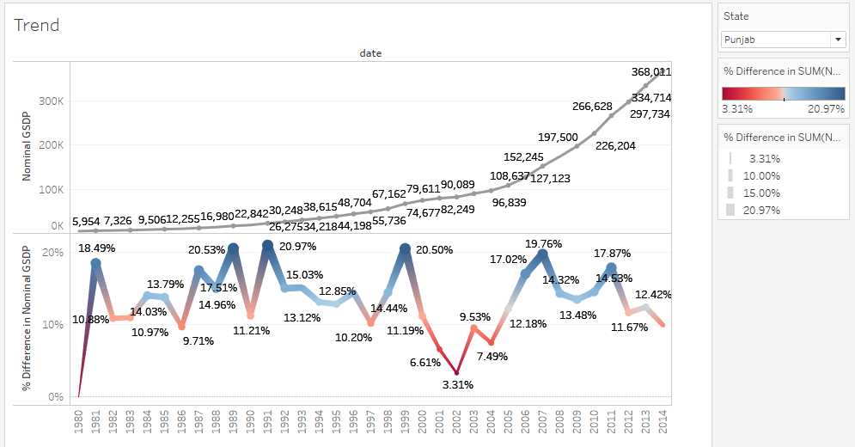
Trend Visualization
This visual can be used to visualize the trend along with percentage changes for any given state
By changing the state in the ‘State’ filter, we can visualize the trend for different states

Slide 22
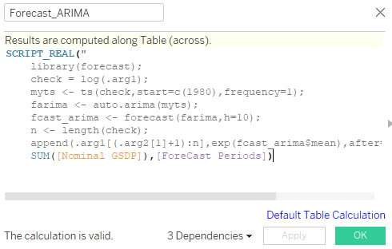
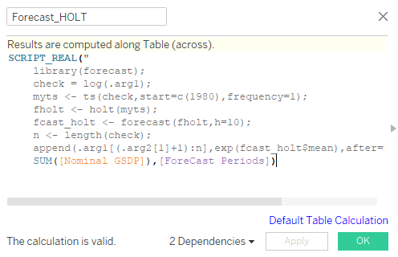
Modelling in Tableau
Because of its integration with R, modelling can be directly performed in Tableau. Following were the scripts used to perform time series modelling in R

Slide 23
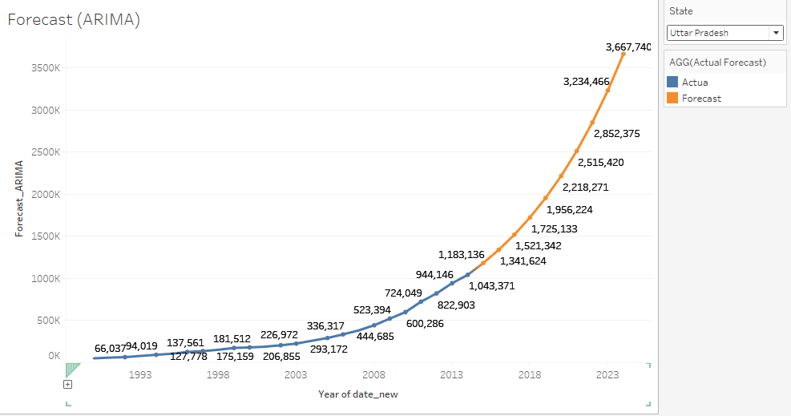
ARIMA
By changing the state in the ‘State’ filter, we can do the forecasting for different states

Slide 24
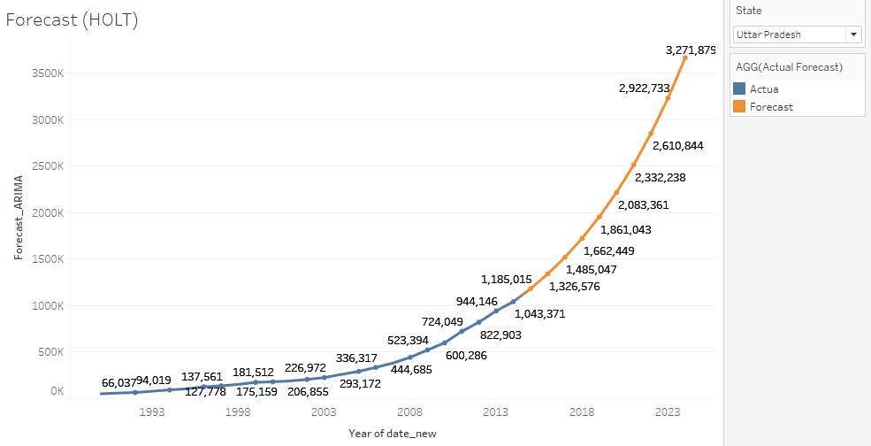
HOLT

Slide 25
Thank You

Slide 26
References
Online analytics websites, primarily Analytics Vidhya (https://www.analyticsvidhya.com/)
Time Series Forecasting Module in Jigsaw LMS

