Slide 1




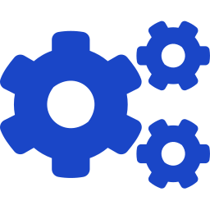

A
THE SOLUTION
Meet Your Developer Twin
END-TO-END FLOW
Poll Watch Jira / mail for new bugs assigned to me
1
Gather Pull context from Jira, Confluence & Gerrit
2
An autonomous AI teammate
Generate Kiro CLI writes the fix + unit test cases
3
Handles development and bug fixes from story creation to code push — with minimal human intervention.
Validate CI builds and runs the tests
4
Review Push the change to Gerrit for human review
5
Developer Twin · AI in SDLC
Autonomous bug resolution — story to code push

Slide 2






B
HOW IT WORKS
Multi-Agent Architecture
Multiple specialized agents, orchestrated by Kiro CLI, move a bug through the lifecycle end-to-end.
POLL & PARSE
GENERATE
VERIFY
VALIDATE
REVIEW
Jira Agent
Dev Agent
Test Agent
CI Agent
Gerrit Agent
Detects the bug, extracts requirements
Kiro CLI writes the fix to guidelines
Creates & runs unit test cases
Builds and runs the pipeline
Pushes changeset for human sign-off
Backend: Kiro CLI | Context sources: Jira · Confluence · Gerrit | Human intervention: review & approve only
Developer Twin · AI in SDLC
Autonomous bug resolution — story to code push

Slide 3




C
BENEFITS
Effort & Quality Gains
Hours → Min
Less toil
Built-in
Consistent
Faster first response to bugs (target)
Manual effort per routine fix reduced
Unit tests generated with every fix
Coding guidelines applied every time
The bottom line
Routine bugs are resolved faster and to consistent, test-backed quality — humans spend effort only on review, so developers stay focused on high-value work.
Developer Twin · AI in SDLC
Autonomous bug resolution — story to code push

