Slide 1

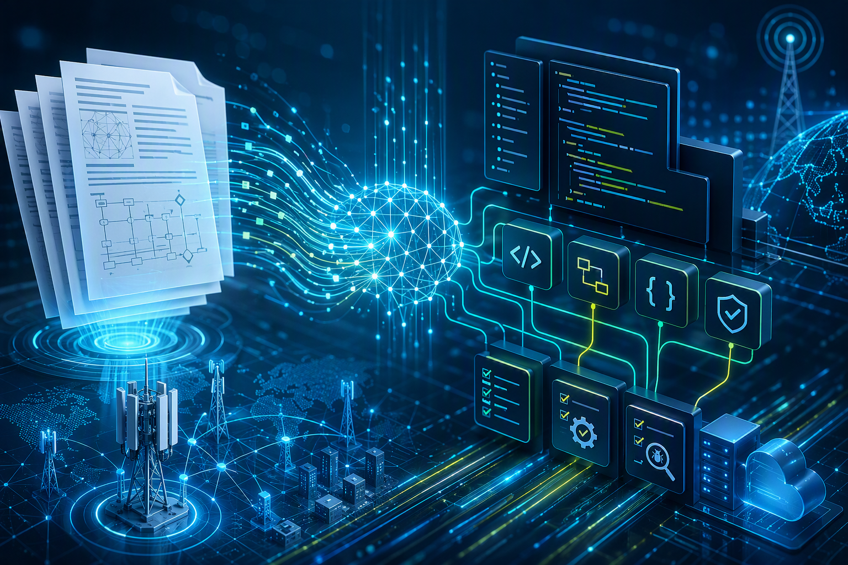
Kiro Developer Workflow.
Developer Workflow using Kiro CLI
Tech Challenge
Presenter: Sanjog, Rajasekhar, Himanshu
9th Jul 2026, Ericsson Account Tech Day
Notes:
Speaker notes A structured AI-assisted Development Lifecycle for PMIC developers that guides Kiro CLI from requirement intake to reviewed implementation with full traceability. [Sources] - Input file: README.md - Kiro Developer Workflow (turn6search1). - Template source: Tech_Talk_Template.pptx (turn5search1). - Related enterprise material: Kiro Training from AWS (turn8search1); Wipro-ENM monthly review (turn8search3); Kiro First Call Deck (turn8search18).

Slide 2

Overview, Setup and 14-Phase Lifecycle
Slide 1 of 3
What it is
Prerequisites
14-phase flow (0-13)
• Structured SDLC for developers using Kiro CLI
• Guides Kiro from requirement intake to implementation and review
• Ensures quality, traceability and consistency
• Kiro CLI installed and configured (kiro chat)
• MCP servers optional: jira, gerrit, confluence, jenkins, enm-opengrok
• Works without MCPs - asks manually
• A cloned PMIC repo or working directory
0
Requirement Intake
1
Workspace Detection
2
Requirement Challenge
3
DA Preparation
4
DIS Preparation
5
Self-Review
Package contents
Configuration steps
6
Confluence Prep
• README and QUICKSTART
• steering/ - workflow spec, challenge gates, audit rules
• templates/ - requirement input, DA and DIS templates
• examples/ - future workflow runs
• Create ~/.kiro/steering and ~/.kiro/specs/templates
• Copy steering specs (workflow, challenge gates, audit rules)
• Copy templates (requirement input, DA, DIS)
• Verify folder structure
• Optionally customise Confluence defaults (Phase 6)
7
Review Gate (pause)
8
Comment Resolution
9
Implementation Planning
10
Implementation
11
Unit Tests
12
Build & Verify
13
Final Closure
Kiro Developer Workflow | Tech Challenge
02
Notes:
Speaker notes Combines README sections What Is This, Package Contents, Prerequisites, Configuration Procedure and the 14-phase list. [Sources] - Input file: README.md - Kiro Developer Workflow (turn6search1). - Template source: Tech_Talk_Template.pptx (turn5search1). - Related enterprise material: Kiro Training from AWS (turn8search1); Wipro-ENM monthly review (turn8search3); Kiro First Call Deck (turn8search18).

Slide 3
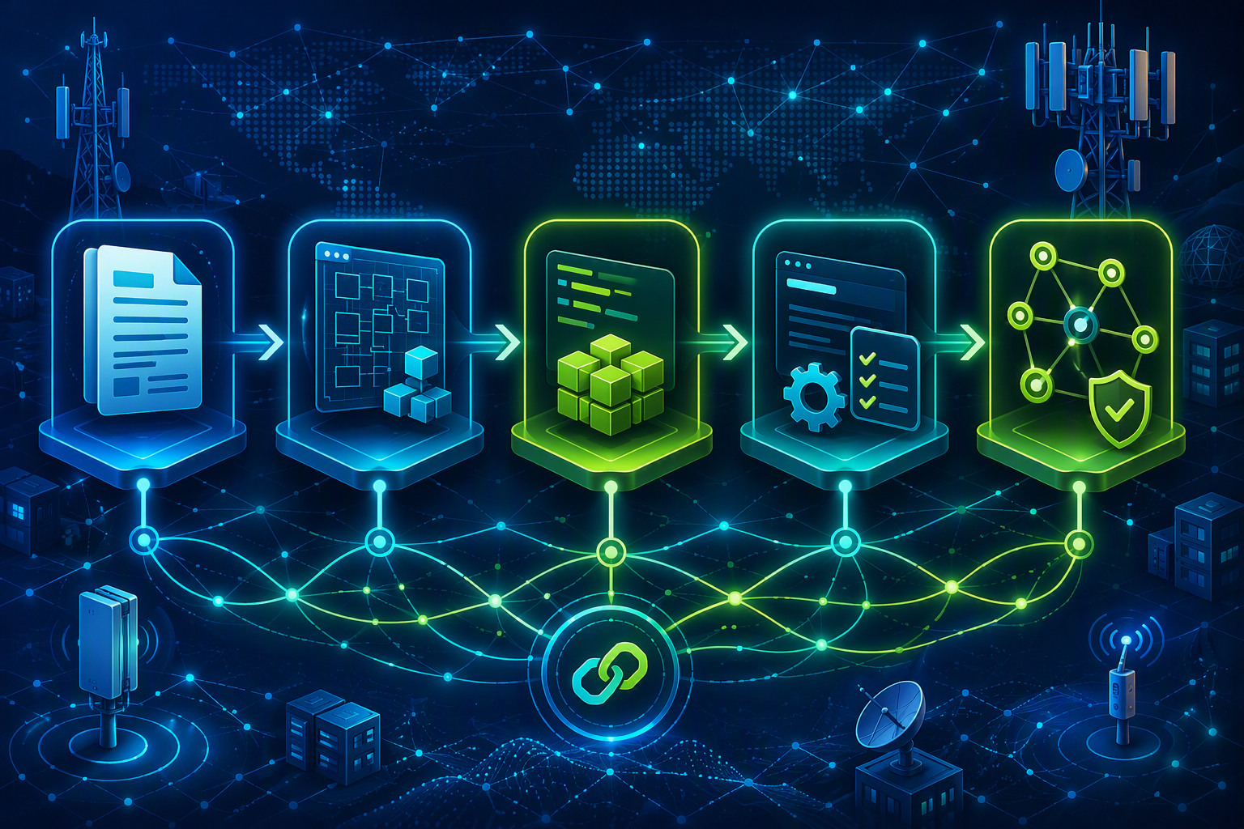
How It Works and What It Produces
Slide 2 of 3
What Workflow will do
Generated outputs under .kiro
• Fetch Jira - extract fields automatically
• Check existing work - reuse or ignore
• Ask input mode - edit file directly or answer one by one
• Collect remaining requirement fields
• Detect workspace and impacted components
• Challenge before design
• Generate DA and DIS drafts
• Pause for formal review at the review gate
• Implement after approval
• Test, verify build and generate PR description
Requirements
requirement-input.md
requirement-challenge.md
Design
DA-draft.md
DIS-draft.md
da-dis-self-review.md
Review
DA/DIS-confluence-ready.md
review-outcome.md
review-comment-resolution.md
Key features
• Workflow Challenges at every stage (need, safe, minimal, testable)
• No skipping - no implementation before DA/DIS approval
• Audit trail - every decision in .kiro/audit/audit-log.md
• Resume support from any phase after interruption
• Desinger allowed to cancel support and cleans generated files
Delivery
implementation-plan.md
implementation-summary.md
unit-test-summary.md
Closure
build-verification-summary.md
final-summary.md
pr-description.md
Kiro Developer Workflow | Tech Challenge
03
Notes:
Speaker notes Covers README sections How the Workflow Works, Key Features, What Kiro Will Do, and Generated Output Files under .kiro/specs, .kiro/state and .kiro/audit. [Sources] - Input file: README.md - Kiro Developer Workflow (turn6search1). - Template source: Tech_Talk_Template.pptx (turn5search1). - Related enterprise material: Kiro Training from AWS (turn8search1); Wipro-ENM monthly review (turn8search3); Kiro First Call Deck (turn8search18).

Slide 4
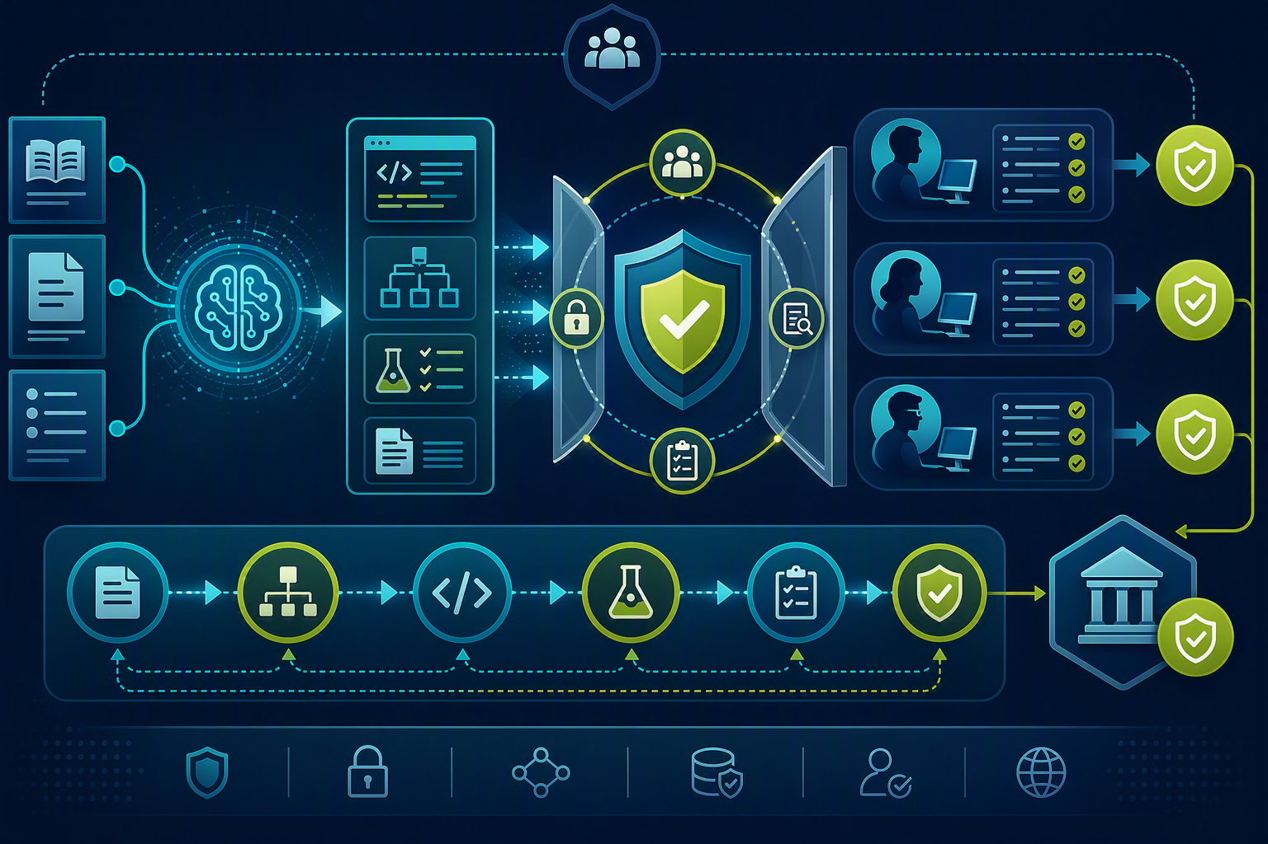
Using the Workflow
Slide 3 of 3
Tips for best results
Troubleshooting quick-look
• Provide a Jira key so Kiro extracts most fields
• Be specific about impacted components
• Use "Answer one by one" for first-time use
• Use "Edit file directly" once familiar
• Do not skip challenge - catches design issues
• Keep audit log - supports review and knowledge transfer
Kiro does not follow flow
Steering files in ~/.kiro/steering/
Skips input mode
Steering spec needs the "must NOT write" blocker
Jira fetch fails
Check jira-mcp configuration
How to run it
Customization
Confluence page fails
Use manual paste mode
• Start: Start Kiro Developer workflow for <JIRA-KEY>
• Resume: same command - Kiro asks resume or restart
• Cancel: Cancel Kiro ... and delete output files
• Skip a phase: e.g. Skip DA - I already have a DA on Confluence
• Skip recorded in the audit log
• Requirement template - ~/.kiro/specs/templates/
• Challenge questions - developer-stage-challenge-gates.md
• Confluence settings - Phase 6 in workflow spec
• Add coding standards as steering rules for enforcement
Does not resume
Ensure .kiro/audit/audit-log.md exists
Build commands fail
Confirm correct repo directory
Kiro Developer Workflow | Tech Challenge
04
Notes:
Speaker notes Combines Usage Procedure, Tips for Best Results, Customisation and Troubleshooting from README. [Sources] - Input file: README.md - Kiro Developer Workflow (turn6search1). - Template source: Tech_Talk_Template.pptx (turn5search1). - Related enterprise material: Kiro Training from AWS (turn8search1); Wipro-ENM monthly review (turn8search3); Kiro First Call Deck (turn8search18).

Slide 5

Thank you.
Questions?
Kiro Developer Workflow
Notes:
Speaker notes Thank the audience and invite questions. [Sources] - Template source: Tech_Talk_Template.pptx (turn5search1).

