Slide 1
Credit Risk Modelling
By Manoj Eedupuganti

Slide 2
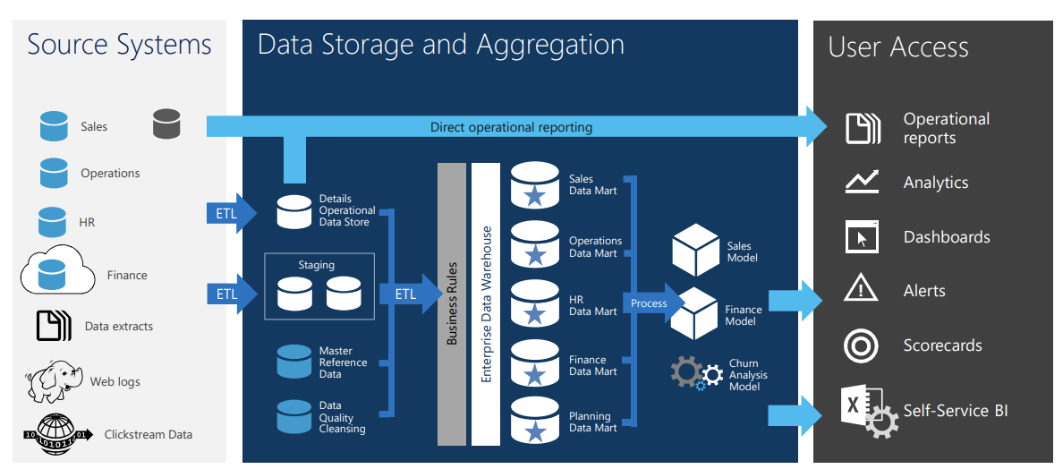
Business Intelligence Lifecycle

Slide 3
Lending Club Loans Data
Collected lending club loans data for all the loans that were approved and rejected.
The quarterly loan applications data were available in multiple excel sheets from the site
The excel sheets contain 121 attributes and 1 million records where each record is a new application
Each record contains the borrowers personnel information such as his age, salary, employment status, employment level and financial information such as credit score, number of credit cards and credit history.

Slide 4
ETL
Merged Multiple Excel Sheets
Removed Null Values
Dropped unwanted rows
Performed Data Manipulations
Text Cleaning

Slide 5
Predictive Modelling
Built a predictive model to predict if a loan applied by the customer will be repaid by him or will he default on it.
The data has records of 1 million and 74 Features
Actions performed are
Loading Data
Data Preprocessing
Exploratory Data Analysis
Built Classification Model
Evaluated the Model

Slide 6
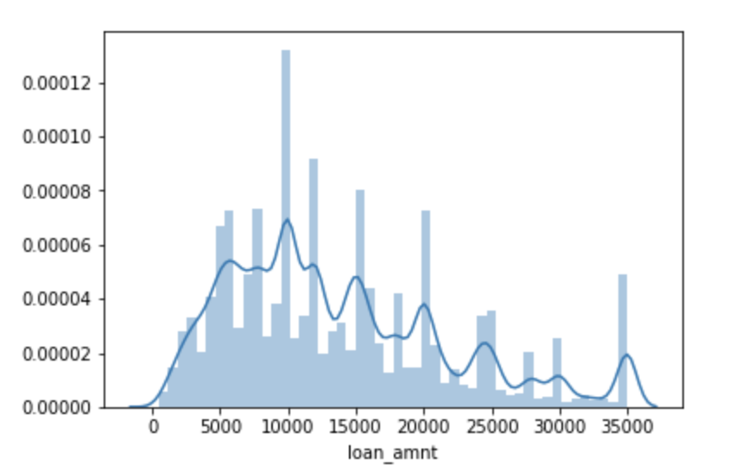
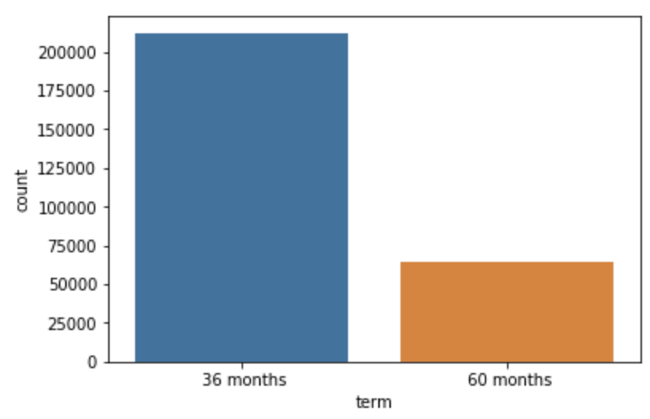
Exploratory Data Analysis
Performed Exploratory Data Analysis on the data using seaborn and matplotlib libraries in Python
Removed unwanted rows
Normalized Target Variable

Slide 7
Data Pre-Processing
Encoded the categorical variables
Imputed missing values
Train-Test Split
Feature Scaling

Slide 8
Down-Sampling
Handled imbalance classes in the target with down-sampling
Randomly sampled without replacement from the majority class i.e. good loans, created a new subset of observations with equal in size with the minority class i.e. Bad loans.

Slide 9
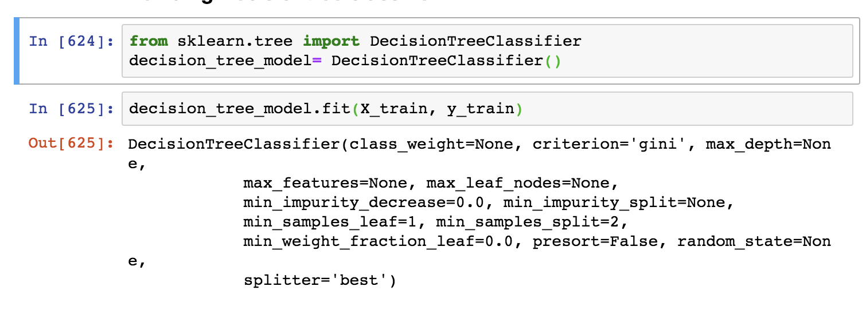
Building the Decision tree classifier

Slide 10
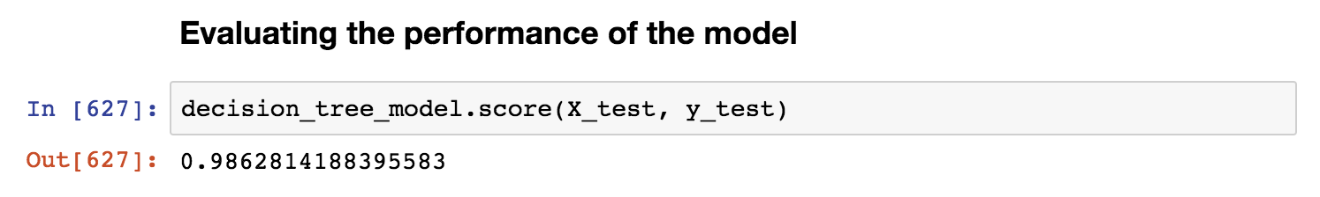
Evaluating the Model Performance
Built the model with 98.6% of accuracy

Slide 11
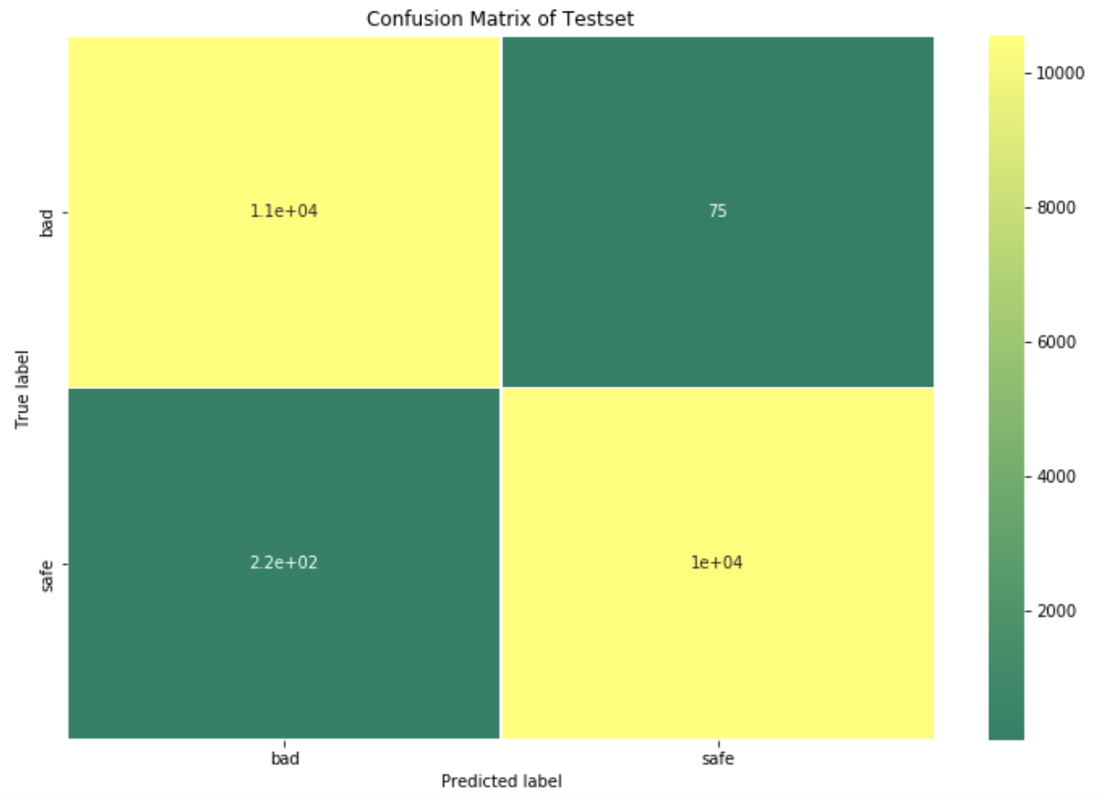
Confusion Matrix

Slide 12
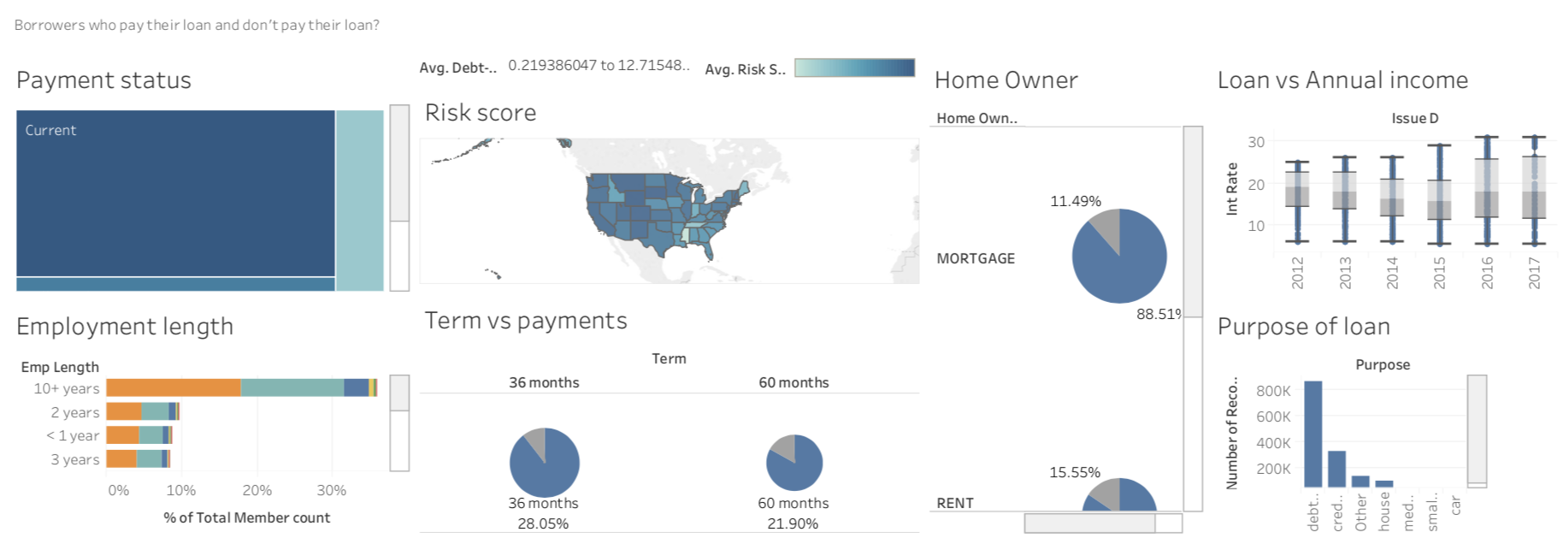
Built Dashboards Risk Analysis

Slide 13
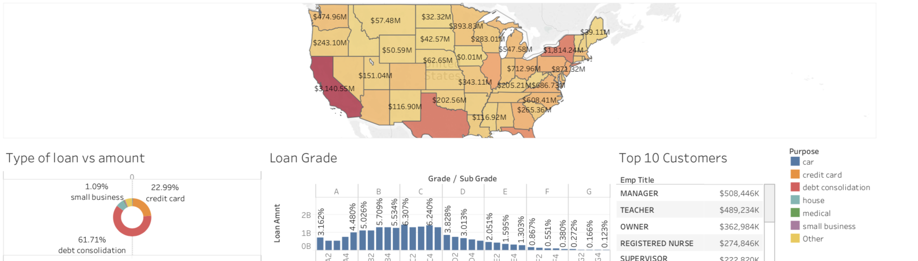
Approvals of loan in various state

Slide 14
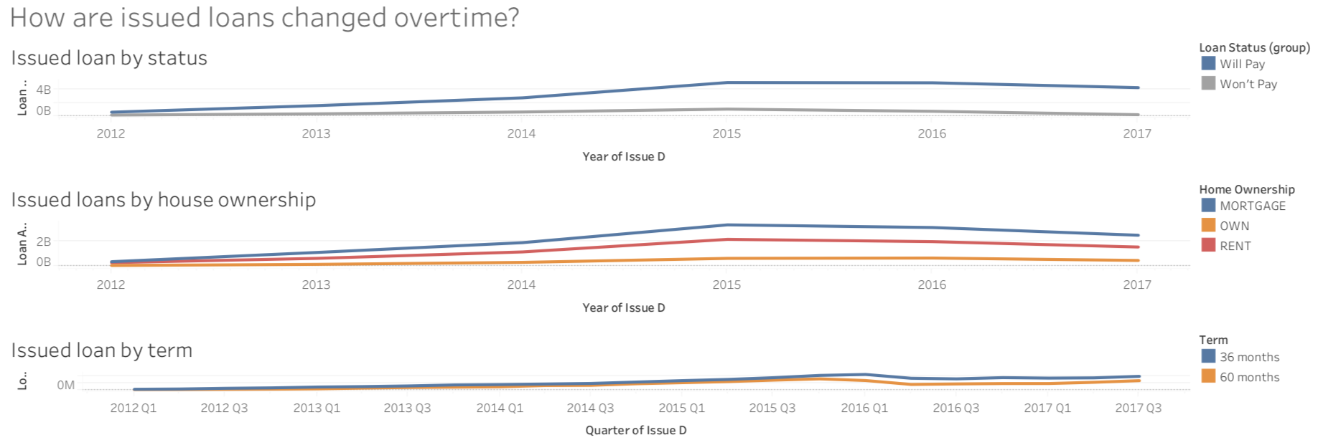
Loans changing overtime

Slide 15
Thank You

